Slide 1
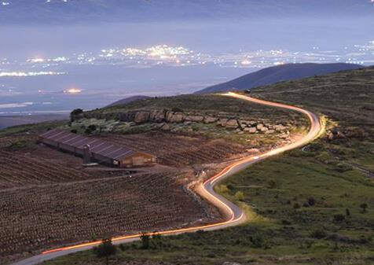



“Gandhi” Heritage Center
Land of Israel and Jewish heritage studies
In memory of Knesset Member and Cabinet Minister, Maj. Gen. (res.) Rehavam Ze’evi-“Gandhi”

Slide 2
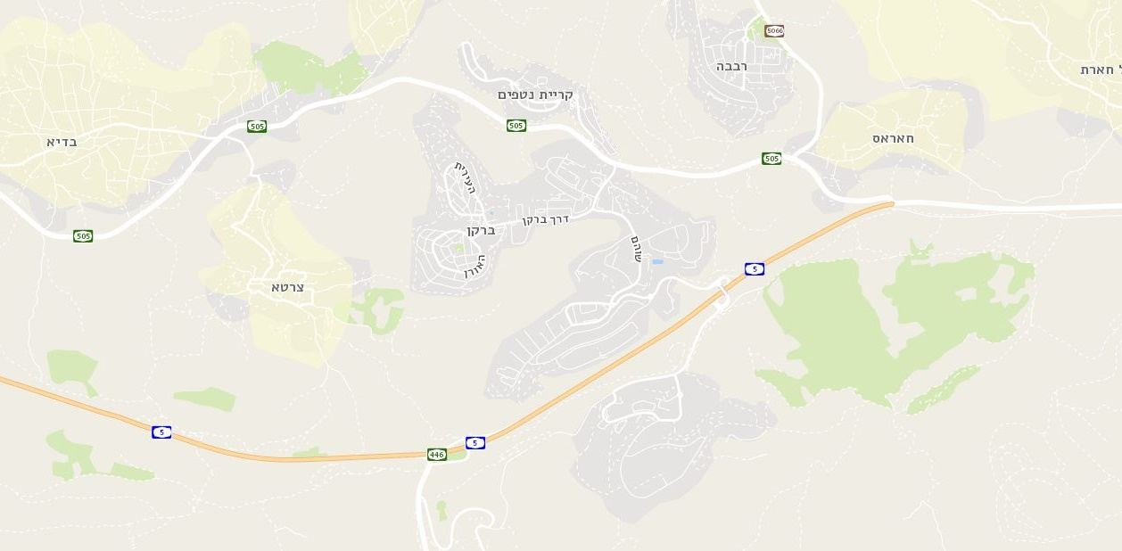

Site location

Slide 3
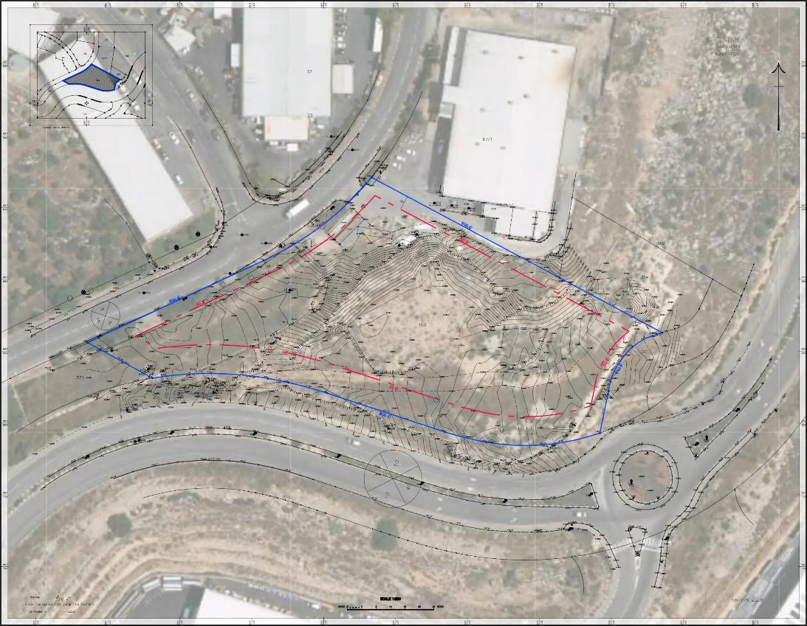
Aerial View of Location: photo

Slide 4
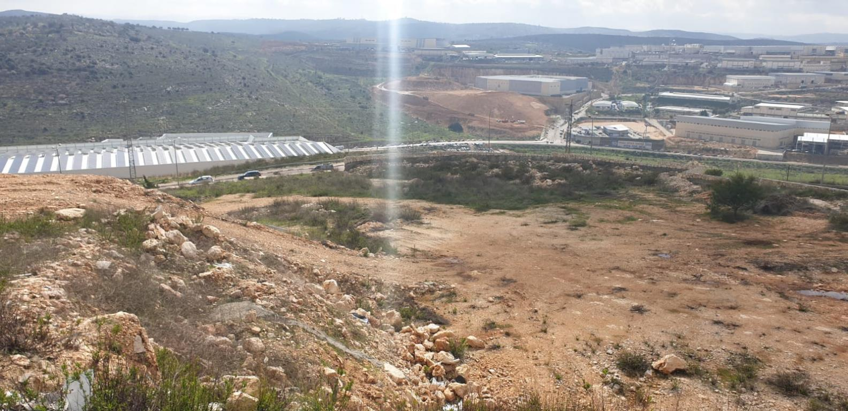
View from the site

Slide 5
Values
A window to Samaria
Innovation
“Gandhi” Heritage Center
Architectural Icon
Sustainable construction

Slide 6
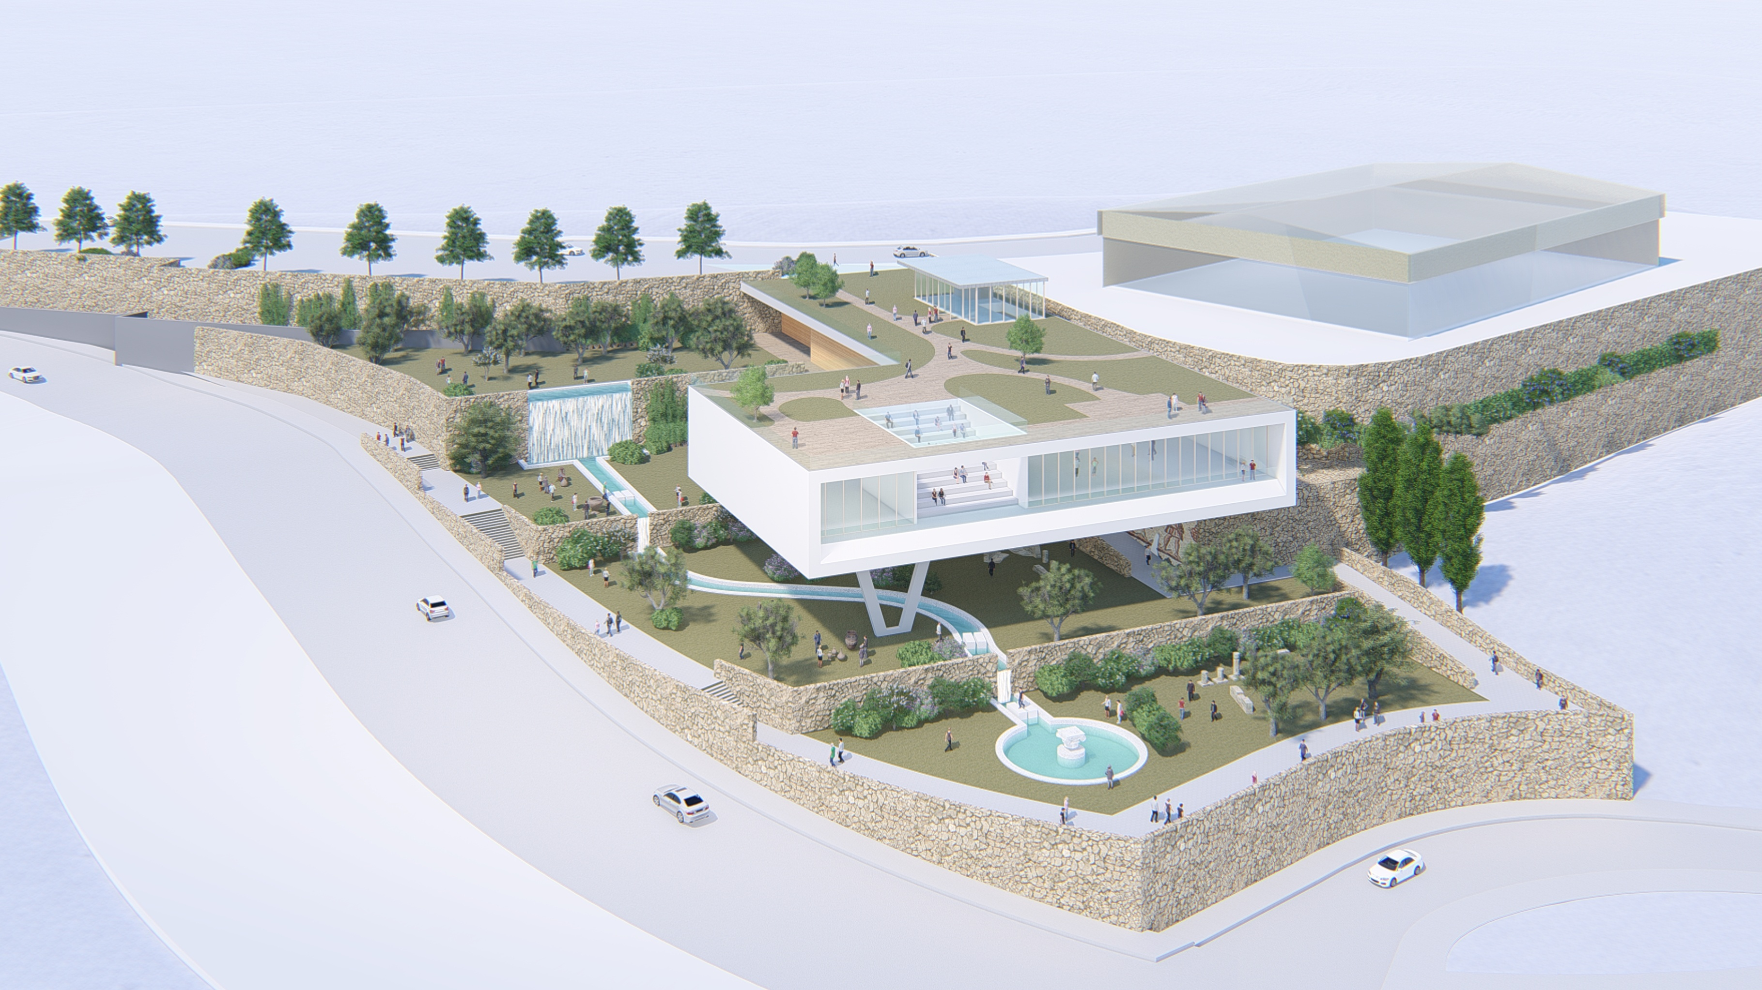
Genral top view

Slide 7
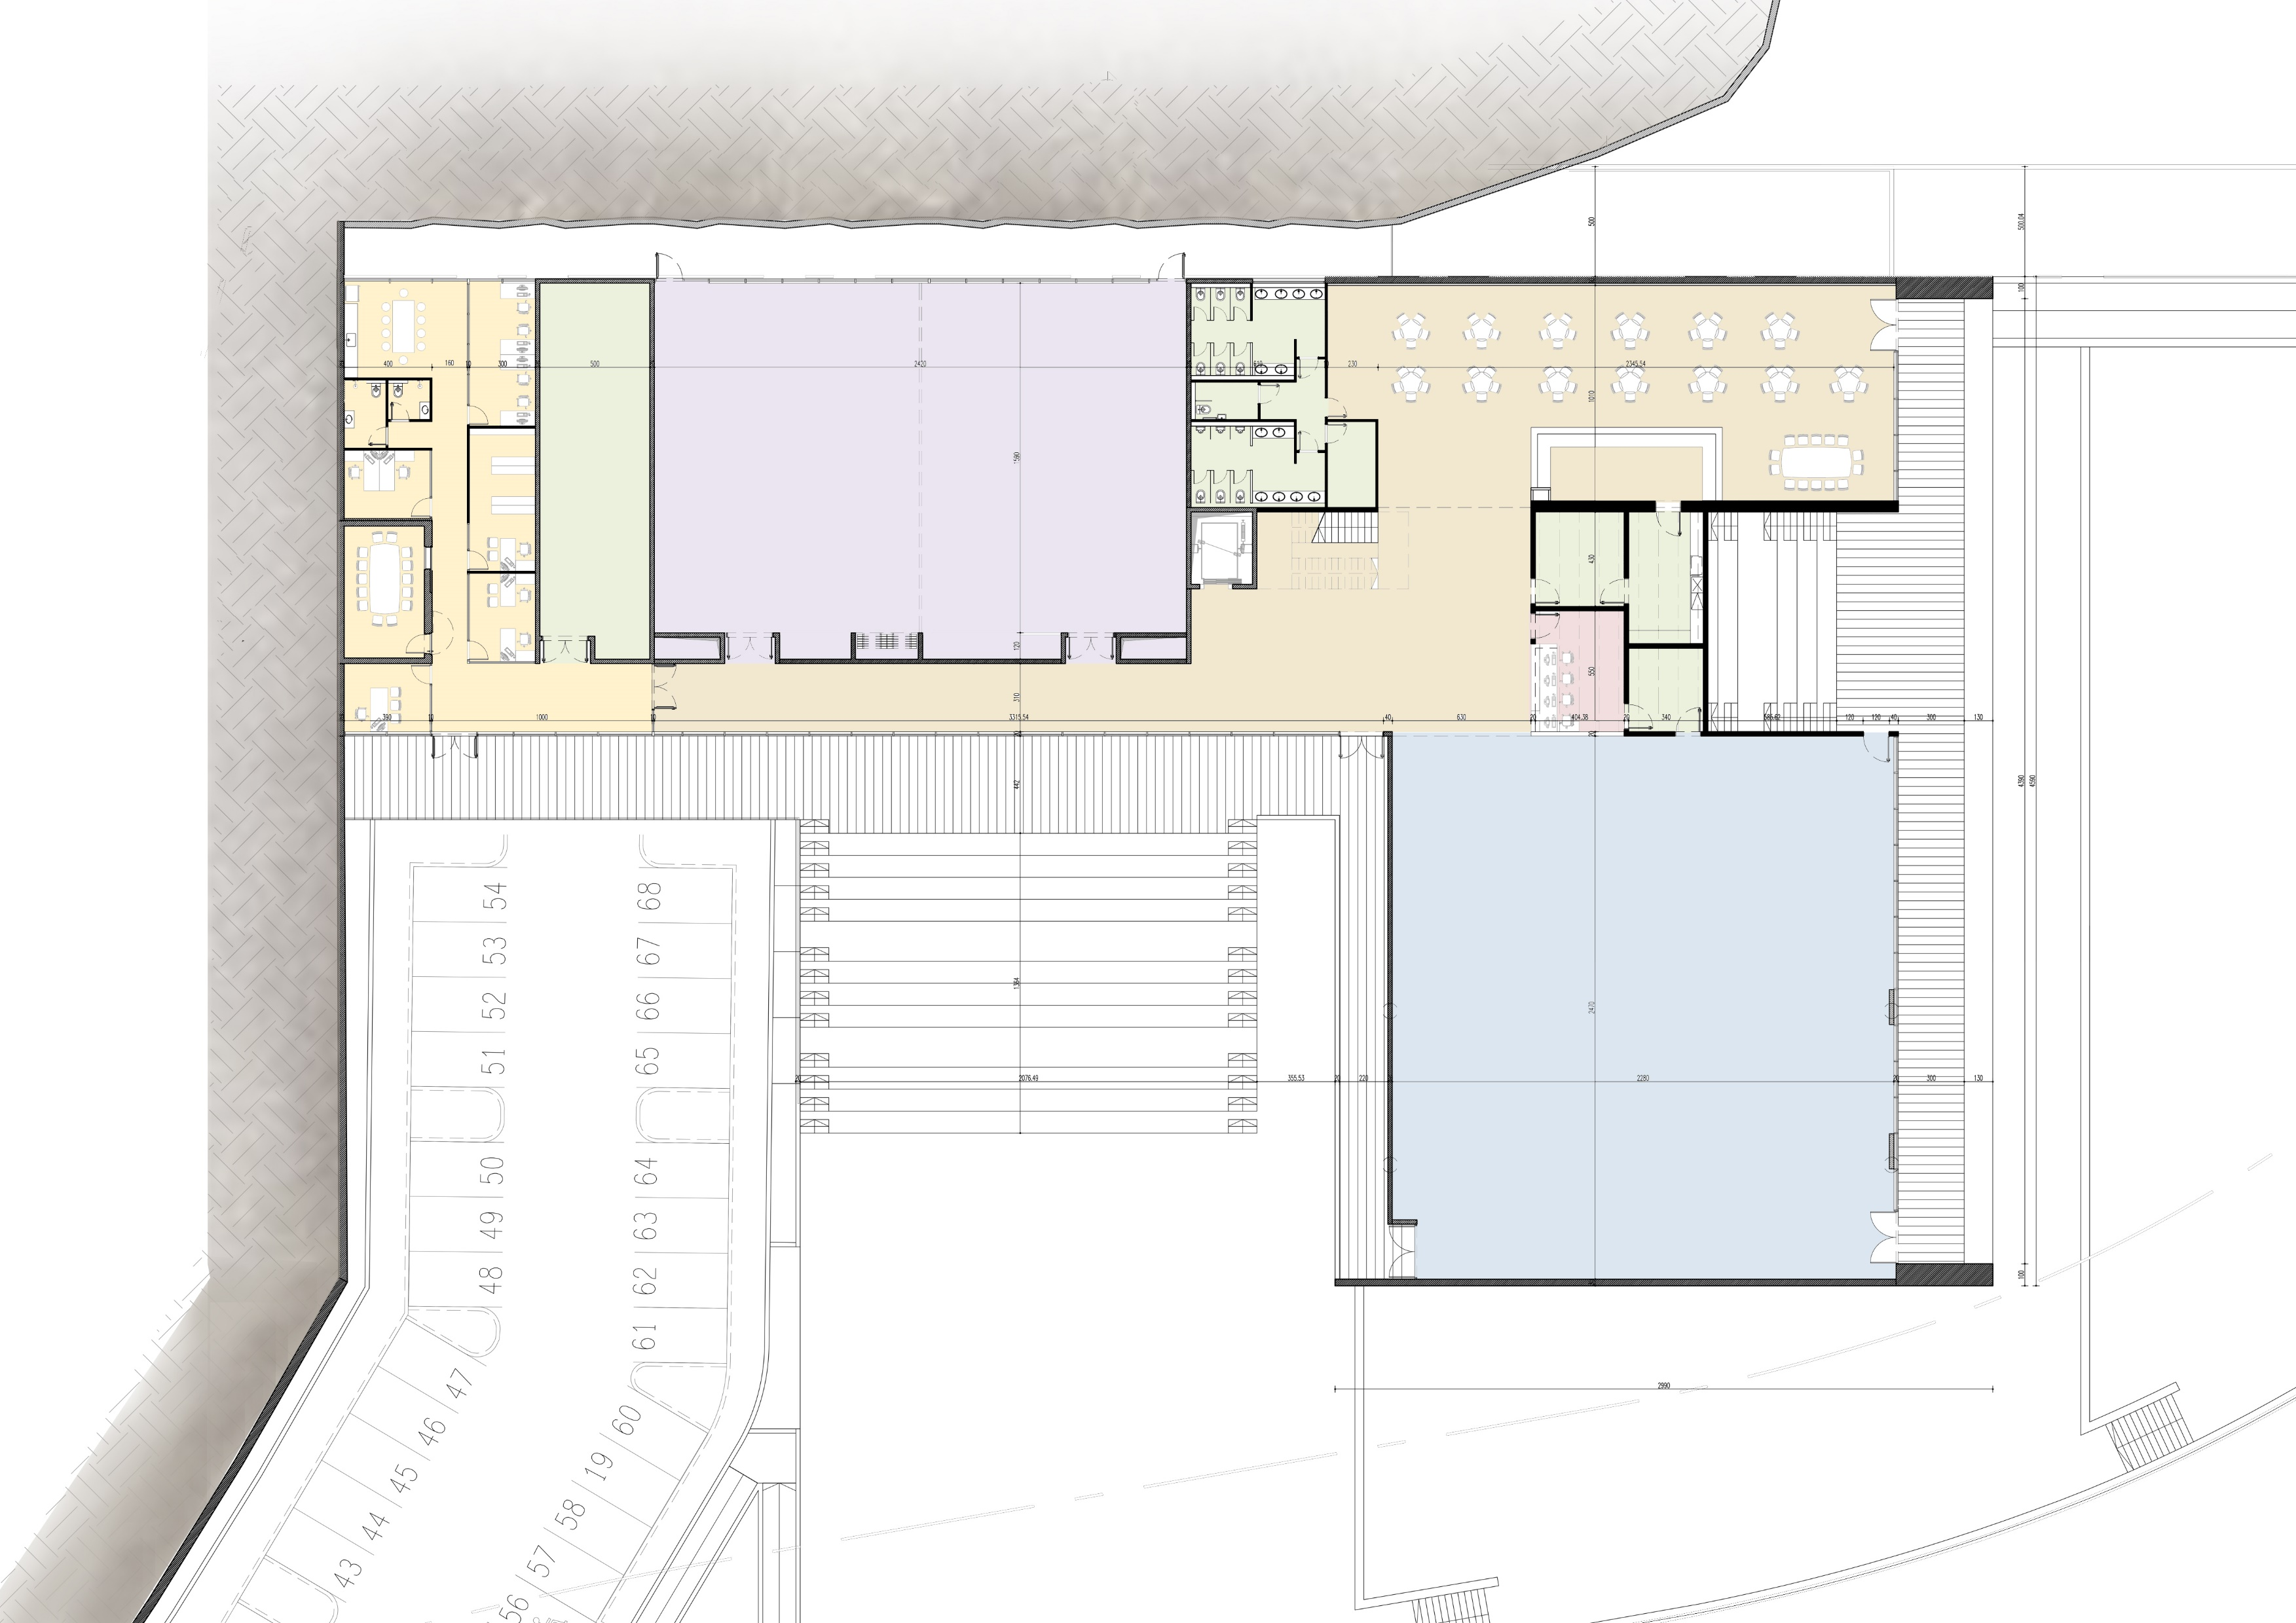

The Center’s Floor Plan
C
D
E
B
G
F
Plan Legend
A- Main gallery
B- Conference hall
C- Cafeteria
D- administration
E- Storage
F- Reception
G- Sky Amphitheater
I- Garden Amphitheater
I
A

Slide 8
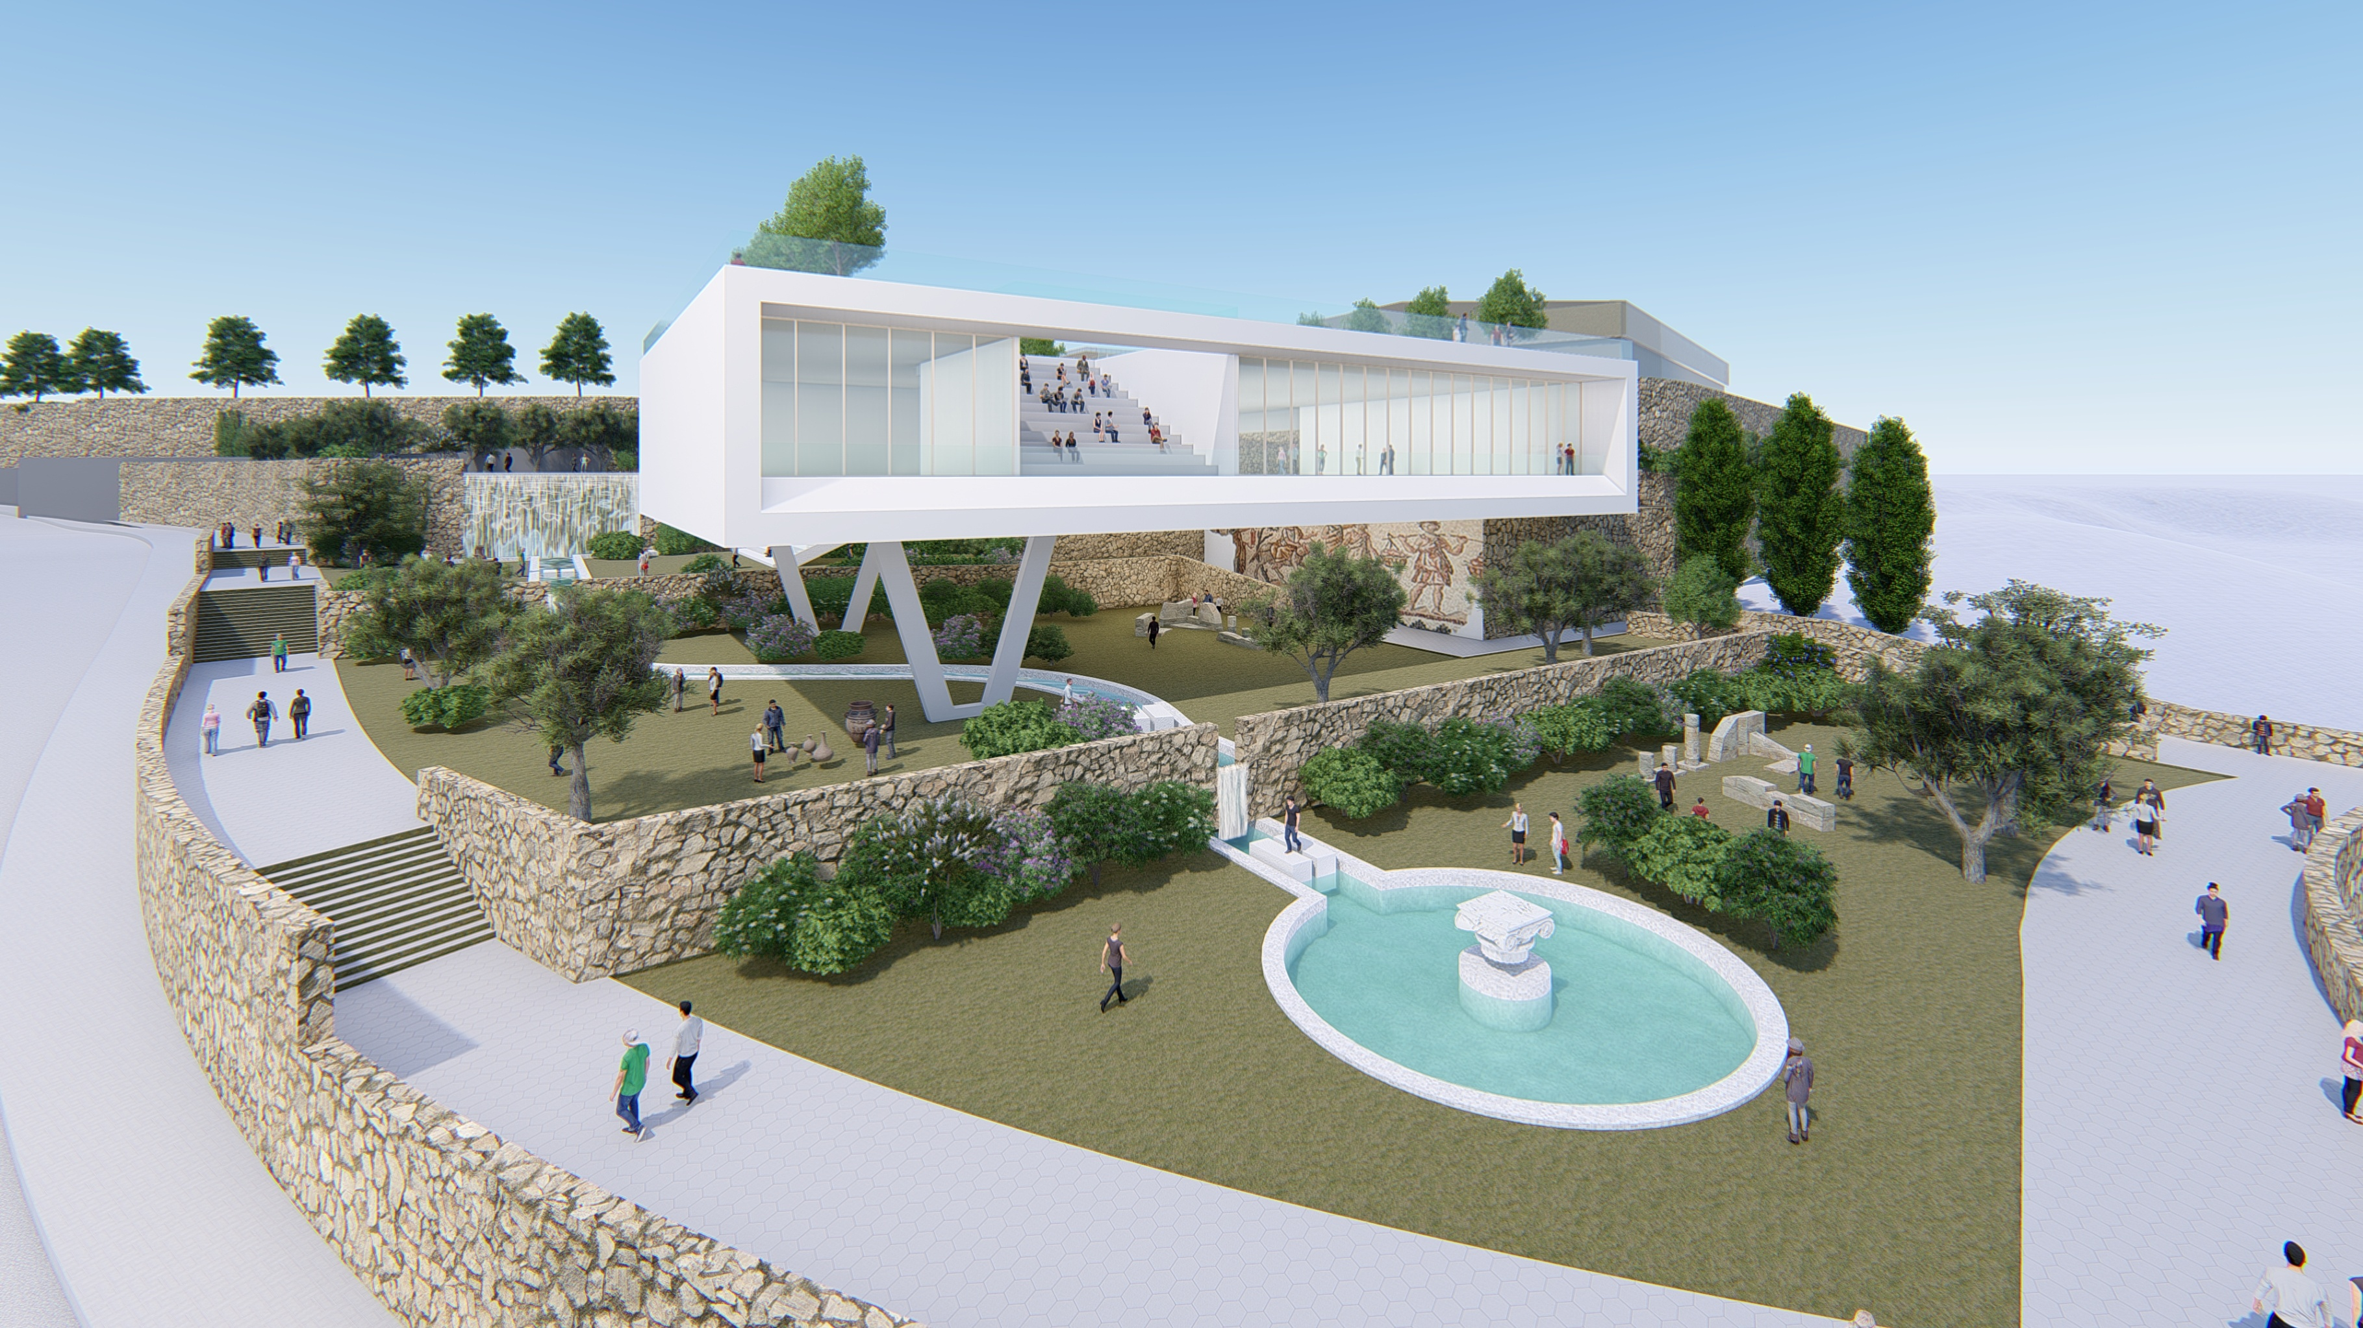
Southeast View

Slide 9
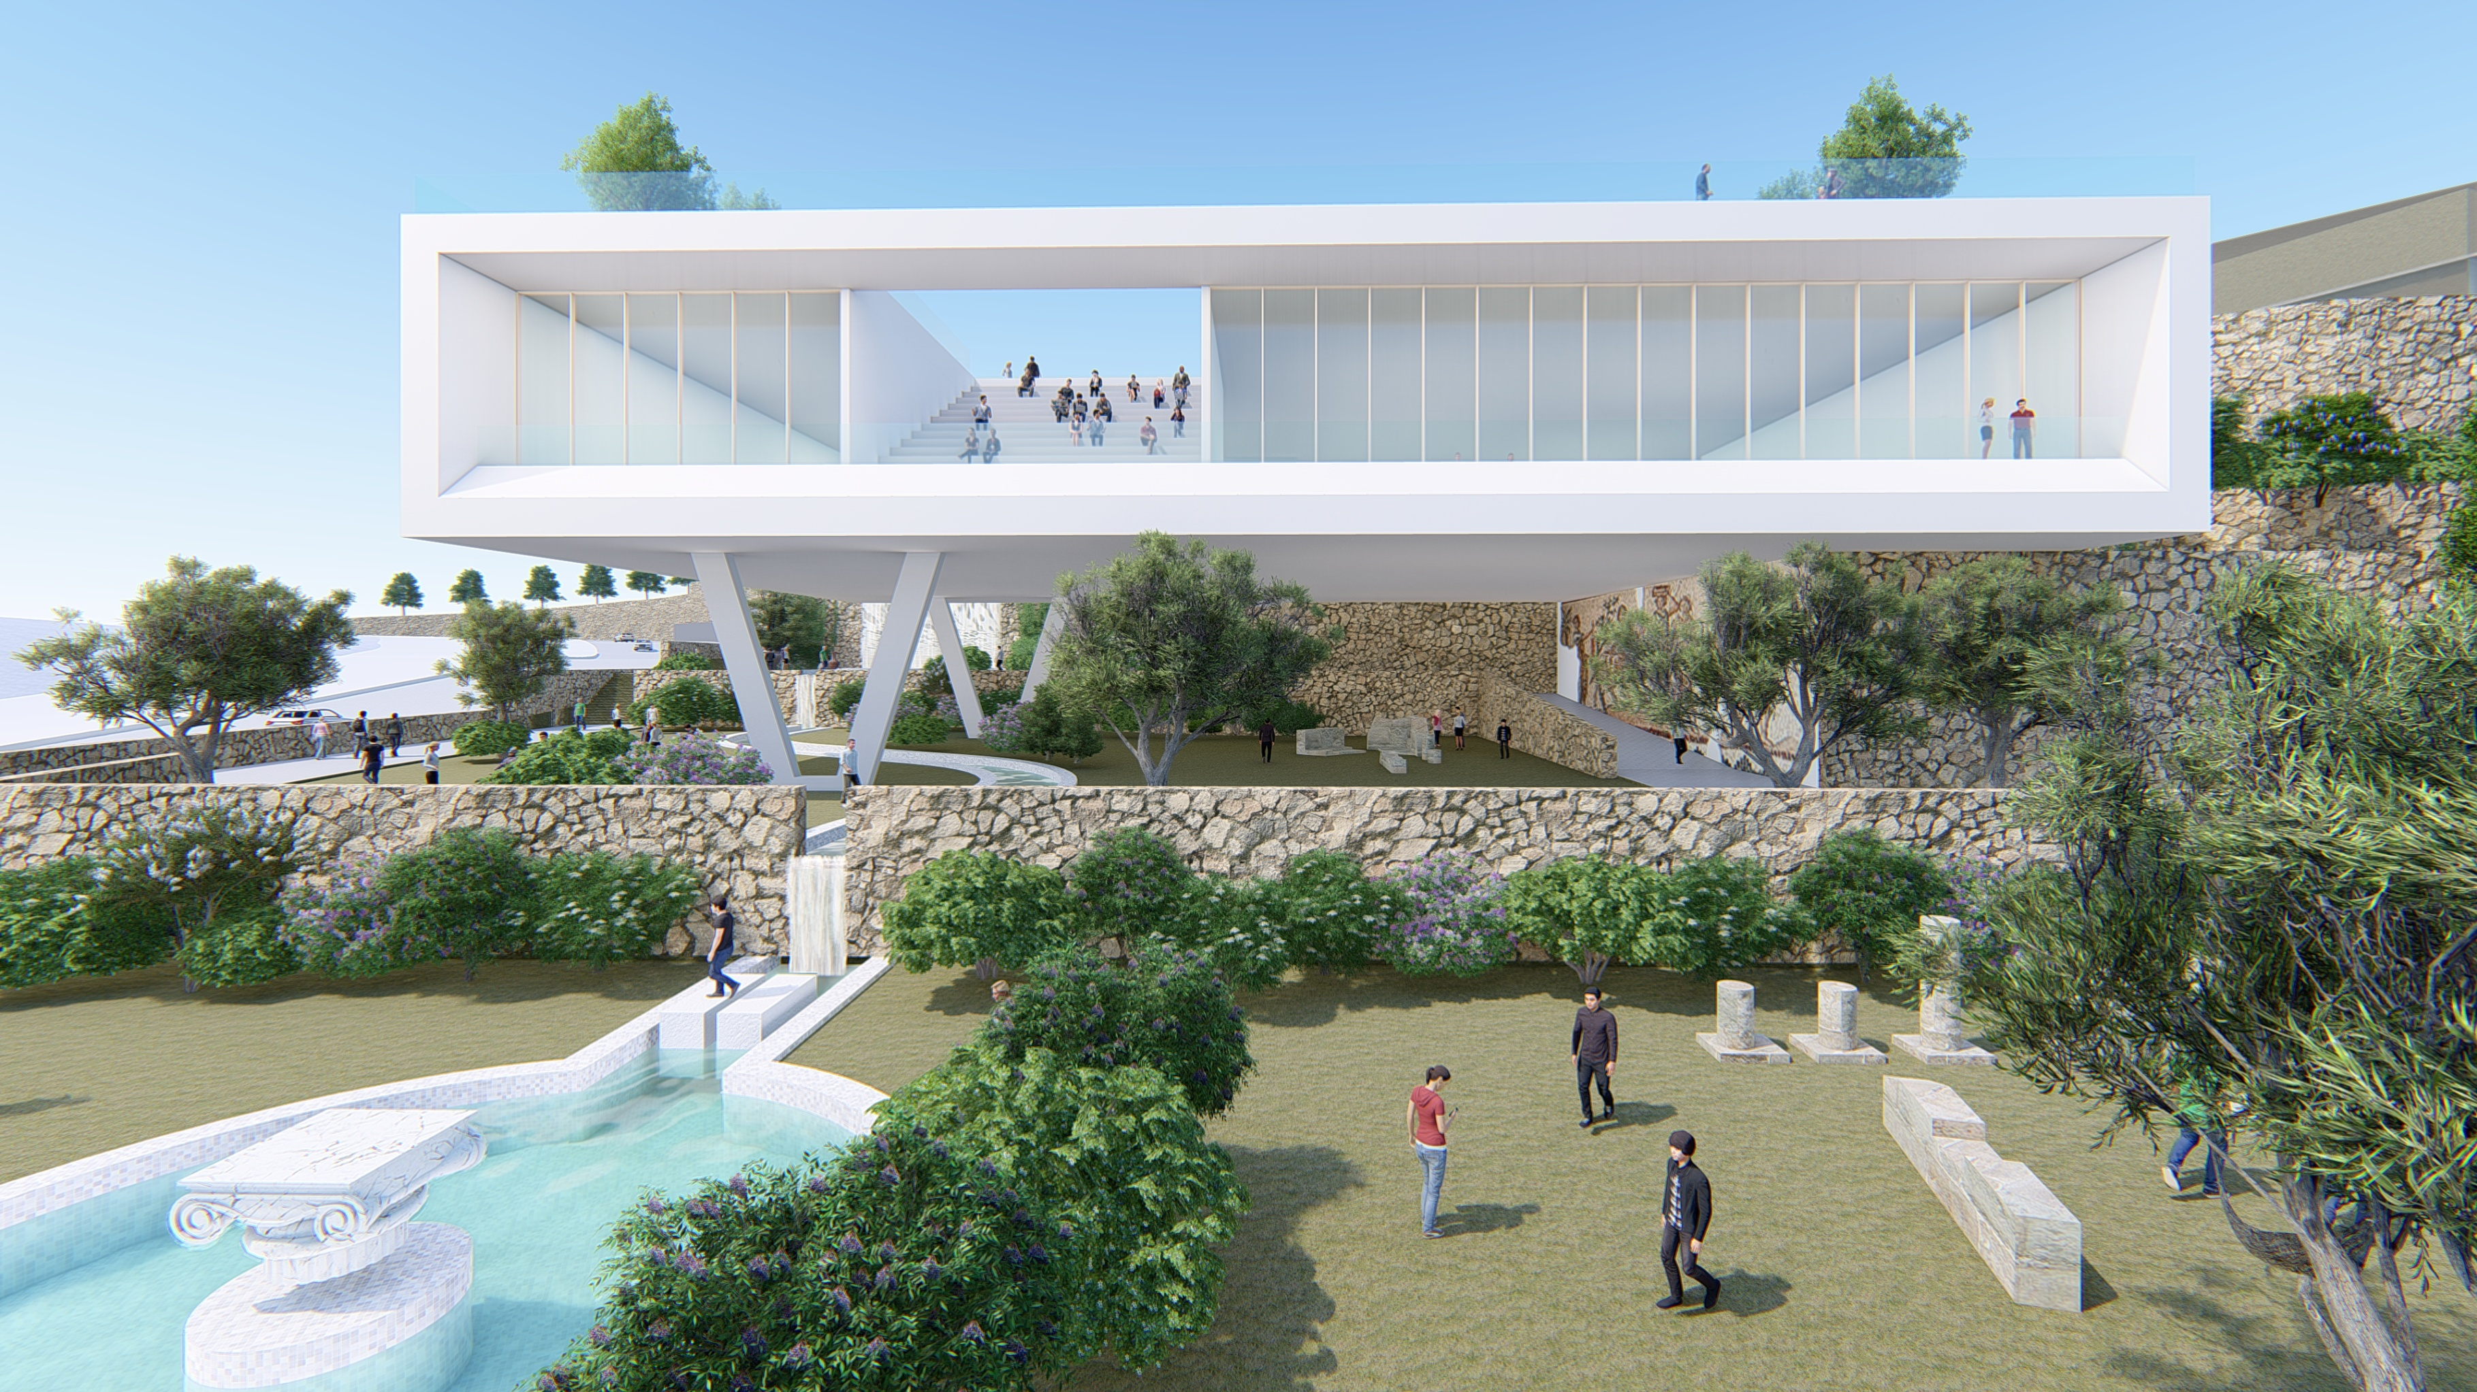
View from the Main Road

Slide 10
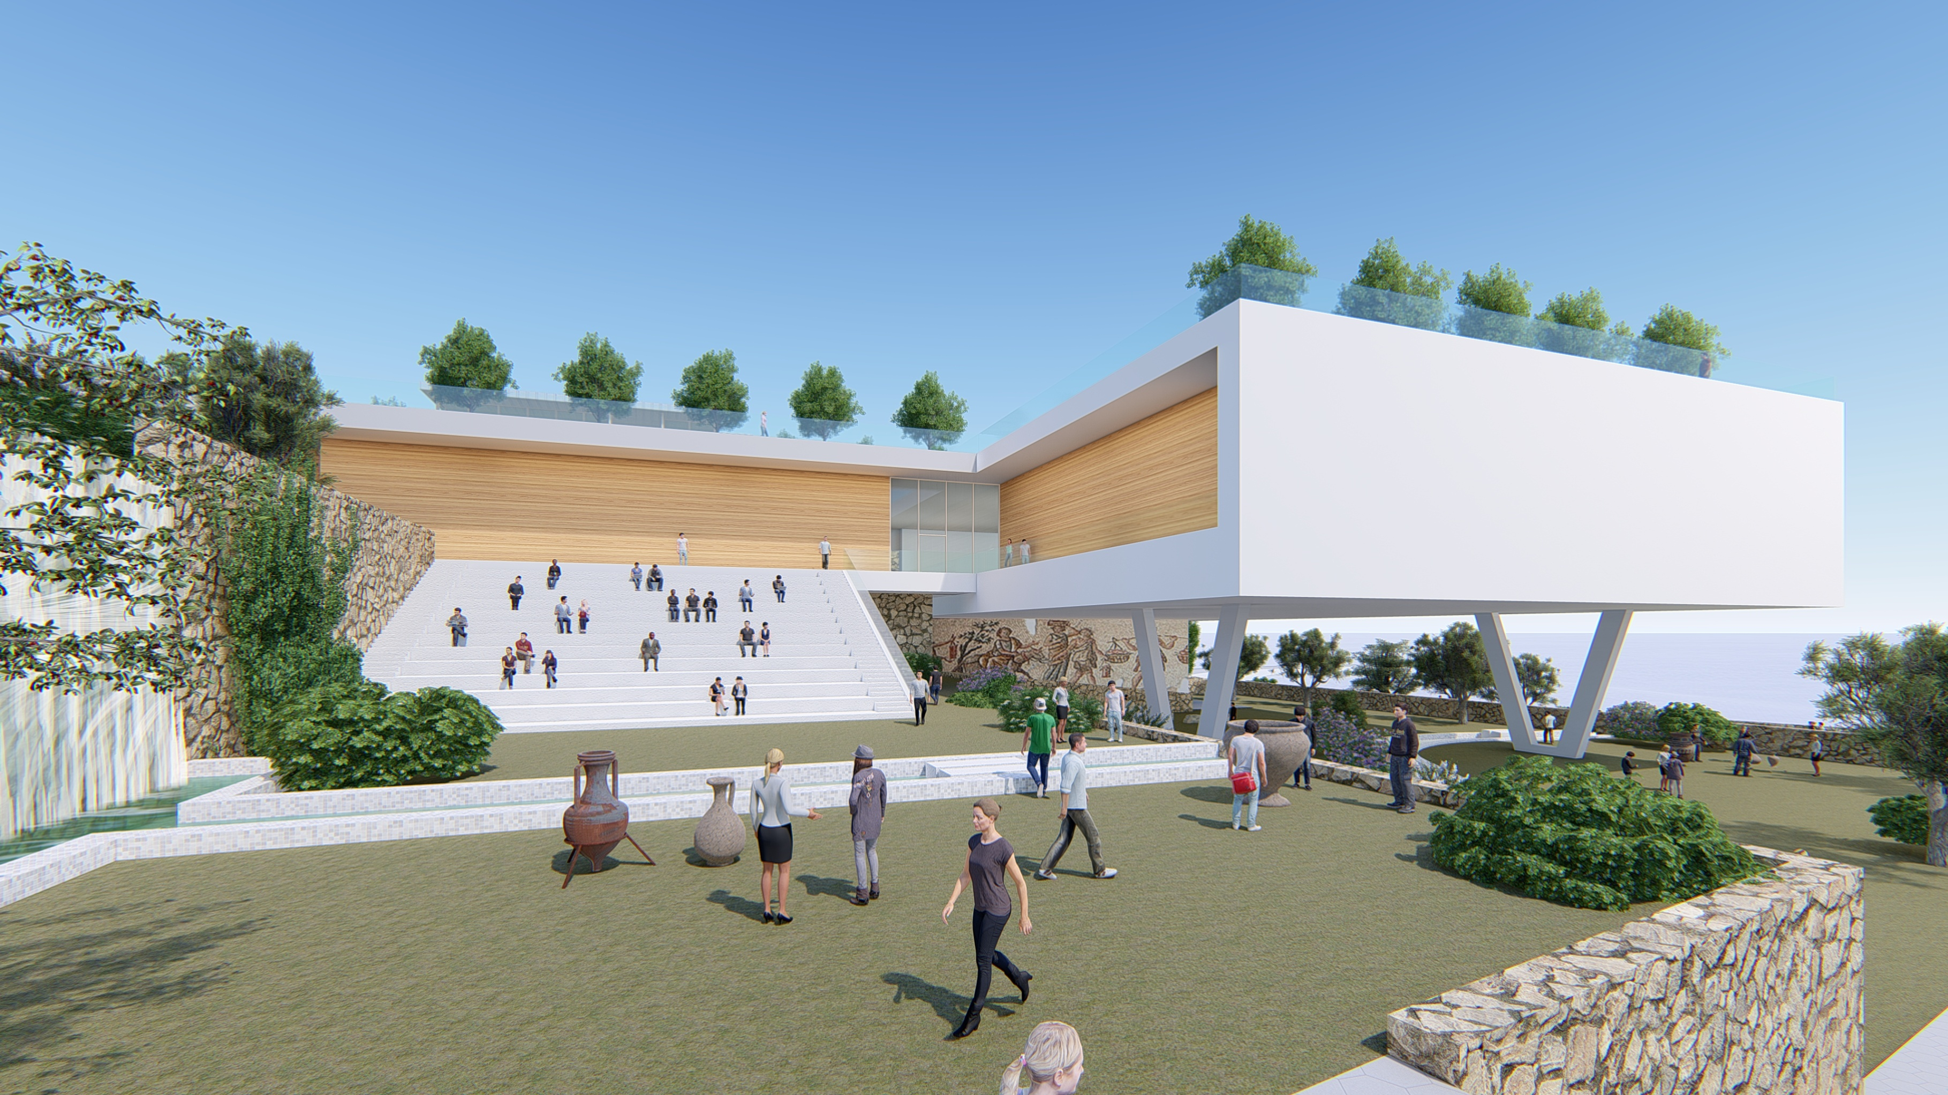
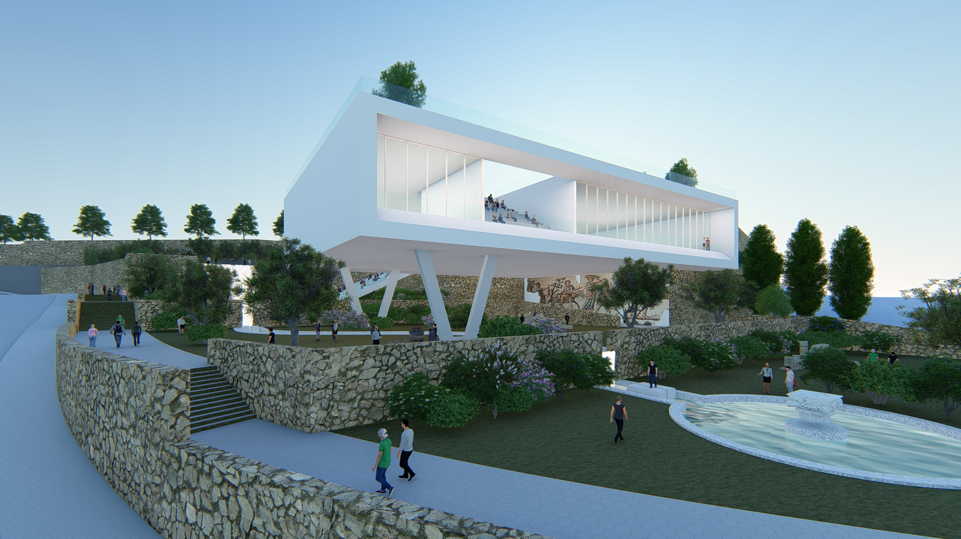
View from the Archaeological Garden’s Top Terrace

Slide 11
Night View from the Archaeological Garden

Slide 12
Budget for the Derech Eretz Gandhi Heritage Center
 | Description | Phase | Amount including VAT
1 | Execution cost for structure, as per budget of RCH (Regional Council Head) | Construction | NIS 14,410,618.00
2 | Execution cost for development and infrastructure, as per budget of RCH | Infrastructure | NIS 2,277,739.00
3 | Execution costs for content and exhibits | Content | NIS 5,616,000.00
4 | Costs for management and supervision and RCH project control company | General | NIS 921,609.00
5 | Costs for planners and structural advisors | Planning | NIS 1,341,990.00
6 | Content planning costs | Planning | NIS 1,053,000.00
7 | Coordination costs between planning and RCH project control company | Planning | NIS 378,299.61
Total Budget NIS 26,000,000

Slide 13
Expenditures and Budget Supplement
 | Description | Phase | Amount including VAT
1 | Phase 1 development costs for walls and excavation | Development | NIS 6,500,000.00
2 | Enlargement of assembly hall from 250 to 480 seats | Construction | NIS3,000,000.00
3 | Modular roofing for exterior dais | Infrastructure | NIS 2,000,000.00
4 | Glass-walled winter enclosure for lower assembly hall underneath the building | Infrastructure | NIS 1,000,000.00
5 | Flooring/paving, development, gardening and lighting – lower garden area | Infrastructure | NIS 1,500,000.00

