Slide 1

UMatch Analytics
More than just connections

Slide 2
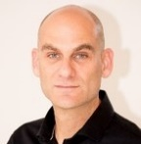
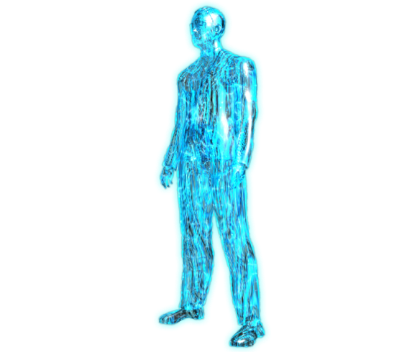
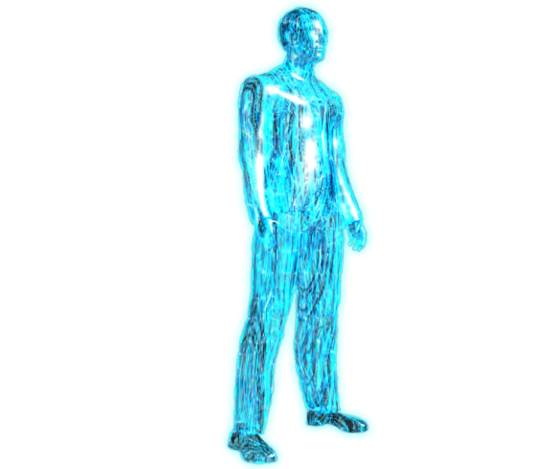
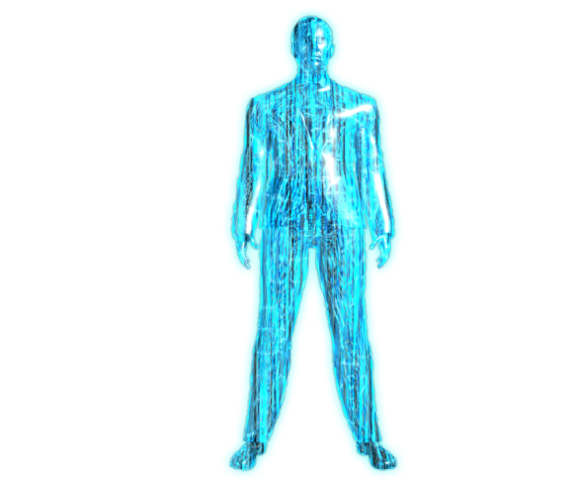


Let me Take You behind the scenes of the cyber intelligence world
Golan Malca | Founder & CEO
LTC (IDF) – A Lieutenant Colonel (reserves), serves as a head of staff in artillery brigade in Israel’s Northern Command
Former Vice President of Business Development in the intelligence and cyber division at NICE and Elbit systems.
For over 20 years and spanning more than 30 countries, has led unique technological business activities from the need stage through the sales stage and up until delivery, in the fields of defense, HLS, and cyber.

Slide 3


“THE BIG BUSINESS LEGO GAME”

Slide 4





THE NEED
We Want To Bring Real Business Value:
At a
Specific TIME
In a
Specific PLACE
For
Specific PEOPLE
With
Specific CONTENT
FOR A NEW MATCHING PARADIGM
WE MUST BRING NW KNOW- HOW
8
9

Slide 5
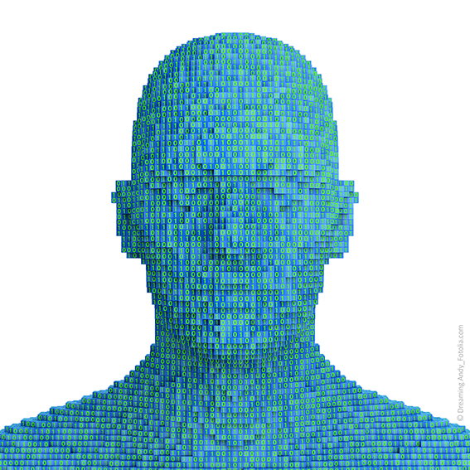
THE TECHNOLOGY
UMatch’s breakthrough business-matching technology knows companies intentions and people’s motivations and encourages action

Slide 6

THE TECHNOLOGY
COLLECTING AND
ANLAYZING DATA
HIGH VOLUME RELEVANT AUTOMATIC DATA COLLECTION
DATA PROCESSING BASED ON DEEP LEARNING ALGORITHMS
BI ANALYTICS DASHBOADS

Slide 7
BI PLATFORM LAYERS
01
Startups
02
Investors
03
Corporates
04
Academies (Research)
Main Trends in Industry
05
Personnel
06
08
Motivations
07
Transactions

Slide 8


PLATFORM SECOND LAYER
Creating a business synergy network between companies and people that learns the market deeply and automatically creates day-to-day business insights and connections.

Slide 9




THE PLATFORM
Main Services
Dynamic up-to-date data collection & analytics
Ability to ask questions of the platform connection map and receive answers
“Your Business WAZE” - Platform recommendations for all upcoming business steps
Predication – upcoming transactions in the field, industry, acquisitions, etc.
Creation of B2B event connections

Slide 10

Users Profiles 4
COOPERATES
STARTUPS
INNOVATION CENTERS
TECH
VENDORS
INVESTORS
INVESTMENT BANKERS
ACCELERATORS
ENTERPRISES
CAPITAL
MARKETS
ADVISORY
COMPANIES

Slide 11
Thanks
Golan Malca | Founder & CEO
E-mail: golan@umatchbi.com
Tel: 0523452855

