Slide 1
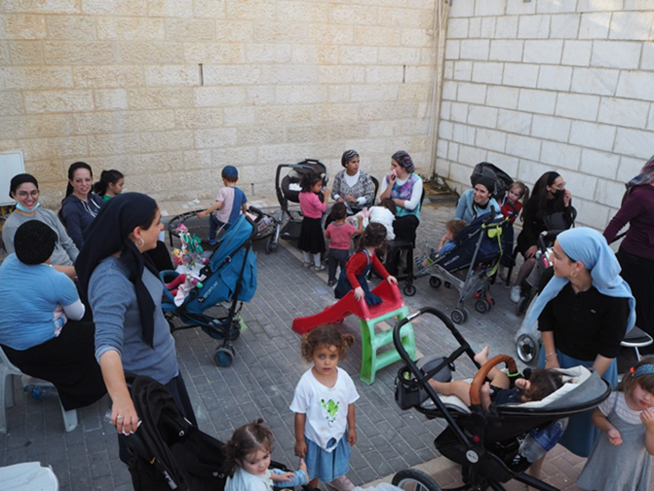
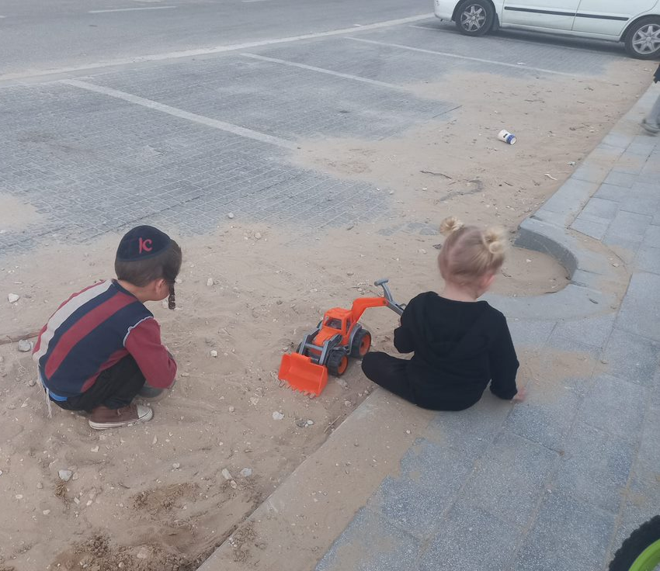
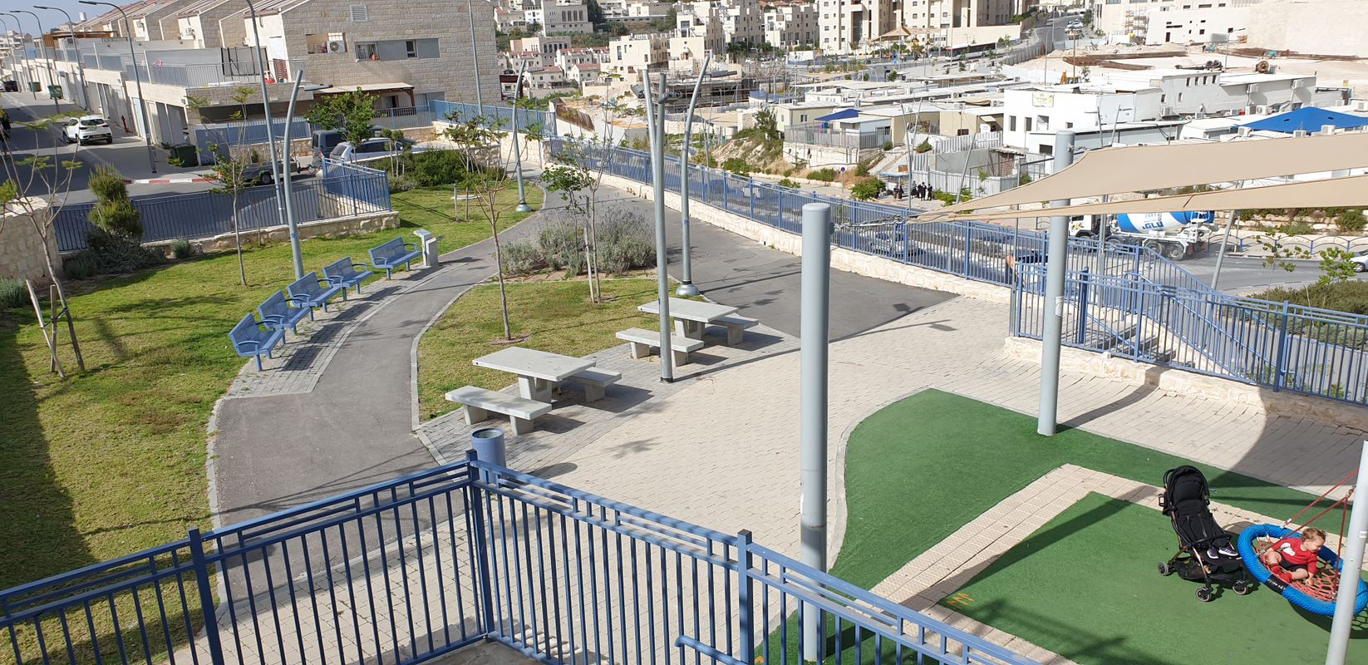
Baseline Report for the Urban95 Program in Beit Shemesh
Status Report Prior to Intervention Implementation
May 2022
The CET’s Program Evaluation Unit offers a range of tools and services to support social and educational initiatives and aid in their success.
צילום: "מסע"

Slide 2
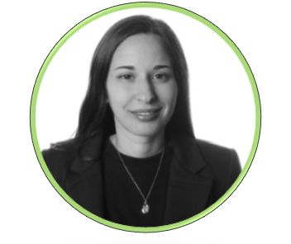
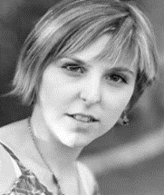
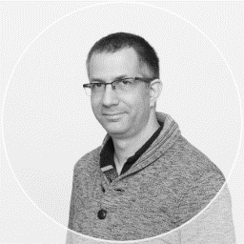
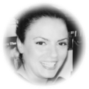
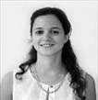
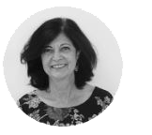
Research Team
Reoute Diamend, PhD
Researcher & Program
Evaluator
Alona Tsirulnikov
Researcher & Program
Evaluator
David Ben Shitrit
Researcher & Program
Evaluator
Noit Kadosh Maman
Research Coordinator
Tal Mishaan Spiegel, PhD
Director of the Program
Evaluation Unit
Hava Newman, PhD
Head of Measurement & Evaluation Administration

Slide 3
Table of Contents
Background…...............…..…………………………………………………………………………....................................................... 4-19
Young Children and Their Caregivers in Ultra-Orthodox Society in Israel………..……………………………………………….…….….4-14
Data from Beit Shemesh Pertaining to Young Children and Their Caregivers…………………………………………...…………..…..15-19
Research Goals…..……...………………………………………………………………...................................................................…..20
Research Design……...…………………………………………………………..…............................................................................21
Inputs and Outputs……………………………………………………………………………………………………………………………..22
Chapter A: Target Audience – Officials and Decision Makers in Beit Shemesh’s Municipality………………………….….23-31
Perceptions and Expectations (Based on Learning Interviews, Steering Committees and Workshops)………….…….……23-30
Summary and Recommendations……………………………………………………………………………………………………………………………….31
Chapter B: Target Audience – Beit Shemesh Residents: Parents and Their 0–6-Year-Old Children……………..………...32-45
Needs and Obstacles (Based on Focus Groups, a Resident Survey and Field Observations)………………………….………….32-44
Summary and Recommendations…………………………………………………………………………………………………………………..…………..45
Chapter C: Hinds of Change in Beit Shemesh…………...............…………………………………………...................................46-56
The Perceptual Shift among Municipal Officials .....………………...............................................................................................................47-50
Case Study – Zaira Parents’ & Children Activities in the Public Space………………………..…………………………………………..........51-56
Appendixes.…………………………………………………………………………………………………….............................................57-70
Bibliography – List of References and Documents…………………………………………………………………………………...……………………58
List of Interviewees …………………………………...……………………………………………………………………………………………………….………….59
Need Mapping Survey Questionnaire among Beit Shemesh Residents – Parents of Young Children ……………………...….60-65
Example of a Activity Observation Layout …………………………………………………………………………………………….………………..……66-69

Slide 4
Background – Urban95 in the Social & Geographic Periphery of Israel
The Urban95 program in the social and geographic periphery of Israel is a joint initiative funded by the Bernard Van Leer Foundation (BvLF) and operated by the Israeli Green Building Council (ILGBC). In the first stage, the program operates in the two “anchor” municipalities of Tira and Beit Shemesh. In the second stage it will operate in a third municipality located in the social and geographic periphery of Israel. The program’s activity in the three municipalities will serve as a model for other cities for promoting early childhood needs. In the third stage of the program interventions of a more limited scope are intended to be implemented in 9-12 additional satellite municipal councils.
The goal of the Urban95 program is to promote the development of a supportive urban-communal environment that provides equal opportunity regarding raising and nurturing young children and regarding the welfare of their caregivers.
The following report focuses on the findings of the evaluation conducted at the start of the program’s activity in the Beit Shemesh municipality and describes the state of the city prior to implementing the interventions on the ground.
The CET’s Program Evaluation Unit offers a range of tools and services to support social and educational initiatives and aid in their success

Slide 5
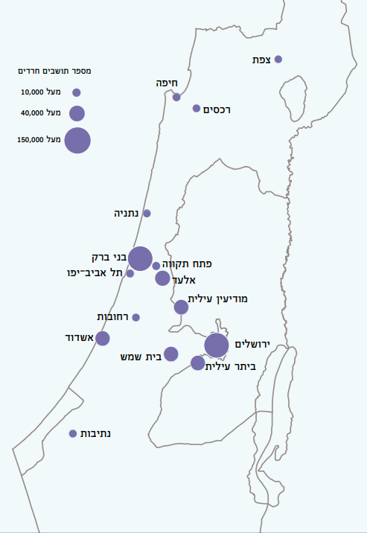
Haredi Society in Israel—Basic Data*
As of 2020, the Haredi (Ultraorthodox) population of Israel is approximately 1,175,000 people. Its rate of natural increase is 4.2% per year (compared to 1.4% for non-Haredi Jewish Israelis). The proportion of young people, aged 0-19, among the Haredi population, is 58%, compared to 30% among non-Haredi Jewish Israelis.
34% of Haredi Israelis live in Haredi localities (in which over 80% of residents are Haredi—Bnei Brak, Modi’in ‘Illit, Beitar ‘Illit, Elad, Rekhasim, Emanuel, Kiryat Ya’arim, Tifrah, and Kfar Habad). 37% of Haredi Israelis live in localities in which 50-80% of residents are Haredi (Jerusalem, Beit Shemesh, Tzfat, Kokhav Ya’akov, and Yavne’el). 11% of them live in localities where 16-50% of residents are Haredi (Ashdod, Netivot, Tzfat, Kiryat Gat, Ofakim, Tiberias, Givat Ze’ev, and Arad). Finally, 18% of them live in localities where under 16% of residents are Haredi (Petach Tikva, Netanya, Haifa, Tel Aviv, Rehovot, Holon, Be’er Sheva, and Ashkelon).
As of 2019, the average Haredi family consists of 5.32 people, which is higher than among non-Haredi Jewish Israelis (3.16).

Slide 6
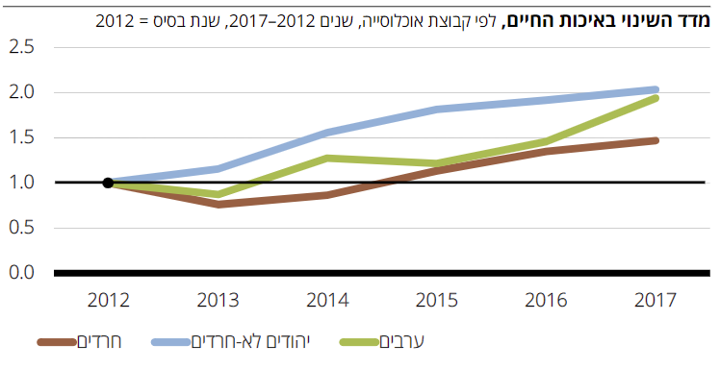
The Quality-of-Life Index of the Ultra-Orthodox Population in Israel*
Summary of the Weighted Quality of Life Index for 2017
According to the 2017 Weighted Quality of Life Index, the aggregate quality of life measure for the Haredi Israeli population is 0.64, which is slightly lower than for the non-Haredi Jewish Israeli (NHJI) population (0.71). The Haredi population’s measures of income, employment, infrastructure, public transit, and environment is lower than that of NHJIs.
Despite the significant disparities in material quality of life, the Haredi population’s measures are higher than that of the NHJI population for health, personal welfare & family life, and community & social life.
 | Orthodox Jews | Non-Orthodox Jews | Arabs
Healthcare | 0.95 | 0.75 | 0.00
Personal welfare & family life | 0.80 | 0.53 | 0.12
Education & higher education | 0.50 | 0.89 | 0.02
Income & economic situation | 0.56 | 0.94 | 0.00
Employment | 0.35 | 0.77 | 0.40
Housing | 0.42 | 0.47 | 0.41
Community & social life | 0.99 | 0.51 | 0.05
Personal safety & exposure to crime | 0.47 | 0.47 | 0.60
Municipality, public transport & the environment | 0.48 | 0.99 | 0.19
Aggregate of the QUALITY-OF-LIFE Index | 0.64 | 0.71 | 0.18
Change in Quality-of-Life Index, by population groups, 2012-2017
From 2012 to 2017 the quality-of-life index increased gradually for Haredi Israelis while it rose more saliently for the entire Israeli population.
However, the trend of change in quality of life for Haredi Israelis remains more moderate than for NHJIs.
Orthodox Jews
Non-Orthodox Jews
Arabs
*Source: The Quality of Life of Populations in Israel – The 2019 Quality of Life Index, October 2019. The Haredi Institute for Public Affairs

Slide 7
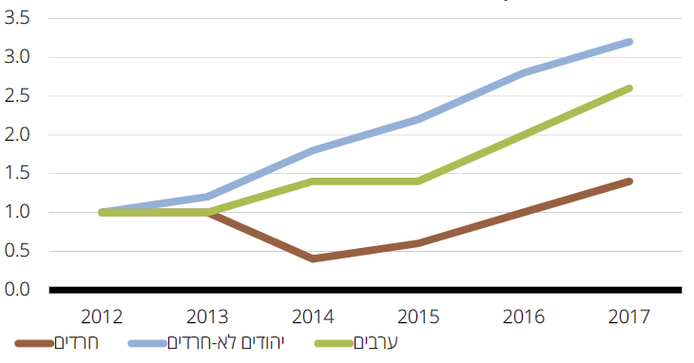
The Quality-of-Life Index of the Ultra-Orthodox Population in Israel – Education and Higher Education*
The Education and Higher Education Indexes for 2017
The proportion of Haredi Israelis who have a matriculation certificate or an academic degree (53%), and the proportion with an academic degree (18%) is lower than among Non-Haredi Jewish Israelis (NHJIs) (77%; 44%). Additionally, Haredi Israelis participate in professional training courses at a lower rate than NHJIs (28% vs. 36%). However, Haredim have more years of education than NHJIs. This disparity stems from continued Torah study by Haredi men in Yeshiva Gevoha and Kollel seminaries.
 | Orthodox Jews | Non-Orthodox Jews | Arabs
Number of years of education | 18.2 | 14.6 | 11.8
Rate of those with a matriculation certificate or higher diploma ACADEMIC DEGREE | 53.2 | 76.7 | 48.8
Rate of those with an academic diploma DEGREE | 17.7 | 43.5 | 20.0
Rate of those participating in professional training courses | 27.8 | 35.9 | 14.6
Total private expenditure on education per household with children aged 0–18 | 1,788 | 2,086 | 980
Standardized Relative Education & Higher Education Index (ranging from 0–1) | 0.50 | 0.89 | 0.02
Change in Education and Higher Education Indexes, 2012-2017
The index of change in education and higher education has increased among all Israelis, including among Haredi Israelis, primarily from 2015 to 2017.
Orthodox Jews
Non-Orthodox Jews
Arabs
*Source: The Quality of Life of Populations in Israel – The 2019 Quality of Life Index, October 2019. The Haredi Institute for Public Affairs

Slide 8
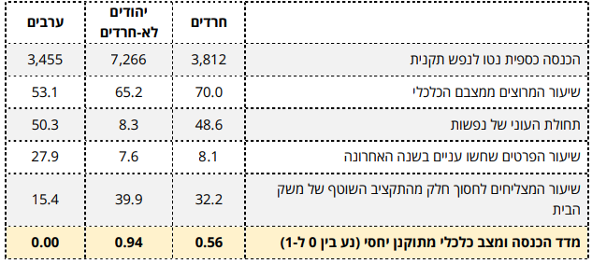
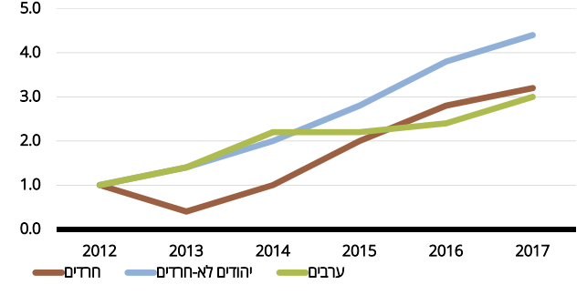
The Quality-of-Life Index of the Ultra-Orthodox Population in Israel – Income & Economic Status*
Income & Economic Status, 2017
The adjusted net income per capita among Haredi Israelis is significantly lower than for non-Haredi Jewish Israelis (NHJI): (NIS 3,812 vs. 7,266). Haredi Israelis have one of the highest poverty rates among Israeli population groups: approx. 50% live in households in poverty. However, the subjective poverty rate among Haredi Israelis is only 8%, like that of NHJIs. A lower proportion of Haredi Israelis reported that they are able to save part of their regular household budget than the proportion of NHJIs (32% vs. 40%).
Change in Income & Economic Status Index, 2012-2017
The index of change in income & economic status has increased among all Israelis, including among Haredi Israelis.
Orthodox Jews
Non-Orthodox Jews
Arabs
*Source: The Quality of Life of Populations in Israel – The 2019 Quality of Life Index, October 2019. The Haredi Institute for Public Affairs

Slide 9
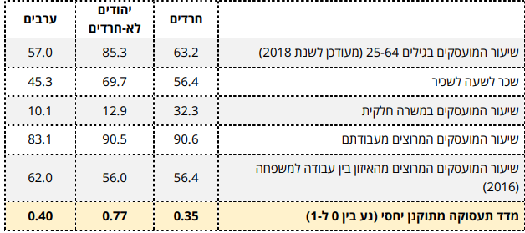
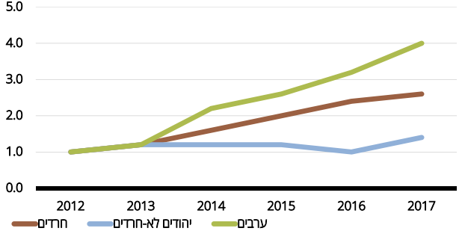
מדד איכות החיים בחברה החרדית בישראל – תעסוקה*
Employment Indices, 2017
The employment rate among Haredi Israelis is 63% (as of 2018), much lower than the rate among NHJIs (85%). The hourly earnings for salaried workers among Haredi Israelis is 19% lower than for NHJIs. The rate of Haredi Israelis employed part-time is significantly higher than that of NHJIs (32% vs. 13%).
Change in Employment Index, 2012-2017
The index of change in employment has increased gradually among Haredi Israelis.
Orthodox Jews
Non-Orthodox Jews
Arabs
*Source: The Quality of Life of Populations in Israel – The 2019 Quality of Life Index, October 2019. The Haredi Institute for Public Affairs

Slide 10
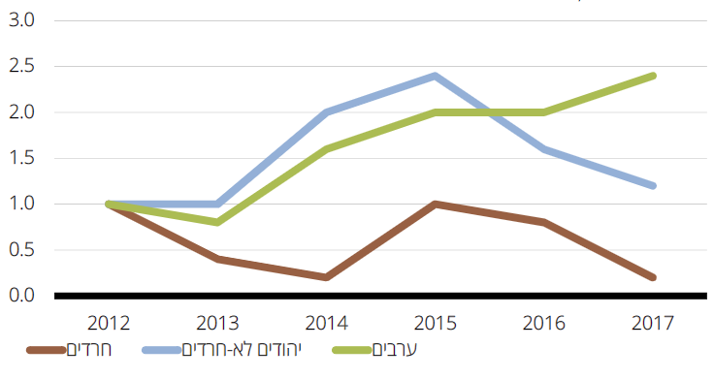
The Quality of Life Index of the Ultra-Orthodox Population in Israel – Municipality and the Environment*
Municipality and the Environment Indexes, 2017
RATE OF THOSE… | Orthodox Jews | Non-Orthodox Jews | Arabs
pleased with the functioning of their municipality* (2015) | 66.7 | 70.7 | 40.2
pleased with the level of cleanliness in their area of residence | 49.0 | 57.8 | 39.4
pleased with public transportation in their area of residence | 58.0 | 57.6 | 49.2
who reported being disturbed by outside noise in their apartments | 34.1 | 33.0 | 33.1
who reported being disturbed by air pollution in their area of residence | 36.5 | 33.3 | 36.4
Standardized Relative Municipality, Public Transport & Environment Index (ranging from 0–1) | 0.48 | 0.99 | 0.19
About two-thirds of Haredi Israelis are pleased with the functioning of their municipality, and about half are pleased with the level of cleanliness in their area of residence. These are lower proportions than those of NHJIs. The proportion of Haredi Israelis who reported noise disturbances and air pollution was like that of NHJIs.
Change in Municipality & Environment Indexes, 2012-2017
It is evident that over the years Haredi Israelis have experienced a gradual decrease in municipality & environment indexes.
Orthodox Jews
Non-Orthodox Jews
Arabs
*Source: The Quality of Life of Populations in Israel – The 2019 Quality of Life Index, October 2019. The Haredi Institute for Public Affairs

Slide 11
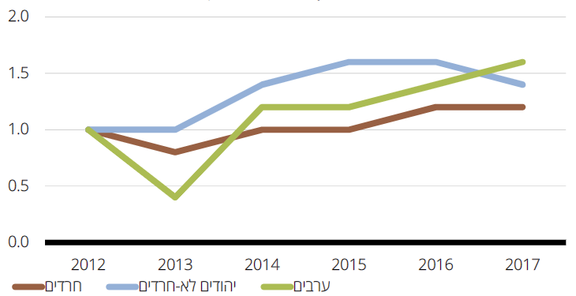
The Quality-of-Life Index of the Ultra-Orthodox Population in Israel – Personal Welfare and Family Life*
The personal welfare and family life indexes were highest for Haredi Israelis compared to NHJIs and Arab Israelis. The proportion of those satisfied with life was higher among Haredi Israelis than among NHJIs. A high proportion of Haredi Israelis expect their economic situation to improve (61%). The rate of those managing to cope with their problems among Haredi Israelis is 79%, higher than among NHJIs. Additionally, the rate of those experiencing a sense of loneliness among Haredi Israelis is lower than among NHJIs. However, 37% of Haredi Israelis reported experiencing religious discrimination, much higher than among NHJIs (5%).
The Personal Welfare and Family Life Indexes for 2017
Rate of those… | Orthodox Jews | Non-Orthodox Jews | Arabs
satisfied with life | 98.2 | 91.6 | 75.5
expecting their economic situation to improve in the future | 60.5 | 45.1 | 40.4
managing to cope with their problems | 79.3 | 69.7 | 55.7
experiencing a sense of loneliness | 10.3 | 22.2 | 23.5
experiencing religious discrimination | 36.6 | 4.9 | 18.0
Standardized Relative Welfare Index (ranging from 0–1) | 0.80 | 0.53 | 0.12
Change in Personal Welfare and Family Life Indexes, 2012-2017
The index of change in personal welfare and family life indicates a continuing improvement over time.
Orthodox Jews
Non-Orthodox Jews
Arabs
*Source: The Quality of Life of Populations in Israel – The 2019 Quality of Life Index, October 2019. The Haredi Institute for Public Affairs

Slide 12
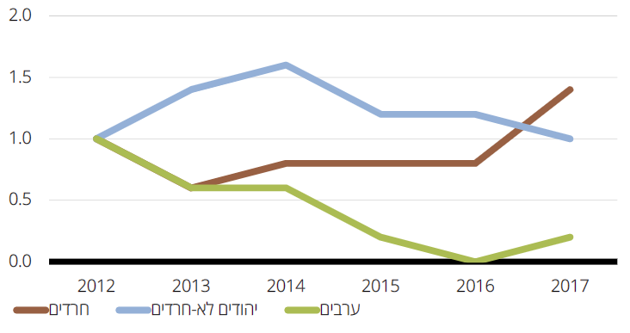
The Quality-of-Life Index of the Ultra-Orthodox Population in Israel – Community and Social Life*
Community Life Indexes for 2017
RATE OF THOSE… | Orthodox Jews | Non-Orthodox Jews | Arabs
pleaseD with their place of residence | 92.2 | 87.1 | 69.2
pleased with their relationships with their neighbors | 93.0 | 86.4 | 88.0
who believe people of different backgrounds get along well in their area of residence | 90.2 | 91.5 | 61.6
who volunteer | 38.3 | 22.5 | 7.6
Rate of contributing households | 75.8 | 27.0 | 7.6
Standardized Relative Community and Social Life Index (ranging from 0–1) | 0.99 | 0.51 | 0.05
In the community and social life indexes, Haredi Israelis had a higher score than the other groups (NHJIs and Arab Israelis). The proportion of Haredi Israelis pleased with their place of residence and their relationships with their neighbors is high (92%, 93%). Similarly, 90% of Haredi Israelis believe people of different backgrounds get along well in their area of residence (measured in 2014). Finally, both the rates of volunteers and of contributing households are significantly higher among Haredi Israelis than among NHJIs.
Change in Community Life Indexes, 2012-2017
The index of change in community and social life indexes among Haredi Israelis has been increasing since 2016.
Orthodox Jews
Non-Orthodox Jews
Arabs
*Source: The Quality of Life of Populations in Israel – The 2019 Quality of Life Index, October 2019. The Haredi Institute for Public Affairs

Slide 13
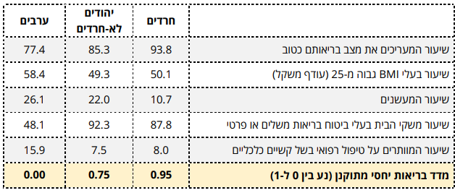
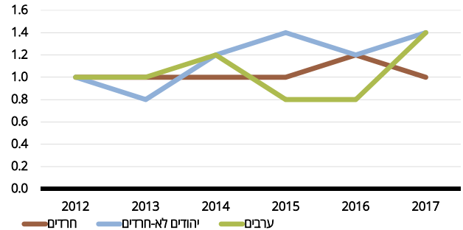
The Quality-of-Life Index of the Ultra-Orthodox Population in Israel – Health*
Health Indexes (Relative Index), 2017
In 2017, 94% of Haredi Israelis evaluated their health as good, a higher proportion than that of NHJIs. Haredi Israelis were similarly better off than NHJIs regarding the proportion of people with BMI over 25, of households with supplemental or private health insurance, and of people who have foregone medical care due to financial difficulties. Moreover, it is evident that the rate of Haredi Israelis who smoke is 50% lower than that of NHJIs.
Change in Health Indexes, 2012-2017
There has been no significant change in the health indexes among Haredi Israelis in recent years.
*Source: The Quality of Life of Populations in Israel – The 2019 Quality of Life Index, October 2019. The Haredi Institute for Public Affairs

Slide 14
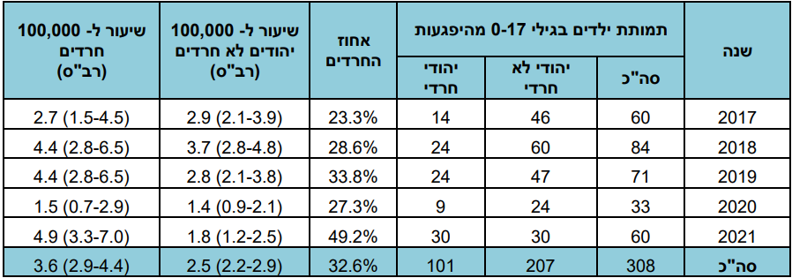
Safety in Public Space and the Home Among Haredi Israeli Children
Distribution of Child Mortality Cases from Unintentional Injuries, by Sector among Jewish Israelis, 2017-2021
During the past five years, the rate of child mortality from unintentional injories is 1.4 times higher among Haredi children than among NHJI children: 3.6 cases per 100,000, compared to 2.5 cases per 100,000, accordingly.
The relative weight of road accidents is lower among Haredi children (25%) than NHJI children (49%). However, 30% of Haredi child mortality cases occur in the home and public space, which is higher than among NHJI children (22%).
Distribution of Child Mortality Cases from Unintentional Injuries, by Injury Location and Sector among Jewish Israelis, 2017-2021
* Source: Beterem – Report on Child Mortality from Unintentional Injury for 2021. January 2022

Slide 15
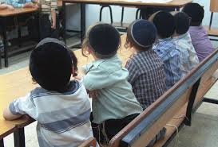
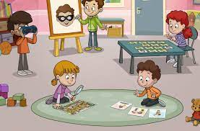
Programs to Promote Early Childhood among Haredi Israelis
Interventions to promote child development necessitate adaptation of programs to the social and cultural context in which the operate. Therefore, it is necessary to understand the social and cultural characteristics of Haredi society. The groups that make up Haredi society have shared characteristics: reliance on rabbis in all fields of life, including children’s education; life in closed communities; developed community mechanisms, including mechanisms of mutual assistance and support for the poor; significant use of Yiddish, and of internal dialects and linguistic codes; division within Haredi society into subgroups with their own separate educational institutions; gender-based dress codes and behavioral norms; and segregation between men and women in various fields of life.
Examples of interventions in the Haredi education system:
The “active courtyard” intervention operated as part of the National Program for At-Risk Children and Youth. It aimed to enable early intervention among children suffering from developmental challenges. The program included training for preschool teachers and other teachers to increase their awareness and ability to identify children expressing developmental challenges and refer them to further treatment.
As part of the Program for Developing Language Skills Among Preschoolers, an intervention operated aimed at influencing the linguistic environment in the classroom to promote an atmosphere of discussion, to create opportunities for broader discussions, and to build vocabulary through mediated instruction. The intervention included training for teachers and preschool teachers with a special emphasis on cultural and linguistic adaptation for the target population in Haredi society.
The Haredi Institute for Public Affairs
CET – The Center for Educational Technology The Israel Teachers’ Union Fund for Professional Advancement
*Source: Evaluation of Programs Aimed at Promoting Early Childhood Education: Literature Review, Center for Educational Technology, April 2016

Slide 16
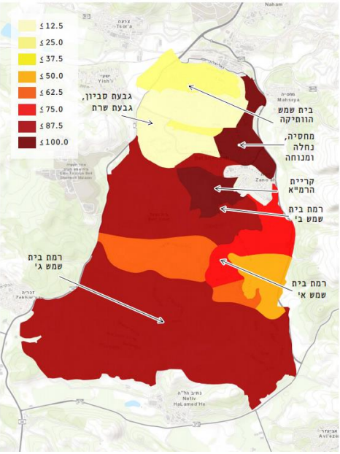
Beit Shemesh: Socioeconomic Status
Concentration of Haredi Population in Beit Shemesh The Haredi Institute for Public Affairs
Municipal jurisdiction 38,670 dunam (9555.5651 acres) | 132,544 residents (as of 2020) | 23,061 children aged 0-4 52% of the population are children aged 0-12
Beit Shemesh is in Socioeconomic Cluster 2 (2017) | Average # of persons per family: 5.04 (2019) | Annual population growth rate: 7.1%
The employment rate is 57% in Beit Shemesh, lower than the Haredi population nationally (62%) and the national average (85%) | The average monthly salary among the Haredi population in Beit Shemesh is NIS 6,926 (compared to NIS 7,892 among Haredi Israelis nationally and NIS 13,382 among NHJIs [non-Haredi Jewish Israelis]).
* Source: Central Bureau of Statistics (CBS). General Data – 2020.
* Source: CBS, Families in Israel – Data in Honor of Family Day, 2021
* Source: Introduction and Opening Meeting – Urban 95 Beit Shemesh, Feb. 15, 2021
* Source: Mapping of Human Capital in Beit Shemesh. Eitan Regev, Itzik Crombie, and Shani Zusman-Efrati. The Haredi Institute for Public Affairs and Beit Shemesh Municipality. October 2021.

Slide 17
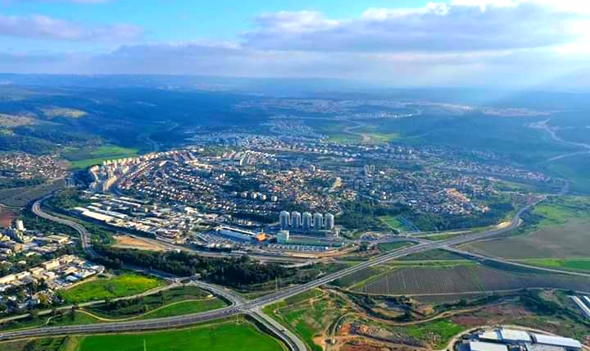
Beit Shemesh: General Data*
Beit Shemesh is a focal point that connects the Jerusalem area to the Bnei Brak area and central Israel.
Veteran Beit Shemesh is in the northern part of the city, around which additional neighborhoods grew. The city expanded south, and there is currently a huge building trend that will transform Beit Shemesh from a city of 150,000 to a city of 250,000 residents in three years.
Beit Shemesh is divided into ten main areas which were settled several waves.
The city has a diverse social-cultural fabric (Haredi-majority neighborhoods and mixed neighborhoods), a result of the city’s having developed and been populated over time. Today over half the city’s residents are Haredi and belong to various Haredi streams.
Haredi residents live in communities, surrounding public buildings, specifically synagogues. There are several streams: Hassidic/Lithuanian/Sephardic, and there are several sects in each stream – each sect has external distinguishing markers and different public needs.
The variety of religious and Haredi streams in the city and the very high proportion of children necessitate tools that appropriately address the lack of public space and public buildings.
*Source: Beit Shemesh Overall Master Plan, Planning Division, Construction and Housing Ministry, Armon Architects and Kaiser, December 2020.
* Source: Summary of Beit Shemesh Steering Committee, Apr. 28, 2021
* Source: Introduction and Opening Meeting – Urban 95 Beit Shemesh, Feb. 15, 2021

Slide 18
Beit Shemesh: Public Buildings, Transit, and Mobility*
Given the city’s rapid growth, public buildings are lacking in some neighborhoods (specifically family health centers and sports & leisure buildings).
There are 4 community centers in the veteran neighborhoods, and 3 centers are currently being built (between C1 and C2, in Naveh Shamir, and in Ramah D).
Also, given the rapid growth, there are many temporary and portable public buildings (used as synagogues, preschools, and schools)
There is a disparity between the city’s educational needs and the facilities in place (a lack of approx. 1,000 classrooms)
The lack of parking spaces adjacent to the preschools creates an unsafe environment—frequent movement of cars during drop-off and pick-up times
The city lacks about 15 bus stops and needs additional inter-city bus lines.
Most residents travel by bus (80-90%)—Beit Shemesh has 143 cars per 1,000 residents (nat’l avg. – 335)
The city has a new master plan and an approved urban building scheme (which will add 8,000 housing units).
Part of the master plan’s goal is to create pedestrian contiguity, addressing the hilly terrain, which challenges travel by foot.
As part of the umbrella agreement, the construction of family health centers in the new neighborhoods was defined as a condition in the urban building scheme.
Health clinic buildings and courtyards have potential as space for children’s activities.
* Source: Introduction and Opening Meeting – Urban 95 Beit Shemesh, Feb. 15, 2021
* Source: Steering Committee Meeting #4 Summary, Aug. 9, 2021
* Source: Steering Committee Meeting in Beit Shemesh Summary, Apr. 28, 2021
*Source: Beit Shemesh Overall Master Plan, Planning Division, Construction and Housing Ministry, Armon Architects and Kaiser, December 2020

Slide 19
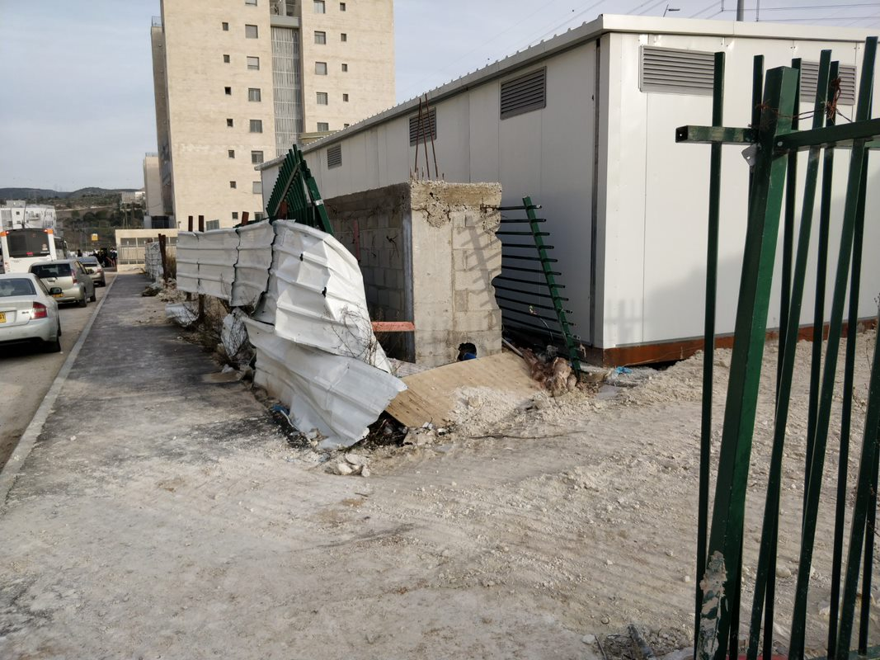
Beit Shemesh: Public Space – Ramat Avraham and Ramat Beit Shemesh C1*
The master plan includes the construction of 20-30–story residential buildings – there is opposition among residents.
There is a lack of public space, shade, and trees alongside the sidewalks (primarily in new neighborhoods).
There is a lack of pocket gardens (primarily in new neighborhoods).
The existing public parks are not appropriate to the population types and to various ages.
Encouraging culturally adapted mixed-use (e.g., dedicating public buildings for double use – synagogue/school(/seminary), mikveh / family health center)
Ensuring public space is culturally-adapted (e.g., locating street benches not facing buildings, locating playgrounds not near mikvehs)
* Source: Introduction and Opening Meeting – Urban 95 Beit Shemesh, Feb. 15, 2021
* Source: Steering Committee Meeting in Beit Shemesh Summary, Apr. 28, 2021

Slide 20
Outlining the evaluation research for the Urban95 program in Beit Shemesh, including developing a primary logic model for the program and a separate one for Beit Shemesh, including mapping and formulating evaluation indicators aligned with BvLF indicators.
Accompanying evaluation research: Research to map needs, in order to examine possible interventions for Beit Shemesh.
Formative evaluation research: Conducting pre-intervention measurements as part of a range of pilot programs in Beit Shemesh, in order to refine intervention processes and solutions based on the needs of the target audience and examine the effect post-intervention.
Evaluation Research Goals
for the Urban95 Program in Beit Shemesh

Slide 21
Research Design
Evaluation Period – Stage 1 of the Urban95 Program in Beit Shemesh, June 2021-May 2022
Learning and Planning
Baseline Evaluation Municipal Stakeholders
Baseline Evaluation
Residents
Training Evaluation
Pilot Programs - Formative Evaluation
8 learning interviews to identify needs & align expectations with Key stakeholders in Beit Shemesh municipality.
Logic model workshop on October 17th 2021 with key participants:
The BvLF team
The ILGBC team
Various key officials from Beit Shemesh municipality.
Evaluation indicators were defined.
3 focus groups with residents
Residents’ survey
Feedback survey to assess team training sessions
Focus group with the leading municipal team
7 observations on the ground pre-intervention:
4 activity observations
2 Xplore observations
1 Fathers & children tour observation
The CET’s Program Evaluation Unit offers a range of tools and services to support social and educational initiatives and aid in their success

Slide 22
Inputs & Outputs
Outputs and Results at the End of the 2021 Activity Year | Goals and Inputs
Training program for city staff: Study day in Holon on early childhood development and study day in Tel Aviv-Yafo on playgrounds and public space. High satisfaction among participants in the training sessions. | Training and seminars for acquiring knowledge and tools to raise awareness of the importance of addressing early childhood needs in all areas of life
Learning interviews were held to identify needs and adjust expectations. The activities, goals, impact, and target audience of the program in Beit Shemesh were defined through the logical model. Focus groups were held with residents and a survey was distributed among residents. A feedback survey was distributed regarding the training sessions for the professional staff. | Mapping needs and identifying opportunities for creating accessible content for young children and their caregivers, to support interventions in the municipality’s urban environment
A meeting with the city staff and mothers who are Beit Shemesh residents + a tour. 2 meetings of the mayor, the program director, and influential women from various neighborhoods and sectors in the city. | Engaging various municipality officials with the Urban95 vision, with a focus on senior officials
Zaira activities—A set of 3 programs for young children (early childhood) and their mothers in public space close to the home, which were held in 2 rounds, in 2 neighborhoods in the city (Ramat Avraham and Ramat Beit Shemesh C1). 2 guided tours were held for fathers and their children in nature near the home. The program’s directors took part in forming a group of Haredi activists, encouraged them to submit initiatives to the urban hackathon, and assisted them during it. Since then, efforts have continued to advance the initiatives. A contact list was created of activist mothers in Ramat Avraham and Ramat Beit Shemesh C1. | Initiating pilot programs that include an array of accompanying content in the municipality’s physical environment
An inter-departmental municipal work team was created and holds regular meetings to promote initiatives as part of the program (regular monthly meetings and additional meetings and additional meetings between the program’s directors with municipality officials as needed). Connections were made between municipality officials and activist residents of Ramat Avraham to encourage creating intimate public space in private open space (in unused parking spaces). Collaboration was initiated between the municipality, on the one hand, and Haredi early childhood entrepreneurs and experts who are Beit Shemesh residents, on the other hand. | Building a work team in the municipality and forming collaborations inside and outside the municipality

Slide 23
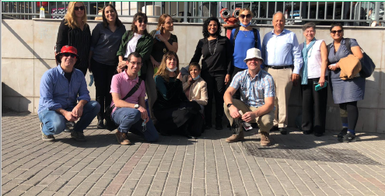
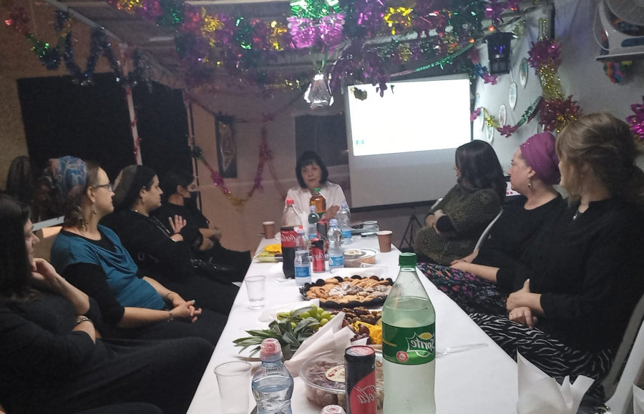
Chapter A
Target Audience – Officials and Decision Makers in Beit Shemesh Municipality

Slide 24
Logic Model for Beit Shemesh Municipality: the Urban95 Program in Israel’s Social and Geographical Periphery
Target Audience | Inputs | Actions | Outputs | Short to Mid-Term Results (up to 3 years from program’s onset) | Long Term Results (3-5 Years) | Impact
Officials & municipal decision makers, and professionals in the field | Personnel: - ILGBC team - Anchor municipality program manager - Municipal officials - External consultants - Program partners (inside and outside of the municipality) - Previous knowledge and experience from BvLF, ILGBC, Urban95 TLV and at the national roundtable - Projects’ funding - Measurement and evaluation | Participation in meetings and committees to promote early childhood development (ECD) in the anchor municipality Participation in trainings & seminars to acquire knowledge and tools and to raise awareness for ECD importance in all aspects of life Mapping of potential interventions in public space and mobility domains in the anchor municipality Mapping needs and identifying opportunities to provide relevant contents for young children and their caregivers, supporting the interventions in the urban environment in the anchor municipality Engaging municipal stakeholders in pilots’ implementation Connecting with external partners for resources’ utilization and expending opportunities for additional collaborations Initiating pilots in the urban environment, including providing accompanying contents The municipal program manager will support interventions’ implementation and accompany municipal stakeholders in assimilating inter-administrative collaborative work models | A permanent seat for program leaders at the anchor municipality’s decision-making table, to examine possible touching points between the early childhood domain and the municipality’s ongoing work-plans Extent of municipal officials who have participated in seminars for acquiring local and international knowledge and tools regarding early childhood Satisfaction of trainings’ participants Extent of new partners’ engagement and inter-department collaborations Identification of well-defined and differentiated intervention locations, to implement pilots in the domains of public space and mobility Initiating pilots’ implementation while defining inter-departmental division of labor and engaging relevant officials from in and outside of the anchor municipality Extent of data-based work: using knowledge and experience accumulated from the program’s partners network, the program’s website, and peer learning | Early childhood is permanently present on the municipal agenda Municipal officials are knowledgeable and understanding of early childhood needs Municipal officials are using work mechanisms and new management practices, along with inter-department collaborations Collaborations between municipal officials and external partners, while utilizing resources dedicated to promoting early childhood Beit Shemesh Pilots’ implementation in the mobility and public space domains: adjusting them for young children and their caregivers’ use, and providing contents for young children and caregivers to support these interventions Promotion of municipal investment in adjusting the urban environment for safe and accessible stay, use and mobility of multiple young children and their caregivers Beit-Shemesh constitutes a source for peer learning to other municipalities | Municipal officials are implementing acquired knowledge & understanding of ECD needs for decision making and for promoting solutions for young children and their caregivers’ benefit Young children & caregivers’ P.O.V is considered when planning public spaces suitable for multiple participants Increase in number of public spaces and infrastructures renovated and adjusted for the use of caregivers and their children, by the Urban95 principles & standards Beit-Shemesh municipality is utilizing external resources and acts independently to promote ECD needs The anchor municipal urban planning, that is based on Urban95 principles, is recognized as a “success story” and echoes in other municipalities | A policy for promoting an urban environment that is adjusted for optimal development of early childhood is properly and sustainably embedded in all of Beit-Shemesh’s municipal administrations, that are acting in full coordination and collaboration

Slide 25
Indexes
Indicator / Tool | Data Review & Analysis | In-depth Interviews | Focus Groups | Trainings’ Participants Feedback
ECD is on the municipal agenda | V | V | V | V
Officials poses knowledge in and understanding of ECD needs | V | V | V | V
Using inter-administrative practices and collaboration mechanisms | V | V | V | V
Initiating collaborations with external partners, including resource utalization for ECD | V | V | V | V
Public space & mobility pilots’ initiation close to home, including accompanying contents | V | V | V | V
Allocating positions b & budgets to promote physical space adjustments for ECD needs | V | V | V | V
Beit Shemesh as peer-learning source to other municipalities | V | V | V | V
Data driven decision making, to promote solutions for young children and their caregivers | V | V | V | V
Considering young children & caregivers’ P.O.V in planning suitable, close to home, public spaces | V | V | V | V
Implementing projects to adjust public spaces by Urban95 principles, on a municipal scale | V | V | V
Beit Shemesh municipality independently promotes urban initiatives to advance ECD | V | V | V
The Urban95 program in Beit Shemesh is recognized as a “success story”, which echoes in other municipalities | V | V | V | V

Slide 26
Extent to which Early Childhood is on the Municipality’s Agenda and Integration of the Child and Caregiver’s Point of View in Planning Appropriate Public Spaces
Municipal officers dealt with issues pertaining to early childhood before Urban95 entered Beit Shemesh. The city has an early childhood department and an early childhood forum.
However, before Urban95 entered the city, the topic of early childhood was insufficiently considered in planning public space (including preschools and playgrounds), primarily in the new neighborhoods.
“There is a statement the mayor is promoting. She puts early childhood in our focus and therefore we have a department that gives services for early childhood.”
“We also have the early childhood forum that is present and starting to be active. There are responses for young parents, even for adolescents, support groups for women after birth.”
“Early childhood is always in discussions but…it is not so much part of the public space. Rather, more in ensuring that buildings are built in advance of the construction of new neighborhoods, and it means taking them into account numerically.”
“Most responses were given up to now to the veteran part of Beit Shemesh. There are many new neighborhoods that were built and they barely have responses and services. They barely have family health centers, there are no community centers, and even basic things like preschools.”
“I was happy about Urban95 that it will enable us to stop putting out fires and think deeper. It is a bonus because we are so busy with the basics and construction.”

Slide 27
Extent to which Municipal Officials Are Knowledgeable and Have an Understanding of Early Childhood Needs
“Regarding public space and young children [early childhood], the challenges are the lack of space, preschools, parks, and places to spend time. There are very large parks, but one must travel to them.”
“Today many mothers don’t come for treatment because they cannot leave all their children at home and travel with one child to the veteran part of Beit Shemesh, while they live in a different neighborhood with services.”
“In the playgrounds in the city there is no attention given to the fact that a mother needs to sit and be able to see all the children, or that the facilities are for older children and there are not enough facilities for early childhood.”
“Street infrastructure with garbage cans on sidewalks…in some places, parents walk on the street with strollers because the sidewalk is impassable.”
“There are issues of road safety. Several times children were hit by cars in recent years.”
Officials recognize the needs of early childhood and are aware of the disparities in the field, such as the lack of public buildings and services for early childhood and their caregivers near the home, and the issue of road safety and adapting public space:
Officials express commitment to the program and promoting early childhood needs in that they make sure to participate in Urban95’s professional training sessions despite their regular workload:
On a tour, I saw a different city and learned what can be improved in my city and I received inspiration. In Tel Aviv we saw a place that has sand and whatever, which is something that really enters my heart, and already entered my task list.”
“We are very busy, and you will need to lessen and not add to our load, but rather the more you can simplify so that all the relevant entities stay in the picture.

Slide 28
Extent to which Officials Make Use of Inter-Administration Collaboration Practices and Mechanisms
There are several collaborations in Beit Shemesh between departments on behalf of joint projects (such as a school for parenting).
In the learning interviews, officials expressed understanding of the importance of the collaborative work (despite the workload and intensiveness of their work), and spoke of potential collaborations that can advance the Urban95 project in the city:
“The school for parenting in the community opened last January at the request of the mayor. Most of the departments are significant partners in this process. For example, the education, youth, and community administration in all the departments, 360, the psychological service, the early childhood department, the young people department, and the welfare wing.”
“We have a welfare wing that is less engaged with the community niche and even if it pertains to community, it is referred for specific welfare-focused families. We in the education administration have the community and youth wing, and work in amazing collaboration.”
“It will be difficult to recruit them because of availability, but when we succeed it will be a double benefit. In terms of collaboration everyone wants it, but also when I send an email to the city beautification department, I add a WhatsApp message along with the email because it receives dozens of emails a day and will not be received otherwise, and everyone does this.

Slide 29
Scope of Collaborations Initiated with External Entities, Including for Pooling Dedicated Resources to Promoting Young Children and Allocating Positions and Budgets to Promote Adaptation of the Urban Environment to Meet Early Childhood Needs
“The 360 program is a collaboration of 5 government ministries. The early childhood department (education administration) and I work very closely together. The programs that operate here currently are programs the municipality chose. In early childhood we also have the Developmental Unit, Locating and Sorting, Play as a Tool at the family health centers, the Or program in preschools which works on language, there is also Paths to Parenthood, there is Open Door which provides consulting for parents of preschool-age children, and now we are starting an enrichment center for preschool children.”
“In the world of city beautification and operations, there is at least twice a year an urban cleaning day when we connect the residents to education and responsibility—going out with us to deal with public and private space. We see a trend through the scale of participants in the cleaning days, both in the amount and in the sectors.”
“In the hackathon that was held to involve residents in initiatives (led by the education administration), there were almost 100 teams that proposed initiatives to influence public space from various disciplines. 3-4 initiatives were chosen, and the city is investing resources in them. This also serves as a database to understand where the painful problems are.”
In addition to the early childhood forum and the role of early childhood coordinator in the education administration, there are several collaborations in the city with external entities (such as the 360 program). It is evident that the city involves residents with the various initiatives (hackathon, urban cleaning day).

Slide 30
Scope of Pilot Programs Initiation in the Fields of Mobility and Public Spaces, Including Accompanying Content
In the learning interviews held with municipal officials, various pilot programs were proposed that match Urban95’s principles, such as:
In the field of supportive content to promote parental welfare, it was proposed to promote community strength and the parent-child connection by connecting among women through joint play with their children.
In the field of public space, ideas were raised to promote playgrounds such as adapting facilities to various ages, and placing signs as a source of developmental information.
In the field of mobility, it was proposed to create a new mothers and nursing mothers path that enables safe and pleasant passage for parents with strollers.
“If something can be done to connect mothers, something that creates bonding with them in the form of a joint and enjoyable game such that not only the child goes alone, but rather partnerships are created through enjoyment rather than obligation.”
“Regarding playground facilities, the playgrounds need to be dedicated to different populations. For example, the height of the water fountain.”
“A playground can be a place that provides information…think about how through the playground facilities and through some explanation at the playground…signs with information such as “at age 3 a child should know how to climb ladders”…”Something that enables making information accessible through the playgrounds.”
“Create a board with information or facilities that encourage thinking about babies’ development.”
“Maybe a new mothers and nursing mothers path should be made, to make the physical space accessible. Assume that I want to go out for two hours with a baby, or want to exercise on the path with a stroller, there are no nursing corners.”

Slide 31
Summary of Chapter A - Target Audience: Municipal Officials
Municipal officials dealt with issues pertaining to early childhood before Urban95’s entry. It is evident that the point of view of early childhood has not yet been inculcated in the public space planning context. | Municipal officials recognize early childhood needs and are aware of the disparities between what the municipality currently provides and residents’ needs, in making services accessible, institutions, and space. | There are currently several collaborations among the various departments in the municipality, but they are limited. | There is a positive potential of collaboration with various external entities such as the 360 program. Additionally, it is important to ensure continued practices of involving the public to engage residents, build trust, and develop community.
Accordingly, it is desirable that some of the content in the context of the professional training sessions deal with tools and practices of integrating early childhood needs in planning and engineering, so they are relevant to the officials in their work. Additionally, it is recommended to continue and strengthen the fellows learning channel in dealing with similar challenges (influential from other urban area in Israel and worldwide). | It is recommended to promote discourse about ways of providing quick responses to various needs (urban tactical) to raise the sense of self-efficacy among officials to act to narrow disparities. Additionally, it is desirable to leverage the sense of commitment by officials to act to implement the solutions through emphasizing their contribution to changes already occurring in the field and their public echoes. | It is worthwhile to emphasize the success of the limited collaborations in order to develop practices and mechanisms of collaboration among administrations as part of the routine of municipal work. | It is recommended to promote initiatives to harness partners in places there is a joint interest and potential among external entities. Additionally, activity should be continued to harness residents, which contributes to building trust with municipal officials and establishing an active and entrepreneurial residents community.

Slide 32
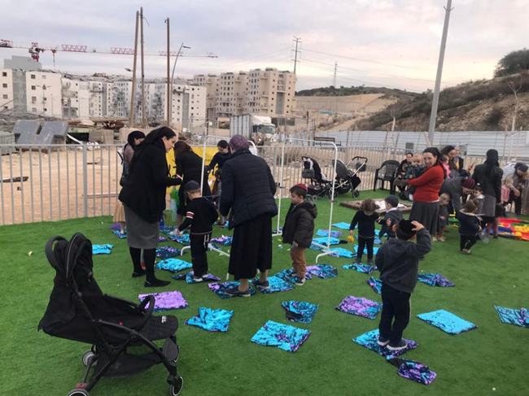
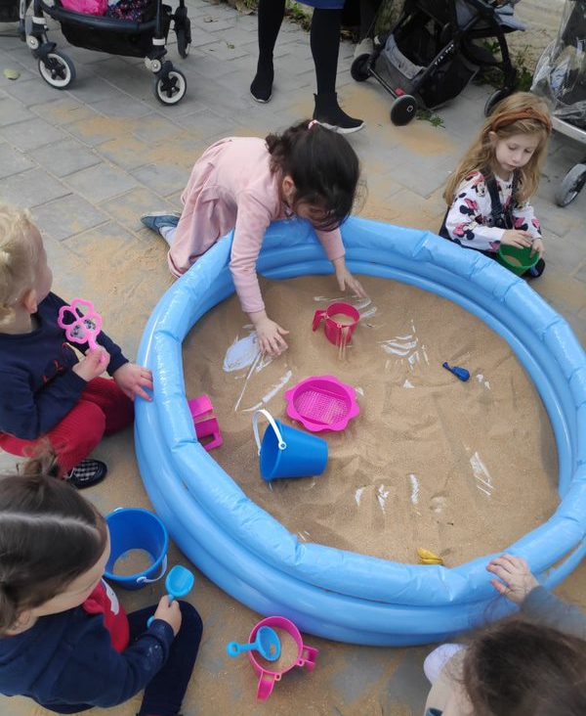
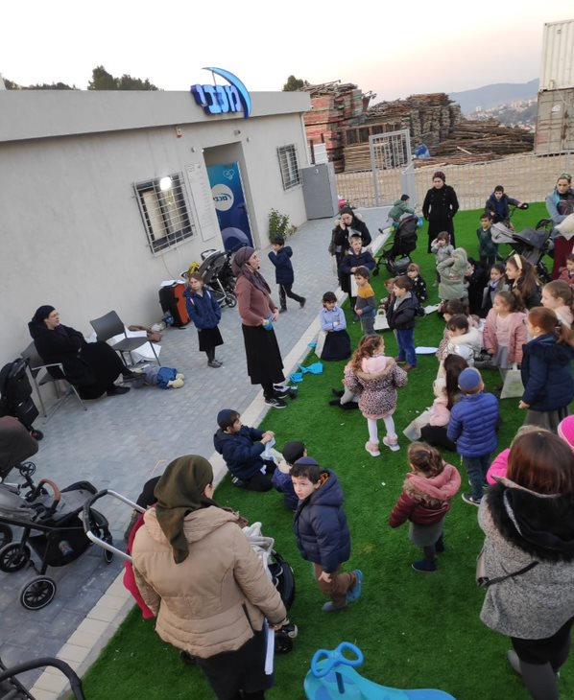
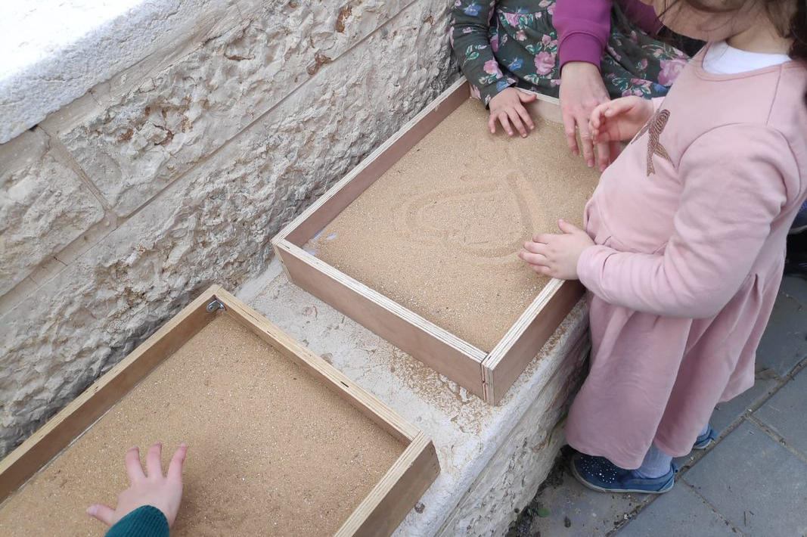
Chapter B
Target Audience
Beit Shemesh Residents: Parents & their 0-6-Year-Old Children

Slide 33
Logic Model for Beit Shemesh Municipality: the Urban95 Program in Israel’s Social and Geographical Periphery
Target Audience | Inputs | Actions | Outputs | Short to Mid-Term Results (up to 3 years from program’s onset) | Long Term Results (3-5 Years) | Impact
Beit -Shemesh’s residents - children from birth to the age of 6 and their parents and caregivers | Personnel: - ILGBC team - Anchor municipality program manager - Municipal officials - External consultants - Program partners (inside and outside the municipality) - Previous knowledge and experience from BvLF, ILGBC, Urban95 TLV and at the national roundtable - Projects’ funding - Measurement and evaluation | Identifying and characterizing needs and barriers among city residents of all sectors, regarding adjustment of the build environment in their neighborhoods for suitable and accessible use. Identifying and characterizing the needs of city residents of all sectors, and their young children, to develop accompanying contents, promoting a sense of parental welfare. Engaging partners to pilots’ implementation (inter-municipality and cross-sectional), including partners among city residents. Initiating public space pilots (including accompanying contents), to promote accessible knowledge appropriate to all sectors, especially in weakened neighborhoods (topics of security, safety from harm, parental coaching, etc.). Initiating establishment of playgrounds or play areas close to home, based on Urban95 principles, across the city. Development of accompanying contents for municipal services and urban space interventions, to strengthen parental welfare and parental capabilities, and promote community ties, while characterizing and adjusting services and contents to weakened populations. Promoting processes of public participation as part of pilots’ ’implementation. Initiating mobility and accessibility pilots, to promote walking and bicycling, including the promotion of security and safety issues as part of the interventions (safe driving for residents and professional workers, etc.). | Extent of implemented interventions, adapted for various communities, and specifically for the ultra-orthodox sector. Extent of parental coaching activities, suitable for the ultra-orthodox sector, and accessible for weakened populations. Extent of activities and events for young children and their caregivers, taking place in the city. Beit-Shemesh residents, parents of young children, are aware of and familiar with the program, and its actions and activities. Extent of residents, parents to young children, who are involved in public participation processes. | The post-intervention public spaces are suitable for safe use and stay of young children. Increase in contents and services consumption (provided as part of the program’s interventions) by caregivers of young children (dealing with parental coaching, promoting parent-child relation and ECD), across the city and especially by weakened neighborhoods. High satisfaction of caregivers and their young children, from the contents and services consumption (provided as part of the program’s interventions). Increase in the extent of caregivers, parents and young children staying in post-intervention playgrounds or public space play areas. Young children’s caregivers report more joint play and encouraging independent play (exploration and discovery), when using and staying at post-intervention public spaces. Increase in the extent of caregivers, older siblings, and young children safely getting around by foot or by bicycles, maintaining awareness of road safety rules, around post-intervention public spaces. Increase in number of young children and caregivers participating in activities in tactic intervention areas (place making) on city streets Increase in sense of community belonging among city residents of different sectors, parents of young children. | City residents of different sectors are satisfied with the living-life experience, in terms of use, stay and safe mobility in public spaces suitable for young children’s needs. Residents and their young children frequently spend time in public spaces, which were adjusted to their needs and designed by the Urban95 principles. A strong sense of safety among young children and their caregivers when staying in and mobilizing through post-intervention urban space. Strengthening sense of community and belonging to the city, and extended social interactions among city residents of different sectors, parents and their young children (including between children) Sense of parental welfare improved among city residents, parents of young children | An urban environment with equality, that optimally promotes early childhood development and parental welfare in the city

Slide 34
Indexes
Indicator / Tool | In-depth Interviews | Field Observations | Focus Groups | Caregivers’ Surveys
Using suitable infrastructures and staying at an urban space adjusted adapted for young children and their caregivers | V | V | V | V
Consuming services provided as part of the ‘accompanying contents supportive content’ (including satisfaction) | V | V | V | V
Extent and frequency of parent-child joint play, independent exploration & discovery games, of among young children in post-intervention public spaces |  | V | V | V
Extent and frequency of using, staying at, and being satisfied from with playground equipment and play areas in the public space |  | V | V | V
Extent of participation in Urban95 activities in tactical intervention areas (including satisfaction) | V | V | V | V
Mobilization Mobility by foot and by bicycles through an adjusted adapted public space |  | V | V | V
High sense of security in the public space |  | V | V | V
A sense of community among parents, social interaction, and a sense of belonging to the city of Beit Shemesh |  | V | V | V
Improvement in parental welfare and city life experience |  | V | V | V

Slide 35
Research Design – Evaluation Actions
The research actions took place between November 2021 to May 2022:
Research Tool | Quantity | No. of Participants/ Respondents | Gender | Age | Area | Data Collection Date
Activity observations | 7 תצפיות לפני ובמהלך ההתערבות 4 תצפיות ביום במסגרת פעילות זעירא 2 תצפיות אקספלור 1 תצפית סיור אבות ובנים |  |  | הורים לילדי הגיל הרך | רמה ג'1 שכונת רמת אברהם | ינואר- מאי 2022
Interviews with activity participants (as part of the observations) | 22 ראיונות עם תושבים 8 ראיונות עם אנשי צוות | כ-30 מרואיינים |  |  | רמה ג'1 שכונת רמת אברהם
Discussion groups | קבוצת אבות | 6 אבות | גברים | הורים לילדי הגיל הרך | רמת אברהם ורמת בית שמש ג'1 | 23.12.2021
 | קבוצת נשים במעמד סוציו גבוה | 8 נשים | נשים |  | רמת אברהם | 14.11.2021
 | קבוצת נשים במעמד סוציו נמוך | 6 נשים | נשים |  | רמת בית שמש ג'1 | 24.11.2021
Parent survey among Tira residents |  | 155 משיבים | 71 נשים 84 גברים |  |  | אפריל 2022
Trainings’ Participants Feedback | 2 הכשרות | 14 משיבים | 9 נשים 5 גברים |  | יום עיון בחולון בנושא התפתחות ילדים בגיל הרך יום סיור בתל אביב-יפו בנושא גני משחקים והמרחב הציבורי | מאי 2022

Slide 36
Demographic Profile of Survey Respondents
155הורים לילדים בגילי לידה עד 6 תושבי בית שמש
5+
גילי הילדים
3-4
מגדר
מספר ילדים במשפחה

Slide 37
Socio-economic Profile of Survey Respondents
תעסוקה
השכלה
תעסוקת בן/בת זוג
שכונת המגורים
37

Slide 38
Findings Adjusting the Urban Environment to Ensure Safe Mobility
Most Beit Shemesh residents travel with their children on foot throughout the day. The findings of the baseline study point at the following reasons for this:
Cultural reasons
Lack of safety in public space
Mobility difficulties (long distances and the city’s topography)
(Focus groups, women)
“My children don’t go out alone. In general, this needs to be dealt with more, maybe to introduce it to the schools and preschools. Four-year-olds cross the street and don’t understand the dangers.” (Ramat Beit Shemesh C1)
“My children are young, but I am not in favor of sending children alone on public transit, partly because of safety concerns at crosswalks. There is also an issue of keeping them safe from strangers. This scares me personally.” (C1)
“It bothers me greatly in terms of accessibility that on the path between streets they only made steps. I go with my babies to the grocery store and must go all the way around to get there. And also, there is no way for a disabled child to live in the neighborhood and enjoy the playgrounds.” (Ramat Avraham)
42%
think the neighborhood streets and public spaces are unsafe for young children (early childhood) (50% among parents to children aged 0-3)
36%
think the neighborhood streets and public spaces are not fit for hanging out for young children (41% among parents to children aged 0-3)
57%
travel by foot with children on the way to or from school
travel in the afternoon by foot (80% of women and 63% of men, 91% of Ramat Beit Shemesh C1 residents) and 52% by bus (18% of C1 residents)
71%
8%
of residents are interested in using subsidized transportation services to and from school for their children.
(Focus group, fathers)
“We need a place the children can go out to outside the building, and there’s nothing in the building. There is no space for the children to be outside the building.”
“Because there is no park in the neighborhood, we use the car. If not for me, they don’t go to the park.”
“I live on a one-way street in C and there is a roundabout [where children play] and several children have already been hit by cars there. We asked to put a speed bump…”
Why don’t you travel by foot or bicycle? (Survey of Residents)
“If it’s close to home then by foot, and if far then by car. With three children, biking is inappropriate.”
“For far places it is hard to walk with the children, there are mountains and hills in the neighborhood.”
“Also for religious reasons”
“It is close to the road and unsafe. There are no safe places to bike ride.”
“We don’t have a bike.”
“The girls are still too young to bike.”

Slide 39
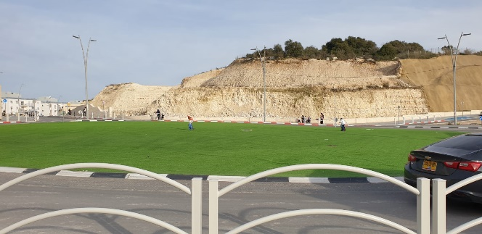
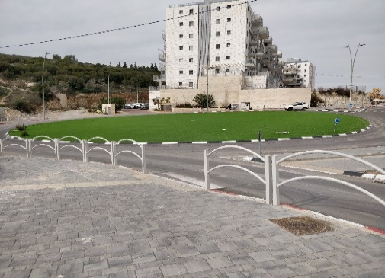
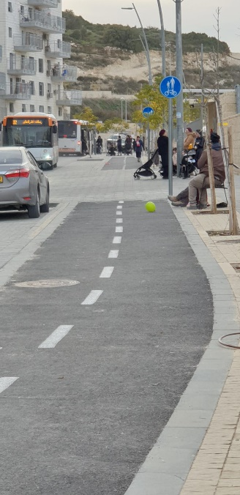
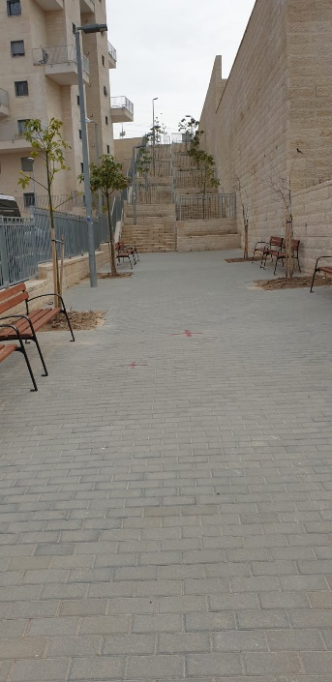
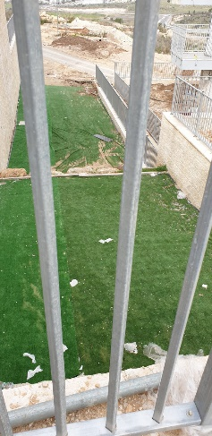
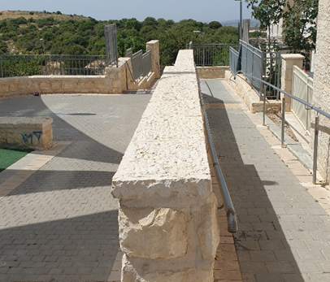
Observations & Pictures from the Ground Adjusting the Urban Environment for Safe Mobility
Ramat Avraham—The Green Roundabout
The XPLORE observations revealed differences between the Ramat Avraham and C1 neighborhoods
C1:
Has safe places to spend time with young children
Has many play areas, permanent public buildings
Clean public space, well-maintained, and almost no obstacles
Mobility is mostly by foot despite the topography; few residents own cars and buses are infrequent.
Lack of activities for parents and children (who generally spend afternoons at home)
Ramat Avraham:
Lack of safe places to spend time with young children
The neighborhood’s spaces primarily serve for moving between points.
Lack of interesting sites, places to sit, and shade
Obstacles to mobility (construction sites, non-fenced land)
Ramat Avraham—Grossman Street
Mobility
Ramat Avraham
“[People] generally don’t spend time in the public space because of the lack of safety.”
C1
“There are many crosswalks and safety guardrails; we feel safe to walk on the street and in the public parks.”
“It is easy to move around by foot in the neighborhood; there is access to everything; bike riders keep to the bike paths.”
C1—The Letters Park & Ahiya HaShiloni St.
Unmet needs/requests
Ramat Avraham
“Build a safe space for bikes and scooters. Facilities where kids can ‘get out their energy.’”
“Primarily, improve safety pertaining to parking spots and cars. Add exercise equipment, places to play basketball or soccer. Build shopping centers. Increase the frequency of public transit lines.”
C1
“There are no activities for children / parents and children in the neighborhood, there is no gym—for everything one must travel outside the neighborhood, but public transit is infrequent and there are traffic jams at the neighborhood’s exit.”
“We would want there to be more activities here.”

Slide 40
Findings Establishing Areas for Spending Time and Playing Together
Most residents do not spend time in the city’s public space / playgrounds because of a lack of parks in residential neighborhoods, of facilities for spending time and for play that are appropriate for children of various ages, lack of safety, and cultural reasons (discomfort by men because children are mostly accompanied by women).
43% reported that they spend time with their children in public space / playgrounds outside of school/preschool hours.
“About 2-3 times a week we search for parks in other neighborhoods, like beggars.”
Only 30% think the city’s nature areas are adapted for young children, primarily because they are insufficiently safe and lack facilities for spending time (benches, picnic tables)
(20% among parents of children aged 0-3)
“Even in a big park, when I go out with the kids, I feel like an outlier. I [barely] see fathers going out with their kids. It’s 80% mothers and 20% fathers.”
An observation conducted in the C1 neighborhood revealed there are several public spaces in the neighborhood, in addition to the Letters Park and the courtyard of the commercial center, that may have potential for intervention / can serve as temporary spaces for play and spending time:
At the lower level of the pocket garden adjacent to Ahiya HaShiloni 16, there is a pleasant, fenced grass area with several benches and picnic tables.
At the lower level of the playground on Elisha St, and in the alley facing Volunteer House—a dead end alley, the buildings’ parking lot, paved with integrated pavestones and well shaded and lit.
Moshe Rabeinu St.—a dead end street leading to a medium-size playground. Because it is a dead end street, the children also play on the street and sidewalk adjacent to the park.
“In the park there is a safety issue, that I must make sure she doesn’t go [towards], are there is also the baby who is crawling…it’s reasonable but it means that we go home very quickly because they are cold and uncomfortable.” (Ramat Beit Shemesh C)
“We thought about building ourselves a park. My child is 3; we went to a park recently and he doesn’t know how to climb up to a high slide. He was simply not in a park because of COVID; we barely left home. He wasn’t in a park for half a year, so the kid isn’t ‘in shape.’ It took us a long time to get him used to climbing; he really didn’t know how to do it.” (Ramat Avraham)
An observation conducted in the Ramat Avraham neighborhood revealed there are several public spaces in the neighborhood, in addition to the Letters Park and the courtyard of the commercial center, that may have potential for intervention / can serve as temporary spaces for play and spending time:
The back road between the Nof Tzurim and the Ramat Hasidim buildings, which is adjacent to nature that is close to home (outdoor activities or guided nature walks).
The paths with seating adjacent to the stairway between Grossman and Edelstein streets.
The archaeological site on a Tel at the neighborhood’s entrance.
“They talk about how 2 parks are now being built; we live at least a 15 minute walk away from the two planned parks. It’s irrelevant; if I need to walk with my kids half an hour, it simply won’t happen. It means driving by car again, and if we are already driving by car we will go to a [larger] park.” (Ramat Avraham)

Slide 41
Findings Establishing Areas for Spending Time and Playing Together
95% of children spend afternoons with their mothers
Among parents who reported that their children spend afternoons only at home (n=28), the most prominent reason was the children’s young age and convenience.
About half of children spend time in some public space (park / street / construction site / parking space), while twice as many children spend time in small parks close to home compared to children who spend time in large parks (61% vs. 28%).
Only 7% spend time in enrichment activities / afterschool programs, 39% of whom do so through private arrangements in the neighborhood.
מקומות בהם הילדים מבלים מחוץ למסגרות

Slide 42
Findings Accompanying Supportive Content to Promote Parental Welfare
According to parents, there is a lack of dedicated services for young children in the residential neighborhoods (activity groups, swimming pool, public library). Additionally, parents report difficulties in reaching family health centers due to their sparse distribution in the city, limited opening hours, and overloads in appointments, which even lead to delays in providing routine vaccinations for their children.
19% of children are in Economy Ministry supervised daycare centers. About half of respondents reported that the daycare centers are not walking distance from their homes.
90% of parents used family health center services in in the city, and almost half used child development services; only 5% of children did not participate in any service (because the parents were unaware of the services / did not need them). Note that 13% of Ramat Beit Shemesh C2 residents did not use any of these services.
More of the parents use consultation/guidance services before birth in private or communal frameworks (compared to those using HMO or family health center services). After birth, more parents use consultation/guidance services from HMOs or family health centers (than private/communal services).
32% of parents did not use any of these services. This is primarily because they thought there was no need for them (59%), or they did not know these services existed in Beit Shemesh (35%).
“I didn’t do all the vaccines. There are no morning appointments. Their morning starts at 9:00. The nurses arrive late. And then if the child gets a fever there is an appointment only in half a year.”

Slide 43
Findings Accompanying Supportive Content to Promote Parental Welfare
Only 18% of residents are satisfied with the municipality’s handling of early childhood needs.
20% reported that the municipality tries to resolve problems connected to public space infrastructure in response to requests from residents.
30%of residents receive information about events in the city and municipal programs for young children from local media (58% of C2 residents), 18% receive information from signs / notices / fliers, and 14% reported that they do not receive any information on the topic from the municipality.
24% among women
21% among parents of children aged 0-1
32% among women
29% among parents of children aged 0-3
31% among parents of children aged 4-6
14% among women
35% among women
46% among Rama C2 residents
42% among women
46% among parents of children aged 4-6
25% among women
29% among Rama C2 residents
“It’s not something established from the municipality, it’s not a program, it’s private individuals who open programs. We also have programs in the school afternoon frameworks. It’s not professional, but rather amateur. It’s nice but it’s not true enrichment for the child.” (Mothers, Ramat Avraham)
“There are only private things. One can pay privately for baby massages, and it’s an expenditure” (Mothers, Ramat Avraham)
“Near us there is no advertising of city services; I am personally exposed to media and hear about things. My children are registered for afterschool programs in Ramat Beit Shemesh A and it’s like a ‘babysitter.’” (Fathers focus group)

Slide 44
Findings Community Among Parents, Social Interaction, and Sense of Belonging to Beit Shemesh
Analysis of the survey’s findings indicates that—
54% of Beit Shemesh residents feel a great sense of social belonging to the parents' community in their neighborhoods (61% for parents of children aged 0-3). In terms of neighborhoods, C1 residents feel less community belonging that respondents as a whole (36%).
68% of them trust that their neighbors/friends will be able to help them when needed (73% of parents to children aged 0-3).
A quarter of residents initiate or are greatly willing to act to advance early childhood issues in their area of residence (38% among C2 residents).
34% reported that residents do not maintain the order and cleanliness of the public spaces surrounding their living area.
The differences between C1 and Ramat Avraham residents were also expressed in statements by focus group participants and in conversations with residents during the observations.
Mothers living in Beit Avraham spoke about meetings on Sabbath evenings, organized social evenings, and meetings in building parking spaces. In contrast, only some of the C1 mothers spoke about a sense of community. Among the fathers (from both neighborhoods) there was agreement that there is only minimal connection among neighbors.
Ramat Avraham Mothers
“I didn’t think it would be so nice with the female neighbors; people are very pleasant; everyone is very caring towards others. On Shabbat night we go down to a central roundabout, where it’s impossible to sit during weekdays; this is the meeting spot; there is artificial grass there.”
“The neighbors are like brothers and sisters.”
C1 Mothers
I have neighbors, but it’s less [a matter of] help, because it is difficult to take care of the children. They all have their own [children] and are very busy.”
Fathers
“[Interactions among] [n]eighbors are ‘Hello,’ ‘Hello;’ there are not many meetings beyond [that]. I am not personally yet connected to a community here. This is something that I and my children lack. Among men there is not much interaction.”

Slide 45
Summary of Chapter B – Target Audience: Beit Shemesh Residents, Parents and Their 0-6-Year-Old Children
Most Beit Shemesh residents don’t own a car and move around in the neighborhood on foot throughout the day, while physical conditions involve long distances, hilly topography, infrequent buses, and safety hazards from construction work. | Most residents don’t spend time in public space / playgrounds in the city because they lack playgrounds near their homes; play facilities are not adapted to a broad spectrum of ages; and spaces are not adapted for spending time or unsafe. | There is an evident lack of dedicated services for early childhood in residential neighborhoods. About a third of residents did not make any use of early childhood services or content for parents (institutional or private). | Most Beit Shemesh residents feel a high sense of belonging to the city and trust that their neighbors will help them when needed. Some are willing to tinitiate and act to advance early childhood issues in their areas of residence.
It is important to address safety in public space, primarily in neighborhoods with massive construction ongoing. It is worth considering the topic of the frequency of public transit in Beit Shemesh, primarily in C1. It is recommended to promote initiatives that contribute to the sense of safety in public space (e.g., road safety activities in preschools). | It is worth acting to map possible spaces for spending time near the home and promoting making them usable as temporary spaces for play and spending time through initiating activities in public space. It is worth considering the possibility of building pocket gardens in broad distribution, with play facilities adapted to a variety of ages. | It is desirable to consider the distribution of early childhood services in the city such that residents receive the services they need within walking distance of their homes. It is recommended to hold activities for parents and children in neighborhood centers, in collaboration with community or municipal entities (e.g., family health centers, HMOs, community centers, and schools). | In planning initiatives for young children and their parents, it is recommended to involve parents interested in taking part in them. This can also improve the level of residents’ trust in the municipality. It should be considered whether communities of active parents can be encouraged in various neighborhoods, primarily in C1.

Slide 46
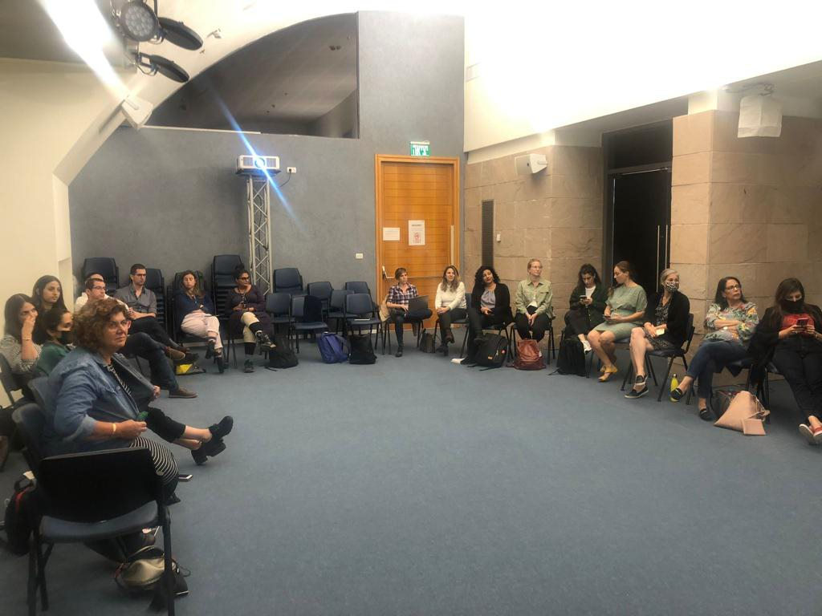
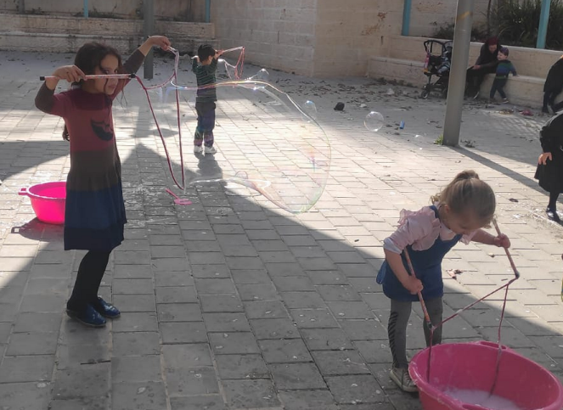
Chapter C
Hints of Change in Beit Shemesh

Slide 47
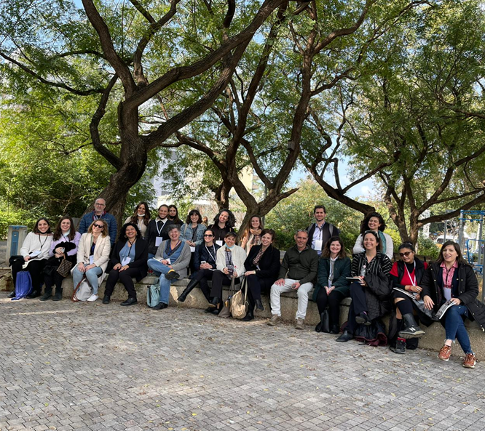
The Burgeoning Perceptual Shift among Municipal Officials
Three training sessions were held as part of the training for team members from the anchor cities participating in the Urban95 national expansion program:
A day tour at early childhood centers in Holon and Tel Aviv Port
A joint seminar with the Beit Shemesh team in Holon
At the end of each training session the participants were given a questionnaire. In the following slides we present the feedback findings regarding the training provided thus far for Beit Shemesh’s leadership team (N=14)
In addition, a focus group with key municipal officials was held in order to characterize their perception of the potential for change.

Slide 48
Post-Training Feedback Findings
Over a third felt that the training programs sharpened their view of the importance of integrating early childhood needs in their work, and about a third understood how they this be implemented in practice.
Over half of participants felt they gained knowledge and tools that will serve them in their work in the near future.
Half of participants felt that the meetings deepened connections among fellows, but only 14% reported that the training sessions were an opportunity for new collaborations.
Most participants noted that the understanding of the needs of young children, meeting the fellows, and expanding knowledge about the Urban95 program and its influences were the training programs’ main contributions.

Slide 49
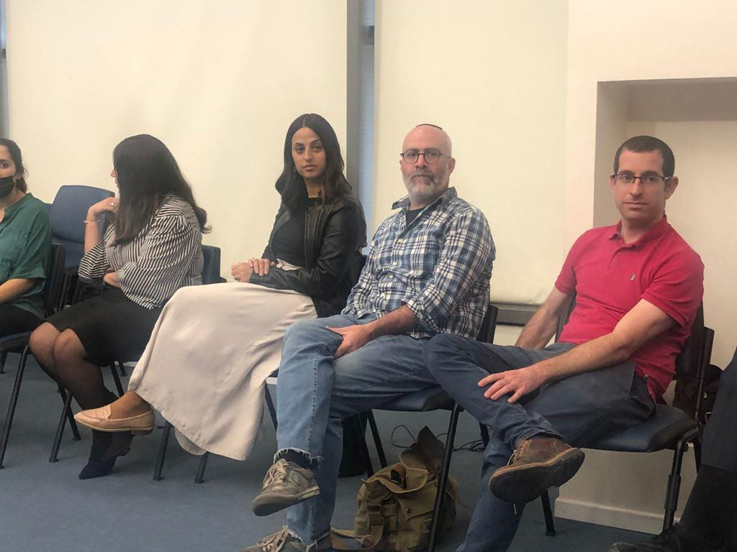
Post-Training Feedback Findings – Open Question Analysis
What new practical tools did you gain from the trainings programs?
Awareness of the topic of early childhood development
Research background regarding early childhood
Familiarization with the national urban planning committee
Integrating early childhood needs in parents workshops
Connecting municipal interfaces with recruitment of officials
What suggestions do you have for adjusting the urban space to early childhood needs?
Creating an early planning policy (in the stage of statutory planning / integration of proposals in construction plans and the city’s leisure areas)
Expanding spaces adapted to activity for young children
Thinking about safety and making public space accessible for young children
Branding the field of adapting urban space to young children among municipal officials and residents

Slide 50
עיקרי תובנות מקבוצת מיקוד עם צוות מוביל
Key Insights from the Focus Group with the Leading Team
“I started to see elements in physical space that pertain to young children, which until now I did not see, because I understood that [the issue] is important.”
A rise in the importance of the issue and its place on the agenda expressed in routine municipal work, through receiving inspiration from familiarization with activities taken in other cities.
A change in perception was observed regarding early childhood issues and expressed, among other ways, in thinking ahead “about the day after.”
A change in work habits—The training programs led to a change in work habits on behalf of young children. However, the need to receive more practical tools arose.
New connections between municipal entities—Joint work to advance the program is an opportunity for collaborative ventures.
Promoting internal motivation—Participants expressed initiative and raised ideas for activities that can be appropriate for the program.
“The game facilities department, which makes the playgrounds, no longer works on autopilot; [its staff] understood that it must adapt [the playgrounds] to other populations.”
“The Zaira program is amazing, but Urban will not stay here, so what will remain in the end? For this reason, we need the tools—to avoid dependence and pass the ball forwards.”
“The applicable aspects of the training programs should be sharpened, and participants should be given a broader emphasis on practice, with the aim of translating it into immediate work in the field.”
“A very fertile collaboration, including vis-à-vis entities not part of the same sphere.”
“I took insights from the program participants, [such as] to make a path for child bike/scooters. [We] must think not only about the playground but also about the street space.”

Slide 51
Case Study –
Zaira Activities
מקרה בוחן – פעילויות זעירא
Several initial insights arose from focus groups the CET unit for evaluating programs held with Beit Shemesh residents who are parents of young children, which point at a lack of spaces for play and spending time in public space in residential neighborhoods, alongside the need for enrichment activities for children within neighborhoods and walking distance from the home.
To address these needs immediately, the Beit Shemesh Urban95 program launched a pilot program—a series of 3 activity sessions in which enrichment content is transmitted that is intended for activity in which parents and children take part together. Every session focused on a different field: motor skills; sensory skills; and linguistic enrichment. Every session had two rounds of identical activity, such that a maximum amount of mothers and children could take part in the activity.
The Zaira activity in Ramat Avraham and Ramat Beit Shemesh C1 took place in two rounds in every neighborhood (8 content activities), for a total of 150 mothers and 420 children. The tours for fathers and children in Ramat Avraham and Ramat Beit Shemesh C1 were attended by 30 fathers and 75 children.

Slide 52
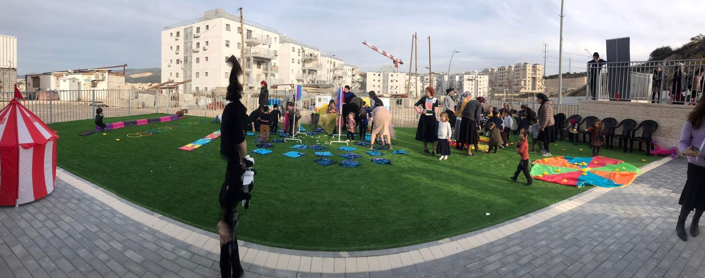
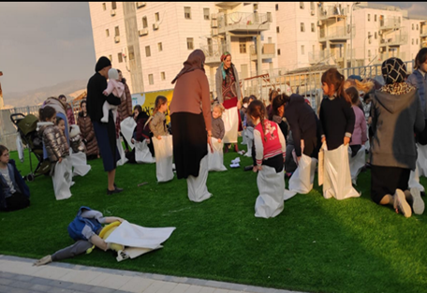
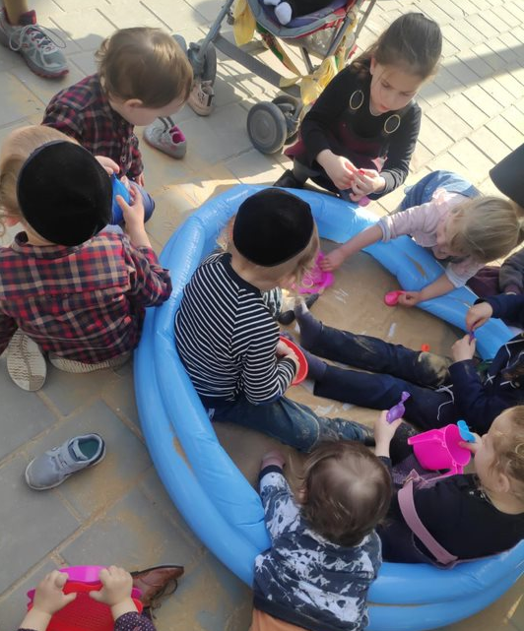
Motor Skills Activity
Case Study –
Zaira Activities
Tours for Fathers and Children
Linguistic Activity
Sensory Activity

Slide 53
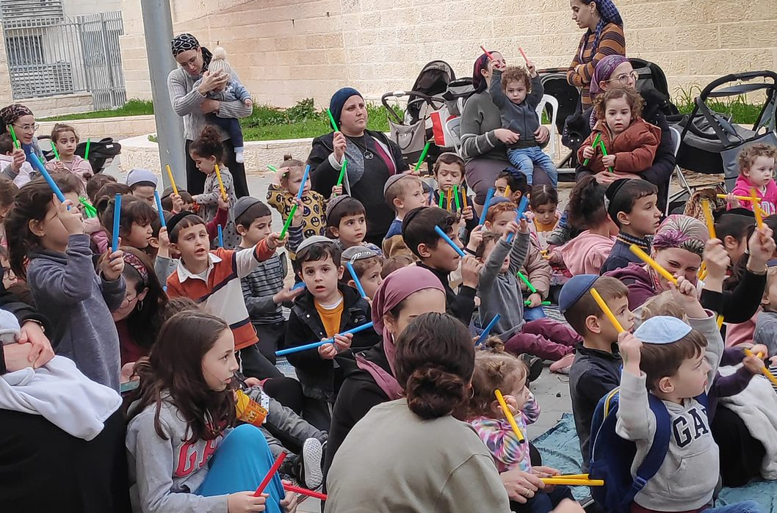
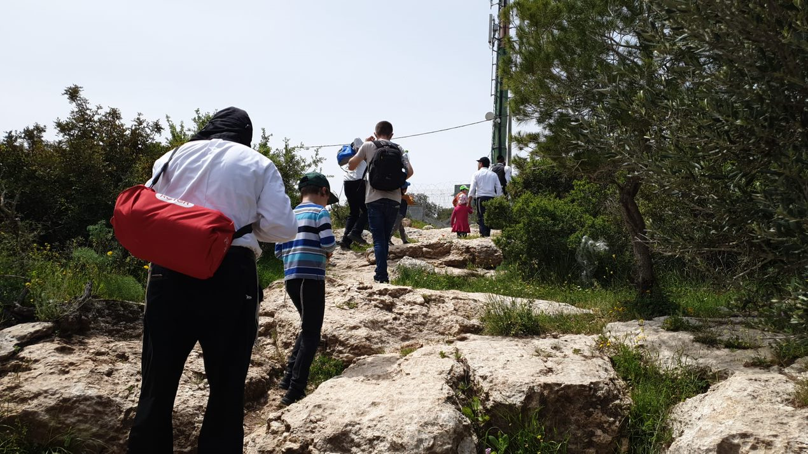
Findings Participation in Urban95 Activity—Including Satisfaction
Zaira Activities—For Mothers and Children
The spaces chosen for the activities matched participants’ needs, and making a comfortable seating area accessible was a significant factor in their satisfaction with attending the activities.
The mothers were happy about the fact of gathering to activate the children, and said they would recommend it to their friends.
The activities with an active character, including physical movement by the children, received greater appreciation among the mothers and children, compared to more moderate activities that included passive listening to a moderator.
The mothers preferred activities that were appropriate in terms of content to a broad age range, such that all the children who attended were able to participate and enjoy them.
The provision of practical ideas for further creative activities with home materials, and the provision of such materials, and/or the provision of a gift, raised participants’ satisfaction (mothers and children).
Tour for Fathers and Children—Ramat Avraham
The trail chosen was adapted to the abilities of the young children.
The fathers were satisfied with the tour and mentioned their interest in additional organized and guided activities.
All participants took an active part in the tour, asked the guide questions, and expressed great interest in their surroundings.
The fathers expressed gratitude for the opportunity they received to encounter the natural space around them as well as the ideas they were give for further tours in nature close to their homes with their families.
“The main contribution is the fact of leaving home for fresh air.” (A mother, linguistic enrichment program)
“I take with me the balance on planters game, the ball game, and jumping in hoops. There is a contribution to developing motor skills, lots of fun and enjoyment, it’s good because there is no park to go out to, to breathe air, or to see the world.” (A mother, motor skills activity)

Slide 54
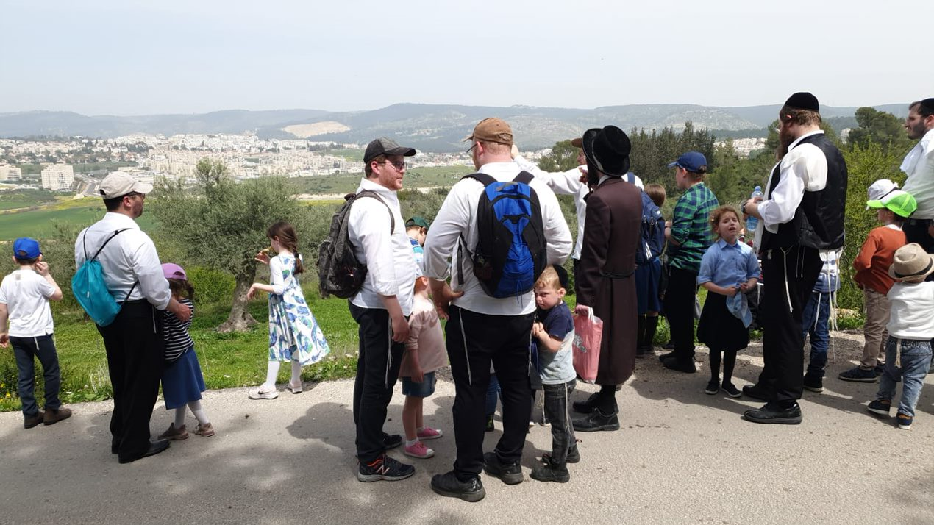
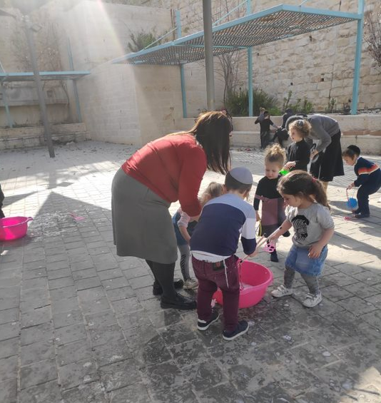
Findings Participation in Urban95 Activity—Including Satisfaction
Parent-Child Interaction
More close and continued communication between mothers and children was observed in sessions with a moderated activity compared to sessions in which children moved among stations without formal guidance.
During the activities, the moderators were observed encouraging active involvement by mothers, and participation by mothers in play with the children, through providing explanations about the influence of involvement in activities on child development.
The fathers and children tour offered varied opportunities for active interaction. Fathers were observed encouraging their children to respond to the guide’s questions and mediated the explanations and riddles to the younger children to help them understand what was going on.
Joint Play and Interaction Among Children and Community
In most of the meetings, participants tended to sit in a small group structure that primarily consisted of a mother and her children.
Most mothers did not see meeting the other mothers as a main motivation for attending the activity.
In the fathers and children tour, the prior familiarity among the fathers in the neighborhood was a connecting factor that accelerated conversations among them. But in most of the breaks in the field, participants broke into their family units.
(Mothers, motor skills activity)
“It’s nice for me to meet other mothers here.”
“I also look forward to it every week, not only the children.”
“They meet friends from preschool, enjoy, they looked forward to it all week; every day they use the booklet we received the first time.”
(Mothers, linguistic enrichment activity)
“In some way it creates a connection with other people in the community”
“A wonderful experience, we enjoy the fact there is activity to leave home and activate the children.”

Slide 55
ממצאים ההשתתפות בפעילות מטעם-Urban95 כולל שביעות רצון
The Activity Staff’s Contribution to the Sessions’ Success
Activities formally moderated by a professional who exudes authority, and the regular presence of the producer in the activity space and her involvement in the activity, contributed saliently to the meetings’ success.
It is recommended to continue to hold the activities with moderation by professionals who can also serve as authority figures, in order to ensure the sessions’ order with many participants.
For the purpose of transmitting the content at the core of the activity, it is worth encouraging the use of active activities that involve movement and collaboration by the children.
In activities that involve a lot of talk, it is worth considering various means to increase their effectiveness and encourage active listening.
Materials for use at home, such as the activity booklets, which received warm responses and include ideas for home activities and strengthening parent-child connections, should continued to be provided.
Everyday items that are present in every home should continue to be integrated in the activities, and available alternatives to these items should be suggested too.
Fathers and children tour—The success of the tours stemmed partly from the moderation by the guide, who sparked the children’s curiosity through riddles, encouraged them to be active, and adapted the content to the participants’ cultural world.
“The moderator is sufficiently creative, the children are enjoying greatly, [as] you [can] see!” (A mother, motor skills activity)

Slide 56
Conclusion
The Zaira activities and the fathers and children tours received very positive responses from the residents, who asked to add many similar initiatives, more frequently and more regularly. The activities encouraged positive interaction between parents and children and among children. However, participants did not see the communal encounter as a main motivation for attending the activities.
A large amount of investment is evident in the activities’ planning and implementation.
Public space is experienced as safe, inviting, and accessible for the residents for hanging out together and spending time.
The activities created varied opportunities for active interaction and play together among caregivers and children.
The mothers expressed higher satisfaction from the activities that were appropriate in terms of content to a broad age range.
It is recommended to continue to hold activities led by professionals who can also serve as authority figures.
It is recommended to adapt future activities such that they also serve to build community among parents of young children.
“In all this we want to enable the city’s children to feel that someone thought about them—about which environment and space we are building for them—through thorough and deep thought.”
(Beit Shemesh Mayor Dr. Aliza Bloch)

Slide 57
Bibliography & Appendixes

Slide 58
Bibliography – References and Documents aAnalyzed as Part of the Evaluation
Quality of Life of Populations in Israeli Society – 2019 Quality of Life Index, October 2019. The Haredi Institute for Public Affairs.
Haredi Society in Israel Annual, Lee Cahaner and Gilad Malach, 2020, Israel Democracy Institute.
Families in Israel—Data for Family Day, 2021, Central Bureau of Statistics (CBS).
Evaluation of Programs Aimed at Promoting Early Childhood Education: Literature Review, Center for Educational Technology, April 2016.
Beit Shemesh Overall Master Plan, Planning Division, Construction and Housing Ministry, Armon Architects and Kaiser, December 2020.
Introduction and Opening Meeting – Urban 95 Beit Shemesh, Feb. 15, 2021
Summary of Beit Shemesh Steering Committee, Apr. 28, 2021
General Data – 2020, Central Bureau of Statistics (CBS).
Mapping of Human Capital in Beit Shemesh. Eitan Regev, Itzik Crombie, and Shani Zusman-Efrati. The Haredi Institute for Public Affairs and Beit Shemesh Municipality. October 2021.
Steering Committee Meeting #4 Summary, Aug. 9, 2021.
Beterem – Report on Child Mortality from Unintentional Injury for 2021. January 2022.
Summary of Beit Shemesh Staff Focus Group—Professional Training Programs.
Findings from Survey of Residents.
Observation Reports (Motor Skills Activity Observation Report, Linguistic Activity Observation Report, Sensory Skills Activity Observation Report, Fathers and Children Tour Observation Report, Xplore Ramat Avraham Neighborhood Observation Report).
Residents Focus Groups Reports (Mothers from C1, Mothers from Ramat Avraham, Fathers Focus Group).

Slide 59
List of Interviewees
Participants in the Focus Group with Beit Shemesh’s Leading Staff
Ohad Cohen—Beit Shemesh City Architect
Shira Levi-Baldasare—Assistant to the City Engineer
Avital Cohen—Director of Play Facilities Department
Yitzhak Glesner—Haredi Sector Coordinator for Community Security
Yehudit Hadad—Assistant to the Mayor for Engineering
Racheli Ben-Shitrit—Director of the Department of Public Inquiries
Learning Interviews
Shir Mishaly—Resource Development (Local Government Cadet)
Sarit Potok—Director of the 360 National Program
Dudu Jamu—Head of Operations Administration
Moran Azu—Director of the Department of the National Authority for Community Safety & Management of the School for Parenting in the Community
Avital Shaked—(Former) Director of the Early Childhood Center
Sari Dror—Head of the Education Administration
Maayan Cohen—Director of the Beit Shemesh Urban95 Expansion Program
Itay Dreyer—Innovation and Strategy Referent at the Education Administration
Rotem Shpigler—(Former) Assistant to the City Engineer
Ohad Cohen—Beit Shemesh City Architect
Yehudit Hadad—Assistant to the Mayor for Engineering
Inbar Weiss—City Engineer

Slide 60
Appendix A: Beit Shemesh Resident Survey
Hello, this is a survey of parents who are Beit Shemesh residents regarding daily life in the city. Please answer the questions honestly and deliberately. Your opinion matters to us.
5. Where is the educational framework your children attend?
In my neighborhood—walking distance from my home
In my neighborhood—not walking distance from my home
In another neighborhood in the city
Outside the city
5. How do you currently get to and from the educational frameworks with your children? (Please mark all relevant answers)
a. On foot
b. Bicycle
c. Bus / shared taxi
d. Car
e. We take turns (with neighbors / friends from kindergarten / relatives)
f. Private transportation we pay for
g. Subsidized transport by the municipality
h. Taxi
i. Other, please specify:
3. How old are your children? (please mark all relevant answers)
a.1-0 0-1
b. 1-2
c. 2-3
d. 3-4
e. 4-5
f. 5-6
g. 6 or older
4. What type of educational framework do your children attend?
(please mark all relevant answers)
No framework, they are at home
Babysitter
Nursery
Economy Ministry supervised daycare
Education Ministry supervised daycare
Daycare (WIZO/Na’amat)
Municipal preschool
Private afternoon childcare facility
Municipal afternoon childcare facility
Other, please specify:
1. How do you identify yourself? (To which stream do you belong?)
Hassidic
Lithuanian
Sephardic
National Religious
Ba’al Teshuva (newly religious)
Refuse to answer
Other
2. How many children do you have?
0
1
2
3
4
5
6 or more
We are expecting

Slide 61
Appendix A: Beit Shemesh Resident Survey
9. Below is a list of places where children from Beit Shemesh can spend time when not in educational frameworks. In which places do you your children generally spend time? (please mark all relevant answers)
At home with their parents
At the home of relatives
At the home of friends/neighbors
At a small park close to home
At a large park in the neighborhood or another neighborhood
At a very large park or in nature close to Beit Shemesh
In a Gymboree/playroom in the neighborhood
At a Gymboree/playroom in another Beit Shemesh neighborhood
At a Gymboree/playroom outside Beit Shemesh
At a library
At afterschool programs / enrichment activities
At a synagogue or Talmud Torah (Torah study center)
Other: _______
11. Earlier you mentioned that your children spend time only at home / at another home in the afternoon. Please detail why:
Open-ended question
12. Which of the following services have you ever used for your children? (please mark all relevant answers)
Family health center services
Early childhood center / community center services
HMO child development services
Private institution child development services
Meetings in preparation for the start of first grade
My children did not use any of these services.
13. Why have you never used any of the services?
a. My children never needed them.
b. These services aren’t available in the neighborhood.
c. There Their opening hours aren’t comfortable convenient for me
d. They’re expensive/too expensive.
e. I didn’t think they would benefit my child.
f. I wasn’t familiar with these types of services.
7. With whom of the following do your children usually spend the afternoon? (You can mark more than one answer)
a. Their mother
b. Their father
c. Their older siblings
d. Their grandparents
e. Their uncles and aunts
f. A nanny / babysitter
g. Friends’/ neighbors
i. Other, please specify:
8. When they are not in educational frameworks, where are and how do your children spend their time?
In our home
At relatives’ home
At friends’/neighbors’ home
In the building’s area or parking lot
In public space—a public park or the street
Accompanying their parents running errands
Other
10. In which educational frameworks are the afterschool programs / enrichment programs your children attend?
At a community center
At a private program in the neighborhood
At a private program in another neighborhood in Beit Shemesh
Other: ______

Slide 62
Appendix A: Beit Shemesh Resident Survey
18. How do you usually get around with your children in the afternoon? (Please mark all relevant answers)
a. On foot
b. Bicycle
c. Bus/shared taxi
d. Car
e. Taxi
19. Why do you not get around with your children on foot or by bike?
(Please mark all relevant answers)
I avoid biking for cultural reasons.
Traveling saves me time.
Lack of crosswalks
Lack of contiguous sidewalks
Lack of stroller-accessible paths
Lack of safety in public space
Lack of shade
Lack of bike paths / dedicated and safe space to bike
Difficulty moving around because of the ascents and descents in the street
Other, please specify:
16. Which services pertaining to early childhood would you like to receive from the municipality?
Streets and sidewalks that are adapted and safe
Cleanliness and hygiene
Small parks near the home
Play facilities adapted to young children
Subsidized shuttles from educational institutions
Community institutions in the neighborhood
Early childhood center
Community center
Family health center
Playroom
Library
Developmental and enrichment activities for children and parents
Other, please specify: ______
17. What content would you like to receive from the municipality in the context of enrichment activities for children and parents?
Meetings in preparation for first grade
Guidance for parents workshops
Joint activities for parents and children
Afterschool programs / enrichment activities for children (sports, music, art, story time, and the like)
Activities in nature
Other, please specify: _____
14. Which of the following services have you ever used as parents? (Please mark all relevant answers)
Consultation/guidance before birth from an HMO / family health center
Consultation/guidance before birth through a private or communal framework
Consultation/guidance after birth from an HMO / family health center
Consultation/guidance after birth through a private or communal framework
Parents meetings / lectures on parenting from the municipality (“School for Parenting”)
Parents meetings / lectures on parenting through a private communal framework
I have never used / participated in any of these services.
15. Why haven’t you used these services?
Because I don’t need these services
Because I didn’t think it would be of use to me
Because I didn’t have time
Because it’s hard for me to arrive on public transit—I don’t own a car
Because the hours of operation are not appropriate for me
Because I couldn’t afford it economically
Because I didn’t know there are such services in the city

Slide 63
Appendix A: Beit Shemesh Resident Survey
24. To what degree, do you feel, do the residents maintain the orderliness and cleanliness of the public space surrounding living areas (e.g., the parking spaces and paths between buildings, small parks alongside buildings, and trees and benches alongside buildings)?
Certainly maintain
To a very great degree
To a great degree
To a medium degree
To a slight degree
To a very slight degree
Not at all
25. To what degree do you feel social belonging or connection to the community of parents in your neighborhood (who are not your family members)?
Certainly feel
To a very great degree
To a great degree
To a medium degree
To a slight degree
To a very slight degree
Not at all
22. To what degree, do you feel, are the nature areas in Beit Shemesh and its surroundings adapted to spending time with young children?
Certainly adapted
To a very great degree
To a great degree
To a medium degree
To a slight degree
To a very slight degree
Not at all adapted
23. What are the reasons why you feel the nature areas in Beit Shemesh and its surroundings are not adapted to spending time with young children?
The areas are crowded.
The natural areas are too loud in my opinion.
The natural areas are not sufficiently safe.
The public areas are not sufficiently clean.
There is a lack of organized hiking trails.
There is a lack of facilities for spending time such as benches and picnic tables.
Other, please specify: ______
20. To what degree, do you feel, is the public space and/or streets of the neighborhood adapted to spending time with young children?
Certainly adapted
To a very great degree
To a great degree
To a medium degree
To a slight degree
To a very slight degree
Not at all adapted
21. To what degree, do you feel, are the public spaces and/or streets in the neighborhood safe for young children spending time in them?
Certainly safe
To a very great degree
To a great degree
To a medium degree
To a slight degree
To a very slight degree
Not at all safe

Slide 64
Appendix A: Beit Shemesh Resident Survey
31. What are the main channels through which you receive information about developments in the city and the municipality’s activities for young children? (Please mark all relevant answers)
I don’t receive information about developments in the city pertaining to young children.
From the municipality’s digital channels—its website, Facebook page
Signs / notices / flyers
A neighborhood WhatsApp group
A neighborhood email list
From the educational institutions
From the arnona (municipal real estate tax) slips
From municipal workers
From the municipal hotline / the 106 hotline
From local press
Through the synagogue
Other, please specify: ______
29 32. Through which other channels would you like to receive information about what’s happening in Beit Shemesh and what the municipality is doing for young children?
Open ended…
28. Please leave your contact details for further communication:
Telephone no. + name_______________________
29. To what extent are you pleased with the municipality’s functioning in regard to early childhood needs in daily life?
a. Completely
b. To a very large extent
c. To a large extent
d. To a moderate extent
e. To a small extent
f. To a very small extent
g. Not at all
30. To what extent is does the municipality try to solve problems related to infrastructures in public spaces in response to residents’ requests?
a. Absolutely
b. To a very large extent
c. To a large extent
d. To a moderate extent
e. To a small extent
f. To a very small extent
g. Not at all
26. To what extent to do you have someone close by you can turn to for help with your children?
a. Always
b. To a very large extent
c. To a large extent
d. To a moderate extent
e. To a small extent
f. To a very small extent
g. Not at all
24 27. To what extent are you willing to take the initiative and work to promote early childhood needs in your area of residence?
a. Already Active
b. Completely
c. To a very large extent
d. To a large extent
e. To a moderate extent
f. To a small extent
g. To a very small extent
h. Not at all

Slide 65
Appendix A: Beit Shemesh Resident Survey
Demographic questions
30 36. What is your gender?
a. Man
b. Woman
31 37. How old are you?
35. 38. In which neighborhood do you live?
The Ultra-Orthodox Borough
The Old City
Ramat Beit Shemesh B
Ramat Beit Shemesh A
Rama C1
Rama C2
Rama D
The Glasses Neighborhood
Neveh Shamir
Ramat Avraham
Other, please specify:
36 34. What is your current employment status?
a. Full-time employee
b. Part-time employee
c. Self-employed
d. Unpaid leave / unemployed
e. Full-time University/ Yeshiva student
f. I don’t work (full-time parent)
g. Other:
37 35. What is your spouse’s employment status?
a. Irrelevant (I don’t have a spouse)
b. Full-time employee
c. Part-time employee
d. Self-employed
e. Unpaid leave / unemployed
e. Full-time University/ Yeshiva student
f. I don’t work (full-time parent)
g. Other:
35 33. What is your highest most advanced education certificate?
a. Elementary diploma
b. Partial high school diploma
c. High school diploma
d. Tertiary / diploma studies
e. Torah education
f. Bachelor's degree
g. Master’s degree or higher

Slide 66
Appendix B—Zaira Activity Observation Indicator
Urban95 Initiative—Indicator for Activity Observation—Early Childhood Activation Program in Beit Shemesh
Observer: | Observation Date: | Location:
General guidelines:
Total observation length—three hours: Activity is planned in two rounds, one hour for each round. One should also sample half an hour of arrangements before and after the activities.
One should observe the conduct of the moderator, the conduct and interactions of adults among each other and with children (and among the children), in accordance with the observation indicator, and document your impressions according to the various criteria. Goals of the linguistic enrichment session (as defined in the operating plan):
Raising awareness of the direct connection between cultivating parental discourse and the child’s language [skills], intelligence, and communication skills.
Providing practical and accessible ideas for cultivating language on several levels.
Training and strengthening the mind by enriching vocabulary, developing memory that assists in naming, recall, and other skills.
Document sensitively (not conspicuously) through photos the area of activity and the participants.
During the observation, address 5-6 mothers for a short discussion (interview), according to the indicator on the last page—it is desired to sample interviewees from each activity group.
Initiate a conversation with the staff—the moderator of the current activity and one of the assisting counselors.
What is the activity’s goal in her view?
What is the degree of cooperation and what are the responses from the participants? In reference to both mothers and children
What can be improved in the upcoming activities in this round? (Regarding conduct, content, marketing, operations, and preparation for moderators)
Thanks and good luck! Urban95 Evaluation Staff, CET
General comments (to document during the observation)—Here is the place to describe what took place in general terms.

Slide 67
Appendix B—Zaira Activity Observation Indicator
Criteria for observation | Evidence from observation of activity (moderator conduct, description of children’s and adults’ behavior)
Demography estimate of the number of adults and children, estimate by percentage of age and gender characteristics Estimate by percentage for the entire makeup of attendees | Adults # present at activity during observation___ Women___ Men___ Relationship: Parent___ Grandparents___ Babysitter__ Older sibling__ Other__ | Children # present at activity during observation____ Girls__ Boys___ Age: 0-3__ 3-6__ 6+___
 | Makeup: Adult & 1 child__ & 2 children__ 3+ children__ Couple & a child__ & 2 children__ 3+ children__ Group (several adults & several children):___ Manner of travel to activity site: Adult/s & child/ren by foot__ adult/s with a stroller____ adult/s & child riding (bike, “bimba” mini-bike, scooter)___ by car___
Estimate of amount of time spent | Part of the hour of activity: most / about half / a minority Full hour of activity: most / about half / a minority More than the hour of activity (participation in an additional round): most / about half / a minority
General description and mapping of obstacles For each criterion: Give a grade from 1 (not at all / very negative) to 7 (positive / to a very great degree) * Were signs placed inviting people to the activity / indicating directions to the site? For each occurrence note the scale of events observed (amount) and describe in broad detail. ** Creative use that contributes to the activity and to participants is not counted as a distraction; detail in the description of conduct | Grade (1-7) Activity space: Convenience to reach (including with a stroller)_ Convenient for activity_ Shade_ Lighting_ Protection from wind/rain_ Safety (dangerous hazard, stairs)_ Cleanliness_ Equipment quality (items used and accompanying materials)_ Suitability for a variety of children’s ages_ Convenience for adults to spend time_ Restrooms_ Ritual handwashing_ Suitability for the # of participants_ Suitability for content (presentation, reading)_ The space is hidden from view and enables participants to conduct themselves freely_ Advertising and directions near the activity*_ Diaper changing and/or nursing space_ General description of the activity space, verbal description of the measures above, and important points to note: Scale of distractions to activity: Answering the phone (by the moderator)_ Equipment malfunctions_ Noise by participants that interfered with the activity (presentation, reading)_ Unsuited use** of activity items (that harms conduct) detail:__________ other, detail:_____ Distractions from external entities in the public space: passers-by of any type__ weather conditions__ noise from the surroundings__ other, detail:__ General detail:

Slide 68
Appendix B—Zaira Activity Observation Indicator
Conduct by staff For each criterion: Give a grade from 1 (not at all / very negative) to 7 (positive / to a very great degree) Detail the way the activity was managed and the moderator’s conduct throughout. | Grade (1-7) Clear moderation_ Suitability and flexibility (to distractions, to participants'’ needs)_ Encouraging joint caregiver-child play_ Encouraging creativity_ Providing additional ideas to parents for activating the children_ Linguistic suitability (regarding age and language-Yiddish)_ Description of the moderator’s conduct during the session (Detail and examples for measures above, attention to functioning in the two different rounds, general attitude to the participants and children, and anything worth noting)
Participants’ (adults and children) conduct and interactions For each criterion: Give a grade from 1 (not at all / very negative) to 7 (positive / to a very great degree) Detail and describe participants’ conduct and all types of interactions, including salient and/or outlying occurrences of any type | Grade (1-7) Care for equipment and materials_ Attention to moderator_ Cooperation and involvement_ Joint adult-child play_ Caregiver-child interaction (because most participants will attend with more than one child, address also the maneuvering among the children and relations within the family units): Estimate of the % of units in which most of the time there is joint caregiver-child play: to a great degree_ to a moderate degree_ to a low degree or not at all (the caregiver only supervises)_ Estimate of the % of units in which most of the time the communication (verbal and physical) within the unit (caregiver-child) is: positive_ neutral_ negative_ Description of the relations within the family units—mother and children: Detail the measures above, allocation of attention, relations among siblimngs, examples of expressions of positive and negative emotions by mothers and children, communication between mothers and children (mothers explain the activity’s guidelines in suitable tone and language; mothers are attentive to messages from their children), sensitivity to responses and needs children express, mothers and children playing together and siblings playing together; do mothers involve and encourage curiosity about the activity among the children? If so, how? Community: Estimate in % of children playing together—among siblings/friends who arrived together_ among children who met at the site_ children do not play together but only with their caregiver/alone_ Estimate in % of adult attendees who interacted with each other—within groups who arrived tougher_ among attendees who met at the site_ no interaction with other attendees_ Obstacles—amount of instances observed: giving a cellphone “to engage” the child_ adults using phones_ other obstacles, detail:____ Description of community—conduct by adults and children, description of communication and interactions (detail and examples of all above measures, attitude to the moderator, active participation in ther various parts of the activity, encouraging children to participate, relations among different family units, parents playing with children and children playing with other children, interactions and discussion among adults; what attracts the children’s attention? What interests and engages them?

Slide 69
Appendix B—Zaira Activity Observation Indicator
Indicator of questions for field conversations with parents/families during observation
 | Answers—Family #_
 | Adult 1 Relationship: parent/grandparents/babysitter/other, Gender: M/F, Age: __ |  | Adult 1 Relationship: parent/grandparents/babysitter/other, Gender: M/F, Age: __
 | Child 1 Gender: M/F, Age: | Child 2 Gender: M/F, Age: | Child 3 Gender: M/F, Age: | Child 4 Gender: M/F, Age:
 | Residence: in the neighborhood / outside the neighborhood—from where?__ Participation in previous sessions (Total of 3): This is the only session / I also participated in the session on linguistic enrichment / sensory activation / in an additional session but I don’t remember which Manner of travel to activity: On foot / bike / car / public transit Frequency of participation in public activities provided by the municipality: Weekly / several times a month / monthly / less / never
 | Where did you hear about the activity? From a friend, fliers in the mailbox, neighborhood WhatsApp groups, neighborhood email list, other__
 | How did you experience the activity? What did you enjoy and what did your child/ren enjoy? What was successful? Address the different parts of the activity and also in general—encouraging creativity, filled the need for fresh air, social encounter
 | What did you less enjoy? What needs improvement? Suitability of the content to children’s ages and the amount of participants, equipment, organization
 | What is the activity’s main contribution for you and your children? What will you “take home” with you? Strengthening connection and positive interaction, new and practical tools and ideas for playing together, learning from the content that pertained to linguistic enrichment, the possibility of spending time in public space
 | The issue of community—Did the activity contribute/encourage the creation of new relationships with other parents? Was this part of your motivations to attend the activity?
 | To what degree would you recommend to others to join here? Why or why not? To what degree would you want to participate in a similar activity / to come again to such an activity? Why or why not?
 | Who in the family generally spends time with the children in the afternoon? Where do you generally spend time with the children? Where do the children generally play? Are there places for spending time with children in public space in Beit Shemesh? Are there places for spending time with children in public space in the neighborhood? (playgrounds, spaces appropriate for spending time) Have you participated in activities for children provided by the municipality in the past?
 | Give a score (1—the least to 7—the most) to the degree the activity space: cleanliness and maintenance_ shade/lighting_ suitability to weather conditions (heat, cold, wind, rain)_ child safety_ assistive equipment_ convenience to travel to the site (in general and with a stroller)_ Convenience for caregivers to spend time (seating, location, restrooms)_ Activity length (note—too long / too short / successful)_ Suitability to the # of participants (was it too crowded)_ Give a score (1—the least to 7—the most) to the degree the activity content provided: strengthening relations and joint play between adults & children__ interaction among children_ encouraging community and discourse with others_ variety in the child’s play routine_ suitability for children of various ages_ encouraging creativity_ providing new ideas_ the need for fresh air_

Slide 70
Thank You!

