Slide 1
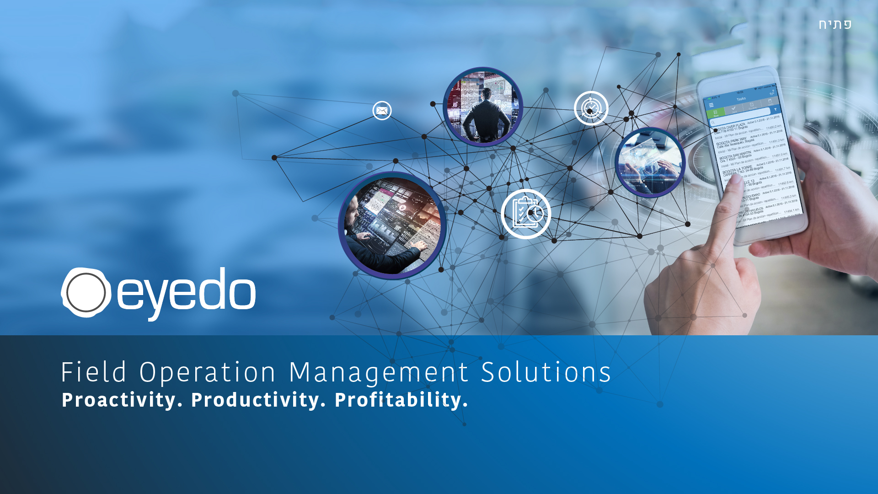
Presentation to Retailers
חתפ
2022
eyedo
Field Operation Management Solutions
Proactivity. Productivity. Profitability.

Slide 2

Agenda
Company
Industry and product
Retailer usages and use cases
Onboarding roadmap

Slide 3
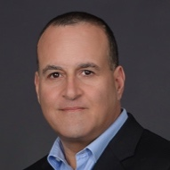



company
Incorporated at 2017 after 3 years incubation
Self funded, held by original founders
60+ clients, 75%+ of IL food and convenient retailers
Team
Ronen Yemini
CEO, Product
Former P&G retail execution owner, operations & field operations expert
Daniel Cohen Gindi
CTO
Technology guru, experienced with mature and startup companies worldwide
Mazal Shrem
Active Director
Former INTEL senior at Israel and Europe
Shlomi Ashkenazi
Active Director
Pango Polska partner, former Nextcom’s CEO, and SVP at HOT Telco

Slide 4
Retail Industry
Significantly complexed industry subject to few main factors:
Significant difference between branches (trading area, Variety, equipment, Size, Structure etc’)
Uncontrolled changes subject to actions taken by clients (product return to wrong place, unreported damages and more)
Rapid stuff replacement (creates a need for fast onboarding process and clear reachable procedures)
Rapid floor changes subject to regulation changes, launches, promotions, recalls and many other

Slide 5
Product
* Real-time PAAS, designed for organizational digitation
* Native apps for IoS/Android smart device, accessible to users both online and offline
* End to end capabilities (plan, execute, analyze)
* Various self developed and integrated technologies
1
Automate check-lists and accelerate completion of action items to reduce regulation deviations to minimum
2
Validate display accuracy, availability and Planogram compliance
3
Generate real-time, actionable performance data, educate new hires on-the-job
4
Cultivate relationships with customers through faster, better and more professional service
5
Communicate on all levels of the organization and motivate employees through greater efficiency and productivity

Slide 6
Product
UX AND ROI
Easy to operate
Quick onboarding
~100% efficiency lift
~8% sales lift
~50% cost savings
*Highest is 22%
*fines and break

Slide 7



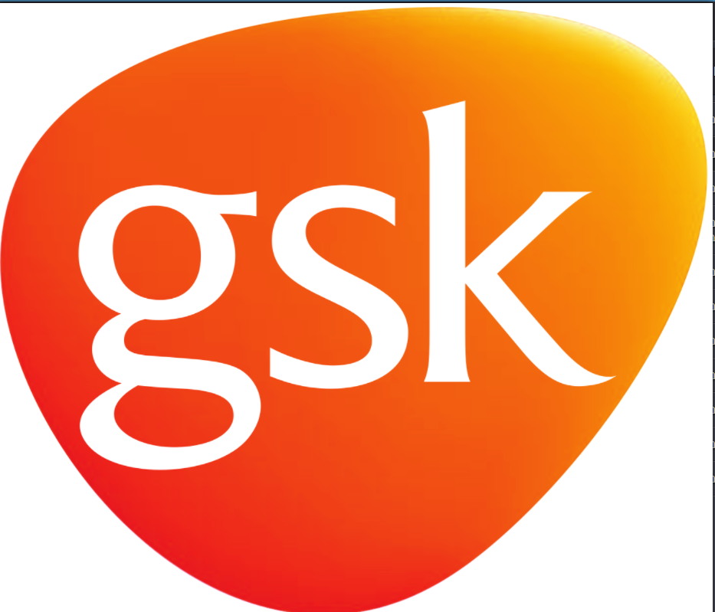
Clients and numbers
Critical Recall - Chilled Food Product
large scale monitored assets, 2,000 users, less then an hour
Supermarket chain
Increased efficiency and sales
Sense of confidence & control, reliable field feedback
CS chain
Excellency in field operations
For both routines and ad-hoc tasks
Food Distribution
Product availability and shelf share
shelf share and sales lift
CPG manufactorer
City-wide sensor array management
water system maintenance and support
Municipality
100%
10%
30%
75%
Customer Satisfaction
Sales Increase
floor time increase
Execution Time Savings

Slide 8







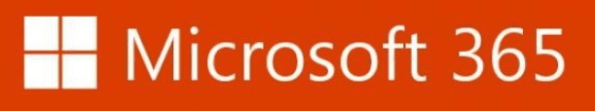
Product Strategy
PAAS – we understand that our clients know their business better than us, so we give them a vast platform allowing them to implement both structure and methodology.
Learning – We know that our clients are the experts so we learn from them and constantly improve our platform to align with the needs
Collaboration – We know that smart tools increase ROI so we collaborate with other technologies and integrate 3rd party’s tech (BI, sales app, computer vision, optimization and routing, data filing)

Slide 9
Product Features
Business process automation
Automatic Corrective actions
IOT generated tasking
Computer vision (for retail)
Manual / auto Messaging
Intensive reports system
Management support Dashboards
Offline automatic modulation
behavioral based restrictions
Vast dashboarding options
Conclusion based automatics
restrictions
Geofencing
Step by step process indicators
AI based time planning
In app calendar
Goal definition and stimulation perfect execution percentage
Feedback mechanisms for perfect quality of execution
Open Architecture for perfect compatibility to your business structure

Slide 10
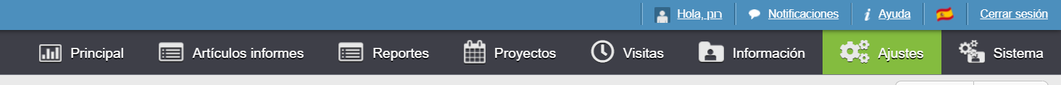
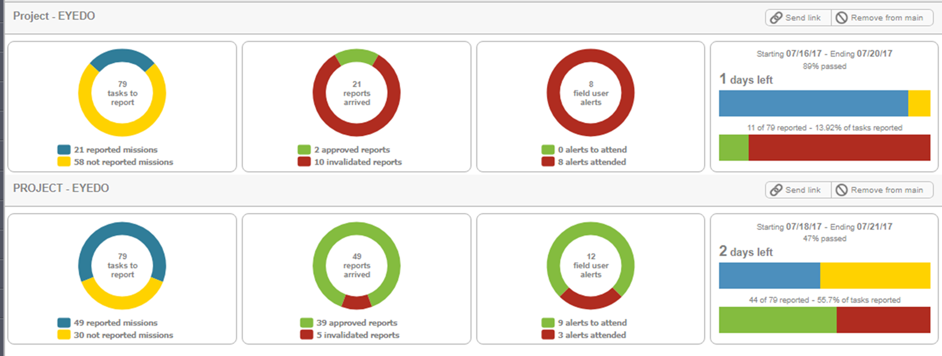
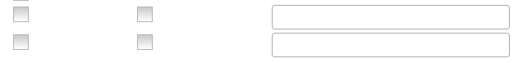
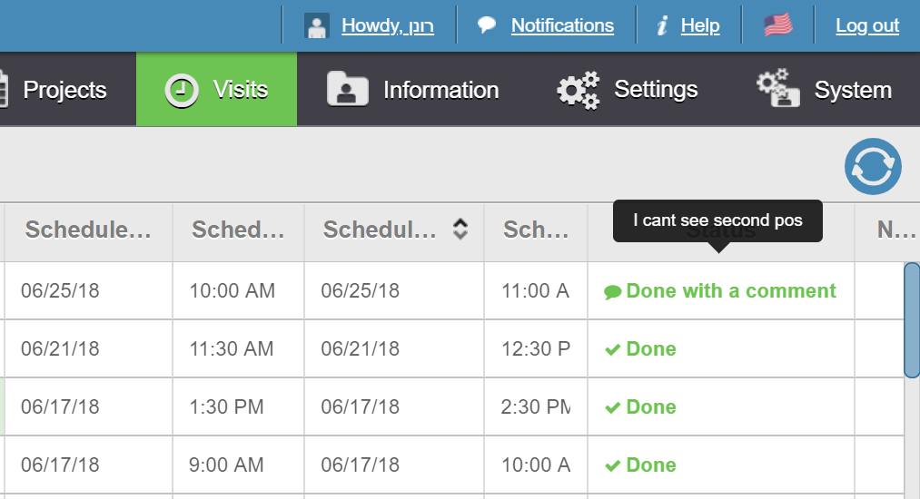
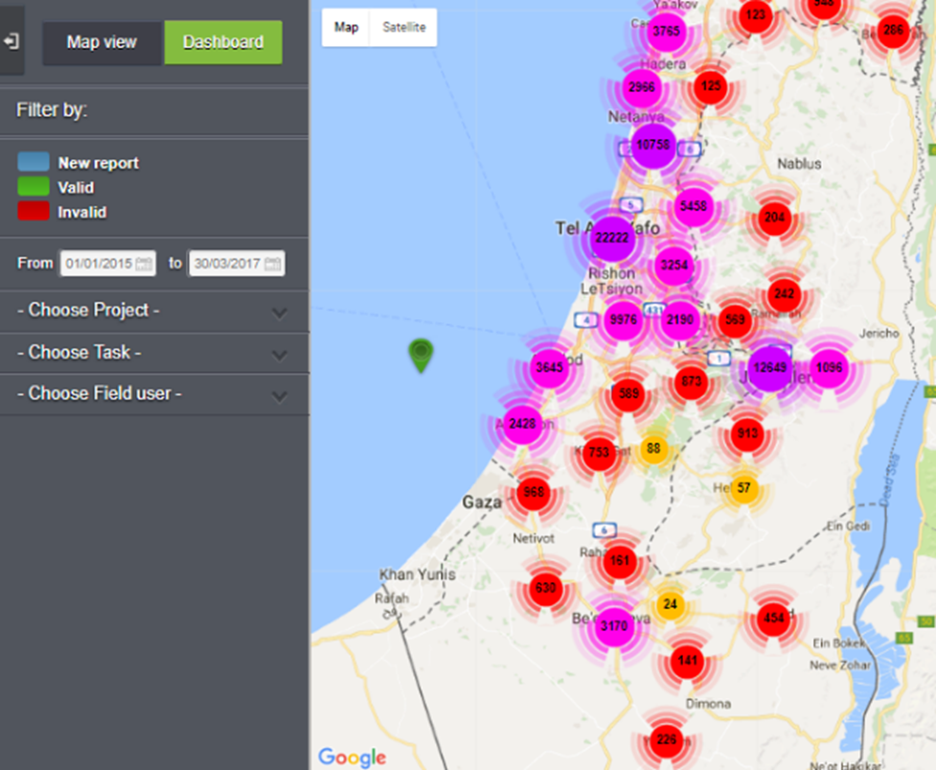
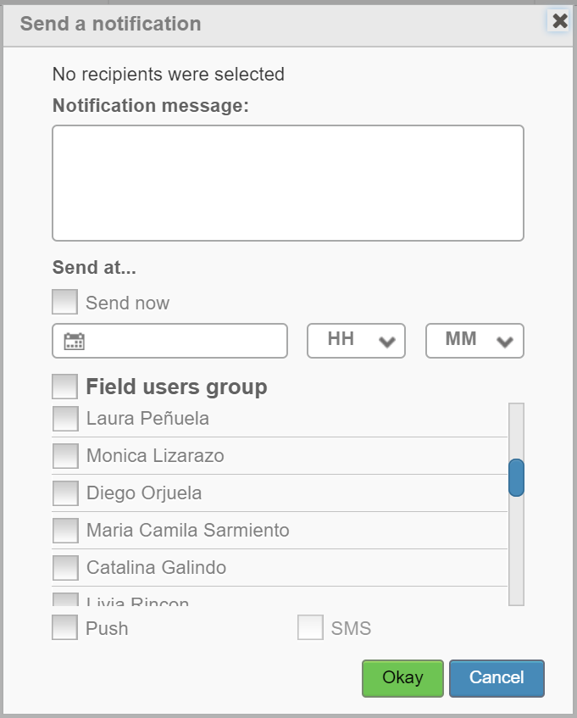
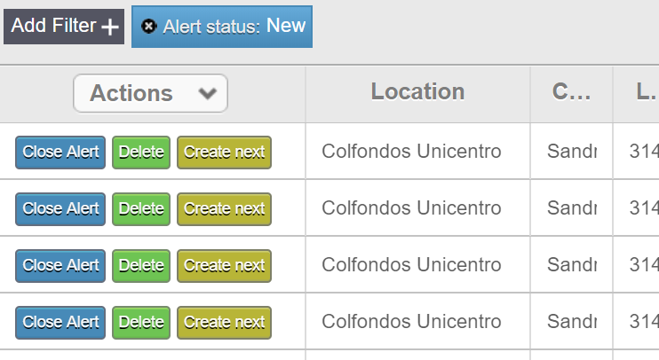
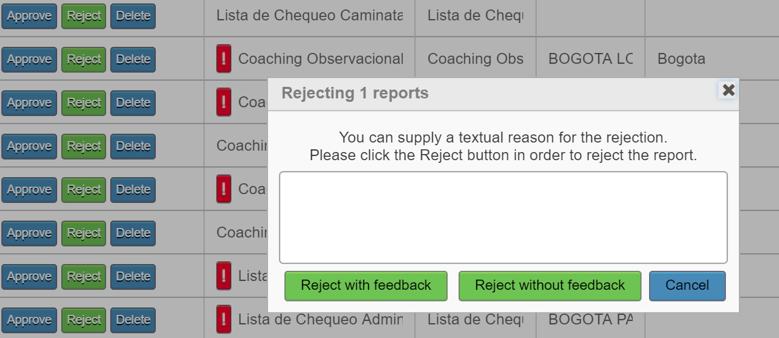
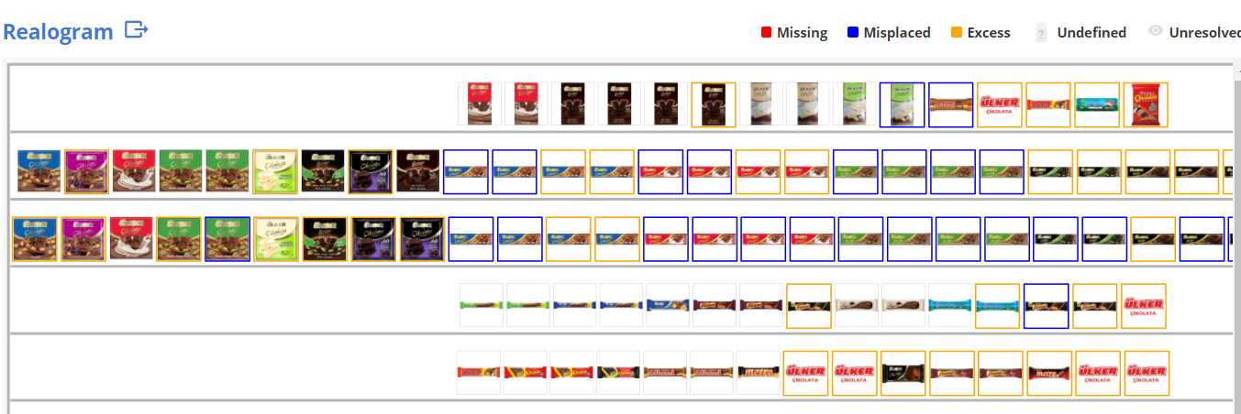
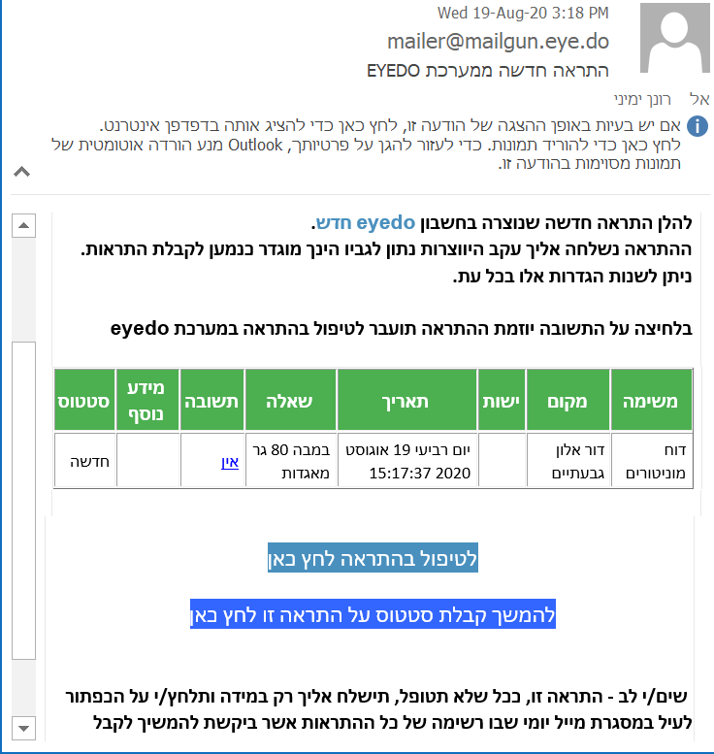
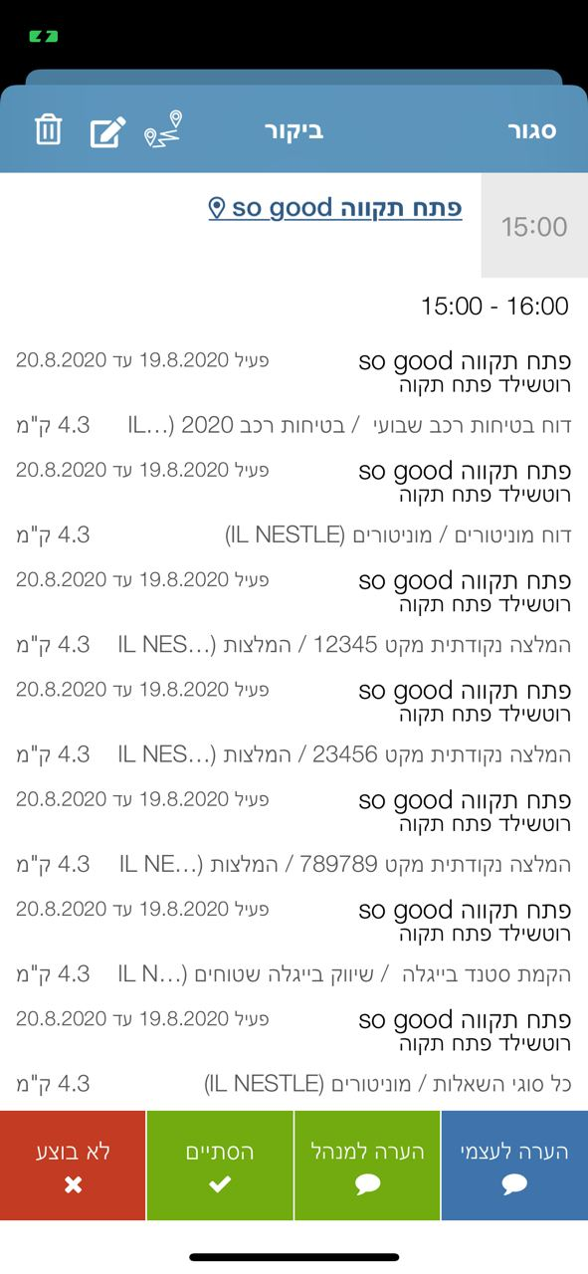

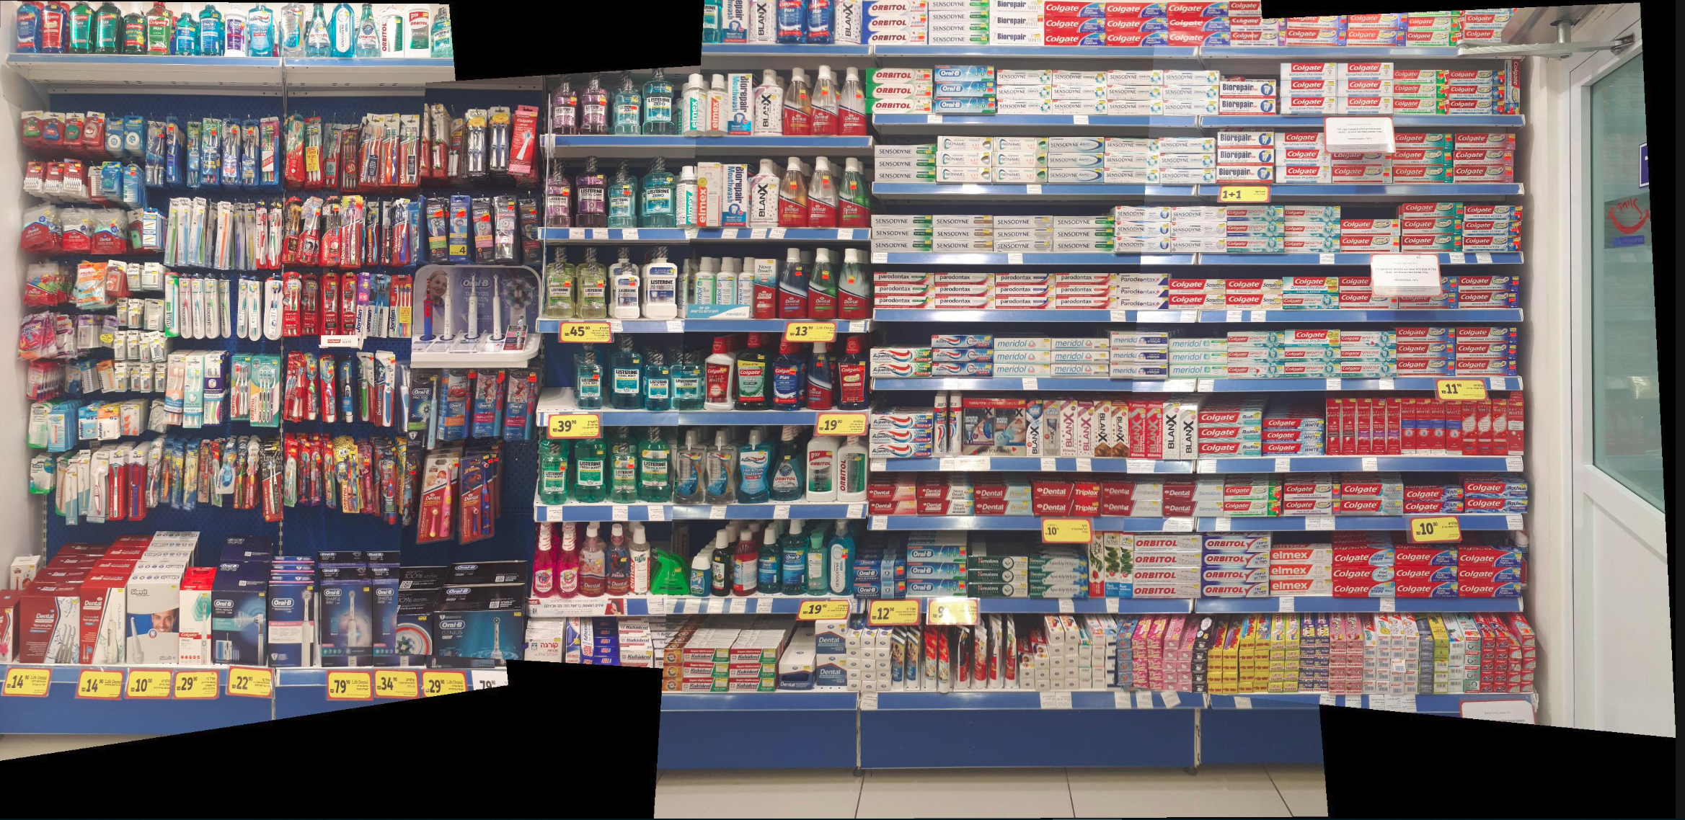
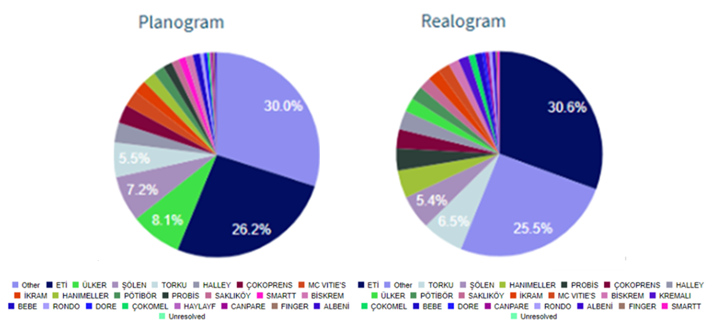

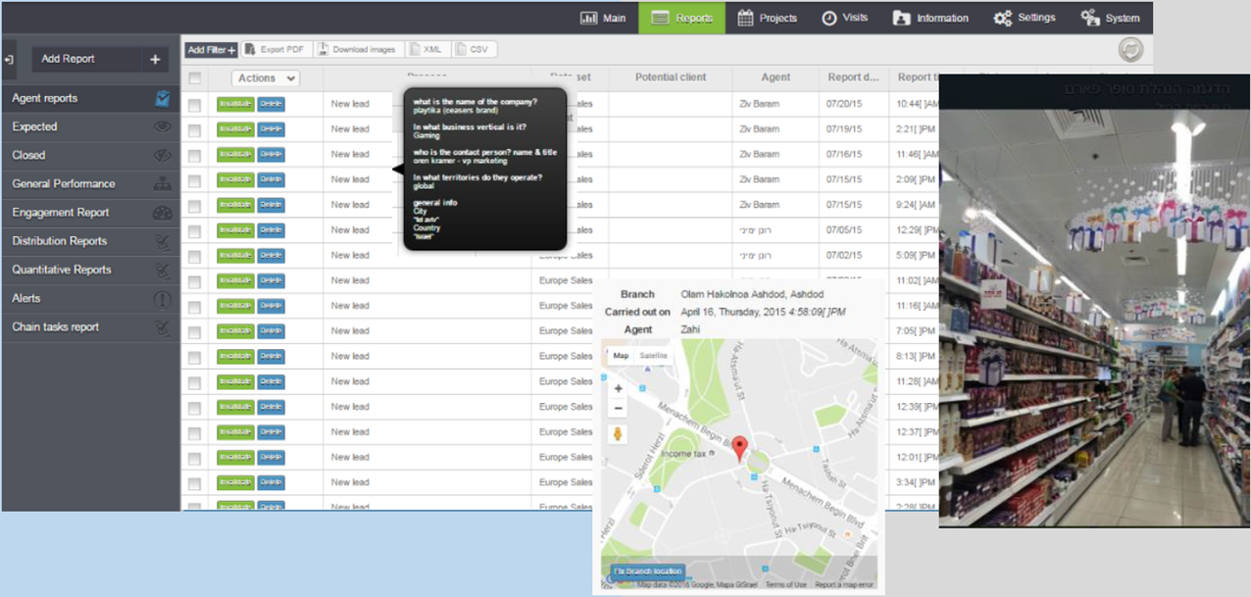
Product Features
Vast dashboarding mechanizm
Real Time Communication
Geo location reporting
Representative has arrived to your location
Send SMS
Computer vision driven shelf analytics
conclusion based automatics
Digitize protocols, surveys, audits and more

Slide 11

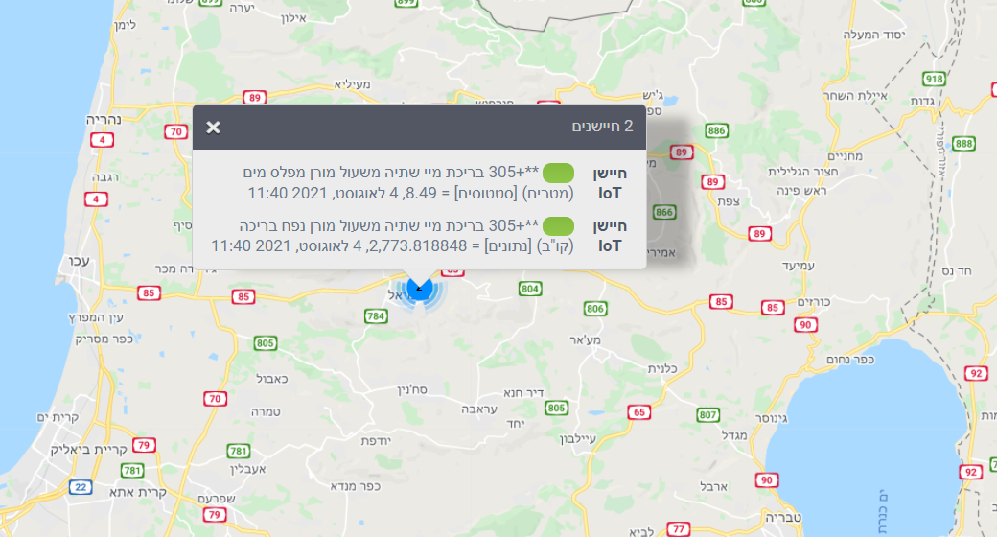
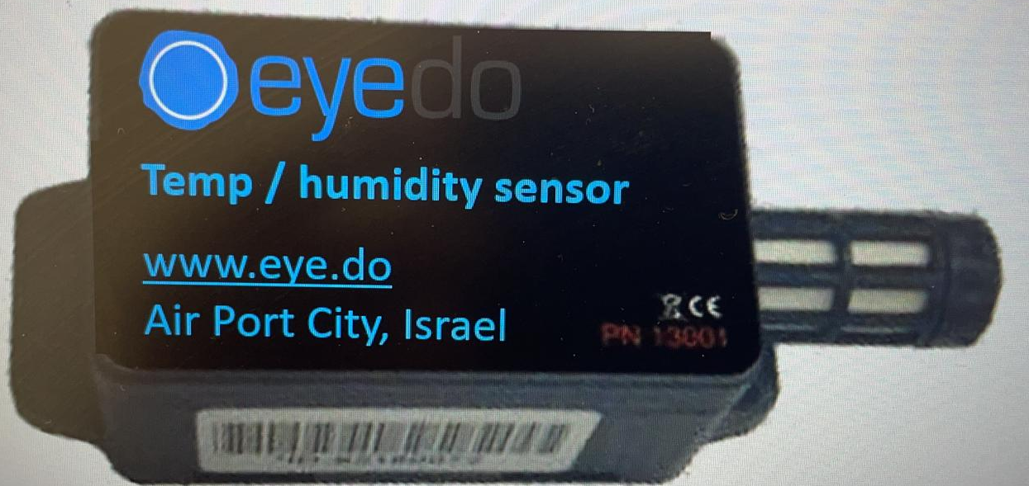
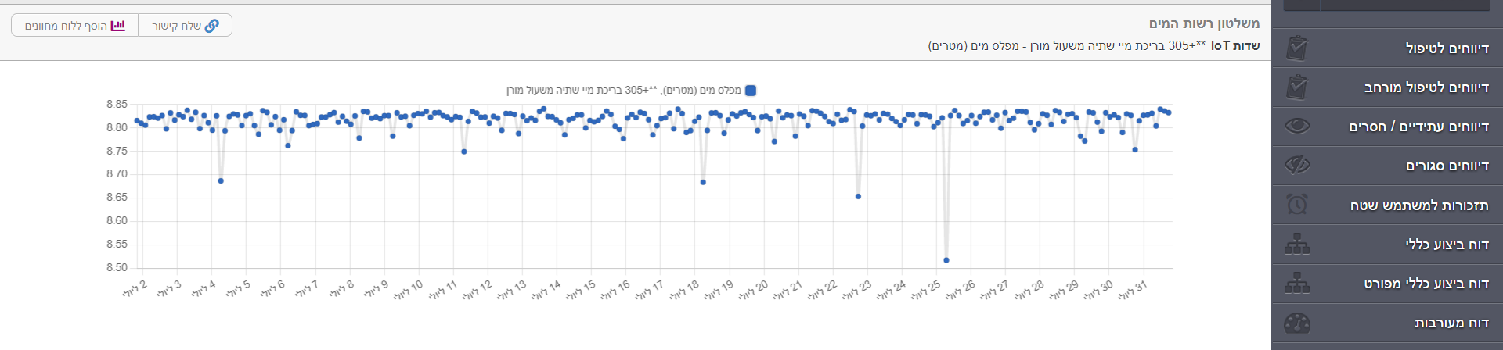
Sensors based tasking

Slide 12
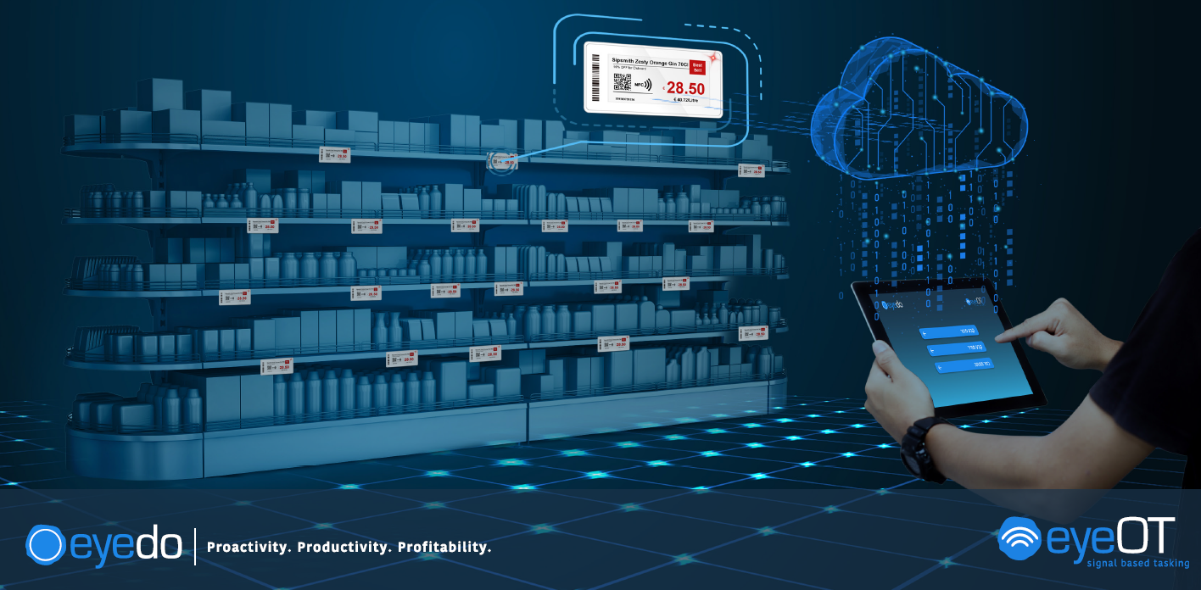
ESL integrated system

Slide 13
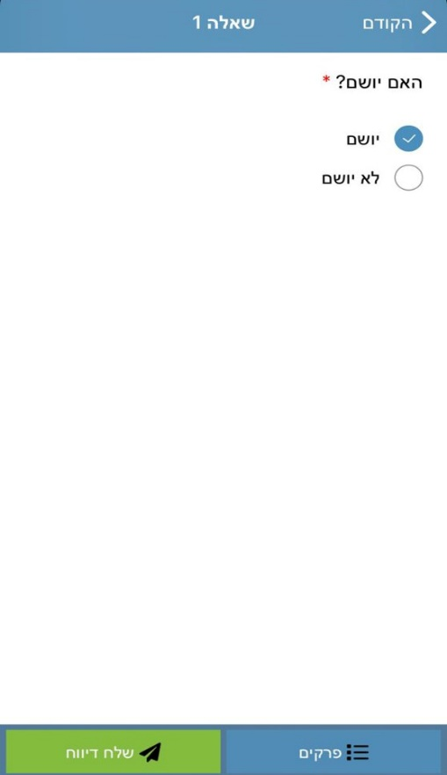
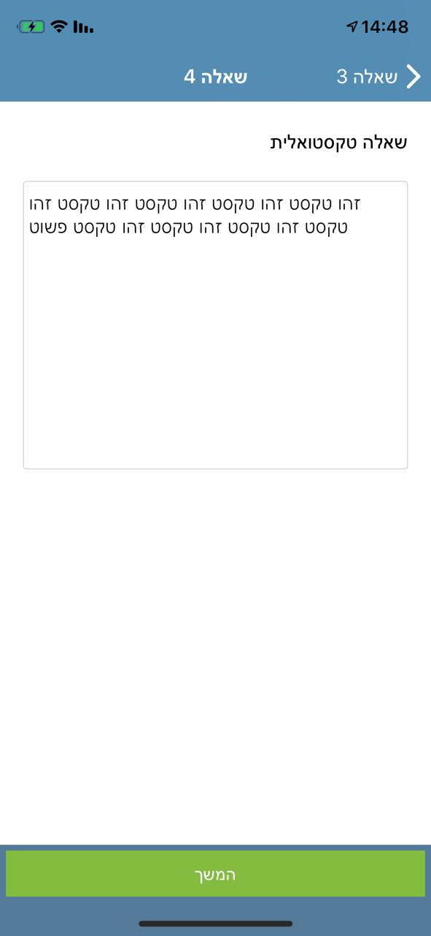
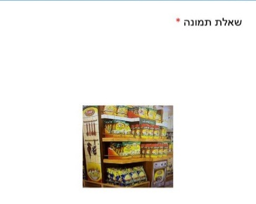
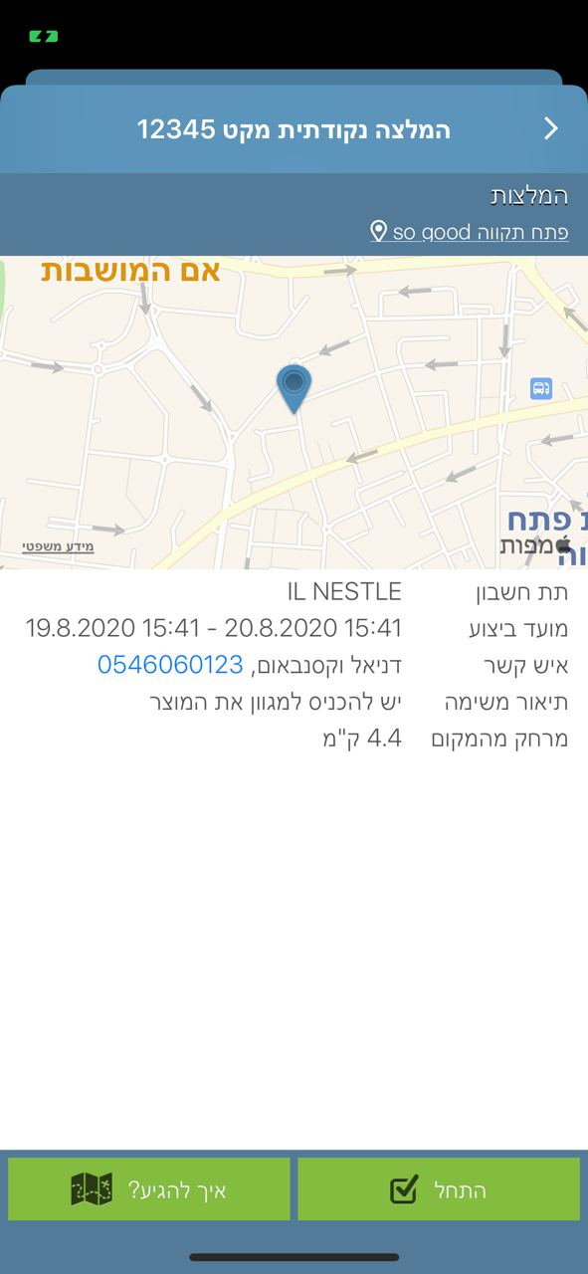
Usages in Retail
Regulation compliance
Food safety
Promotions
Home delivery automation
Availability management
Efficiency monitoring
Private brand
Planogram compliance
Safety
Security
HR surveys
Maintenance
Training
Customers experience
Cleaning
Signage
Recall
Data access

Slide 14
Use cases
Use case | Details | Results
Product launch | Successful launch Includes Thousands of actions that needs to be executed (POS allocation planning, receive POS materials, receive products (all variants), receive planograms, complete setup. | 100% execution
Regulations compliance | Retailers need to comply with various regulators – municipalities, governmental, internal etc’. Digitizing regulations helps HQ to manage real time changes, perform periodic recorded surveys and make sure nothing is neglected or unprovable. | Close to 100% recorded execution saves retailer internal resources (audits, follow up, damage control management) and money (Fines and lawsuits)
Recall | Recall completion is complex. Completion % is uncertain and liability is sometimes heavy. | From ~85% execution within 2 days to 100% validated execution within 30 minutes.

Slide 15
Use cases
Use case | Details | Results
Product availability | Product availability is tricky. You can put it in variety and even planogram but an SKU may easily get OOS or unavailable due to logistics or operational problems, and even as a result of a touch of a client. Using Computer vision or manual structured tools for availability checks helps retailers to prevent loss of sales | 4% lift in category revenues
Home delivery automation | Home delivery is part of a complex integrated processes. From online order, to pick fulfillment branch through picking, handling replacements, assigning a driver and supplying within time window. Automatic planning of all process can make retailer better | 100% raise in order qty with only 40% increase in # of drivers

Slide 16
ROI
Eyedo ROI is disproportionate in relation with its price.
Once you use it, you discover new things you can improve using it every day. Eyedo’s main Business growth engine is the growth of existing clients.
Using the right PAAS can replace other Softwares and help save expanses.
Using one endpoint for various operations saves implementation effort, integrations and costs
Using eyedo can get you 10-100 times ROI, subject to usage depth
Supermarket chain
Convenience Store Chain
Drugstore Chain
«Eyedo is one of the tools that enables us to achieve operational excellence, providing better delivery and differentiating the customers experience»
«Our floor time productivity has increased by 30 %, eyedo makes operating each store much more efficient»
«Eyedo enabled us to increase retail execution from 50 to 95%»
VP Operations
CEO
Analyst

Slide 17
On Boarding timeline
Planning
4 weeks
Pilot
8-12 weeks
Rollout
TBD
Setup
4-10 weeks
Modules to be used
Rolls and responsibilities
SOPS digitation
Training
Close to HQ
Hands on
Testing, focusing
Finalization of Scope
Production setup according to pilot results
Creation of training materials
High-mid level management training
AI learning and integrations
Lower level management and end users training
Full operation

Slide 18


Thank You!
Ronen Yemini, CEO
ronen@eye.do
+97254-6665446

