Slide 1

חתפ
Digitation platform for retail players
eyedo
Field Operation Management Solutions
Proactivity. Productivity. Profitability.

Slide 2

The problem - Retail industry has unique Difficulties.
Planograms not in place
Decentralized structure’s making standardization difficult to deploy
Uncontrolled changes are difficult to track and fix
Task execution is hard to validate
Store staff has no easy access to data
Low efficiency
Signage not in place
2nd POS not in place
Fresh products compromised
Corrective actions not executed
Expired products on shelves
Recalled products on shelves
No regular checkups
Too much office time
Miss matches
Regulations not in place
Those and more, causes damages to equipment, fines, lawsuits, loss of sales, waste of manhour and many more problems.
All affecting the bottom line
Customers disrupt sales area
Fraud and stealth

Slide 3

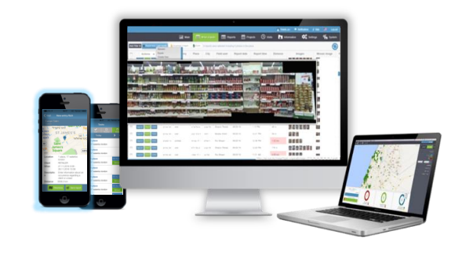
The solution
An all around playing, end to end, robust, flexible and intuitive operation management platform
Decentralized structure making standardization difficult to deploy
Uncontrolled changes are difficult to track and fix
Task execution is hard to validate
Store staff has no easy access to data

Slide 4
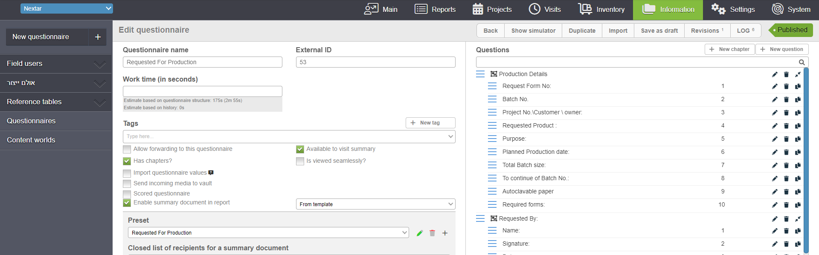
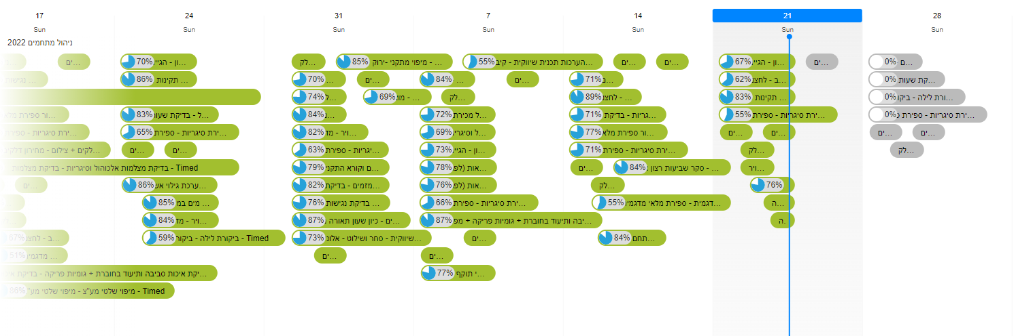
The product - An open architecture digital platform that Includes end to end capability's
Create workflows
Publish to the relevant population at relevant times

Slide 5

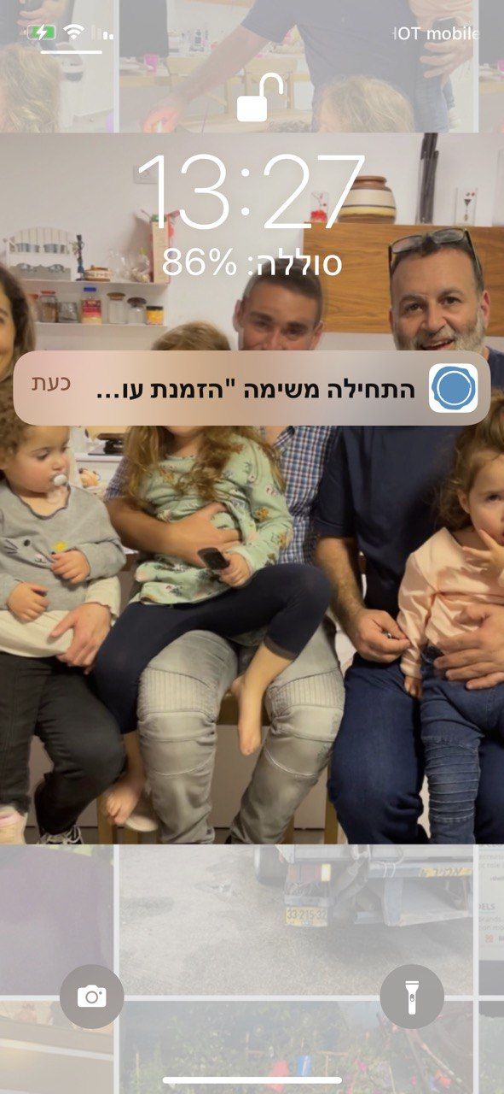
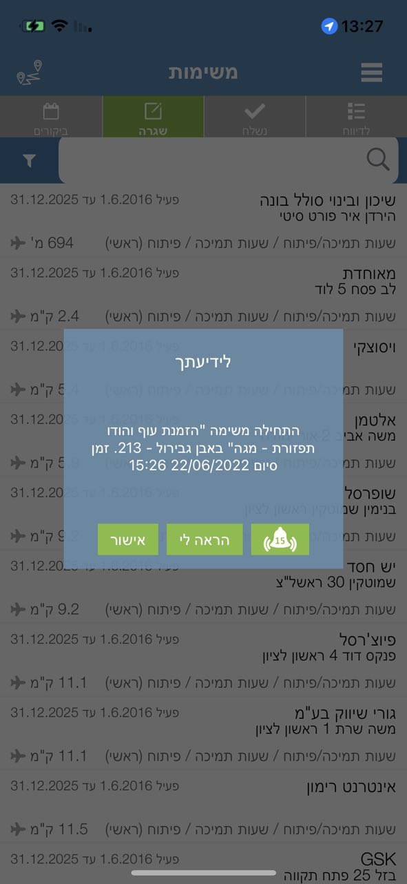
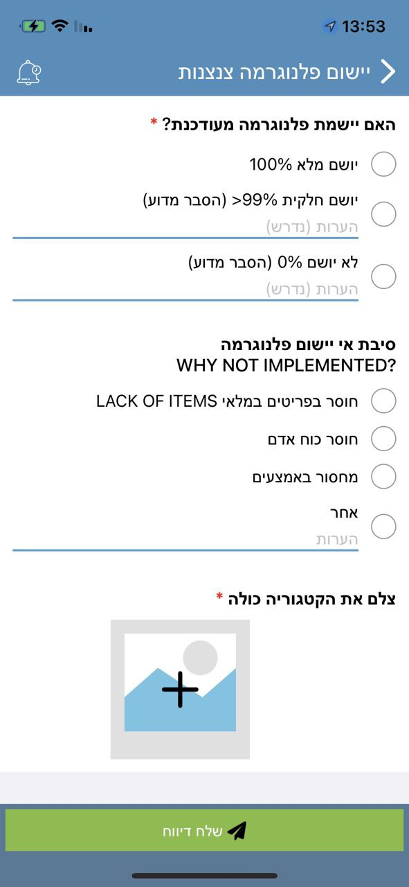
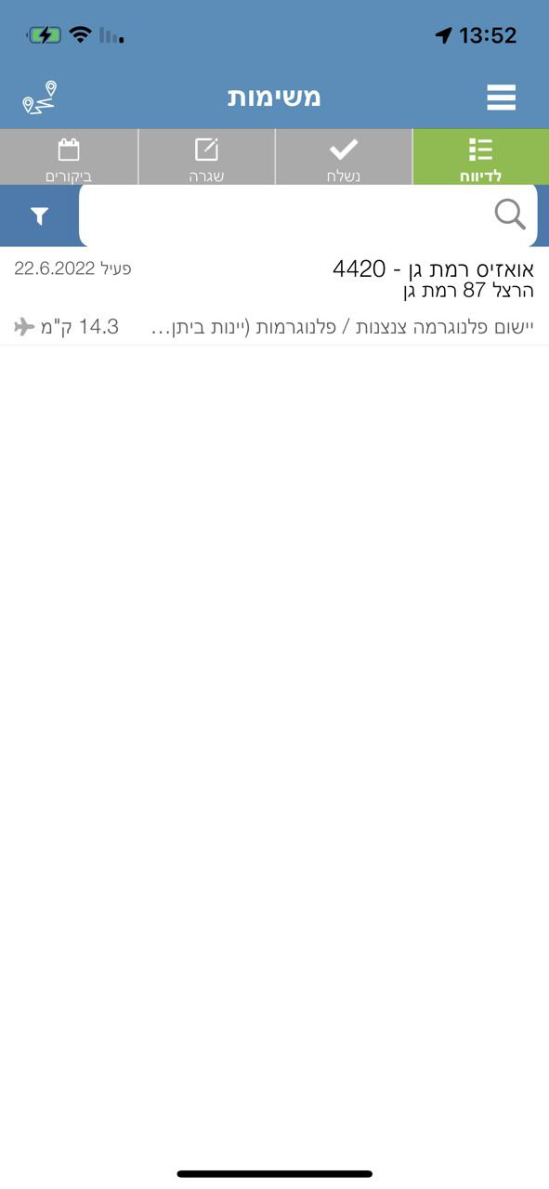
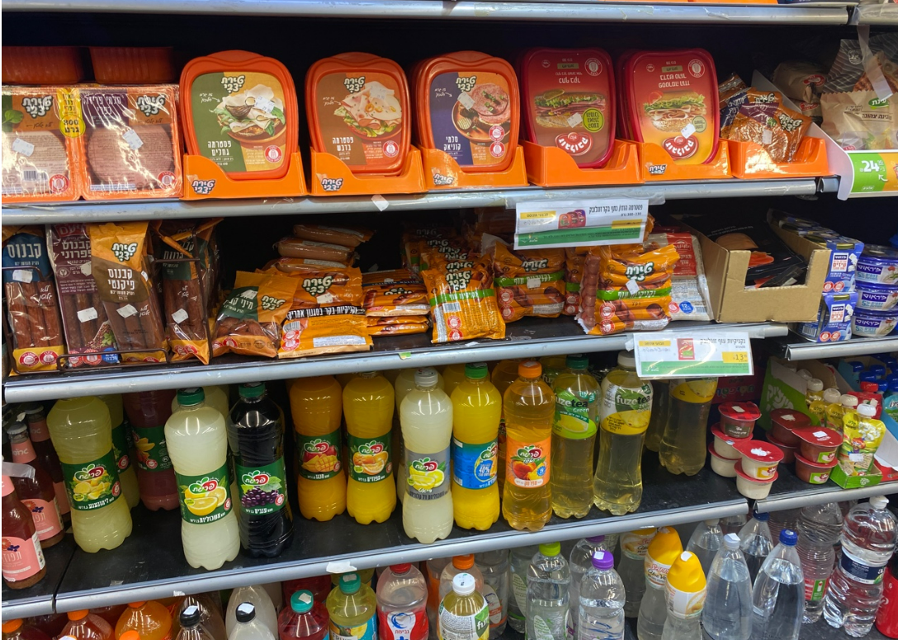
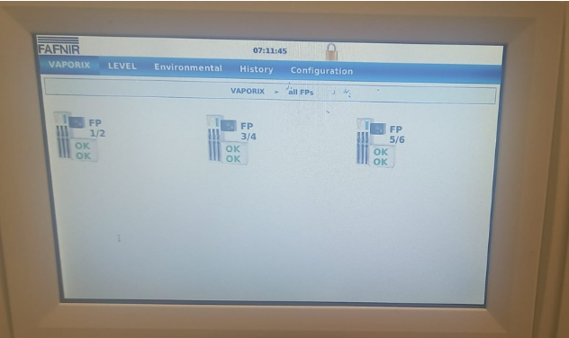
Store staff has easy to use endpoint
Everything they need to know or report in the palm of their hand
Reminders at the right time
Pre-defined workflows, data reach and real time analysis

Slide 6
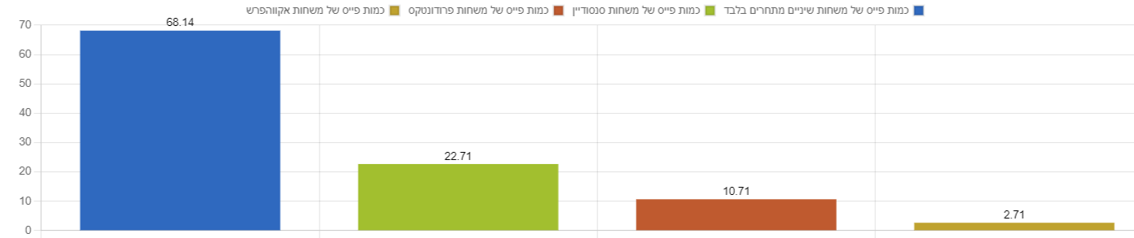
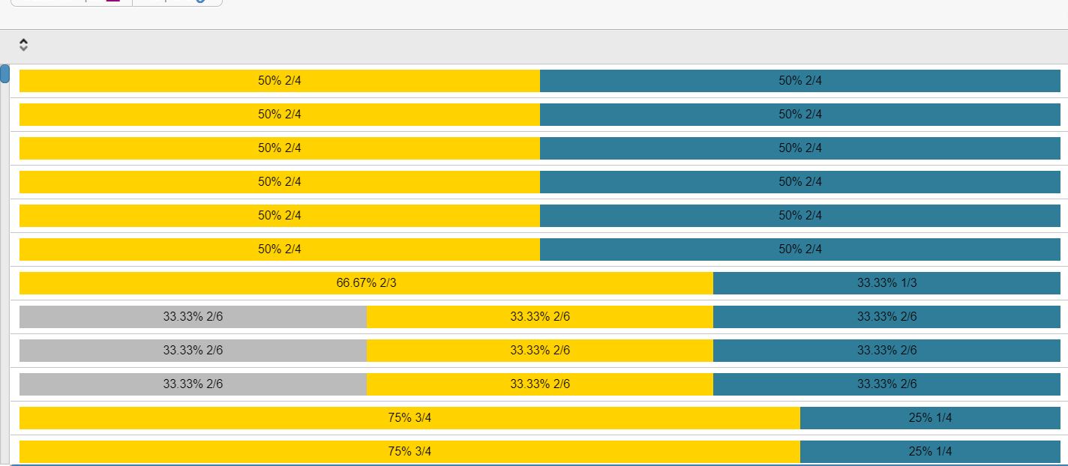
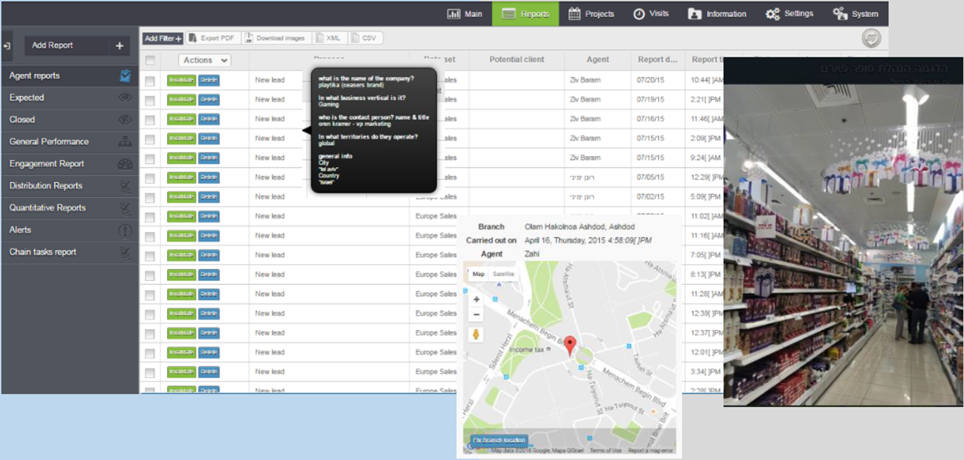
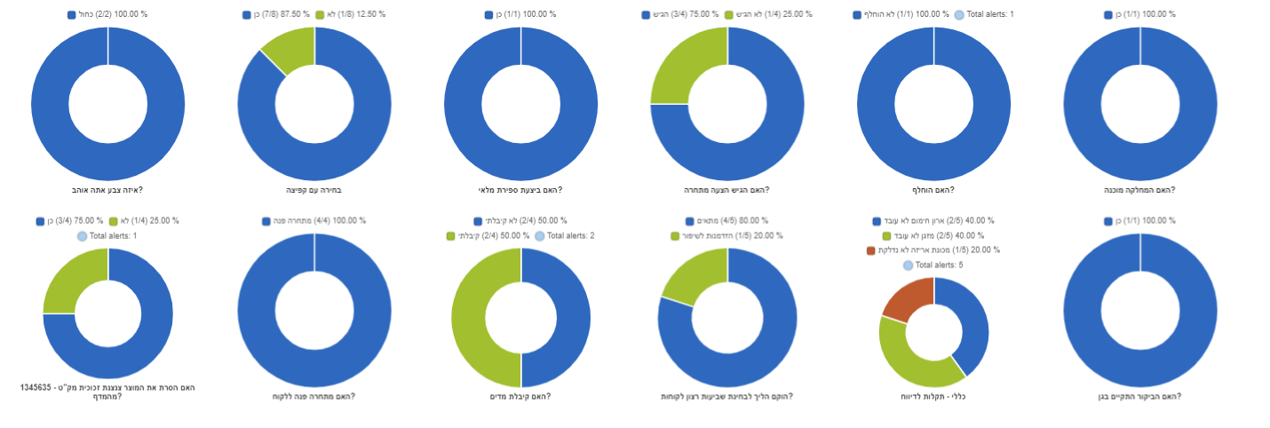
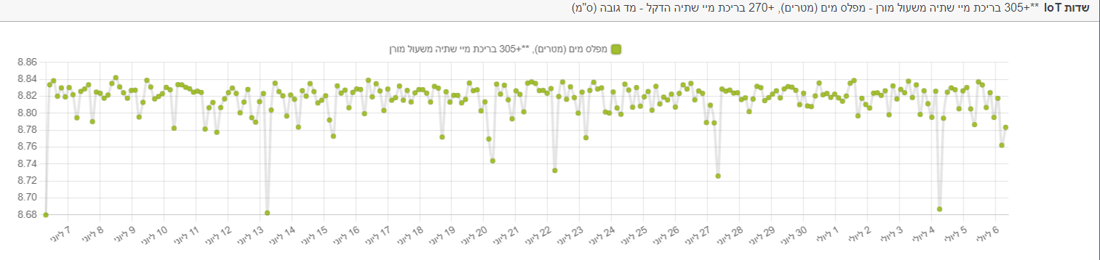
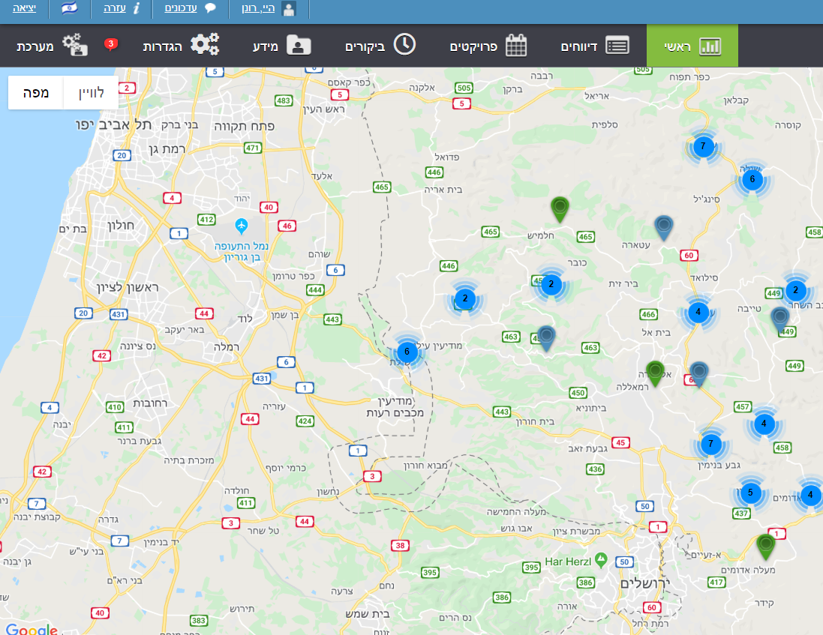
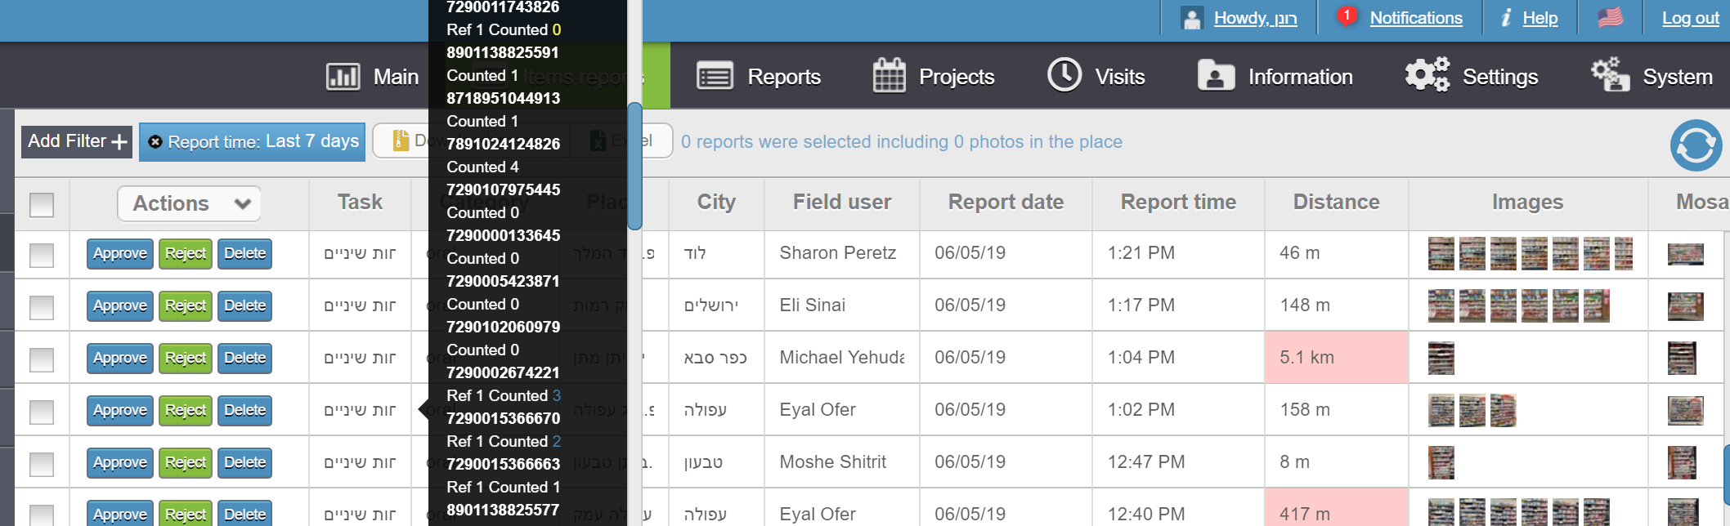
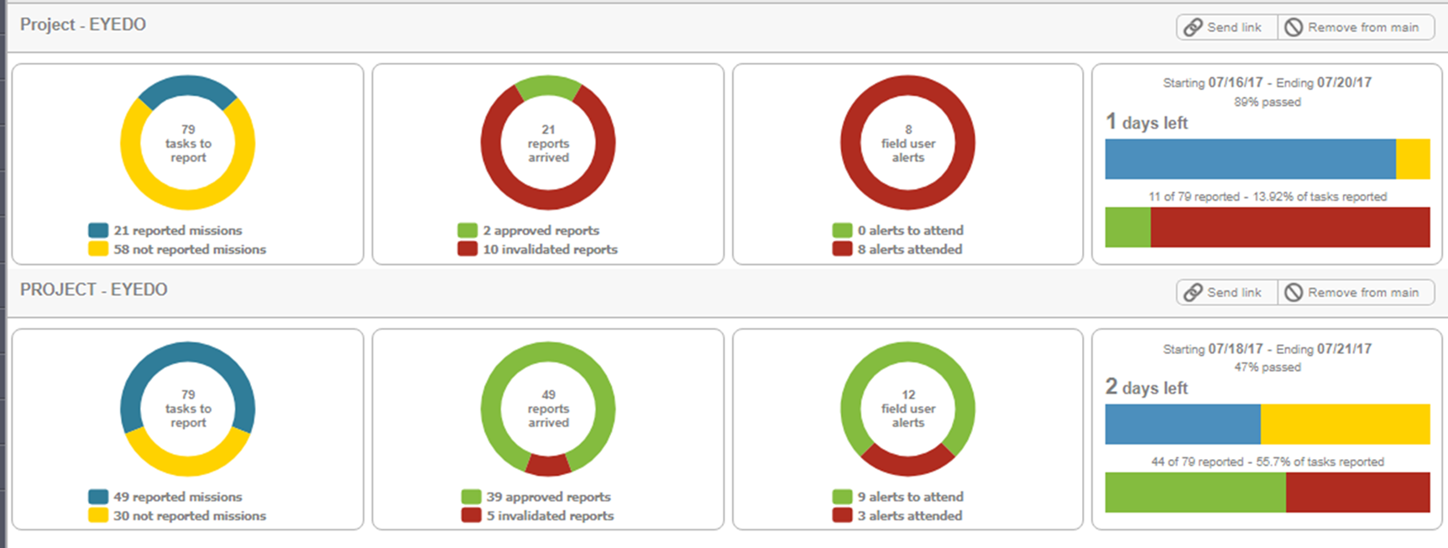
Decision supporting presentations and robust stimulation tools

Slide 7


eyedo’s impact
I’ve seen many technological tools being deployed and operated.
eyedo has changed everything I knew being unexpectedly easy to deploy, compatible to almost everything and has created an immediate impact. ROI started to show immediately.
Shay Fromovitz
Operations chief of staff at Electra Food
Shufersal succeeded to deliver significant savings in the past 3 years by implementing lean culture and by using new digital tools to support its discipline. eyedo’s solution enables us to know in real time if the delivery is 100% and where it fails to deliver as well as to maintain effective operational communication and real time control.
David Laron
VP Operations and Supply Chain
Users say
We add millions to our revenues using eyedo’s unique tools
We make 12% streamlining translated to more than a Million $ savings
We finish a recall within 2 hours
300 employees self onboard the app and the support team drink’s coffee
Over 80% of new sales are Net Promoter Scored generated

Slide 8




























Some of eyedo’s users
RETAIL
Other industries

Slide 9




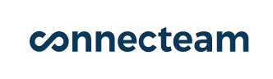

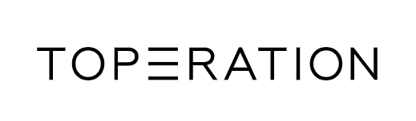
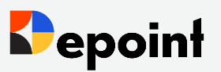
Competition
Performance and reliability
Innovation and market fitness

Slide 10
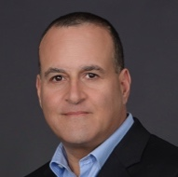



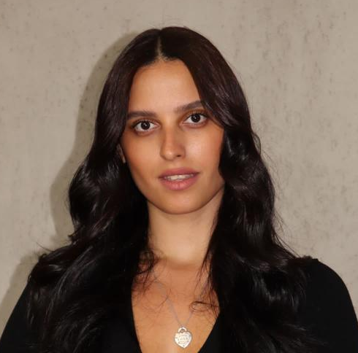

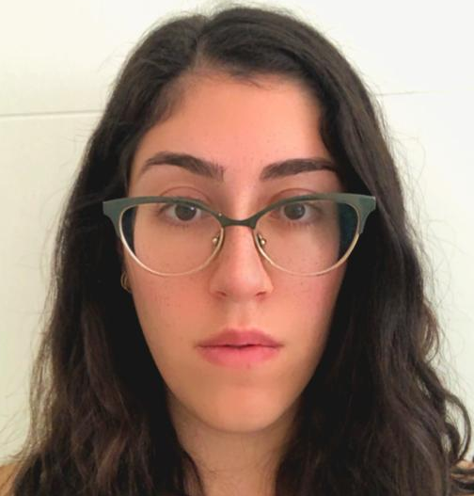
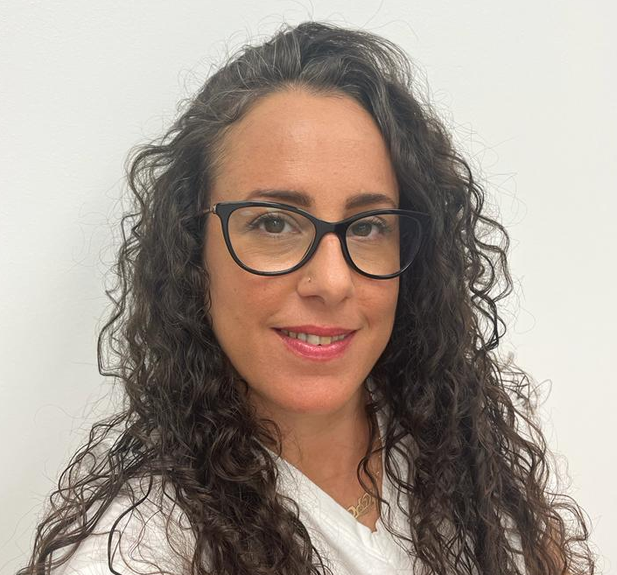
The people
Ronen Yemini,
CEO and Product
Ex P&G retail execution and QA owner
Daniel C Gindi,
CTO and APP developer
Mazal Shrem,
Co founder
Ex intel executive
Shlomi Ashkenazi, Co founder
Ex CEO@ nextcom, EX VP at HOT
Hagar Mirlman, Customers support
Bar Beniloush, Qa
Sari Shahar, web developer
Naama Amit, food safety expert

Slide 11
Cohort stats (retail)
Customers satisfaction helped an increase at # of users and revenues
* As a startup eyedo has not fully charged clients for raise of use

Slide 12
Cohort stats (retail)
Customers satisfaction helped an increase at # of users and revenues
* As a startup eyedo has not fully charged clients for raise of use

Slide 13




Opportunity
8700 + retailers in 80 developed countries
• Top 15 retailers operates more than 250,000 stores
• Less than 10% of the retailers globally use FSM solution
• Retail has least FSM penetration
Source: Retail Index, Markets and Markets
Limited # of players offering FSM software in the global retail sector
Most of them are focused on other industries
Large software players are not flexible and very expansive

Slide 14
We raise 4M$ for 3 years
To Start domestic and international sales operation and generate significant growth
To extend deep tech and unique features development to increase product value
To implement international standards and maximize trust
To explore and develop additional industries
To become a successful sustainable international company

Slide 15
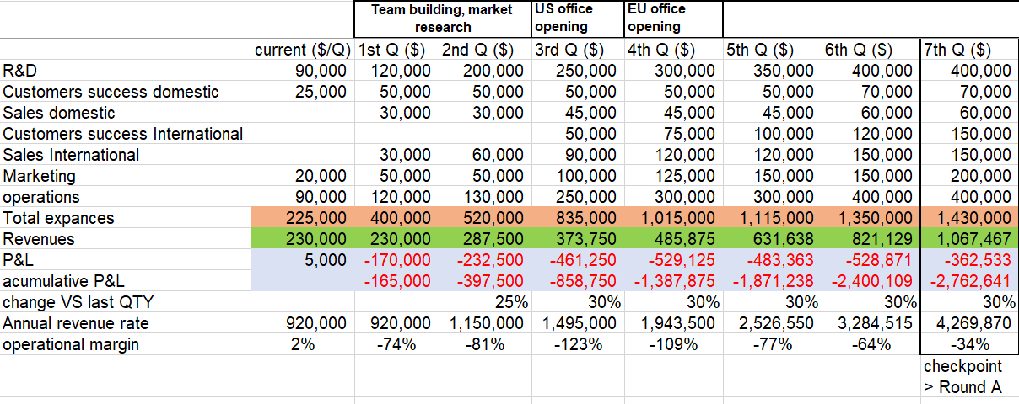
Operational plan (seed only)

Slide 16
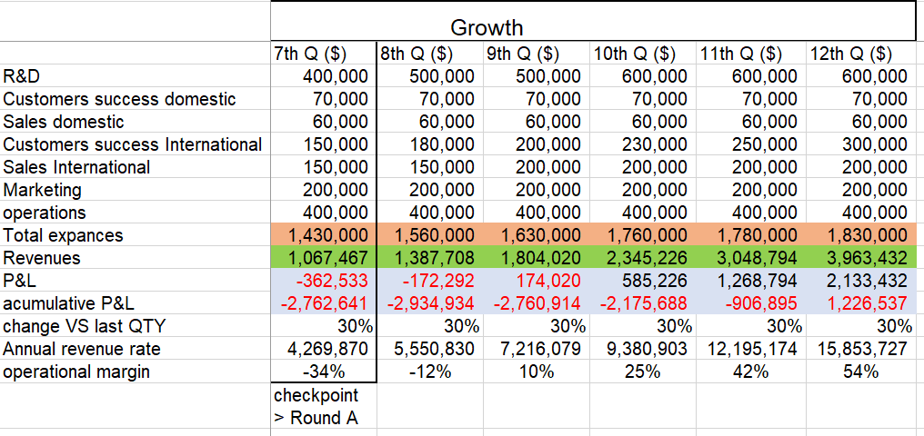
Operational plan (seed only)

Slide 17


Thank you!
www.eye.do
ronen@eye.do
972-54-6665446

