Slide 1
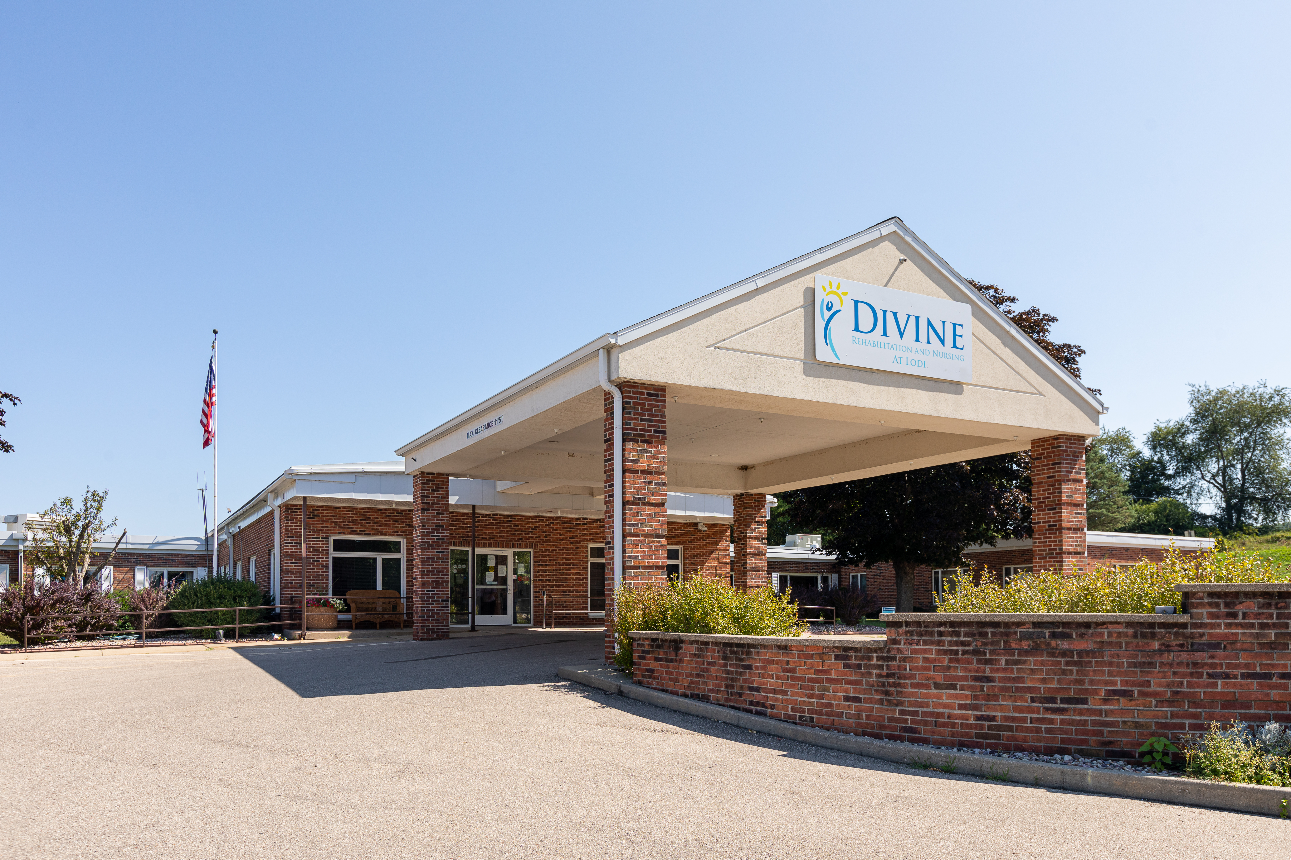
הלוואת גישור ל-:HUD בית אבות
Divine Wisconsin Portfolio
מידע על הנכס
Location | Lodi, St. Croix, Fennimore, WI
Units | 162 beds (combined)
Collateral | SNF (portfolio)
Built | 1967, 1968, 1970
Cap Rate | 12.50%
HUD Takeout Loan | Program: 232/223(f) Refinance Loan
פרטי ההלוואה
Amount | $12,000,000
LTV (As-Is) | 63.7%
DSCR (TTM) | 2.31x
Coupon | L + 6.10% (1.50% Floor)
Term | 22 months
Financing Fee | 1.75%
In July 2020, Dwight Mortgage Trust LLC (“DMT”) closed a $12.0MM bridge loan for Divine Wisconsin Portfolio, which comprised of three skilled nursing facilities (Divine Lodi, Divine St. Croix, Divine Fennimore) in Wisconsin with a combined 162 beds (collectively, the “Subject). The purpose of the bridge loan was to provide financing to facilitate the acquisition of the portfolio. The bridge loan matures on 8/1/2022 and has one 6-month extension option. At closing, loan to value was 63.7% based on a January 2021 “As Is” combined appraised value of $18.84MM at a 12.50% capitalization rate.
The stabilized transaction is sponsored by an experienced owner-operator, who has a long-standing relationship with Dwight Capital, LLC and are repeat HUD borrowers. All properties are within 15 miles of a regional health center or hospital. Prior to the July 2020 acquisition by the operator, the original Sponsors purchased the portfolio for $7.5MM from a non-profit group in February 2019. The prior owners mismanaged Subject, and operations were not profitable. Since that time, all three properties have become profitable through financial restructuring of each property. Since the recapitalization in July 2020, the portfolio has been stable, generating normalized T12 EBITDAR of $2.1MM through 9/30/2021. Over the trailing 12 months, the properties underperformed original underwritten EBITDAR of $2.4MM due to lower reported occupancy (85.6% in July 2020, 78.1% in September 2021); however, the credit metrics continue to support a HUD takeout via a 232/223(f) refinance loan. Subject has not been submitted to HUD as of September 2022.

Slide 2
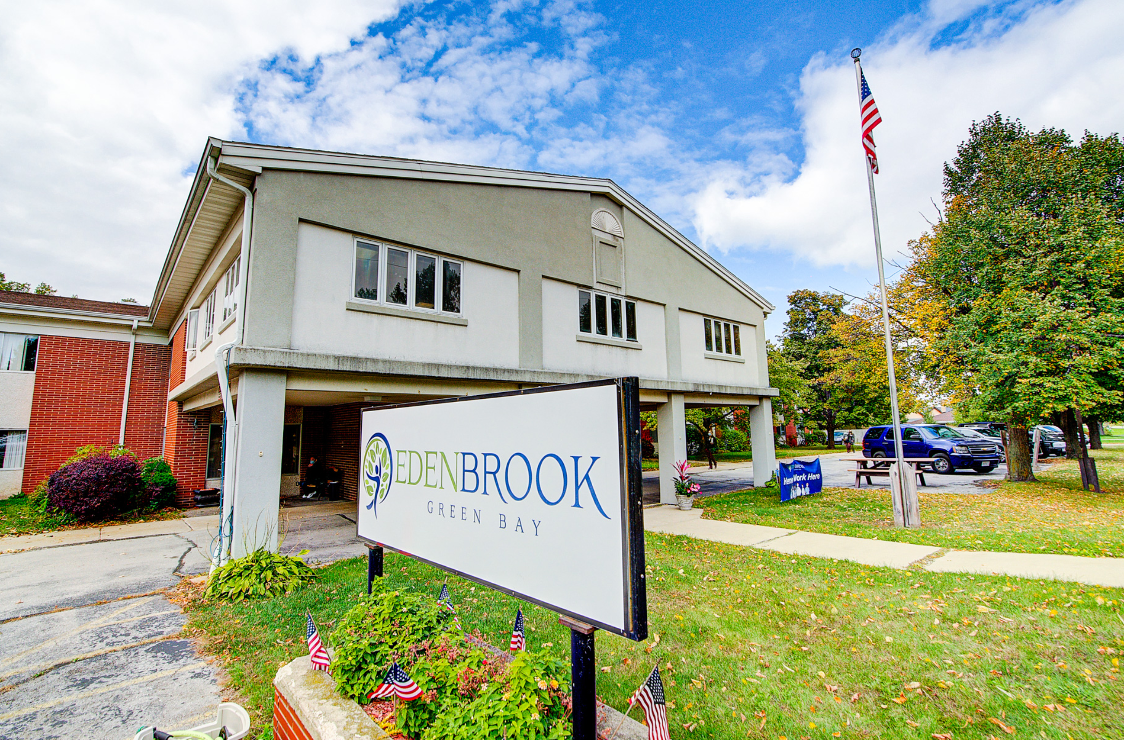
הלוואת גישור ל-:HUD בית אבות
Edenbrook of Green Bay (Parkview)
מידע על הנכס
Location | Green Bay, WI
Units | 48 units / 90 beds
Collateral | SNF
Built | 1979
Cap Rate | 13.00%
HUD Takeout Loan | Program: 232/223(f) Refinance Loan
פרטי ההלוואה
Amount | $4,500,000
LTV (As-Is) | 69.39%
DSCR (TTM) | 3.83x
Coupon | L + 6.00% (0.50% Floor)
Term | 14 months
Financing Fee | 1.00%
In October 2020, Dwight Mortgage Trust LLC ("DMT") closed a $4.5MM bridge loan for Edenbrook of Green Bay, a 90-bed Skilled Nursing Facility in Green Bay, Wisconsin (the “Subject”). The purpose was to refinance existing debt, provide equity recapture to Sponsor, and fund CapEx. The bridge loan matures on 11/1/2022 and has one 6-month extension option. At closing, Lender provided $3.5MM with $1.0MM unfunded and in November 2021, Sponsor received the first CapEx disbursement of $421k, which finances ongoing renovations to units and common areas. At closing, loan to value was 61.95% based on a June 2020 appraised "As Is" value of $5.65MM at a 13.00% capitalization rate. After the disbursement, loan to value increased to 69.39%.
This value-add transaction is sponsored by a 15-year veteran of the skilled nursing industry with extensive operating and turnaround experience. Subject is located within seven miles of its primary referral sources including Bellin Health (heart center), St. Vincent’s (cancer care), St. Mary’s (cancer care), and Aurora Bay Care Medical (acute care). Sponsor acquired Subject in late 2018, which at that time was generating over $600k in annualized losses. After Sponsor successfully executed a turnaround plan, Subject returned to profitability in late 2019. Based on trailing 12-month reporting through September 2021, Subject produced $1.1MM in normalized EBITDAR, which exceeded DMT underwriting of $707k at origination. Financial performance was strong in 2020 and YTD 2021 with credit metrics that continue to support a HUD takeout of the bridge loan via a 232/223(f) refinance loan. The application will be submitted upon completion of the renovation program.

Slide 3
Warehouse Mechanics & Smart Leverage
Loan Risk Profile
Warehouse financing allows DMT access to leverage. A hypothetical loan example is shown below – a $10MM bridge loan.
What our Borrower Sees…
Structured Finance with Warehouse
Spread Allocated to DMT Equity
WAREHOUSE FINANCING
250 bps (spread between warehouse and loan spread) x 3x leverage = 7.5%
56% LTV SOFR+280
WAREHOUSE $7.5 MM
DMT LOAN $10 MM
75% LTV SOFR+475
SOFR + 475 bps spread allocated to unlevered portion
DMT EQUITY
$2.5 MM
Combined spread to DMT Equity/HUD Fund = 12.25%*
56-75% LTV
*Assuming 50 bps LIBOR floor. Excludes origination, management, and performance fees
Warehouse lending provides interim or permanent leverage. Dwight, the Fund, and the Warehouse Lender are well protected by the borrower’s subordinated equity. The Warehouse Lender also benefits from Dwight and the Fund’s equity in the loan, providing them protection on up to 45% of property value decline.

Slide 4
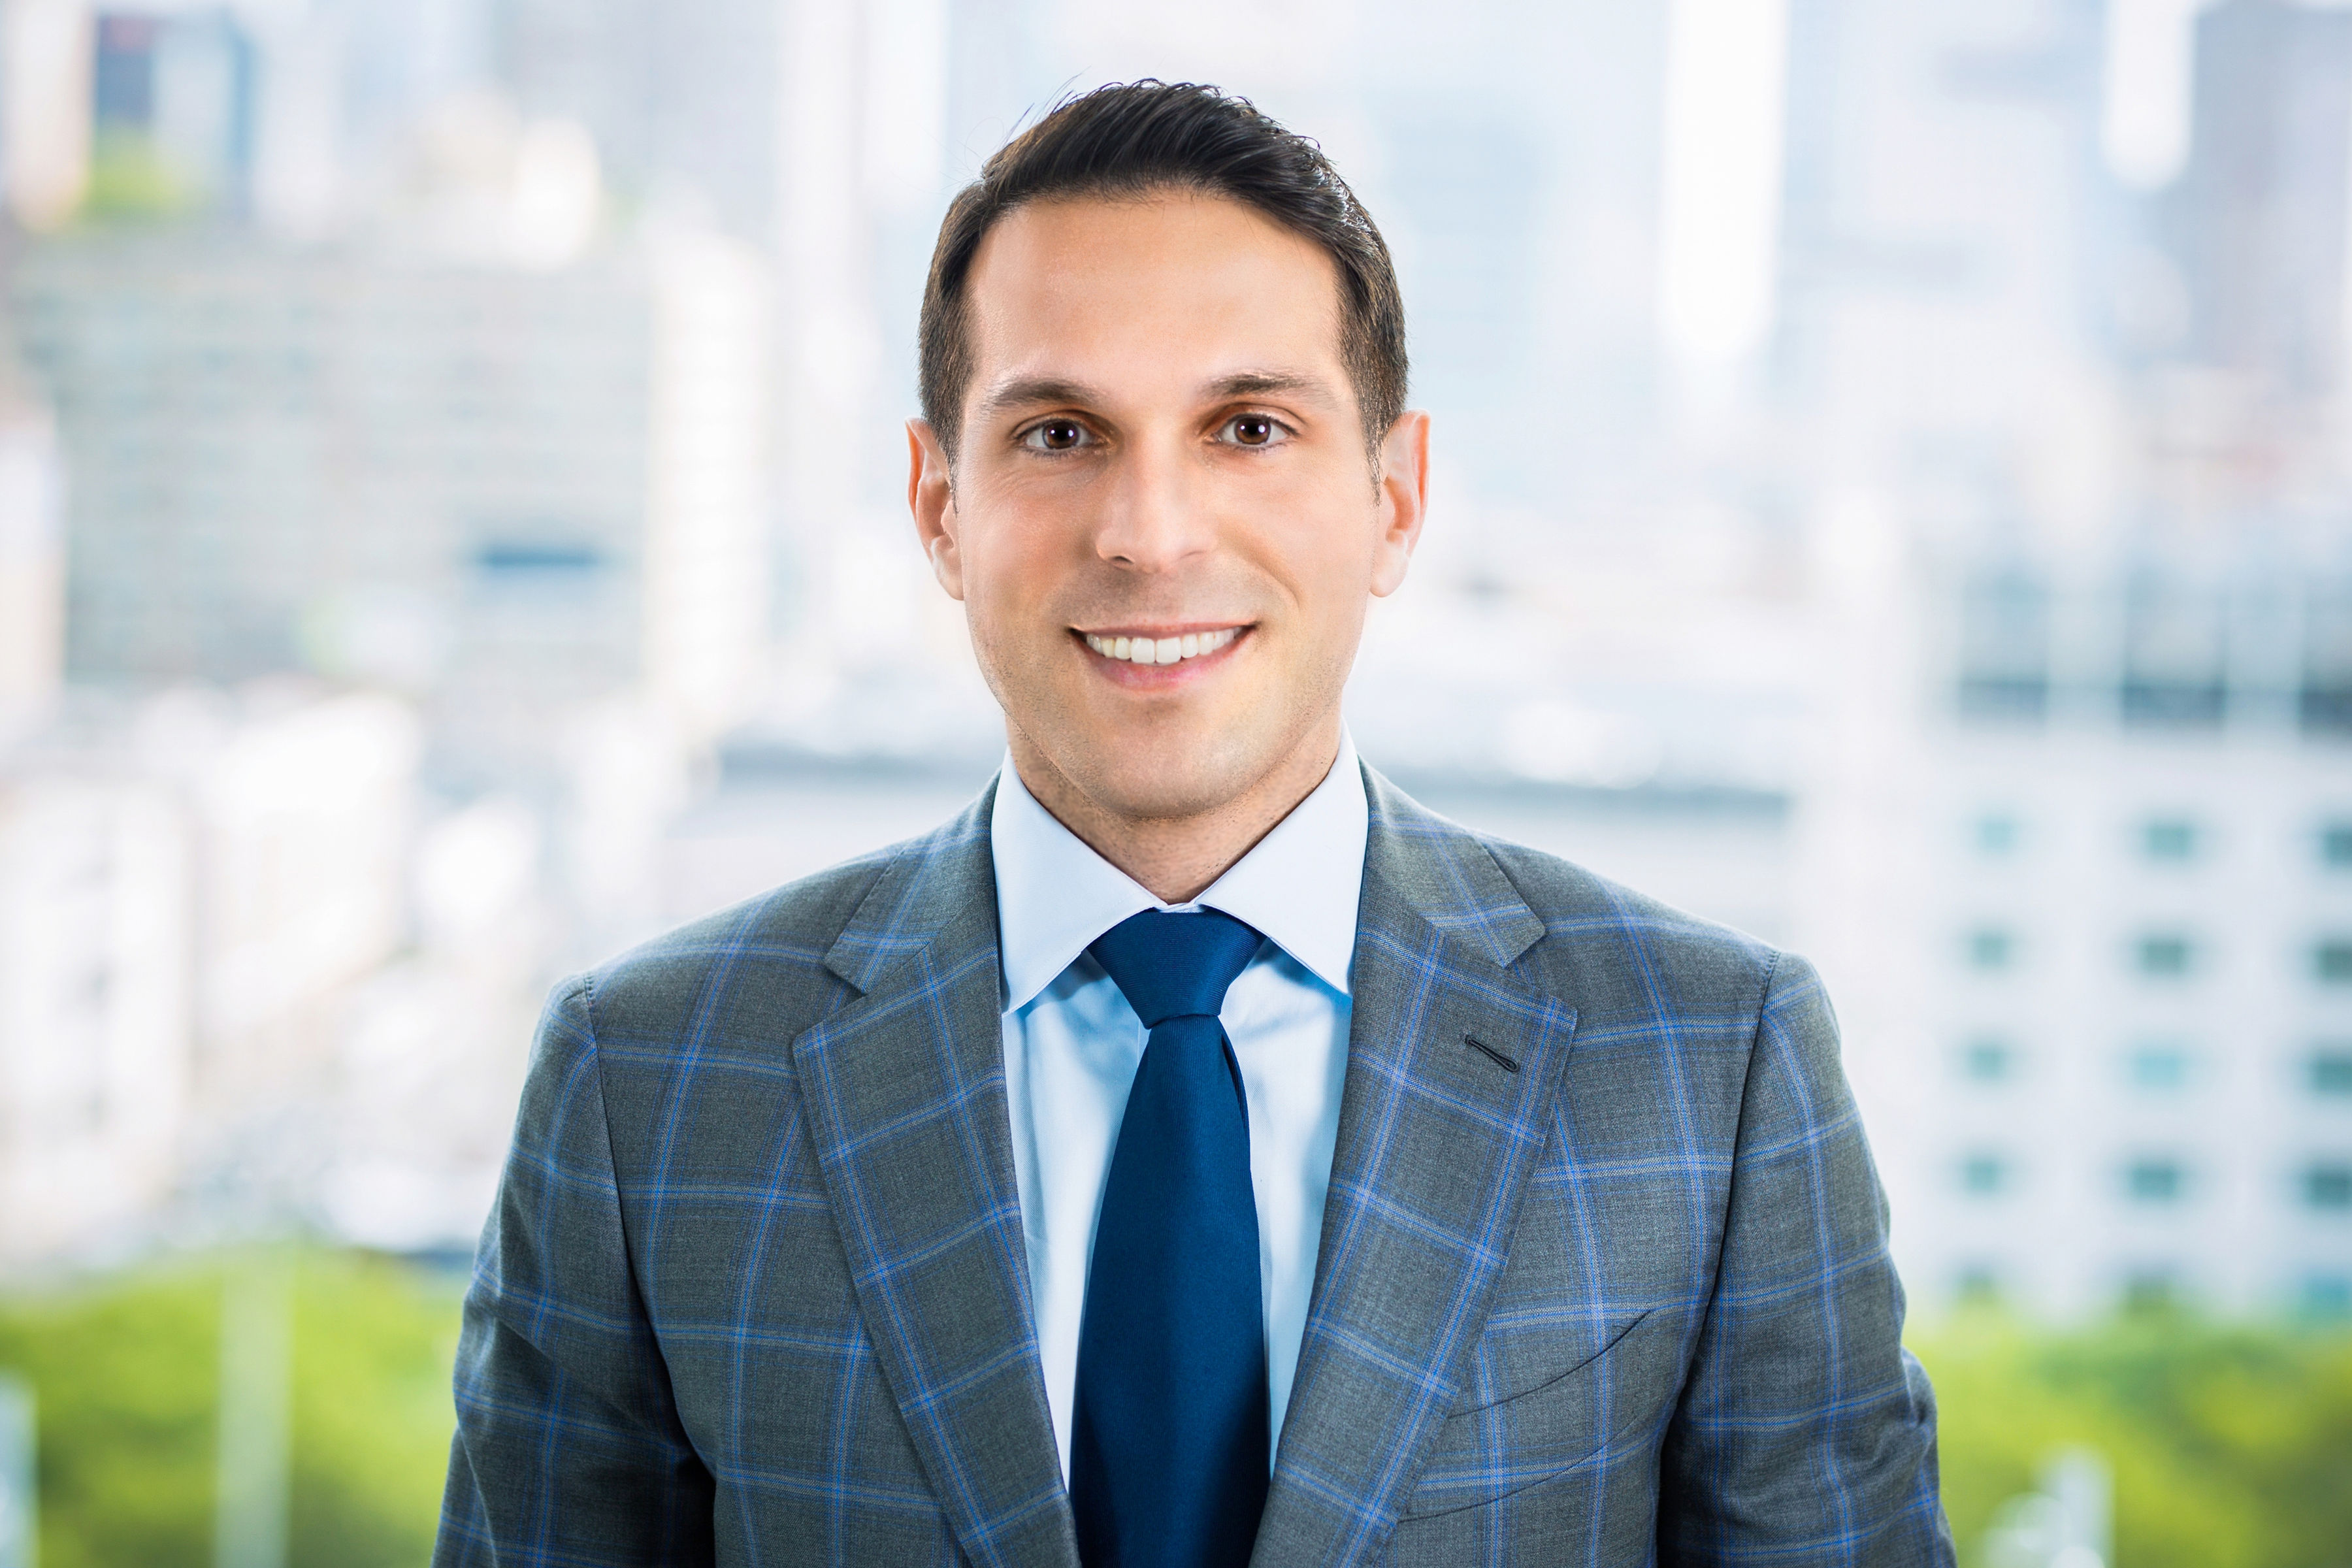
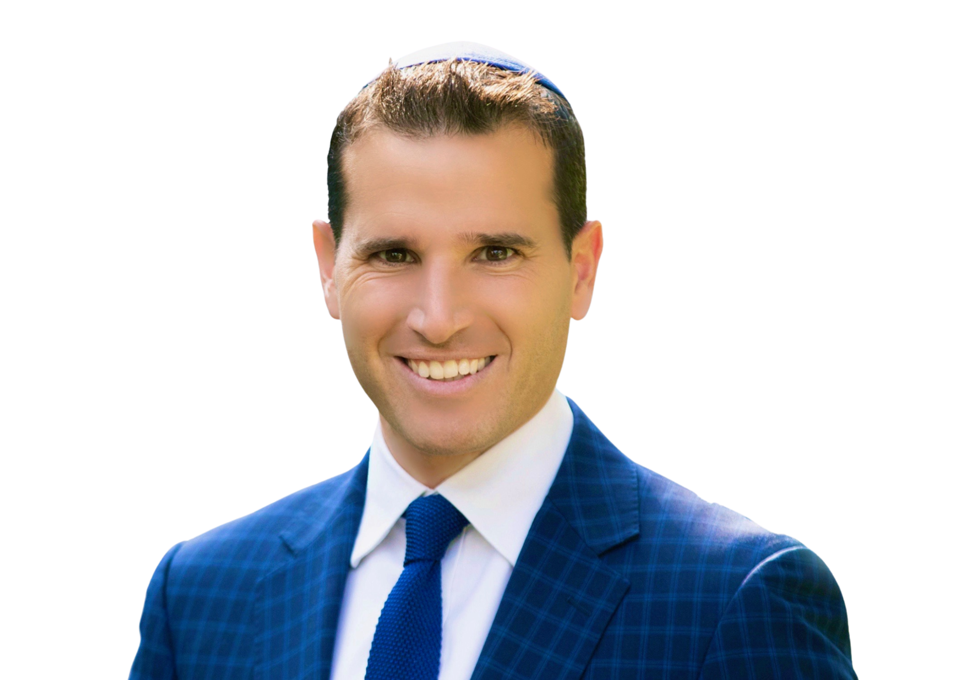
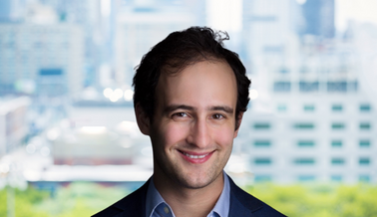
השוק ו-Dwight
המנהלים
אדם ששונס – מייסד ומנכ"ל משותף. כמנכ"ל אדם מעורב בכל פעילויות החברה: ארגון ההלוואות, החיתום, הסגירה וליווי הבקרה. אדם מביא עימו עשר שנות ניסיון בשוק בהן ארבע שנים ב-Greystone, שם הוביל את קבוצת מימון HUD בפריסה ארצית.
Adam Sasouness co-founded and oversees the overall functions of DMT, an actively managed Mortgage REIT specializing in the financing of commercial mortgages across a range of asset classes that has approximately $2.4 billion of loans outstanding through 7/31/22. Adam is also a co-founder and co-CEO of Dwight Capital, which is one of the largest multifamily and healthcare real estate FHA/HUD loan originators and servicers in the country. In his capacity as co-CEO, he manages Dwight Capital’s overall business, including the loan origination, underwriting, capital markets’ activities, closing, and servicing functions. Through August 2022, Dwight services in excess of $11 billion of commercial real estate loans. Over the years, Adam has launched several other business lines including, Dwight City Group, a real estate holding company with approximately 2,500 units under ownership/management; and Dwight Funding, an asset-based lending and factoring company. Prior to Dwight, Adam was a Managing Director at Greystone & Co., where he headed a nationwide FHA origination group from 2009 through 2013. Adam received his B.A. in Economics from New York University.
Ari Spodek, CPA – Chief Financial Officer & CHIEF COMPLIANCE OFFICER
As Chief Financial Officer & Chief Compliance Officer at DMT, Ari is responsible for the accounting, treasury, reporting & investment functions of the bridge loan operation and works closely with the custodians and auditors to ensure proper compliance. With over 15 years of experience in both public and private accounting, Ari was previously at Taboola, an Israeli fintech start-up, which topped the $1B mark in revenue in 2019. Prior to that, he was the corporate controller at Yellowstone Capital, a key player in the merchant cash advance industry. Additionally, he was Vice President at Cantor Fitzgerald for 5 years. Earlier in his career, he worked as an auditor for both PwC & KPMG. He received his MBA in finance from Boston University and is a licensed CPA. He graduated magna cum laude from Yeshiva University in 2005 with a B.S. in Accounting.
JOSH STURM – MANAGING DIRECTOR – SENIORS/HEALTHCARE
Josh is the Managing Director – Seniors/Healthcare for Dwight Mortgage Trust. His primary responsibilities include the evaluation of potential bridge loan healthcare investments, which involves managing new origination pipeline, asset management, and relations with sponsors, partners and potential investors. Prior to joining Dwight, Josh spent 3.5 years at Monticelloam, LLC, a specialized private real estate and asset-based lender, offering financing options for CRE properties across the U.S., including skilled nursing, assisted living, seniors housing and affordable housing properties. Josh studied Finance and Accounting at York University and Economics at Harvard University.

