Slide 1
Blender Financial Technologies Ltd.
The bankers of tomorrow are not bankers at all.
The bankers of tomorrow are technologists
who enable banking experiences your customers will use across the digital landscape
Brett King, Bank 4.0

Slide 2
Legal Disclaimer
This presentation constitutes the principle and marketing presentation of Blender Financial Technologies Ltd. and its subsidiaries (henceforth referred to, together, as "the Company" and/or "Blender" and/or "the Group") and is meant for marketing purposes. It does not constitute a public offering of securities by the Company and should not be construed as a public offering of securities by the Company. The information contained in this presentation is solely abridged information to be used as a general presentation of the Company and does not contain exhaustive data on the Company and its activities. The information contained in this presentation and any other information that may be provided when this presentation is presented (henceforth: "the Information") does not constitute a recommendation or the opinion of an investment advisor or a tax advisor. Investment in securities, and particularly, in the Company's securities, carries risk. One must bear in mind that past data is not necessarily indicative of future performance. Purchasing Company securities requires a thorough review of the data the Company publishes in the Company's reports on the Maya and Magna systems (henceforth: "Company Reports") and the performance of a legal, financial, fiscal, and accounting analysis of that data. The presentation contains additional data that will not be displayed in Company Reports to the public and/or information displayed differently than how it will be displayed in the Company Reports to the public. The presentation is not designed to substitute for a review of Company Reports, whenever they are publicized by the Company. In the event of a contradiction between this presentation and Company Reports, the content of the Company Reports shall prevail.
Forward-looking Information Disclaimer
The Company’s forecasts and assumptions specified in this presentation regarding the consolidation of LTL’s financial results, receipt of the banking licence in Europe and the completion of the LTL acquisition as a result (slides 4, 5, 6, 7, 17, 23 and 24); receipt of the licence for providing credit from the Capital Markets Authority to enable BNPL’s activity and the expected start date of said activity (slides 6, 13 and 15); the anticipated risk of failure rate in Israel for 2022 (slide 11); the strategy for activity in Europe after the banking licence is obtained (slide 17); and the accelerated growth in car financing activity (slide 14), are all considered forward-looking information, as defined in the Securities Law of 1968. Among other things, this information is based on the Company’s assessments regarding developments and events that may or may not take place at an uncertain time in the future that are not within the Company’s control.
By nature, forward-looking information might not materialise as it is uncertain, as aforementioned. Whether forward-looking information materialises or not may be affected by risk factors inherent in the Company’s activity, developments in the financial environment in which the Company operates and external factors, including regulation, that can affect its activity. Therefore, it is hereby emphasised and clarified that the Company’s actual future results and achievements may fundamentally differ from the forward-looking information presented here.
For the removal of doubt, let it be clear that the Company does not undertake to update and/or change the information included in the presentation to reflect events and/or circumstances that occur after the presentation has been prepared.

Slide 3
Our Mission
To build a fast and innovative credit solutions according to our clients preferences and needs

Slide 4
Our Success by the Numbers
4
62K
59M
736M
1.3B
Countries:
Israel, Lithuania, Latvia, and Poland
Paying customers
Total annual revenue
Credit portfolio balance
Total financed loans
42%
96%
75%
Financial data appears in NIS and is accurate as of 30 September 2022; however it has not been audited or reviewed; Managed credit portfolio including the loans in the credit brokerage system and the LTL portfolio balance. the rate of increase in revenue and the growth data refers to 30 September 2022 in relation to the corresponding quarter last year; Gross NON-GAAP income based on the sector notes in the financial reports; including revenue from loans on the credit brokerage system and LTL’s revenue since March 2022.
LTL data is based on reports that have not been audited or reviewed and is not consolidated in the Company’s financial reports.
Notes:
לתקן רווחים בין שורות

Slide 5
Fast and Innovative Credit Solutions

Slide 6
blenderPay - BNPL Market Leader
2464 POS
An increase of 332 in Q3-2022
Continues expansion with leading retailers
including distribution points in Europe and cars dealers

Slide 7
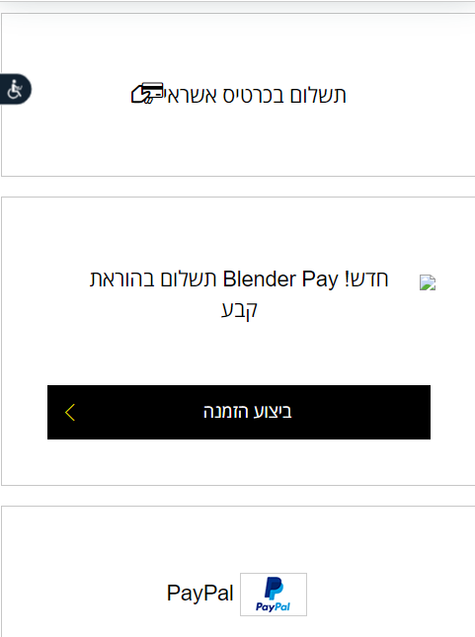
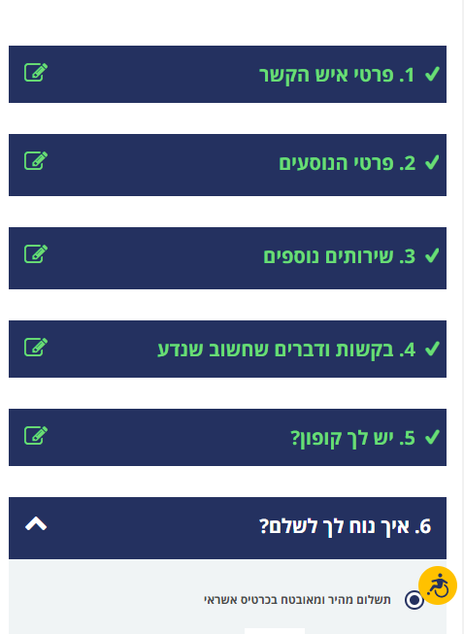
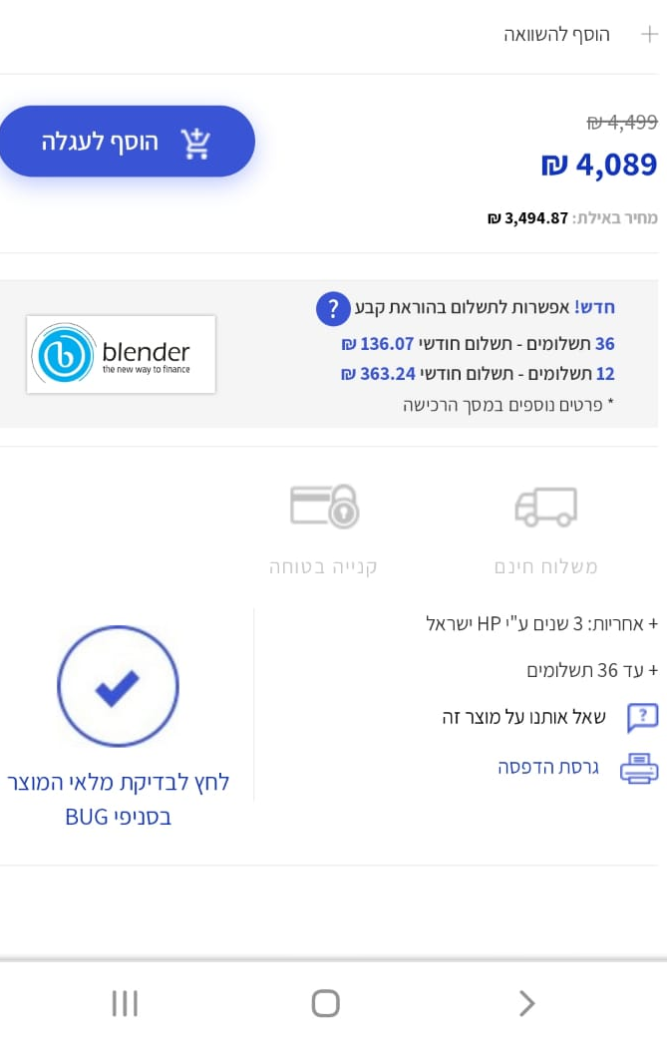
blenderPay - BNPL Market Leader
A unique solution for E-Commerce sites
Notes:
להחליף את הבפנים באפליקציות לאנגלית

Slide 8
blenderPay in Partnership with
The preferred option for installments payments for large purchases in Israel
JV owned 80% by Blender and 20% by Bank Hapoalim
Potential market of 30 billion NIS per year on large purchases in Israel (excluding car-loans)
"Credit at points of sale will grow and boom in Israel”
Avivit Bender, Director of Innovation at Bank Hapoalim: "Blender has the capability and the technology to make quick credit transactions and payments"
The Marker, July 2022
Technology allowing payment in extended installments using quick non-bank credit at POSs
The Company estimates that the JV’s extended credit licence will be received during Q4-2022

Slide 9
blenderCar
The fastest option for car loans in Israel and Europe
In collaboration with:
Wide selection of car dealers operate with blenderCar in Israel and Europe
Transaction authorization within seconds -no forms or paperwork!
Convenient and easy-to-use digital platform for car dealers
A unique technology with a holistic system of rapid credit evaluation and establishment
Wide installment spread tailored to the customer needs

Slide 10
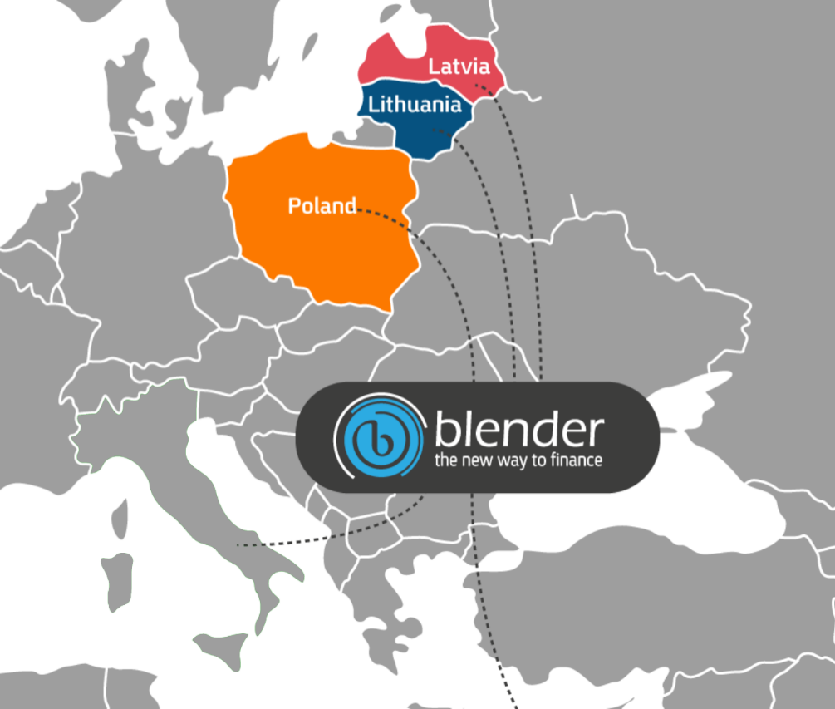
blenderBank
The Game Changer
A dedicated bank specialising in raising deposits, payments and credit
Raising deposits, mainly from Western Europe through dedicated deposit distribution bodies and providing credit through a range of distribution channels: BNPL, car credit and mortgages
100% Digital Native – A Bank without Branches
Based on Blender’s core platform that enables some of the world’s most advanced credit issuance flow, underwriting, customer acquisition and management processes
Focused Profitability Model – Lean Cost Structure Management
Increasing margins by significantly reducing the price of credit sources, along with Blender’s proven distribution capabilities in Europe
Potential for Quick and Significant Growth
Beginning to focus the activity in which specializes in Central European countries while expanding to the rest of the European Union based on Passporting.
Subject to obtaining the banking licence in Lithuania and all the relevant regulatory permits based on the European Directive

Slide 11
Diversified Credit Platform
Deposits
blenderCar
Private Investors (P2P)
blenderPay
Funding Sources
Lending Segments
🡨
Institutional Facilities
Autonomic Underwriting Platform
🡨
blender Loan
Bank LOC
Bonds (under review)

Slide 12
A Unique Technological Platform – Fast and Accurate Underwriting
Data Driven
Broad mapping, forecast and managed credit risks of wide ranged information sources
Fast Underwriting
Credit risk assessment in seconds without prior client engagement
Rating2.0™
A propriety credit rating and underwriting system developed by Blender, enables clients’ quick and accurate digital credit
Secured Integral Architecture
Fraud Prevention
A robust Salesforce based system, significant process efficiency, driven by data-based decisions and APIs
A multi-dimensional model for credit risk assessment and fraud prevention
Digital
An advanced, accessible, and simple digital platform - no forms or paperwork required!
Notes:
Rating2.0TM

Slide 13
Fast and Efficient Customer Experience
6 Steps in 30 seconds
Collateral valuation & underwriting
(vehicle/real estate)
6
Onboarding
(POS, E-Commerce, Car agencies)
Advanced client identification & authentication
5
1
30
Seconds to get a loan
4
2
Client rating and loan profile
Client check with Blender’s propriety platform
3
Automated customer risk and evaluation assessment
30 seconds -Minimal time period

Slide 14
Significant Growth in Revenue and Credit Portfolio
75% Growth in the Credit Portfolio (NIS in thousands)
96% Growth in the Group’s Revenue (NIS in thousands)
75%
Growth
96%
Growth
Europe Income
Israel Income
Consolidated
Europe
Israel
Consolidated
Gross NON-GAAP income based on the sector notes in the financial reports; including revenue from loans on the credit brokerage system and LTL’s revenue since March 2022; financial data appears in NIS and is accurate as of 30 September 2022, however the data has not been audited or reviewed; LTL data is based on reports that have not been audited or reviewed and are not consolidated in the Company’s financial reports.

Slide 15
Proven and Meticulous Credit Risk Management in a Dynamic Market with Changing Interest Rates
Blender Israel
Proven underwriting and risk management model
Protecting investors from borrowers’ defaults with a unique safeguard fund. The monies in the fund accrue from allocations taken from the borrowers and investors in proportion to the risk level, and are held in trust by ‘Ziv Haft BDO’
Credit risk insurance for the safeguard fund by an international insurance company
Diversifying loan origination while promoting collateral based loans
Controlled and supervised lender and borrower processes
Blender Europe
Proven underwriting and risk management model
Increasing the financial margin
Controlled and supervised credit provision process
Europe
Israel
Provisions for Credit Portfolio Balance
Interest APR
Failure rate
Interest APR
As specified in the security fund’s articles of association and the insurance policy.
The data is accurate as of 30 September 2022; however it is unaudited and has not been reviewed.
The failure rate in Israeli in the normal course of business is estimated at between 1.75% and 2.88% for 2022 and between 2.3% and 3.6% for 2021, as specified in the periodic report for 2021. APR for loans placed in the relevant year, as calculated at the time the loan was placed

Slide 16
BLENDER ISRAEL

Slide 17
Blender Israel:
Significant Growth in Revenue and Credit Portfolio
Revenues (NIS in thousands)
Total Credit Portfolio (thousands of NIS)
Shift to positive cash flow while investing in strong growth
Significant growth in credit portfolio
83%
Growth
Positive Cash flow
51%
Growth
Gross NON-GAAP income based on the sector notes in the financial reports; including revenue from loans on the credit brokerage system; financial data appears in NIS and is accurate as of 30 September 2022; however the data has not been audited or reviewed

Slide 18
blender Israel: Triple Growth in Loans Provided
Loans provided (NIS in thousands)
Paying Customers
Consistent growth
Triple the amount of loans compared to the same quarter last year
X 3
40%
Growth
Loans on the credit brokerage system; financial data appears in NIS and is accurate as of 30 September 2022; however the data has not been audited or reviewed; Annual rate is based on the average total credit provided in July‒September 2022 multiplied by 12.
Notes:
גרף אמצעי לסדר את מיקום העיגול והחיצים

Slide 19
BLENDER EUROPE

Slide 20
Blender Europe: LTL acquisition tripled the Credit Portfolio
Revenue (NIS in thousands)
Total Credit Portfolio (NIS in thousands)
Doubling of revenues from same quarter last year
About NIS 200 million EU portfolio
X 2.5
4,900
X 3
194,300
Blender Europe
Gross NON-GAAP revenue based on the sector notes in the financial reports; including LTL’s revenue from March 2022. The data has not been audited or reviewed; LTL data is based on reports that have not been audited or reviewed and is not consolidated in the Company’s financial reports.

Slide 21
Key Events from the IPO
(Jan 2021 – September 2022)
February 2022
50M NIS - Bank Mizrachi Tefahot LOC (line of credit)
Approved by the Competition Authority for Bank Hapoalim and blenderPay transaction
November 2021
Agreement singing, establishing JV with Bank Hapoalim to provide consumer credit at POS and E-Commerce sites (BNPL – Buy Now Pay Later)
April 2022
Expansion in BNPL to leading retailers – (Sunny, iStore, Shekem Electric etc.)
June 2022
BNPL tourism segment expansion
January 2021
IPO at the Tel Aviv Stock Exchange
September 2021
Extended consumer credit brokerage licence by the Capital Market Authority, Insurance and Savings
February 2021 blenderPay for E-Commerce solution launched for
E-Commerce online checkouts
Israel
August 2021
Extended approval for consumer credit in Poland
November 2021
4th LOC received from the French investment group Eiffel, for total funding amount of 18 million euro
January 2022 Credit activity extended in Poland
February 2022
LTL credit union acquisition in order to convert it to a digital bank
May
€50mm Line of Credit Financing received from a leading alternative investment management Company
Europe
April 2021 A 3rd LOC (line of credit) received from, the French investment group Eiffel
October 2021 Official request submitted for a digital banking operation in Europe

Slide 22
Company Objectives for 2022
blender Israel
blender Europe
Objective | Execution
Transition to profitability while maintaining growth in activity | The Company’s activity in Israel kept a positive cash flow in Q3-2022
JV establishment with Bank Hapoalim in the field of BNPL | The Company estimates that the JV’s extended credit licence will be received during Q4-2022. The Company initiated preparations for the operations following the licence
Expansion of credit activity at Points of Sale – Buy Now Pay Later | Expansion in leading retailers in electricity, electronics and tourism segments (Sunny, iStore, Shekem Electric, Disenhause)
Growth in the car financing sector | Start of car credit activity financed by Bank Mizrahi’s LOC
Objective | Execution
Europe Expansion | Tripling of the credit portfolio in Europe compared to the parallel quarter last year.
Preparations for the bank’s activity | Preparing the infrastructure for obtaining the banking licence
Banking Licence | Resubmission of the joint licence application with LTL in Q1-2022 ; it is now in the final approval stages
Increasing LOC (line of credit) | €50mm LOC financing received from a leading alternative investment management Company
Managed credit portfolio including the loans in the credit brokerage system and the LTL portfolio balance since March 2022.
Financial data appears in NIS and is accurate as of 30 September 2022, however it has not been audited or reviewed; LTL data is based on reports that have not been audited or reviewed and is not consolidated in with the Company’s financial reports.

Slide 23
Summary
Doubling the Group’s quarterly revenues to about NIS 19 million
Tripling the volume of loans provided in Israel to an annual rate of about NIS 460 million.
Growing the Group’s credit portfolio to about NIS 736 million
Significant upcoming events:
blenderPay activity in collaboration with Bank Hapoalim
Receiving the banking licence for blenderBank in Europe
Financial data appears in NIS and is accurate as of 30 September 2022; however it has not been audited or reviewed; Managed credit portfolio including the loans in the credit brokerage system and the LTL portfolio balance; Gross NON-GAAP income based on the sector notes in the financial reports; including revenue from loans on the credit brokerage system and LTL’s revenue; LTL data is based on reports that have not been audited or reviewed and is not consolidated in the Company’s financial reports.

Slide 24
The Effect of Deposits on blender Europe’s Credit Margin
Unit Economics
blender LT (Europe) today
Unit Economics
Illustration of deposits as a source of credit
21.5% APR
87%
Growth
21.5 % APR
Credit margin
4.5%
Credit margin
+2.5 % Cost of NPL
+3.5% Cost of Distribution
+2.5 % Cost of NPL
+3.5% Cost of Distribution
+10% Cost of Capital
+2.7 % Cost of Capital
The cost of the money for deposits is calculated based on the currently cost of LTL and information from the Raisin website. Allocations for credit failures are calculated based on the average allocation at Blender Europe.
APR is calculated based on the new loans granted in 2022 by blender Lithuania. The distribution cost is calculated based on blender Lithuania’s current distribution cost.
This is an assessment for illustration purposes only, intended to demonstrate the difference between how LTL operates and how blender Lithuania currently operates.

Slide 25
Blender Europe: 50% More Clients within a Year
Paying Customers
Loans provided (NIS in thousands)
Continued growth in the number of customers
Consistent as LTL is assimilated
X 1.5
17,400
In light of the rise in the inflation rate in Poland, which negatively affected the costs of hedging the zloty against the Euro and shekel, the Company decided to slow down its credit provision activity in Poland considerably in Q2 and Q3-2022; including LTL’s revenue from March 2022. Financial data appears in NIS and is accurate as of 30 September 2022; however, the data has not been audited or reviewed; LTL data is based on reports that have not been audited or reviewed and is consolidated in of the Company’s financial reports.

Slide 26
Growth Strategy
Develop advanced and innovative technology products
Implement a dedicated platform for digital banking
Maintaining technology leadership for all credit products
Raising bonds and rights issue for strengthened expanded operations
Blender Group
Expansion of car loans
Expansion of BNPL - POS credit
Raising additional funding from banks and institutional entities
Entry into the secured real estate business
Blender Israel
Obtaining a digital banking licence
Expansion of credit provision funding
Significant expansion in Europe operations
Expansion in additional countries in Europe
Blender Europe

Slide 27
THANK YOU

