Slide 1
Blender Financial Technologies
Summary of Activity
Q2 2023

Slide 2
Legal Disclaimer
This presentation constitutes the principle and marketing presentation of Blender Financial Technologies Ltd. and its subsidiaries (henceforth referred to, together, as "the Company" and/or "Blender" and/or "the Group") and is meant for marketing purposes. It does not constitute a public offering of securities by the Company and should not be construed as a public offering of securities by the Company. The information contained in this presentation is solely abridged information to be used as a general presentation of the Company and does not contain exhaustive data on the Company and its activities. The information contained in this presentation and any other information that may be provided when this presentation is presented (henceforth: "the Information") does not constitute a recommendation or the opinion of an investment advisor or a tax advisor. Investment in securities, and particularly, in the Company's securities, carries risk. One must bear in mind that past data is not necessarily indicative of future performance. Purchasing Company securities requires a thorough review of the data the Company publishes in the Company's reports on the Maya and Magna systems (henceforth: "Company Reports") and the performance of a legal, financial, fiscal, and accounting analysis of that data. The presentation contains additional data that will not be displayed in Company Reports to the public and/or information displayed differently than how it will be displayed in the Company Reports to the public. The presentation is not designed to substitute for a review of Company Reports whenever they are publicized by the Company. In the event of a contradiction between this presentation and Company Reports, the content of the Company Reports shall prevail.
Forward-looking Information Disclaimer
The Company’s forecasts and assumptions specified in this are all considered forward-looking information, as defined in the Securities Law of 1968. Among other things, this information is based on the Company’s assessments regarding developments and events that may or may not take place at an uncertain time in the future that are not within the Company’s control.
By nature, forward-looking information might not materialise as it is uncertain, as aforementioned. Whether forward-looking information materialises or not may be affected by risk factors inherent in the Company’s activity, developments in the financial environment in which the Company operates and external factors, including regulation, that can affect its activity. Therefore, it is hereby emphasised and clarified that the Company’s actual future results and achievements may fundamentally differ from the forward-looking information presented here.
For the avoidance of doubt, it is hereby clarified that the Company does not undertake to update and/or change the information included in the presentation to reflect events and/or circumstances that occur after the presentation has been prepared.

Slide 3
Our Mission
To provide fast and innovative credit solutions according to our clients preferences and needs

Slide 4
Blender’s Success by the Numbers
3
76K
81M
752M
1.6B
Countries:
Israel, Lithuania and Poland
Paying customers
Total annual revenue
Credit portfolio balance
Total financed loans
36%
75%
33%
Financial data in NIS and is accurate as of June 30, 2023; including loans in the credit brokerage system; the rate of increase in revenues and the growth data refer to Q2 2023 compared to Q2 2022; NON-GAAP gross revenues
Notes:
לתקן רווחים בין שורות

Slide 5
Blender’s Credit Platform
blenderCar
Investors (P2P)
blenderPay
Institutional Facilities
Lending Segments
Funding Sources
Credit Platform Rating 2.0™
blender Loan
Bank LOC
Blender Mortgage Solutions

Slide 6
Key Events from the IPO
(Jan 2021 – March 2023)
November 2021
Agreement signed establishing the blenderPay BNPL company with Bank Hapoalim
February 2022
Line of Credit established for car loans from Bank Mizrahi for approximately NIS 50 million
December 2022
Completion of rights issue and loans for NIS 22 million
July 2023
blenderPay BNPL הפועלים מגדיל את קו האשראי לסך כולל של 82 מיליון ש"ח
March 2023
Launching of blenderPay BNPL
מקבלת קו אשראי של 40 מיליון ש"ח מהפועלים
January 2021
IPO at the Tel Aviv Stock Exchange
February 2021 blenderPay for E-Commerce solution launched for E-Commerce online checkouts
September 2021
Extended consumer credit brokerage licence obtained
Israel
Europe
May 2022
LOC obtained from the Pollen Street Capital investment fund for a total funding of € 50 million
January 2022 Credit activity extended in Poland
February 2022
Acquisition of the LTL credit union in Lithuania
November 2021
4th LOC received from the French investment group Eiffel, for total funding amount of € 18 million
December 2022- March 2023
Cancelation of the LTL deal and return of the investment money
והקפאת העמדת אשראי חדש בלטביה
April 2021
A 3rd LOC (line of credit) received from, the French investment group Eiffel

Slide 7
Risk Diversification Strategy
Maintaining flexibility and adapting to a changing reality
Geographical dispersion
Israel
Europe
BNPL
Risk Diversification
Car loans
Diversity in providing credit
Diversification of funding sources
P2P
Credit for any purpose
Mortgage Solutions

Slide 8
Maintaining growth while striving for profitability
Significant growth of 33% in the credit portfolio in Q2 2023 (millions of NIS)
33%
Growth
Managed credit portfolio including loans in a credit brokerage system as of June 30, 2023;

Slide 9
Maintaining growth while striving for profitability
Increase of 70% in the group’s income Q2 2023
(thousands of NIS)
70%
Growth
NON-GAAP gross revenues include interest from loans in a credit brokerage system. Financial data in thousands of NIS as of June 30, 2023.

Slide 10
Technological Leadership for Fast & Accurate Underwriting
Data Driven
Broad mapping, forecast and managed credit risks of wide ranged information sources
Fast Underwriting
Credit risk assessment in seconds without prior client engagement
Rating2.0™
A propriety credit rating and underwriting system developed by Blender, enables clients’ quick and accurate digital credit
Secured Integral Architecture
Fraud Prevention
A robust Salesforce based system, significant process efficiency, driven by data-based decisions and APIs
A multi-dimensional model for credit risk assessment and fraud prevention
Digital
An advanced, accessible, and simple digital platform - no forms or paperwork required!
Notes:
Rating2.0TM

Slide 11
Fast and Efficient Customer Experience
6 Steps in 30 seconds
Collateral valuation & underwriting
(vehicle/real estate)
6
Onboarding
(Store, Car agency, E-Commerce site)
Advanced client identification & authentication
5
1
30
Seconds to get a loan
4
2
Client rating and loan profile
Client check with Blender’s propriety platform
3
Automated customer risk and evaluation assessment
30 seconds -Minimal time period

Slide 12
Digital Credit Solutions

Slide 13
in collaboration with
The preferred option for payment installments for large purchases in Israel
Activity started in March 2023 with a wide spread of thousands of distribution points.
POS Growth
JV- 80% owned by Blender, 20% by Bank Hapoalim, with funding of NIS 82 million from Bank Hapoalim
Technology enabling payment through extended installments using rapid, non-bank credit at points of sale
Potential market of NIS 30 billion annually for large purchases in Israel (excluding vehicles)

Slide 14
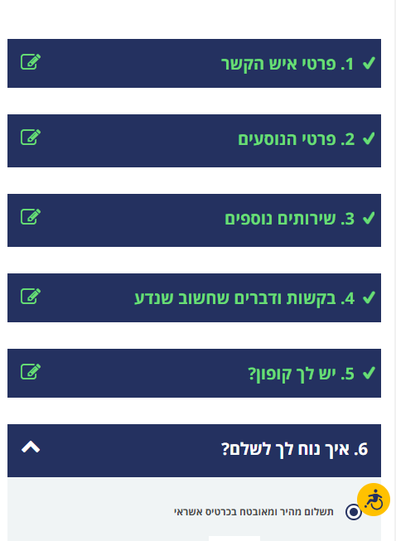
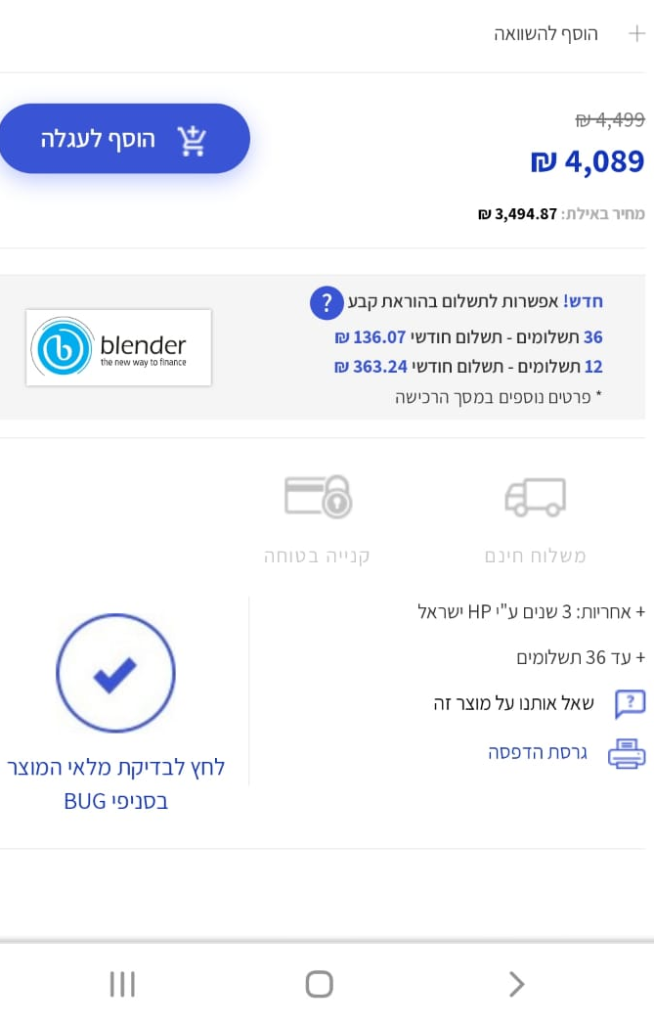
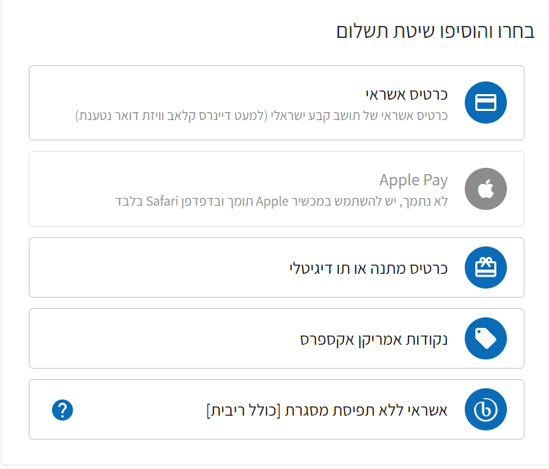
blenderPay - BNPL Market Leader
A complete and unique solution for E-commerce sites for leading brands

Slide 15
blenderCar
The fastest option for car loans in Israel and Europe
In collaboration with:
Wide selection of car dealers operate with blenderCar in Israel and Europe
Transaction authorization within seconds -no forms or paperwork!
Convenient and easy-to-use digital platform for car dealers
A unique technology with a holistic system of rapid credit evaluation and establishment
Wide installment spread tailored to the customer’s needs

Slide 16
Blender Israel: Continued growth
רווח מגזרי (אלפי ש"ח)
תיווך באשראי ומתן אשראי בישראל
Adjusted EBITDA (אלפי ש"ח)
תיווך באשראי ומתן אשראי בישראל

Slide 17
Blender Israel: Continued growth
Revenue in Israel (thousands of NIS)
Total credit portfolio (thousands of NIS)
40%
Growth
81%
Growth
PROFIT
NON-GAAP gross revenues that include interest from loans in a credit brokerage system. Financial data in NIS as of June 30, 2023.

Slide 18
Blender Israel: Increased volume of loans
Paying customers
Total loans provided (in thousands of NIS)
Consistent growth in the number of customers
33%
Growth
Loans in a credit brokerage system. Financial data in NIS as of June 30, 2023.

Slide 19
Blender Europe
Revenue (thousands of NIS)
Total credit portfolio (thousands of NIS)

Slide 20
Proven and Meticulous Credit Risk Management in a Dynamic Market with Changing Interest Rates
Proven underwriting and risk management model
Diversifying loan origination while promoting collateral based loans
Controlled and supervised lender and borrower processes
In Israel, a security fund, unique in the industry, to protect investors from borrower default and credit risk insurance for the security fund by an international insurance company
Europe
Israel
Provisions for
Credit Portfolio Balance
Interest APR
Interest APR
Failure rate
כמפורט בתקנון קרן הביטחון ובפוליסת הביטוח.
עלות ממשית- מחושבת במועד העמדת ההלוואה.
נתוני הכשל המוצגים הנם של מגזר תיווך באשראי. במגזר מתן אשראי בישראל- שיעור ההפרשה לחובות מסופקים עומד על 2.6%

Slide 21
קבוצת בלנדר – גידול בהכנסות וצמצום ההפסד
Adjusted EBITDA
קיטון של כ-79% בהפסד במחצית הראשונה של 2023
שינוי
ב-% | בש"ח | 1-6/2022 | 1-6/2023
36% | 4,689 | 12,930 | 17,619 | הכנסות ברוטו
(43%) | 4,422 | (10,244) | (5,822) | הפסד נקי מדווח
29% | 280 | 973 | 1,253 | פחת והפחתות | הוצאות/הכנסות שלא במזומן
(50%) | (224) | 448 | 224 | תשלום מבוסס מניות
- | 600 | - | 600 | הוצאות פרסום שאינן במזומן
16% | (106) | (675) | (781) | הוצאות( הכנסות) מימון נטו שאינן מיוחסות לפעילות השוטפת
- | (134) | 134 | - | הוצאות משפטיות בגין הסדר תביעה משפטית | הוצאות/ הכנסות במזומן
- | 2,440 | 183 | 2,623 | עמלות מפעילות מתן אשראי שסווגו כהכנסות נטו מראש
- | (720) | 720 | - | עלויות חד פעמיות בגין רישיון בנק בחו"ל וקו אשראי בחו"ל
- | 146 | 10 | 156 | מיסים על ההכנסה
(79%) | 6,704 | (8,451) | (1,747) | Adjusted EBITDA
נתונים כספיים באלפי ש"ח נכון ל-30 ביוני 2023;

Slide 22
אסטרטגיית פעילות 2023
ישראל כמרכז רווח:
blenderPay בשיתוף בנק הפועלים כמנוע צמיחה
המשך פיתוח מגזר מתן אשראי
גוון מקורות מימון - קווי אשראי חדשים וחיזוק פעילות התיווך באשראי
אירופה:
שימור הפעילות במדינות קיימות
מכירת טכנולוגיה:
הסכם שיתוף פעולה עם אמדוקס

Slide 23
THANK YOU

