Slide 1



When Theory
Enters Kindergarten:
Bridging the Theory-Practice Gap in teachers’ training
Notes:
Today we’ll present a research we call: When Theory Enters Kindergarten: Bridging the Theory-Practice Gap in teachers’ training

Slide 2
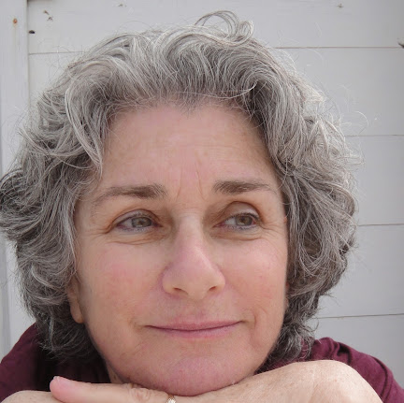
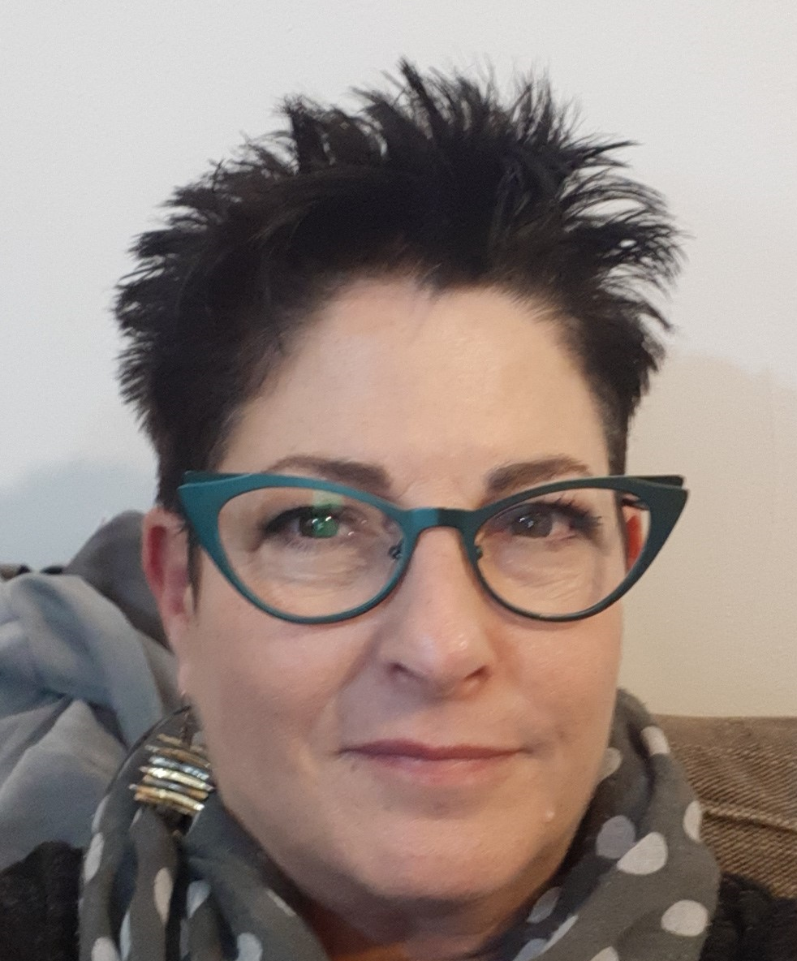
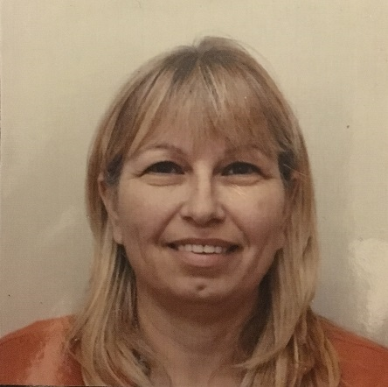

Team presenting: early childhood department
Dr. Nira Wahle
Dr. Talma Florentin
Dr. Smadar Mor
Gabriela Landler-Pardo
Kibbutzim College of Education, Israel
Notes:
And we are: Dr. Nira Wahle; Dr. Talma Florentin; Dr. Smadar Mor; Gabriela Landler-Pardo
We are from the Early Childhood Department at the Faculty of Education at Kibbutzim College

Slide 3






Practice based Theory
Dewey 1904
The Turn Towards Practice-Based Teacher Education (Grossman, Kavanagh, & Pupik Dean,2018)
Enhance Understanding, Theoretical Knowledge, and Critical Thinking Skills (Harpaz, 2016)
Notes:
Traditionally, Teacher Training has emphasized a clear differentiation between theoretical knowledge and practical knowledge.
However, a recent turn has occurred, placing greater emphasis on the application and utilization of knowledge in real-world contexts (as highlighted by Grossman, Kavanagh, & Pupik Dean,2018).
According to Harpaz (2016), when students apply their knowledge in new contexts, it enhances and deepens their understanding, theoretical knowledge, and critical thinking skills.
While the existing body of research focuses on teacher training, there is a lack of studies on kindergarten teacher training.

Slide 4
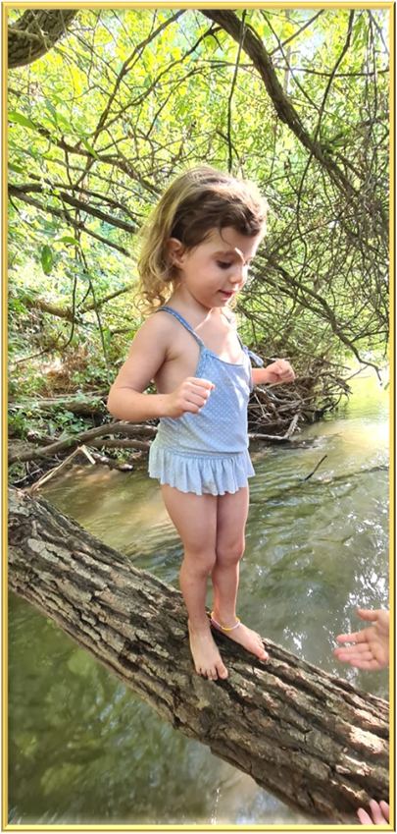

Bridging the Gap
Notes:
In an effort to bridge the gap, we have selected three courses that were previously offered at the college and transformed them into practice-based courses taught in kindergartens. Today, we will present a study that was conducted alongside these courses and highlight the key insights that have emerged from it.

Slide 5
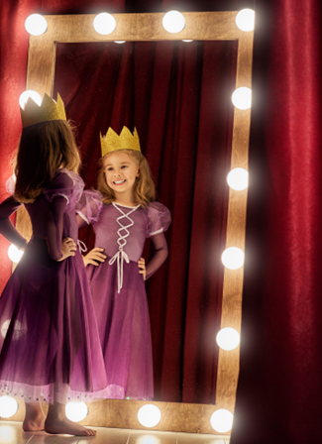
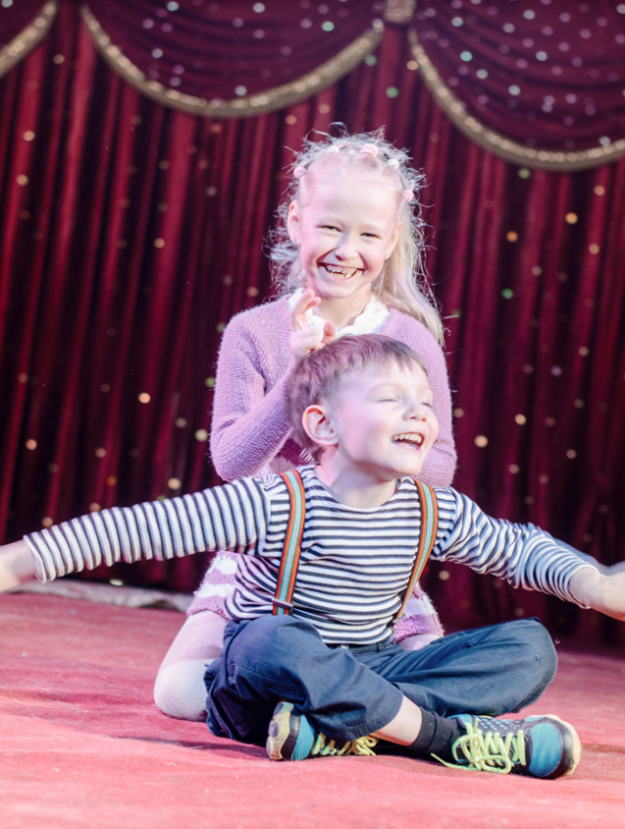


Practice-Based courses
Theatre in
Kindergarten
Development of Theory of Mind
in Early Childhood
Inclusion of Children with Special Needs
Notes:
The courses were
"Theatre in Kindergarten (+),"
"Development of Theory of Mind in Early Childhood (+)“,
and "Inclusion of Children with Special Needs” (+).
The courses were taught in complexes of kindergartens, where the students attend and experience every week as part of their Practicum.

Slide 6
Research objectives
research objective: investigate the impact of practice-based courses on nurturing understanding, meaningful learning
research question: how such integration promotes meaningful learning and effective teaching?
Notes:
The research aimed to investigate the impact of practice-based courses on fostering understanding and meaningful learning, by bridging the gap between theory and practice.
The research question explored how such integration promotes meaningful learning and effective teaching.

Slide 7
Research Methodology
Interviews with students
Interviews with lecturers
Blog &
reflctions anlisys
Notes:
The study participants were 9 students and 3 lecturers.
Open interviews were conducted with the students
and the lecturers. And,
A Blog with reflecting written posts was analyzed.
Ethical considerations were made:
Interviews were anonymous and the students were insured that it would not affect the students' grades.
Gabi Landler Pardo, who is not a member of the early childhood education department, conducted the interviews and their analysis.

Slide 8
Findings: Major Themes
Theory & Practice
Setting Impacts Process
Practice & content
Notes:
Major themes emerged from the data analysis: today we will present only 3 of them:
Theory & Practice: the teaching and learning experience
Setting impacts the learning Process: In terms of Time, Space, and Size of the learning groups
Practice and content acquiring content through practice

Slide 9

Students
Theory & Practice
Lecturers
“I've been teaching this course for many years, and I've never had such a good, exciting experience. The experience was that things were very, very connected and that the students are really learning. as if fulfilling a fantasy of how they should learn to be a kindergarten teacher.”
“I think when you see something practically in front of your eyes, you examine, you write, you come up with ideas, you wrestle with yourself with questions, it is remembered better, it is engraved. It's far more effective than just studying theory and then being tested on it.”
Na
Or
“It was great, I found myself peeling all the excess, all the unnecessary things, really coming to something very, very precise.
But, in order to deal correctly and deeply with this subject, they must come with some theoretical background”
Ni
“I think it would be much better if we study one week in college, and then come to the kindergarten just to experience. We study Theory better at the college.”
Ny
Notes:
The course, which involved student observations, facilitated a profound and accurate integration of theory and practice: (+) “I've been teaching this course for many years, and I've never had such a good, exciting experience. The experience was that things were very, very connected and that the students are really learning. as if fulfilling a fantasy of how they should learn to be a kindergarten teacher.”
As for the students, one of them said: “I think when you see something practically in front of your eyes, you examine, you write, you come up with ideas, you wrestle with yourself with questions, it is remembered better, it is engraved. It's far more effective than just studying theory and then being tested on it.”
The experience created in the course which was based on theory and experiments in kindergarten, reflected the doubts of both the lecturer and the students: (+) “It was great, I found myself peeling all the excess, all the unnecessary things, really coming to something very, very precise. But, in order to deal correctly and deeply with this subject, they must come with some theoretical background”. And the student claimed (+) “I think it would be much better if we study one week in college, and then come to the kindergarten just to experience. We study Theory better at the college.”

Slide 10

Space
Setting
“They said they preferred to study in a different kindergarten complex, because it's a much friendlier complex”
“It was a bit disappointing, because I felt that we were not part of the kindergarten routine. We were externals, sort of intruders”
S
L
“I felt that time did not allow me to teach this course optimally”
Time
“It was like this: we talked about it for fifteen minutes, then we went to see it, then came back, then talked about what happened, and so on… it's a feeling of doing. It’s Experiential learning.”
“One of the things I learned is that the 3 hours is a great gift, I didn't worry that we wouldn't get to learn all the material”
S
“What I liked so much about the structure of the course is that it's very close to how children learn in kindergarten, there is no lesson-break, lesson-break... Learning happens all the time”
Notes:
In the context of the theme “Setting affects the process," several criteria, such as space and time management, were discussed. Some of the students mentioned that they found space challenging: (+) “It was a bit disappointing, because I felt that we were not part of the kindergarten routine. We were externals, sort of intruders”.
It was also present in their dialogue with the lecturer: (+) “They said they preferred to study in a different kindergarten complex, because it's a much friendlier complex”.
The perception of time management varied among the lecturers. One of them stated: (+) ”I felt that time did not allow me to teach this course optimally”.
And the second lecturer expressed the opposite perspective: (+) “One of the things I learned is that the 3 hours is a great gift, I didn't worry that we wouldn't get to learn all the material” Furthermore, regarding time management and its impact on learning, the lecturer elaborated: “What I liked so much about the structure of the course is that it's very close to how children learn in kindergarten, there is no lesson-break, lesson-break... Learning happens all the time”.
The students’ words point out the significance: (+) “It was like this: we talked about it for fifteen minutes, then we went to see it, then came back, then talked about what happened, and so on… it's a feeling of doing. It’s Experiential learning.”

Slide 11
Practice & Content
“It was most successful. Practical and relevant to our everyday life. It was brilliant - we went to observe inside kindergartens, and then came back and reported, and talked about the issues that really concern us. It still resonates when I practice.”
Ny
Students
“The course gave me courage to instruct the children despite the difficulty. after learning and receiving knowledge, that was clear and fragmented, also macro vision and micro vision –
I did it well. I felt comfortable and the children enjoyed it. So yes, it was fruitful. It was the best!”
Tam
Notes:
The students testify that they acquired understanding and tools (practice) in the courses and were able to apply the knowledge in new contexts:
“It was most successful. Practical and relevant to our everyday life. It was brilliant - we went to observe inside kindergartens, and then came back and reported, and talked about the issues that really concern us. It still resonates when I practice.”
And another one said:
“The course gave me courage to instruct the children despite the difficulty. after learning and receiving knowledge, that was clear and fragmented, also macro vision and micro vision. I did it well. I felt comfortable and the children enjoyed it. So yes, it was fruitful. It was the best!”

Slide 12
2 models bridged the Gap
Observation-based
Activation-based
Understanding
(Harpaz, 2016)
conclusions
Notes:
The courses presented two models that bridged the gap between theory and practice:
one model was based on observations in kindergarten,
while the other involved practical activities with the children.
The study's findings indicate that the practice-based courses effectively encouraged and facilitated (+)
the understanding and application of knowledge in real-life situations.
The learning experience in kindergarten significantly contributed to this process, despite the challenges encountered, which highlighted the need for program refinement. One of the study's notable conclusion was that the courses and their teaching approach fostered a strong desire for understanding among both students and lecturers, echoing the conditions given in learning, expressed by Harpaz: Our curricula were stimulating, our teaching methods were encouraging, the learning environment was diverse and adaptable, and the physical infrastructure supported the learning process. We were thrilled to discover that the integration of theory and practice indeed led to a new level of understanding among our students.

Slide 13
Thanks!
Any questions?

Slide 14
Students
Practice & Content
Lecturers
“I was very punctual because if I didn’t, I could continue talking, and they would never enter the kindergarten classes for observations… so there is something in planning and maintaining the planning that is very, very important.”
“It was most successful. Practical and relevant to our everyday life. It was brilliant - we went to observe inside kindergartens, and then came back and reported, and talked about the issues that really concern us. It still resonates when I practice.”
Na
Noy
“The course gave me courage to activate the children despite the difficulty. after learning and receiving knowledge, that was clear and fragmented, also macro vision and micro vision – I did it well. I felt cozy and the children enjoyed it. So yes, it was fruitful. the top for me.”
“first, I instructed the students in theatre exercises. Next, I led modeling with a group of kids on those very exercises. then, the students went to various kindergartens, and applied the same activities with small groups of children. It was a gradual process.”
Tam
Sm
Notes:
בתימה זו האיזון בין הכניסה לגן = פרקטיקה, לבין לימוד התוכן - הוא הנקודה המשמעותית, לא תיאוריה ופרקטיקה אלא תוכן פרקטיקה והאופן ליישמו.

Slide 15

Surprise
Exiting the comfort zone
and meeting the field
Notes:
אחד הדברים שהשפיעו מאד על ההתקבלות של הקורסים היה ההתנגדויות של הסטודנטיות "לצאת" מה"מוכר" שהוא אזור הסמינר. (בל נשכח שזו היתה שנת הסתגלות אחרי קורונה, וסטינג חדש שלא היה מובן ואולי לא תווך מספיק)
והתובנה העיקרית מזה – שחייבים תיווך!!!
השנה השנייה טובה בהרבה, כבר רגילות למבנה, לעצם העובדה שזה בגן, ושזו הדרך.
מה שכתוב בהמשך מיותר – או צריך לכתוב בשני משפטים ולא יותר.
כפי שעלה מהנתונים - המודל הראשון נחווה על ידי הסטודנטיות כמודל נוח יותר, קל ללמידה, ומתאים יותר ללמידה בגנים. מודל זה התבסס על תצפיות בגנים, כדי "לראות את התיאוריה", אך לא דרש אותן להפעיל את הילדים בתחום שהוא חדש להן. המודל השני, דורש הפעלה של הילדים, ועל כן, מבחינת הסטודנטיות, היכרות מעמיקה יותר עימם (בל נשכח שזו היתה שנה של הסתגלות אחרי הקורונה). אין בכך אמירה לגבי יתרון של מודל אחד על השני, אך בשל הערך המוסף של הפעלת הילדים בגנים בתחום ההתמחות של המרצה, אנו משערות שבעזרת תיווך המדגיש את חשיבות הנושא, גם המודל השני יעוכל טוב יותר.
2. עולה מממצאי המחקר, כי החיבור בין התיאוריה והשטח "כאן ועכשיו" – הוא "הצורה הנכונה ללמד חינוך בגיל הרך".
יחד עם זאת עלו ממצאים שאינם עולים בקנה אחד עם תפיסה זו, למרות ההצהרה. לדוגמה, אחת התמות שעלתה היתה 'זרות' שהסטודנטיות חוו באשכול בו התקיים הקורס, כיוון שאינו האשכול בו גן ההתנסות שלהן הקבוע, ועל כן אין להן קשר רציף, מתמשך, הדוק עם ילדי הגן והגננת. בכדי ליישב את הסתירה, אנו חושבות שיכול להיות שעדיף בקורסים אלה שהתצפית/התנסות/הפעלה תתרחש בגן אחד עם גננת אחת וקבוצת ילדים אחת במהלך הקורס.
תמר: אני לוקחת משם אומץ, כי אני מרגישה שעם כל הקושי והזה וזה, עם כל הדבר הזה שחוויתי, בסופו של דבר ברגע האמת, כהוכחה לכך הפעילות שהעברתי בגן, עשיתי אותה טוב. אני הרגשתי נעים, הילדים נהנו. אז כן יש לזה פירות. אז אומץ עבורי, אחרי שלמדתי וקיבלתי דברים, ואני באמת קיבלתי דברים בהירים, באופן בהיר, ומפורקים. גם ראיית מאקרו וגם ראיית מיקרו, וגם כתבתי את זה לסמדר, אני כן מרגישה שאני יכולה להעביר פעילות תיאטרון. זה משהו... טופ של הטופ מבחינתי.
לשרטט על השקף:
מודל 1 - למידה מתגלגלת –
א. למידה תיאורטית ושיח קבוצתי,
ב. יציאה לתצפיות ממוקדות בגנים,
ג. איסוף והמשגה, סיכום של המרצה, וכן הלאה לנושא חדש.
מודל 2 – למידה מבוססת הדגמה ותיווך –
התנסות מעשית של הסטודנטיות )ללא ילדים)
הדגמה של המרצה עם קבוצת ילדים
תיווך המודלינג והשלמה תיאורטית
התנסות מעשית בהפעלת הילדים
איסוף החוויה והמשגה

Slide 16


Extra resources

Slide 17
SlidesCarnival icons are editable shapes.
This means that you can:
Resize them without losing quality.
Change fill color and opacity.
Change line color, width and style.
Isn’t that nice? :)
Examples:
Find more icons at slidescarnival.com/extra-free-resources-icons-and-maps

Slide 18
Diagrams and infographics

Slide 19
You can also use any emoji as an icon!
And of course it resizes without losing quality.
How? Follow Google instructions https://twitter.com/googledocs/status/730087240156643328
✋👆👉👍👤👦👧👨👩👪💃🏃💑❤😂😉😋😒😭👶😸🐟🍒🍔💣📌📖🔨🎃🎈🎨🏈🏰🌏🔌🔑 and many more...

