Slide 1

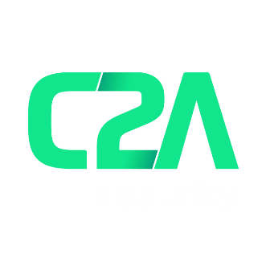
車両内、エンドツーエンド
サイバーセキュリティ
保護
Notes:
Hi, my in Nathaniel Meron and the I'm the chief product And marketing officer for C2A Security.
it’s exciting to see everyone here in Automotive World Japan, thank you for having us.

Slide 2


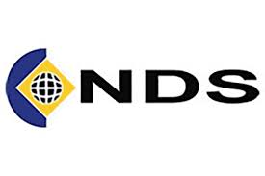
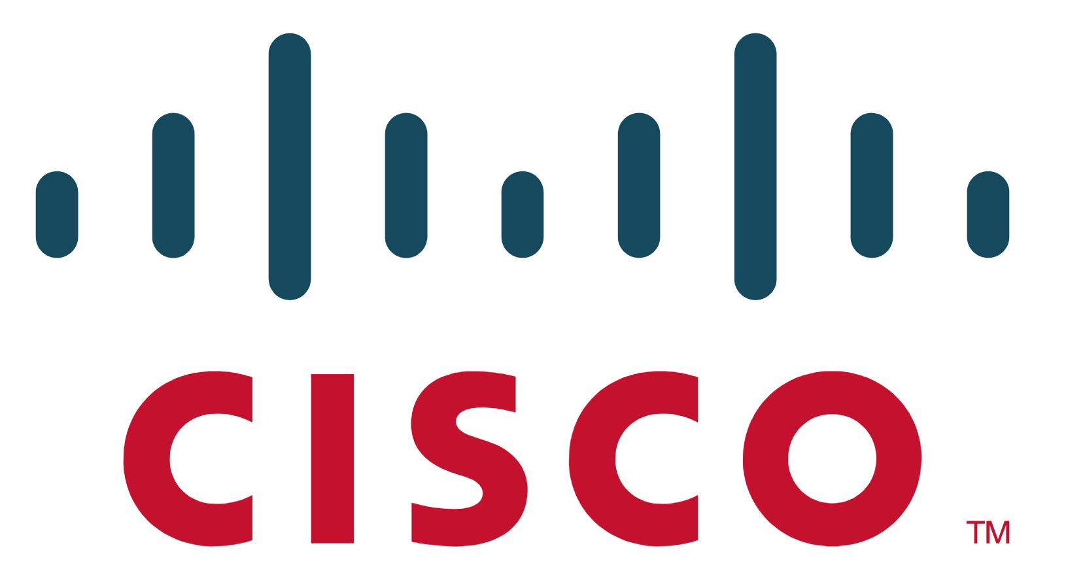
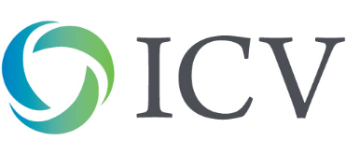
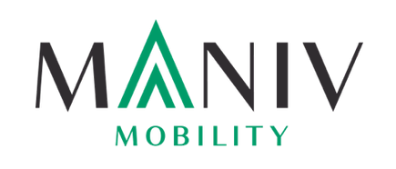





車両内サイバーセキュリティ
チーム
ファンディング
自動車業界のエキスパートと
サイバーセキュリティのプロが集結。
650万ドル
NDS共同設立者のMichael Dick（マイケル・ディックが）創業、のちシスコ社に$50億ドルで事業を売却。
主要投資家からの調達額
Notes:
C2A was founded 3 years ago, dedicated to providing end to end in-vehicle cyber security protection. We gathered a unique multidisciplinary group of people, to create a new approach for automotive cyber security. Our second funding round was led by Maniv Mobility, the leading designated VC for automotive in Israel, who chose to invest in us after a 4 year due diligence journey with countless cyber companies.

Slide 3

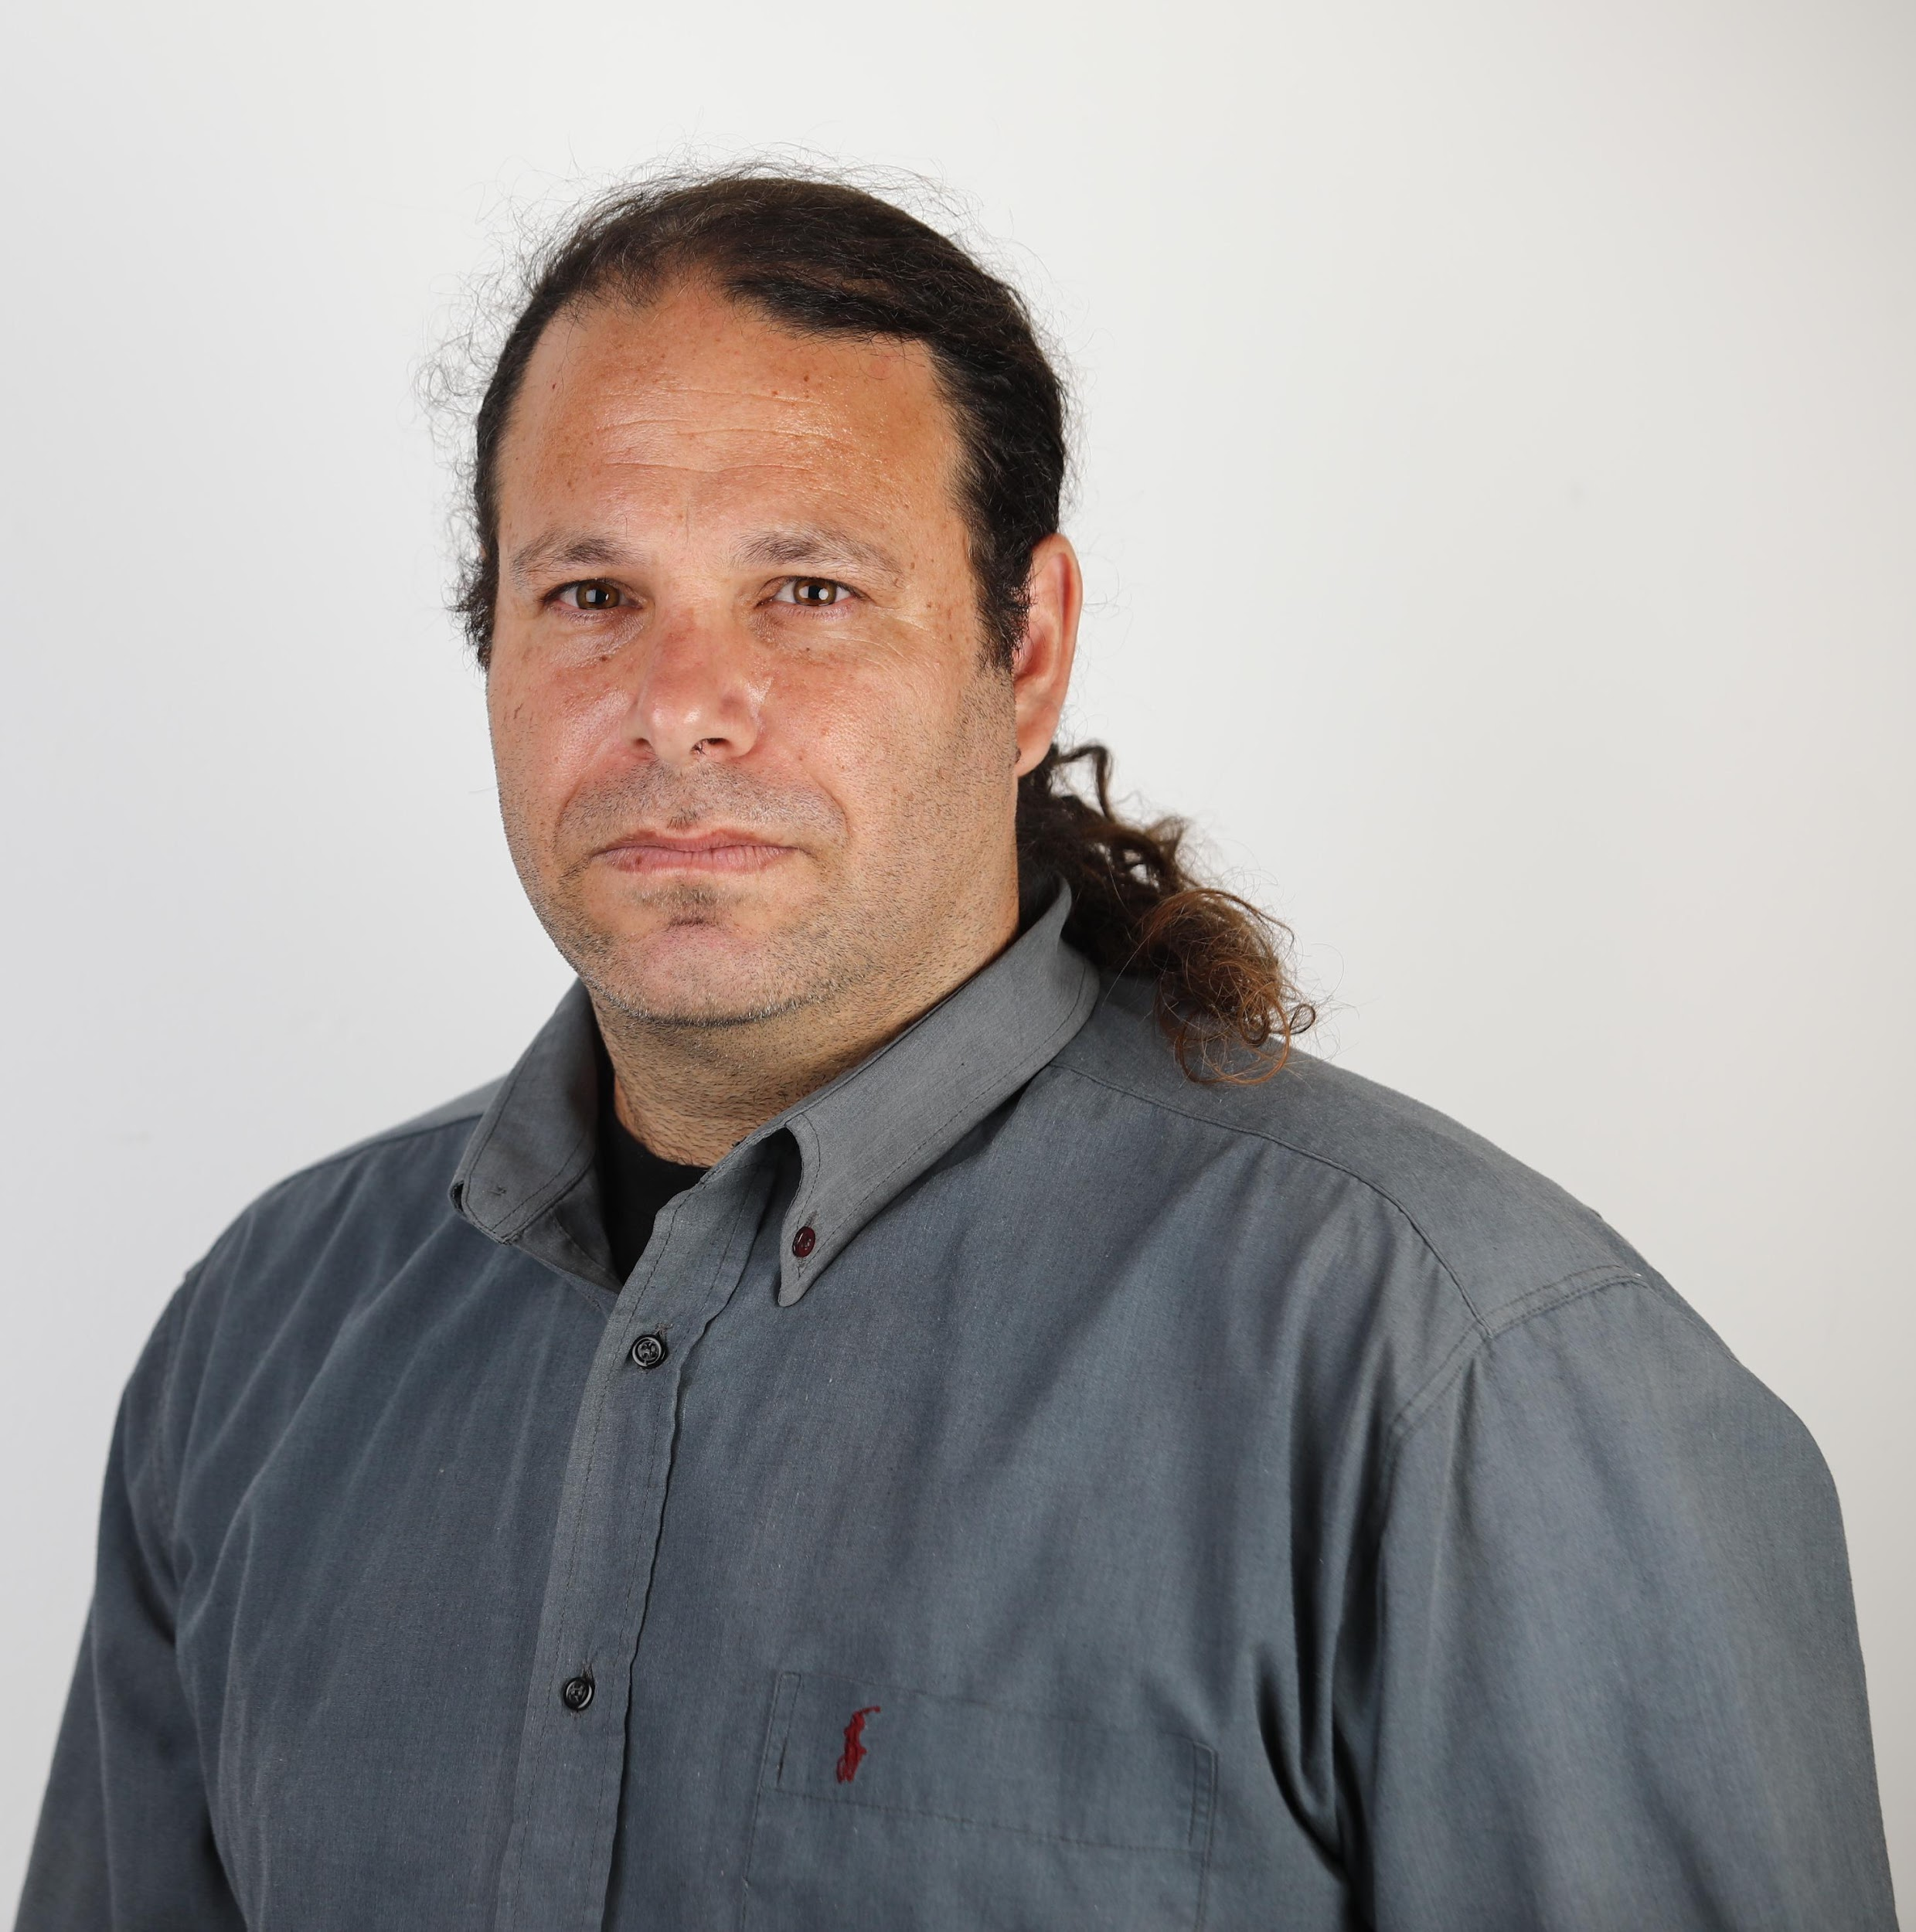



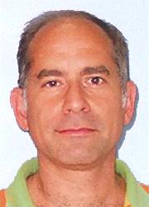
C2A LEADERSHIP
Leadership
Michael Dick
Founder & CEO
Issak Davidovich
VP R&D
Nathaniel Meron
Chief Product & Marketing Officer
Michael Dick
  Founder & CEO
  Co-Founder of NDS, Over 30 years of delivering security in large scale
Issak Davidovich
  VP R&D
  Led global automotive security at Cisco
Nathaniel Meron
  Chief Product and Marketing Officer
  Led security projects at the Israeli Intelligence
Prof. Avishai Wool
  Heading Academic Task Force - Advanced Research Lead
  World renowned cyber security expert
Frank Spitzner
  Head of Safety and AUTOSAR.
  Led AUTOSAR projects and security research at Elektrobit
Dr Aaron Naiman
  Head of Algorithms
  Over 30 years experience in applied mathematics and RT algorithms
  Co-Founder of NDS, Over 30 years of delivering security in large scale
Led global automotive security at Cisco
Israeli Intelligence veteran
Prof. Avishai Wool
Head of Academic Task Force
Frank Spitzner
Head of Safety and AUTOSAR
Dr. Aaron Naiman
Head of Algorithms
World renowned cyber security expert
Led AUTOSAR projects and security research at Elektrobit
Over 30 years experience in applied mathematics and RT algorithms
Notes:
C2A leadership is comprised of both automotive and cybersecurity veterans,
and is led by serial entrepreneur Michael Dick, embedded security pioneer and formerly co founder of NDS.
We recently revealed our Academic task force, headed by Professor Avishai Wool from Tel Aviv University, who also founded AlgoSec.
Having this unique combination of leaders allowed us to successfully tackle various automotive cybersecurity obstacles.

Slide 4
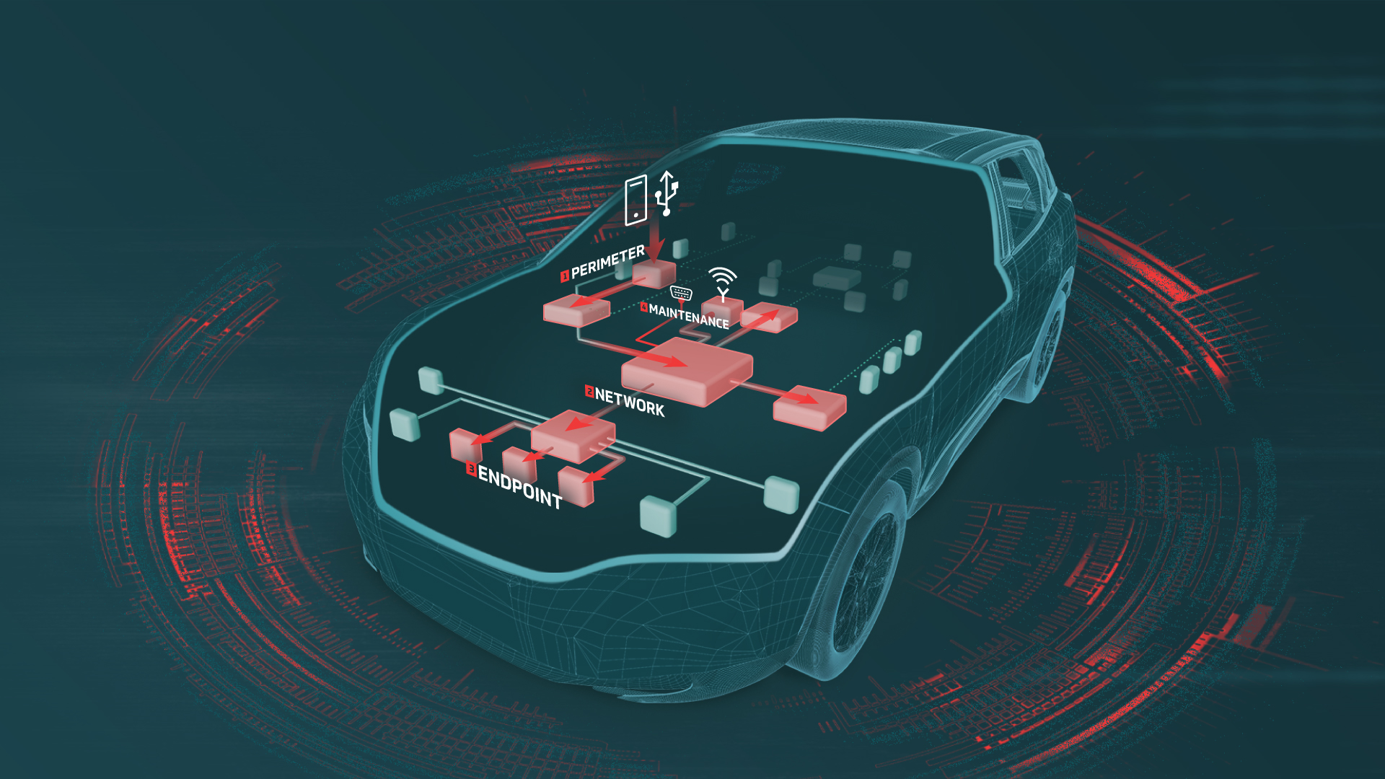
VULNERABLE VEHICLES
Notes:
Before I continue to talk about C2A, Lets understand the landscape in which we operate.
So how does a vehicle cyber attack looks like? First the attacker identify his target and tries to penetrate into the vehicle through the perimeter, abusing multimedia systems, cellular connectivity or even sensors.
Now, what he’s going to see is the vehicle internal networks. He can either attack them, or use them to spread to an endpoint. After taking control over his target, like breaks or gas ecu, or even the ADAS system, the attacker can either disable it, or push the gas pedal to 200.
Basically do anything that he wishes to with the car.
The car is no longer safe.
Last but not least is maintenance related activity. Attackers can actually update themselves into the car systems, and then have full control over them.

Slide 5




C2A 自動車へのアプローチ
信頼性と安全性
実用的な製品
マルチレイヤーのよるアプローチ
自動車に特化した保護
各種安全機能の互換性
統合が容易
性能への影響をほぼ無視できる
コスト最適化
ホワイトボックスアプローチ
セキュリティライフサイクルマネジメント
カスタマイズされた特化ソリューション
可視性とコントロール
セキュリティチームの業務を強化
同時進行のリスク評価
サイバーセキュリティのメンテナンスと配備
セキュリティライフサイクルを自前で管理

Slide 6
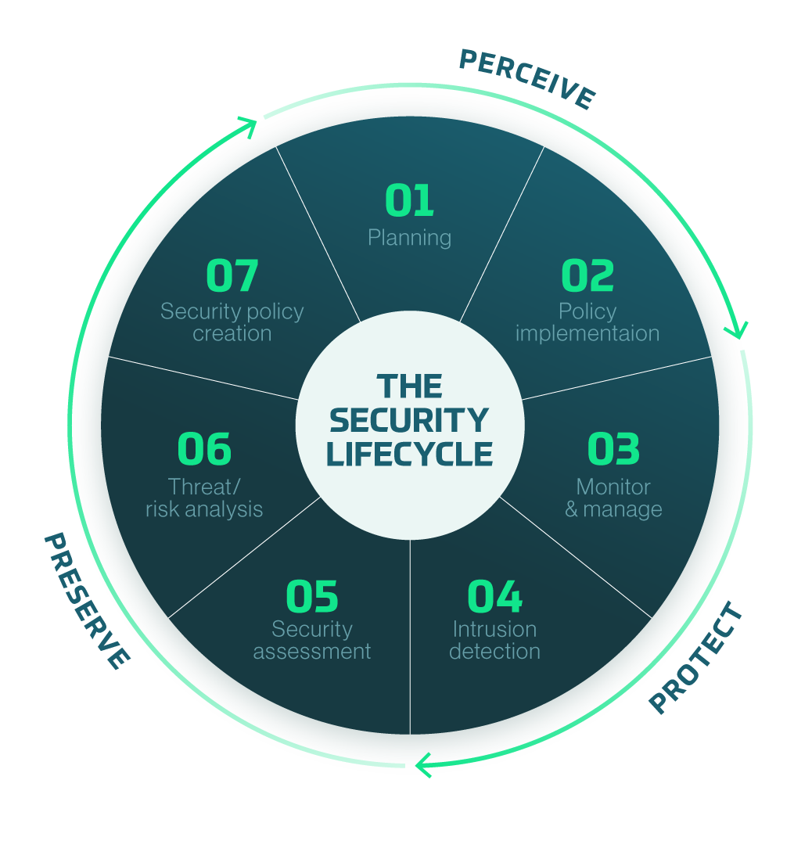
C2Aホリスティック
ソリューション – 3PS
セキュリティライフサイクルを
自前で管理 –
認識、保護、維持
Notes:
Those differences actually allowed us to create a true holistic approach for in-vehicle cyber security.
We provide OEMs and their suppliers solution from the planning phase, through the on board embedded run time security, up to the ongoing management of the vehicle's Security life cycle.
This unique approach is not applied in any cyber automotive venture, and is finally bringing the automotive industry a comprehensive security operating system.
Having this unique approach, we created the first one stop shop for In-Vehicle Cybersecurity, allowing the car manufacturers to have a safe ride.

Slide 7

PERCEIVE
Visibility across all models.
  Investigate SW and HW BOM
  System topology and resilience – understand where you are vulnerable
Analyze vehicle’s threat model
  Risk Audit
  Simulate in-vehicle components behavior
  Deduct required security features
Design and customize in-vehicle cyber security
  Deploy security where it is really needed.
  Configuration of security products

Slide 8
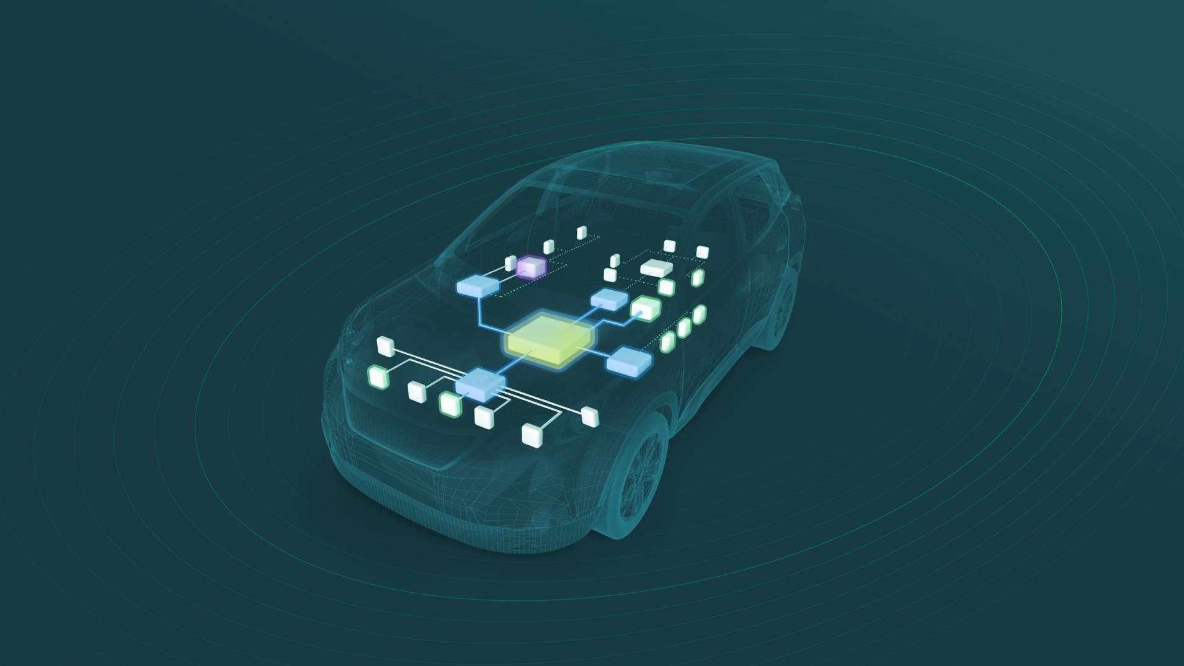

Protect
ネットワーク
車両内ネットワークのIDPSセーフガード
エンドポイント
メンテナンス
埋め込みランタイム保護、ECUでの悪意あるアクティビティを防止
車両内とエンドツーエンドでのセキュアソフトウェア診断と
メンテナンスソリューション
ペリメーター
侵入防止、CANバスアクセスでデバイスを保護
セキュリティ
ライフサイクル
マネジメント
包括的な車両内サイバーセキュリティ マネジメント プラットフォーム
Notes:
So how do we do it?
We saw that there are many different ways and steps in an automotive cyber attack, and there is no silver bullet solution to protect from all of them.
So in order to protect a vehicle effectively from cyber attack, yet practically and efficiently from the automotive industry point of view, we developed a multi-layered solution suite, that is covering all in-vehicle attack scenarios.
To manage all those products, and help OEMs to maintain and OWN the security lifecycle, We created the AutoSec platform, providing the industry one key element to control the entire security lifecycle.
With AutoSec, OEMs can easily plan, design, consume and manage all security related activity in one place.

Slide 9
PRESERVE
Perform ongoing risk assessment, quickly identify affected devices
Asset based management, designed for long product lifecycle
maintain and deploy in-vehicle cyber security
Manage all security products in one place

Slide 10
C2Aセキュリティが選ばれる理由とは？
自動車特化型アプローチ
  自動車技術の専門家として
ホリスティックなソリューション
  セキュリティライフサイクルを自前で管理
信頼性
  経験豊富なチームが、実績ある製品を提供
中立性
  製造企業とは独立。どのような業会社とも協業が可能
Notes:
Why C2A?
Because we're an automotive company creating cyber security products.
We're fluent in automotive.
We understand automotive OEM needs, and will help you through the whole security lifecycle.
In a safety first industry reliability is critical.
C2A is the only automotive cybersecurity startup with an experienced team that already delivered embedded security successfuly for mass markets. Fun fact - NDS digital solution, which was deployed on hundreds of millions endpoints, has never been hacked.
Being Neutral, we're happy to help and integrate our solutions with any of your supplies to secure your vehicles.

Slide 11
お気軽に
お問い合わせください！
nat@c2a-sec.com

