Slide 1


In-Vehicle, End to End
Cyber Security
Protection

Slide 2











IN-VEHICLE CYBERSECURITY
TEAM
FUNDING
Veteran Automotive and Cyber Security Professionals.
$6.5M
Founded by Michael Dick, NDS co-founder, acquired by Cisco for $5bn.
From Leading Investors

Slide 3
C2A Leadership
Michael Dick
  Founder & CEO
  Co-Founder of NDS, Over 30 years of delivering security in large scale
Issak Davidovich
  VP R&D
  Led global automotive security at Cisco
Nathaniel Meron
  Chief Product and Marketing Officer
  Led security projects at the Israeli Intelligence
Prof. Avishai Wool
  Heading Academic Task Force - Advanced Research Lead
  World renowned cyber security expert
Frank Spitzner
  Head of Safety and AUTOSAR.
  Led AUTOSAR projects and security research at Elektrobit
Dr Aaron Naiman
  Head of Algorithms
  Over 30 years experience in applied mathematics and RT algorithms

Slide 4
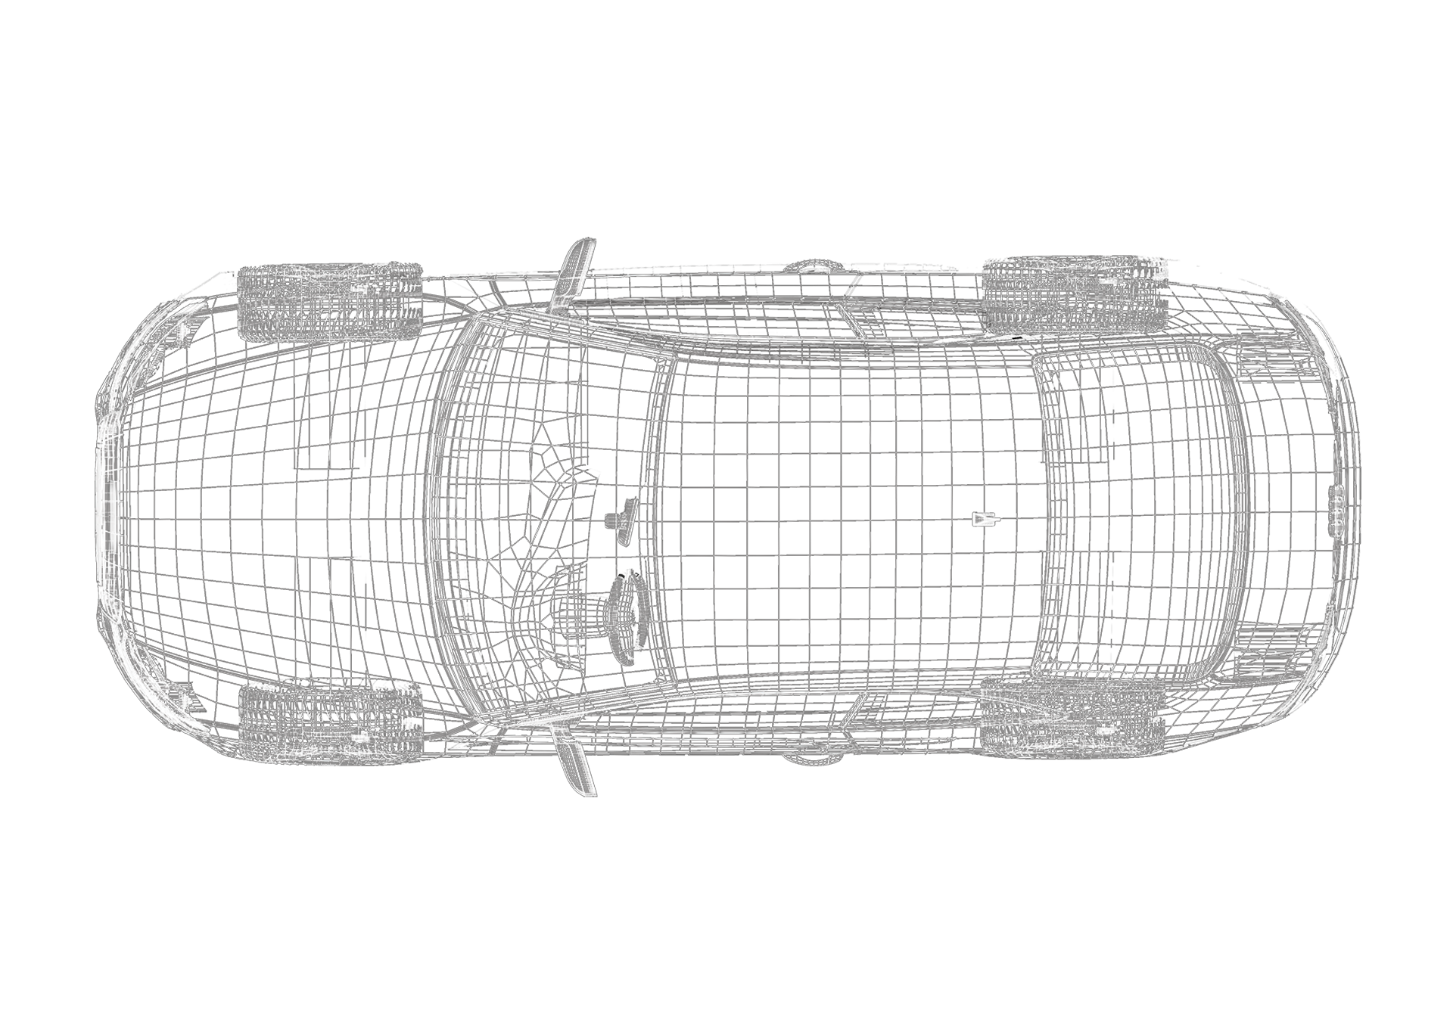
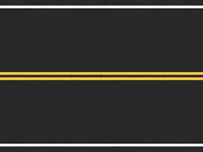
Vulnerable Vehicles
Perimeter
Maintenance
Network
Endpoint

Slide 5




C2A AUTOMOTIVE APPROACH
Reliability & Safety
Practical products
Multi-layered approach
Automotive-relevant protection
Safety compatibility
Easy to integrate
Negligible performance impact
Cost-optimized
Whitebox Approach
Security Lifecycle Management
Bespoke solutions
Visibility and control
Empowering security teams
Ongoing Risk Assessment
Maintain and deploy cybersecurity
Own the security lifecycle

Slide 6
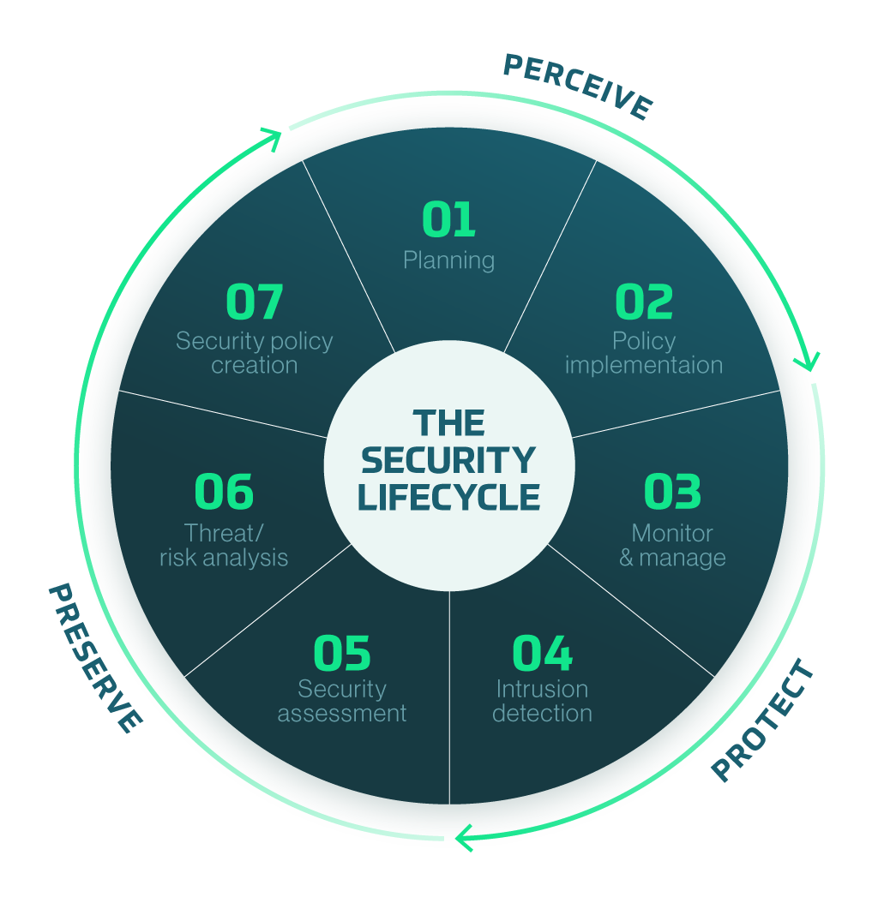
C2A HOLISTIC
SOLUTION – 3PS
Own the security lifecycle –
Perceive, Protect, Preserve

Slide 7
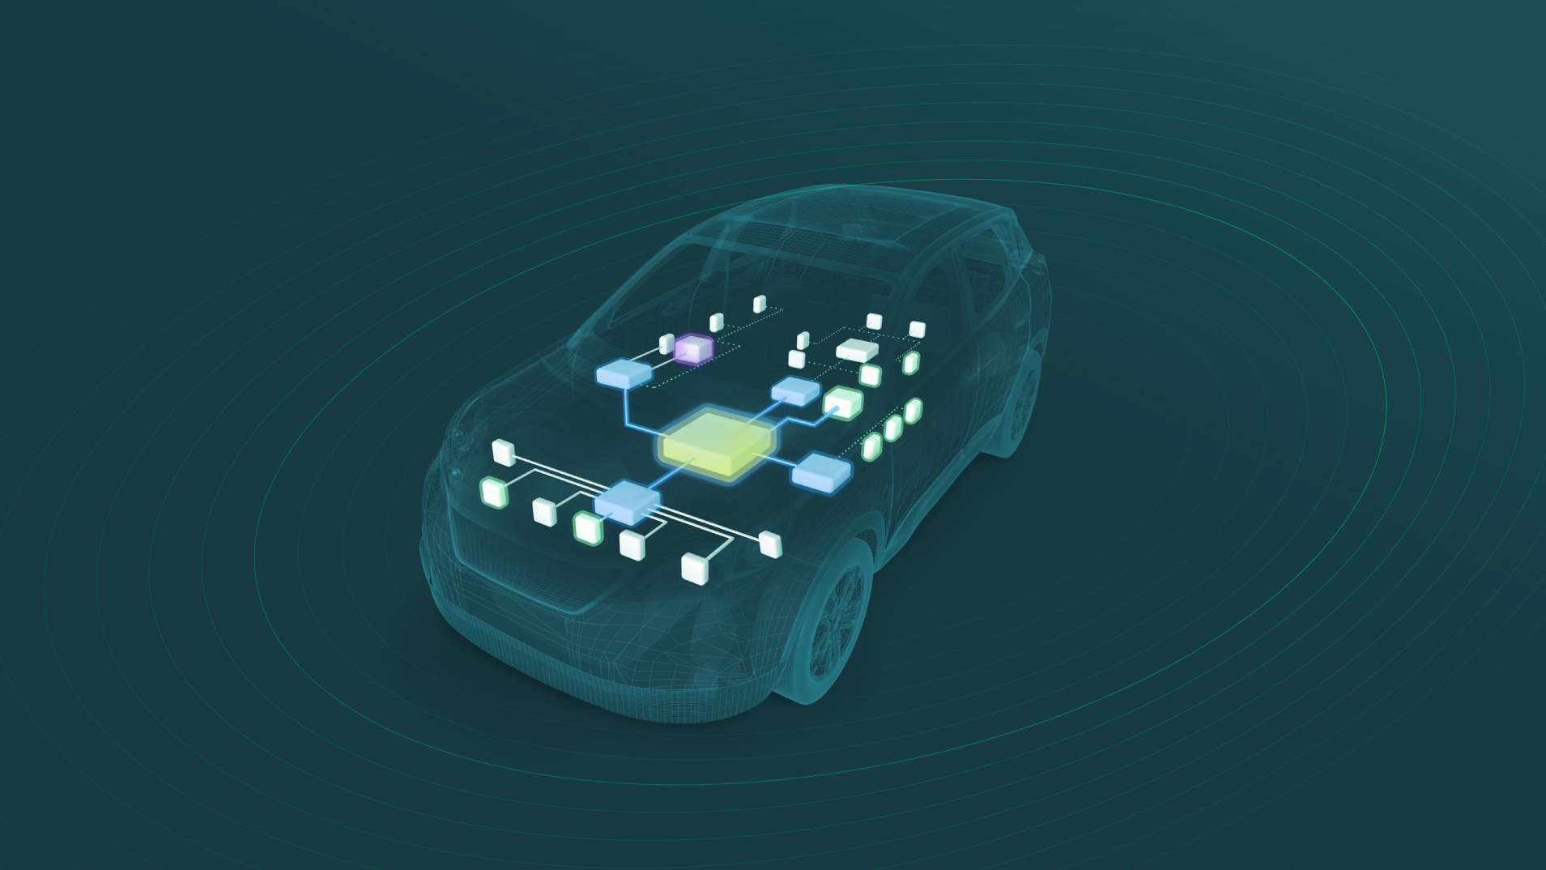

C2A Products
Network
IDPS safeguarding In-Vehicle Networks
Endpoint
Maintenance
Embedded runtime protection, preventing malicious activity at ECU
In-vehicle end-to-end secured software diagnostics and maintenance solution
Perimeter
Penetration prevention, securing devices with CAN bus access
Security
Lifecycle
Management
comprehensive in-vehicle cyber security management platform

Slide 8
Why C2A Security?
Automotive approach
  We’re fluent in automotive
Holistic Solutions
  Own the security lifecycle
Reliability
  Experienced team, delivering proven products
Neutral
  Not affiliated with any manufacturer, can work with everyone.

Slide 9
Contact us!
nat@c2a-sec.com

