Slide 1

Cybersecurity basics training

Slide 2
We all play a critical role in cybersecurity
Notes:
https://web.microsoftstream.com/video/ece97e5b-bfb9-4c20-9d8d-44be52327db1?list=studio

Slide 3
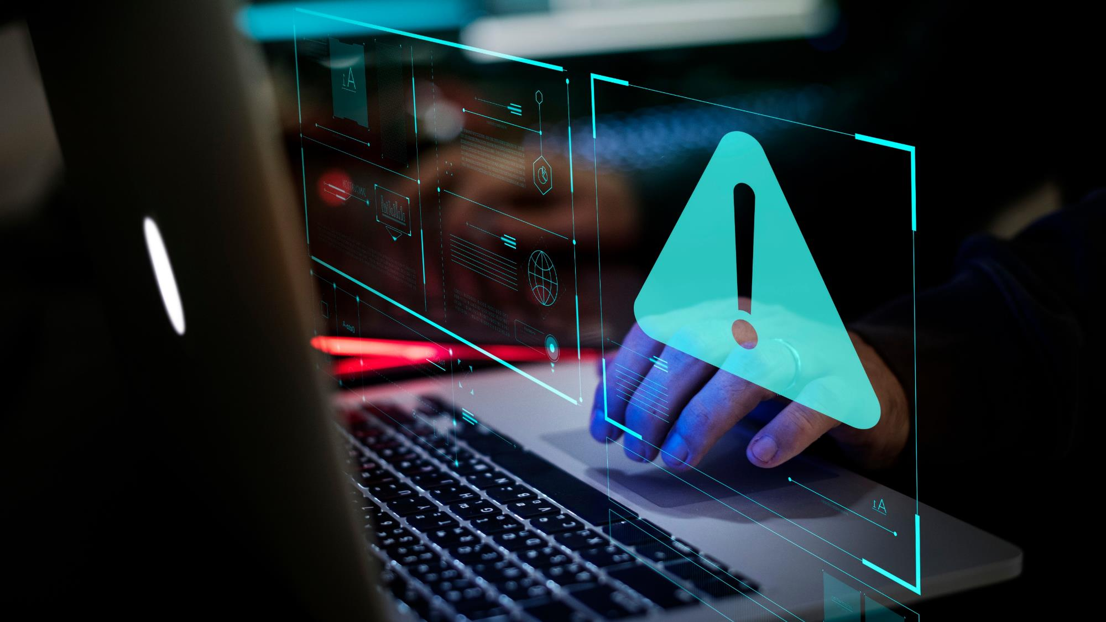
In this training you will learn how to recognize and combat cybersecurity risks to better protect yourself and KONE against hackers and cybercriminals.

Slide 4
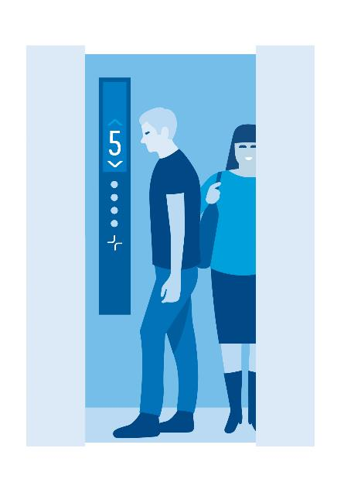
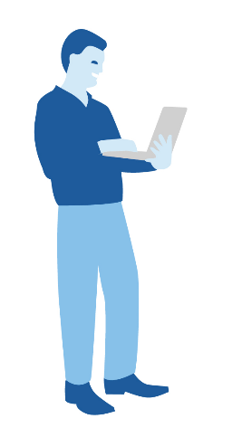


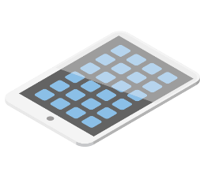
The key cybersecurity elements in your daily work
Secure ways of working
Acting cyber smart in the physical world
1
2
3
Using devices in a secure way

Slide 5
The key cybersecurity elements in your daily work
Secure ways of working
Acting cyber smart in the physical world
1
2
3
Using devices in a secure way

Slide 6

Cybercriminals want our passwords so they can steal information or our identities.
With access to your account a hacker could impersonate you
- for example, send emails in your name.

Slide 7

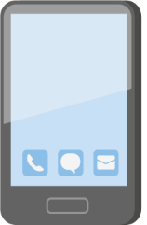
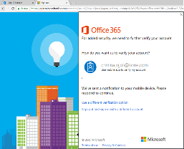

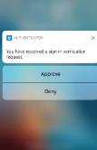
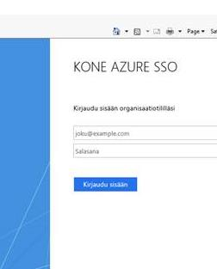
Passwords protect your digital identity
Digital identities, such as KONE user ID,
are used to identify us online.
Different passwords for each account ensure that if one password is stolen, your other accounts are still safe.
Using a password manager application (e.g., KeePass) is a good way to help manage multiple passwords.
Example of a strong password: Swim1!Sleep2Repeat5​
Never use your KONE password or email address for private purposes (social media, personal email, etc.)!
Never share your passwords with anyone!

Slide 8


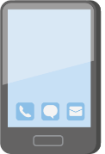
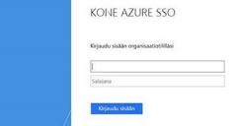


Monitor your accounts
Enable a 2-factor authentication for apps and accounts whenever possible – recommended also for apps in personal use. Even if someone learned your password, you can reject their attempt to access your account!
Also enable alert notifications for devices and online services regarding logging activity. This way you get notified if someone else has tried, or managed, to login to your account.
These features are available with most email, social media, payment and banking accounts, and other platforms!

Slide 9
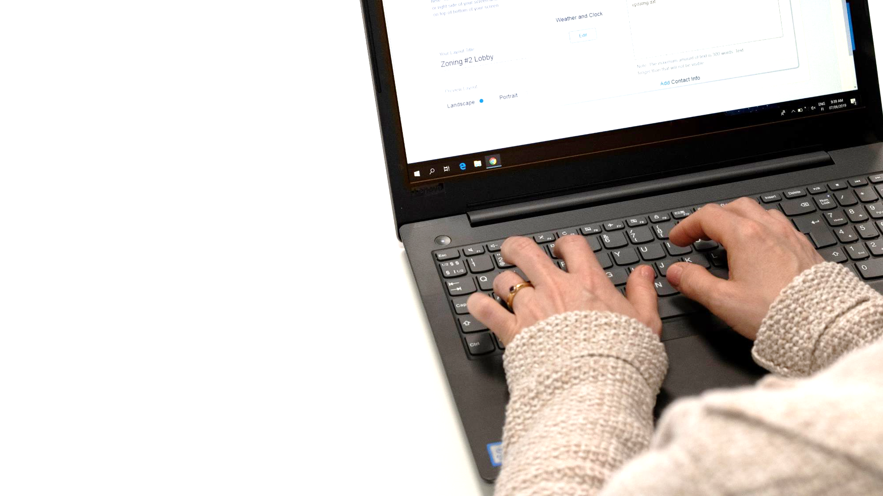
Email is the most popular tool for stealing credentials, installing malicious software, or locking up information in a ransomware attack.

Slide 10
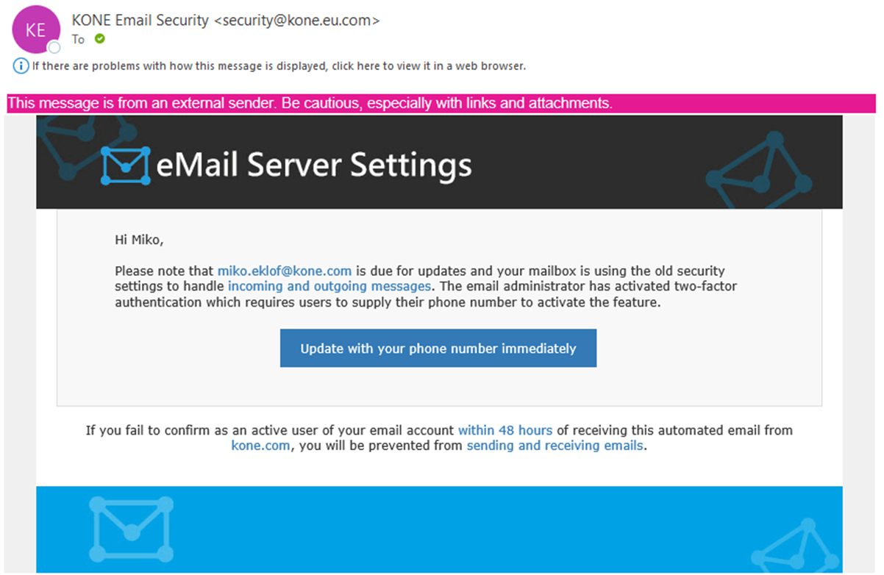

Learn to spot a scam
Check the email address
See if the email looks somehow suspicious or different than normal
If you’re asked to do something unexpected, think twice
Hover your mouse over a link. If the address looks strange, don’t click
If you suspect email scam, report it immediately to KONE cybersecurity team for further investigation by clicking the email reporting button in Outlook
or sending it to Ask IT! Do not
open any attachments or
links, or reply to the email

Slide 11
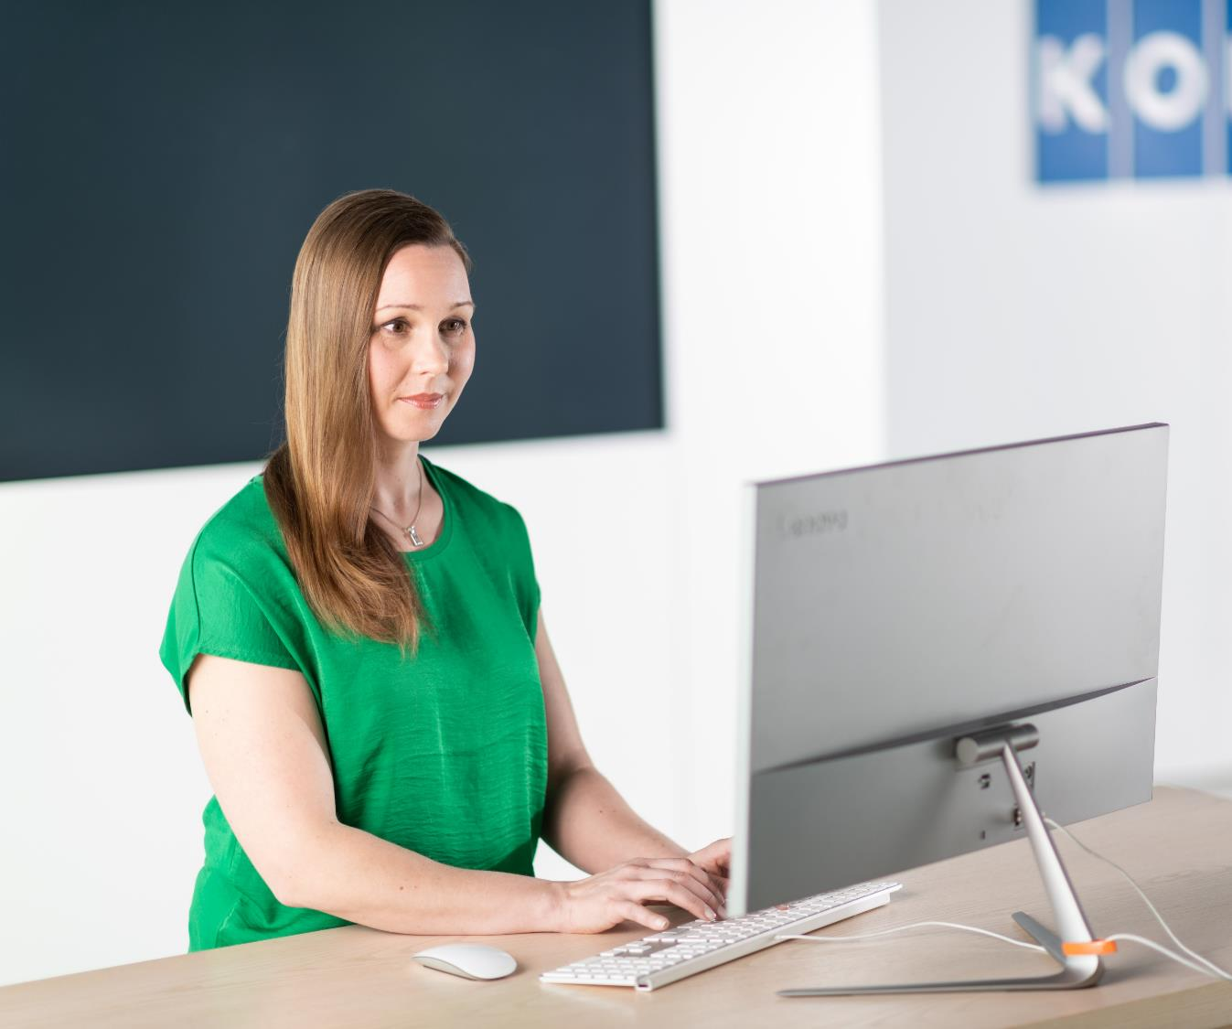
Even clicking once on a bad link can download malware (a malicious computer program) onto your computer.

Slide 12

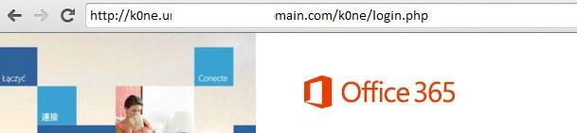
Check your links before you click
This web address looks safe. It points to a well-known location in
KONE SharePoint.
The lock icon and https on the URL bar indicate a more secure website.
The URL says k0ne instead of kone. This is a credential harvesting site set up to trick users.

Slide 13

Classifying your documents ensures that secrets remain as a secret.

Slide 14

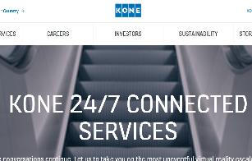
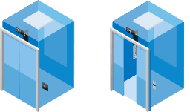
Classify wisely
Highly sensitive, business-critical or otherwise invaluable information require stronger protection than information that can be shared with a wider audience.
Information classification guides us how to store and share materials in a proper way.
Public information is available for everyone...
...but new innovations must be kept secret!

Slide 15
Classification policy
Secret
Confidential
KONE Internal
Public
Insider information, business-critical information, privileged or confidential legal communications, and other information of highly sensitive and restrictive nature.
Can be accessed only by the owner of the information and persons individually authorized by the owner.
If lost or made public, would cause significant financial loss and damage to KONE’s reputation and could have a serious impact on KONE’s critical functions, workforce, business partners and/or customers.
Information related to specific roles within KONE. Information of a more restrictive nature limited to those with a business need-to-know.
Can be accessed by
authorized readers only.
If lost or made public, could potentially cause financial loss or damage to KONE’s reputation, critical functions, workforce,
business partners
and/or customers.
Default classification for information unless specifically classified otherwise. Information of general internal business nature typically produced in day-to-day business operations. Intended for KONE internal use only.
Can be freely distributed within KONE, and to KONE partners subject to appropriate confidentiality undertakings
or agreements.
Distribution of information to
other parties would likely cause inconvenience to KONE but is unlikely to result in financial
loss or serious damage
to KONE’s reputation.
Information of non-sensitive nature. Can be freely distributed also outside KONE.

Slide 16
Classification policy
Secret
Confidential
KONE Internal
Public
Examples:
M&A related documents
Early phase product development related content
Financial results before publishing
Communication about an
injury or potential claim
or legal dispute
Any insider information
Examples:
Management team
meeting minutes
Steering group materials
Employee records and other individual targets and plans
Project financials
Examples:
Intranet content
Newsletters
Project updates & schedules
IT tools instructions
Examples:
Published financial results
Marketing materials,
KONE profile

Slide 17
Ways of working: Test your knowledge 1
A good password is…
Easy to remember – preferably the same that you are using for all your accounts.
Unique and minimum 14 characters.
So complex that you need to write it down to remember it.

Slide 18
Ways of working: Test your knowledge 2
You receive an email which looks a bit weird. What should you do?
Reply to the email and tell the sender that her/his account may be stolen.
Open one of the links in the email and check if it opens a familiar page.
Report the email immediately to the Cybersecurity team or Ask IT.

Slide 19
The key cybersecurity elements in your daily work
Secure ways of working
Acting cyber smart in the physical world
1
2
3
Using devices in a secure way

Slide 20
The key cybersecurity elements in your daily work
Secure ways of working
Acting cyber smart in the physical world
1
2
3
Using devices in a secure way

Slide 21


The devices and software we use for our work are as secure as the weakest link.

Slide 22

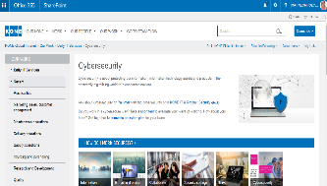


Access KONE data only with secure devices
KONE PCs are protected with security measures and other devices need to be enrolled in a mobile device management solution to gain full access to KONE applications and data.
External employees cannot enroll their computers into Intune. Instead, they are advised to use a KONE PC or a Virtual Desktop (VDI) solution.
Ask IT will support with these arrangements.
Devices, such as USB drives, may carry malware. Connecting unauthorized devices to KONE’s internal network may infect or even take down the whole network.
If you see a suspicious looking device, report it!

Slide 23





Check your mobile device’s security settings
Enable mobile device encryption and activate a passcode. The passcode should be at least 6 digits with no sequential or repeating numbers.
If you lose your mobile device containing access to your KONE email and social media apps, remotely wipe the device and change the password on all affected accounts.
Also, before giving away your mobile device, reset it to factory settings.
If your mobile device is enrolled in the Intune Company Portal, some security settings will be automatically on. Additionally, for some devices, Ask IT may be able to wipe the device when requested.
Set an inactivity timer so that your device will be locked latest after 5 minutes of inactivity.
Always apply updates to applications and the operating system immediately when available.
Only use official application stores such as AppStore or Google Play – Do not install programs from unknown sources.

Slide 24




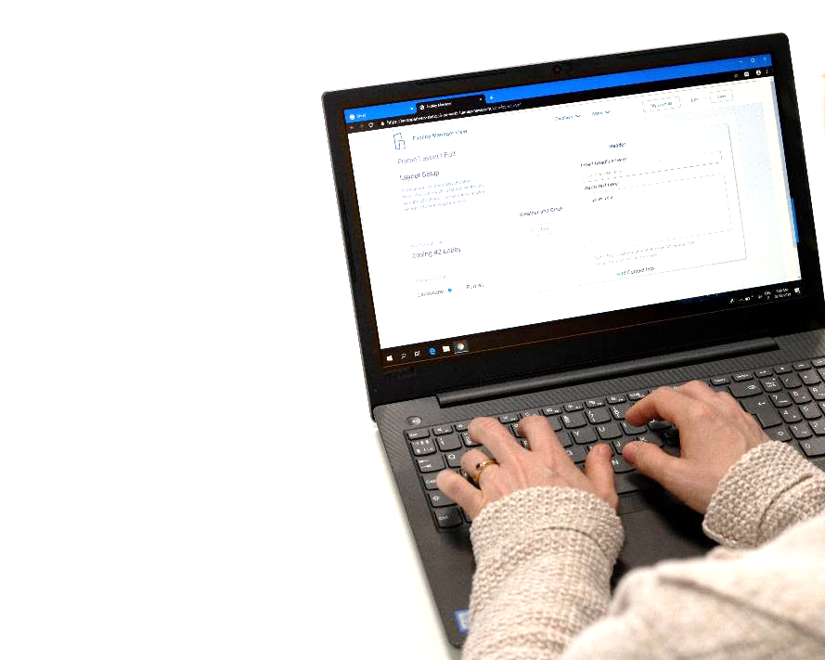







Use appropriate and agreed applications and services
Always prefer KONE's own applications: Office 365 and other solutions mentioned on the KONE intranet, or available in the Ask IT portal / Intune Company portal.
Installing programs and apps only from official web sites and app stores reduces the risk of malicious software or licensing issues. Some programs may have
costs or restrictions if installed on corporate device.
Do not install programs from websites that seem the slightest bit suspicious!

Slide 25




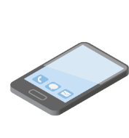
Keep your devices and software up to date
In addition to new features, updates often also include fixes to found vulnerabilities. Therefore, it’s important to always use the latest versions.
Keeping operating systems, browsers, antivirus programs and other software updated helps avoid virus infections and other threats that can harm your device.
You can set most programs, applications, and systems to do this automatically.
KONE IT installs security and other important software and system updates automatically on your KONE PC – and informs you if your actions are required. Don’t delay them!
Applications on mobile devices enrolled in KONE Intune are automatically updated by KONE IT in the background

Slide 26
Using computer and other mobile devices in a secure way: Test your knowledge 3
The mobile phone you are using for work purposes sends a notification that there is a new software update available. You will…
...postpone it as long as you can. The software updates always take so much time.
...install the update during the same evening.
...do not do it at all since something may change and you don’t like changes.

Slide 27
The key cybersecurity elements in your daily work
Secure ways of working
Acting cyber smart in the physical world
1
2
3
Using devices in a secure way

Slide 28
The key cybersecurity elements in your daily work
Secure ways of working
Acting cyber smart in the physical world
1
2
3
Using devices in a secure way

Slide 29

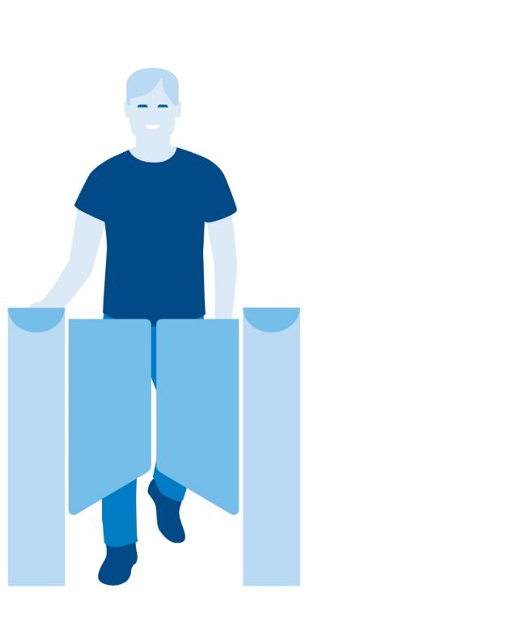

Be aware of tailgating
Only you can use your workplace access key. If someone tries to follow you to KONE premises, ask for identification. Escort unauthorized personnel
to the reception.
For example, you could say:
“Sorry, this area is for KONE employees only. May I see your badge?”
“I work in the marketing team, what team do you work in?”
“Please wait in the reception until your host arrives.”
Authorized personnel only

Slide 30

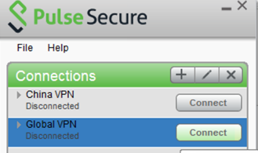
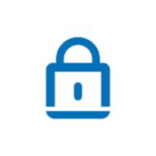
Make secure connections
If you use an unfamiliar wireless network, you risk data being intercepted and stolen.
Wireless networks provided by hotels, meeting centers and other business-oriented locations are usually relatively safe. Check the appropriate name of the network and exact login procedures with staff to ensure that a network is legitimate.
If you don’t have a secure connection available, avoid transmitting any sensitive data or making monetary transactions.
Use a Virtual Private Network (VPN) to add a layer of encryption and security when you connect your KONE PC to a non-KONE Wi-Fi.
You can also use your mobile phone as a Wi-Fi hotspot for sensitive transactions but be aware of possible additional costs.

Slide 31
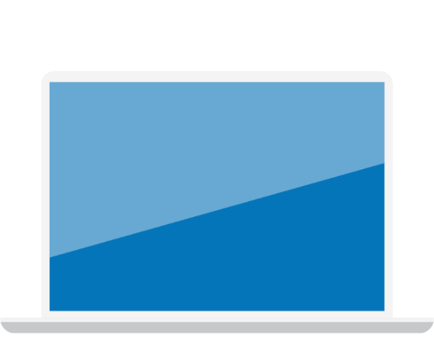
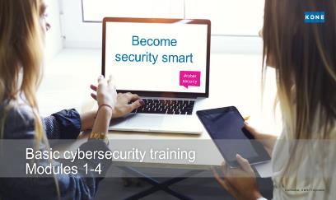
Be smart with your devices
Don’t use publicly accessible computers in hotel business centers, libraries, and cyber cafes for working - they are not safe.
Take care of your phone and laptop. If you must leave your devices unattended, lock the devices or shut them down. When travelling, use a hotel safe if available.
Always use cloud services for storing your files, instead of having them just on your device. All KONE accounts have access to OneDrive for Business cloud storage.
Use a screen privacy filter to keep your screen for your eyes only.

Slide 32
Acting cyber smart at the office and remotely:
Test your knowledge 4
You are working at home and suddenly your home wi-fi disconnects. You have an important meeting starting soon. You...
...check the list of available networks and notice that there is some other open wi-fi that you can connect.
...switch to your mobile phone hotspot.
...run to the cafeteria nearby and connect to their wi-fi.

Slide 33

Key takeaways and additional information

Slide 34

In case of emergency:
Disconnect the infected device and change passwords
If you suspect there might be malware or a virus on your device, it’s vital that you make sure it doesn’t spread to other devices at work or at home.
Disconnect the infected device from the internet and KONE’s network by removing the network cable, turning off Wi-Fi, and powering off the device.
Any internet services you have accessed using the infected device may be compromised, including the passwords for accounts (KONE account, social media, emails). Change those passwords.
It is critical that you also contact Ask IT. Timely reporting allows our Cybersecurity team to limit any further damage or loss of data.

Slide 35
Reporting channels for cybersecurity issues
If the issue is related to email
E.g., emails with suspicous
content, attachments or links
Report it through the
HoxHunt icon in Outlook
If the issue affects KONE customers
E.g., issues with KONE
services or solutions
Send an email to security@kone.com
For all other
cybersecurity issues
Report it through
ASK IT
If you suspect signs of fraud or an attempt of such
Also send an email to compliance@kone.com

Slide 36

Key takeaways
1
2
3
Secure ways of working
Using devices in a secure way
Acting cyber smart in the physical world
Passwords
Create strong and unique passwords and never share them with anyone or write them down on a paper.
Account
Be the only one who uses your accounts and enable a 2-factor authentication whenever available.
Emails & links
When unsure, don't click. Report suspicious emails immediately via Hoxhunt or to Ask IT.
Information classification
Mark emails and documents needing most protection as “Secret” or “Confidential”.
Devices
Use only secure devices to access KONE data and applications.
Updates
Keep your devices and applications up to date and secure.
Back-ups
Back-up important information
by preferring cloud storage
over local devices.
At the office
Remember - only you can
use your workplace access key.
When working remotely
Use safe wireless networks and connect through a
Virtual Private Network (VPN)
to add a layer of security
when using non-KONE Wi-Fi.
In case something goes wrong, report it immediately to Ask IT to limit further damage or loss of data.

Slide 37
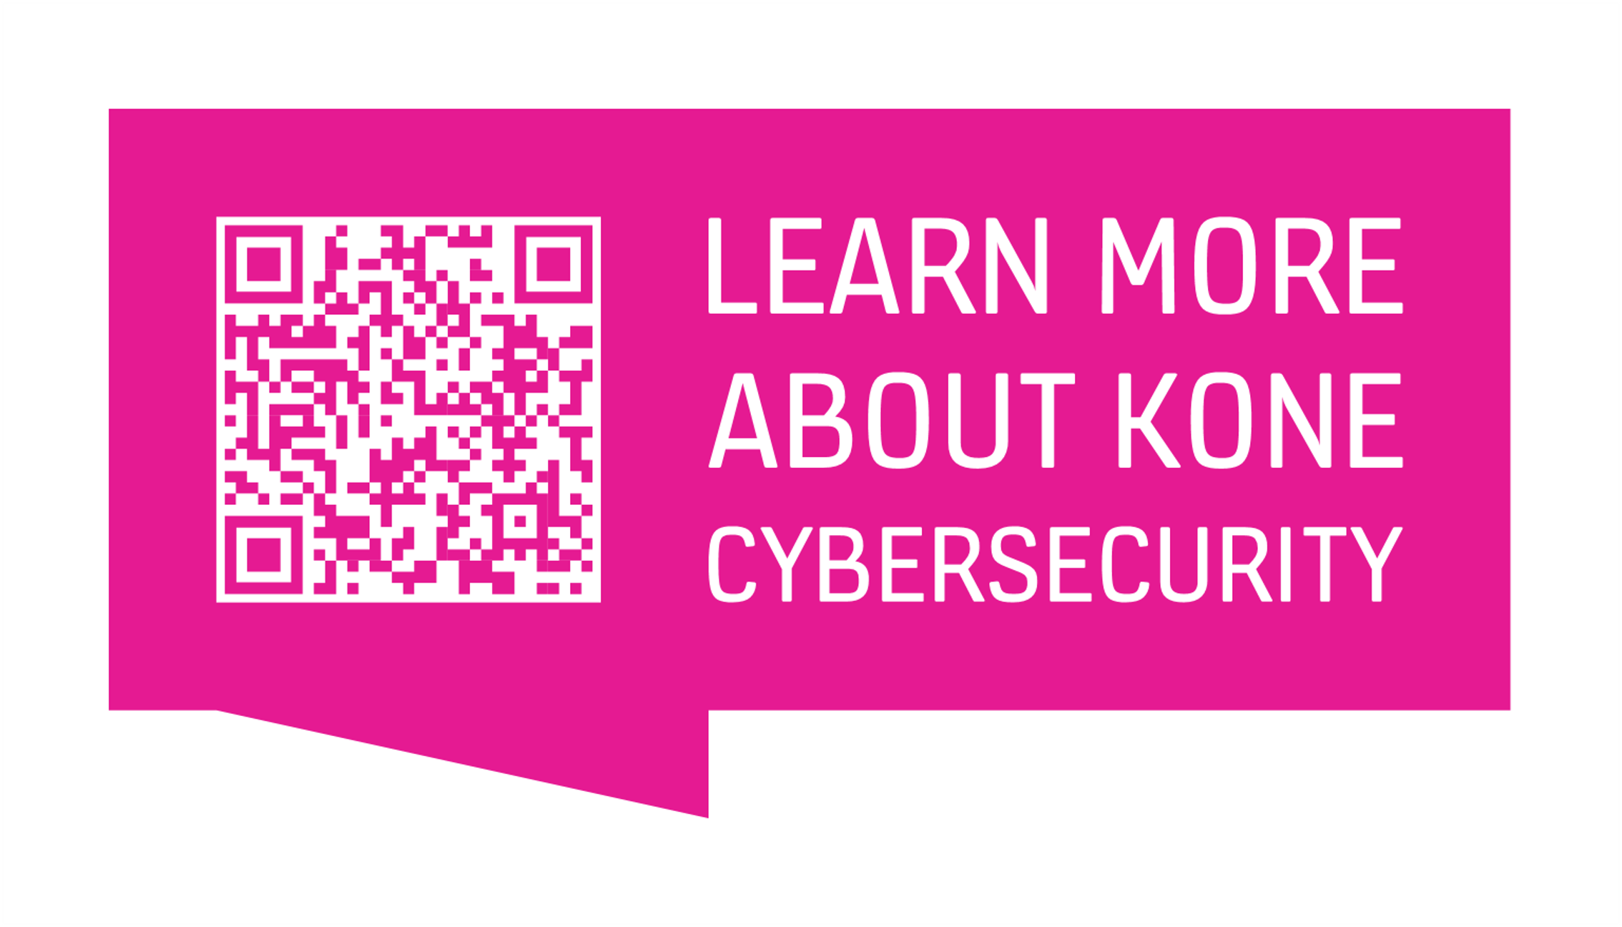
LEARN MORE ABOUT KONE CYBERSECURITY

