Slide 1
CROSS BORDER
E-COMMERCE
LOGISTIC
SAAS PLATFORM
Confidential – This presentation includes proprietary information. All rights reserved © 2016-2018 www.exelot.com

Slide 2
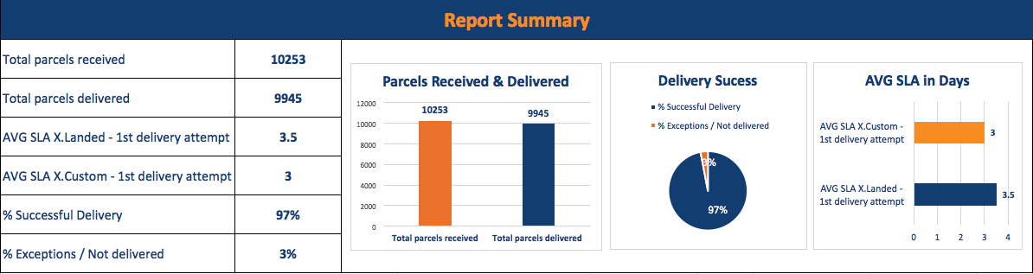



Vision
Connecting e-shops & logistic vendors
for a best cross border e-commerce solution
2

Slide 3
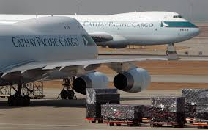

Exelot – Answering Global Logistics Needs
We answer 3 essential needs in e-commerce logistic world:
Connection: Finding reliable providers especially in the last mile
2) Trust: Verifying transaction of shipments at each point with full trust
3) Time & Price: Optimizing logistics channels to cut down time and costs
Post Couriers
3

Slide 4
Need & Solutions
Connecting logistic providers and retailers with cross border customs & last mile delivery:
Physical stores move to online: Logistic companies need to serve them to cross border
2) Countries dictate different regulation (VAT, Customs duty) with many last mile companies
3) Postal slow or inconsistent in many countries / too expensive with couriers (Fedex / DHL)
5

Slide 5

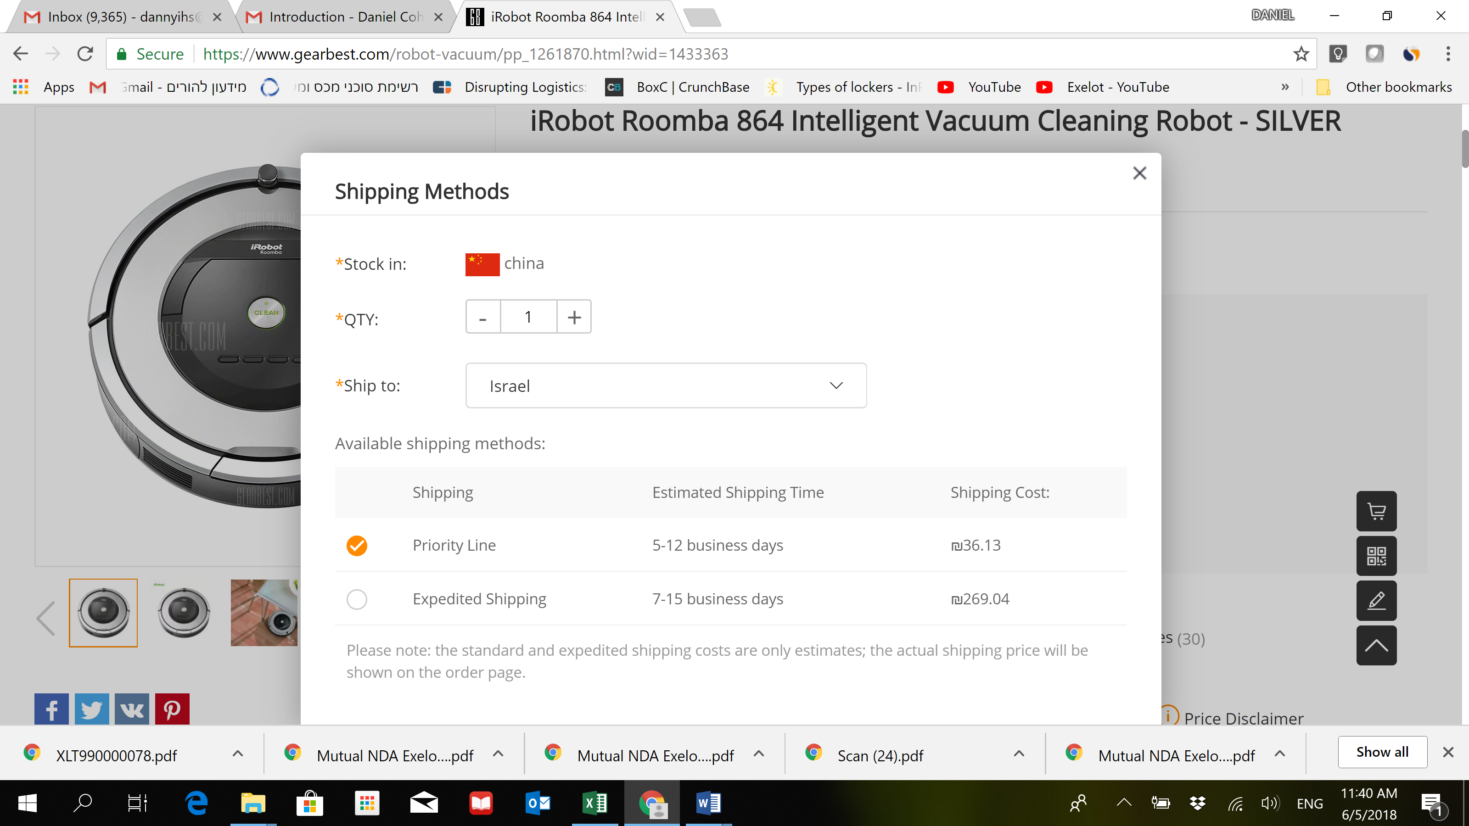
Exelot – Embedded Option in e-Commerce Shops
15

Slide 6
2-5 Days Fulfillment & Delivery in Cross Border
for AliExpress Suppliers in Cyprus
16

Slide 7
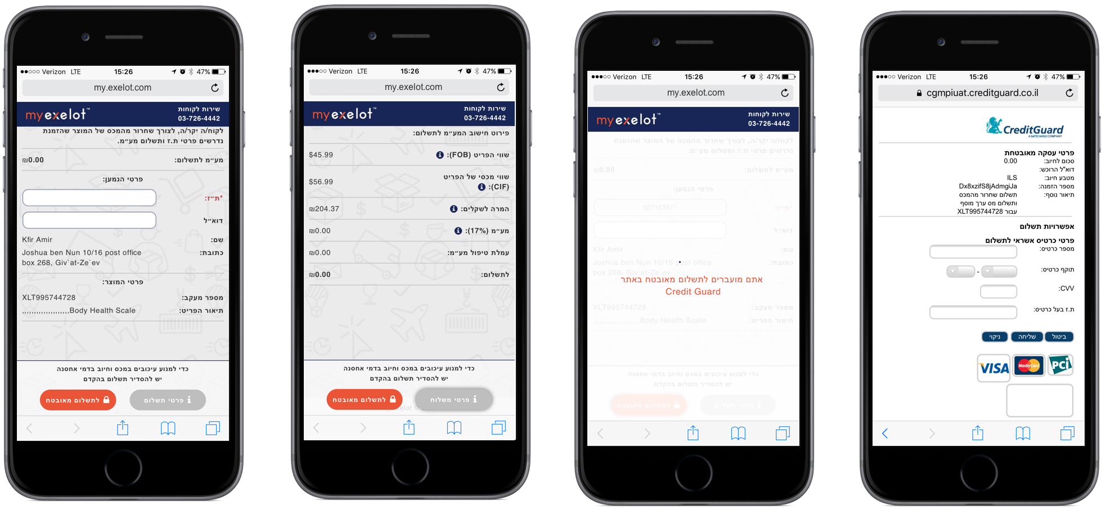
VAT, Custom Duty Payment & Multi-Currency App.
11

Slide 8
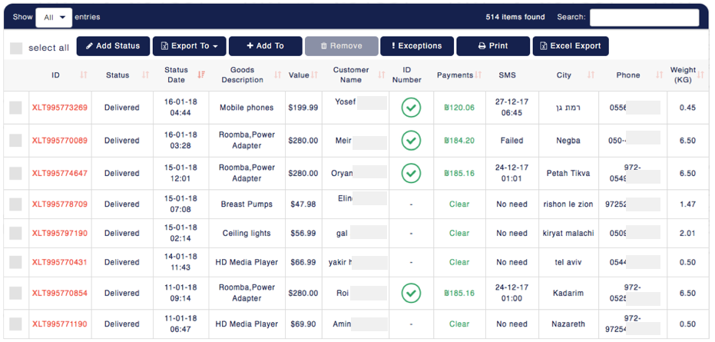
CUSTOM CLEARING & PAYMENTS CONTROL
Batch / Parcels Search
12

Slide 9
EXELOT PLATFORM
CONNECTING E-SHOPS AND VENDORS
TO LOGISTIC SUPPLY CHAIN
Customs agents, Forwarders,
Bonded warehouses & Last mile vendors
  FULFILLMENT
  BONDED / W.H
  FUTURE:
  IoT +
  BLOCKCHAIN
  ENABLER
  SUPPLY CHAIN
  LINE BUILDER
  & OPTIMIZED
  LINES
  DDU / DDP
  PAYMENTS
  & BILLING
  LOGISTICS
  WORKFLOWS
  & REPORTS
4

Slide 10
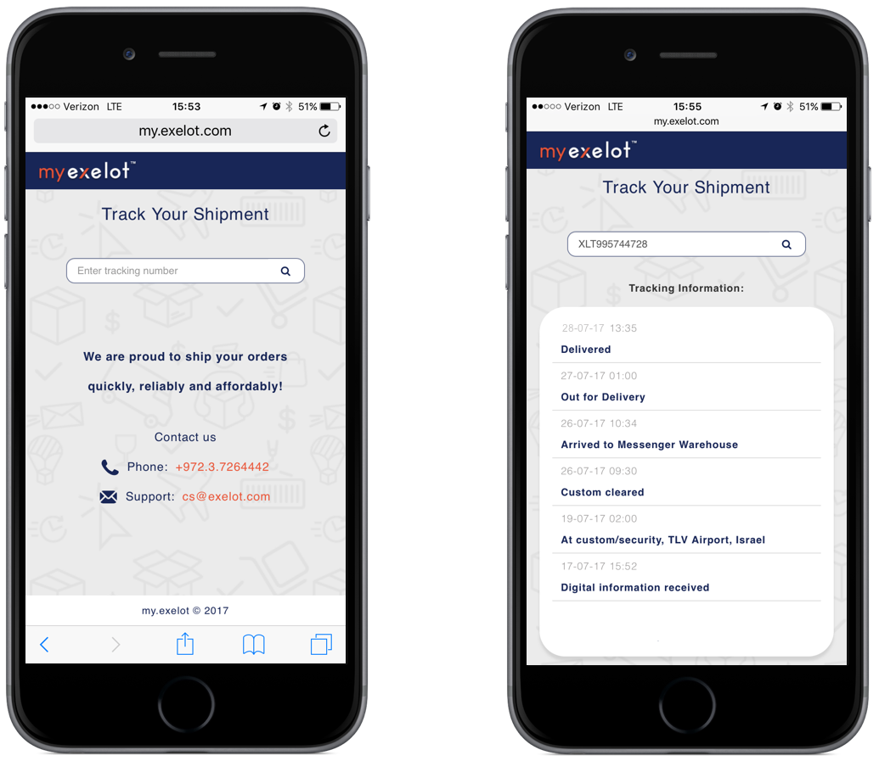
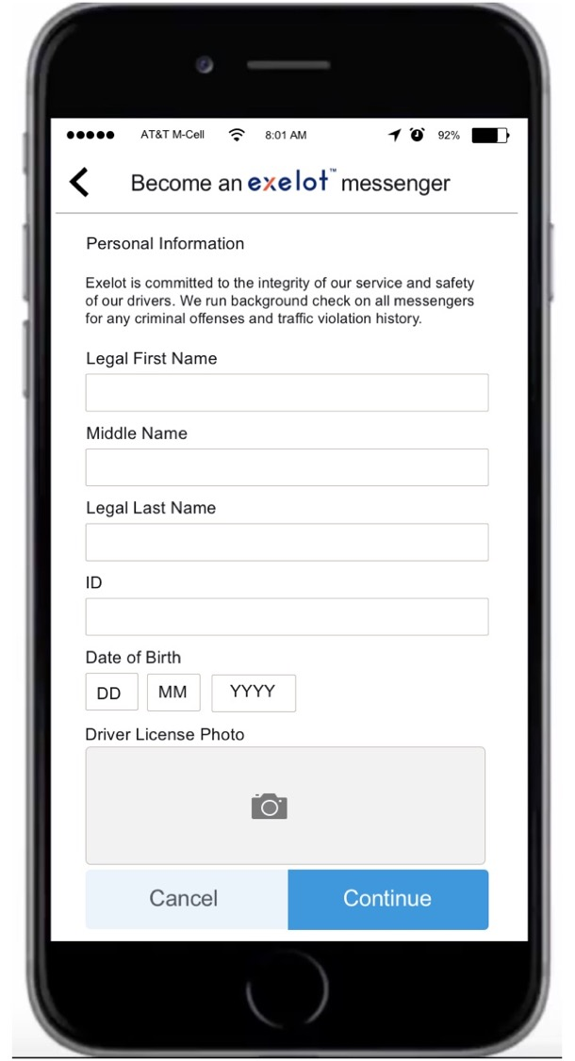
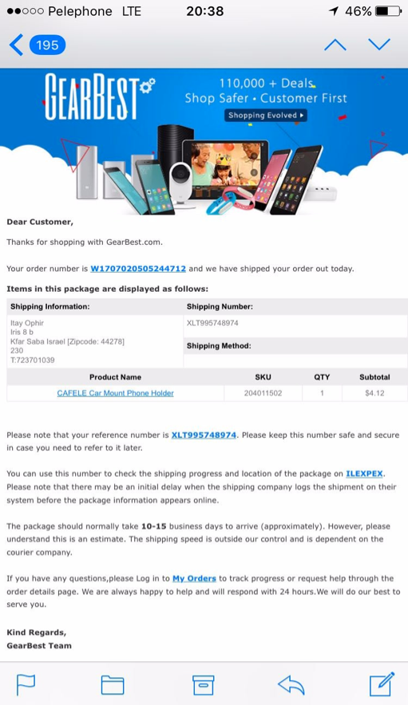
End to End or Modular SaaS Solution
Offering and end-to-end or modular solution, including:
1) VAT & Customs duty calculation & payments modules (DDU-to-DDP)
2) High standard secured delivery
3) A-Z logistic control & Responsibility
Exelot tracking
17

Slide 11
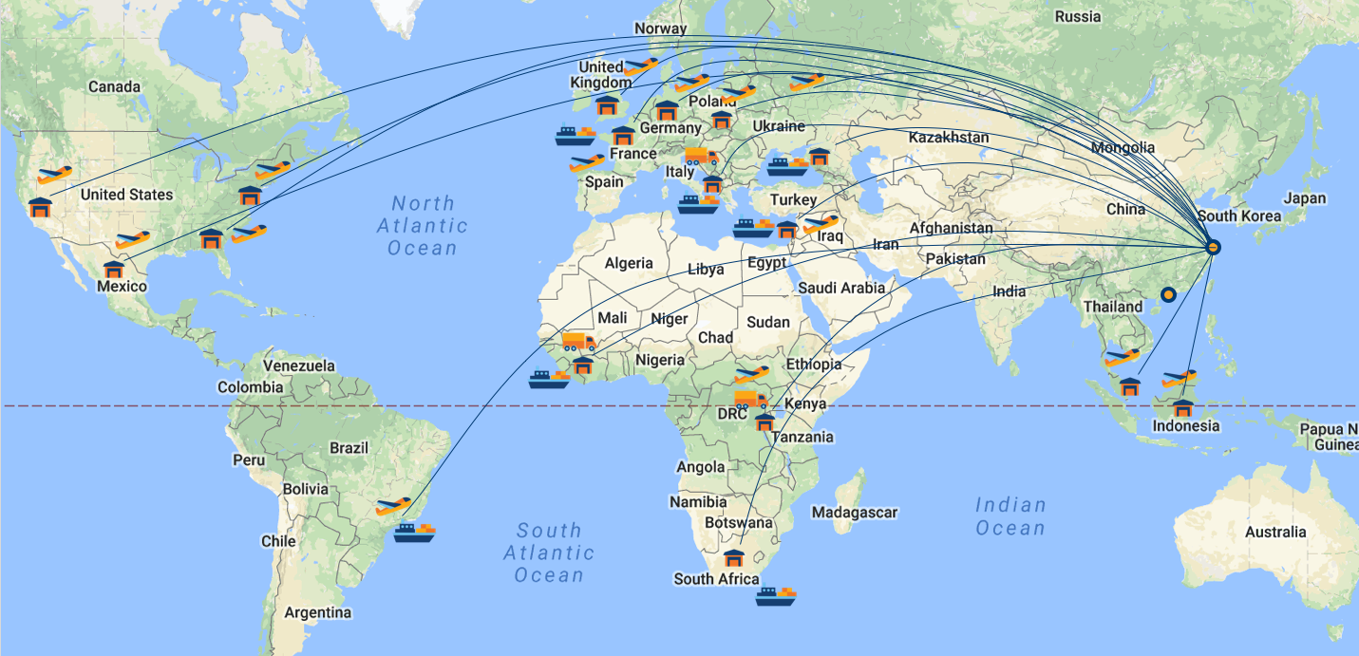
2018 – 2019: Ocean & Air Freight Global Coverage
18

Slide 12





EXPERIENCED MANAGEMENT TEAM
Exelot team has deep market knowledge & extensive experience
Technology, e-commerce, logistics, post & years of business experience
Daniel Cohen
Co-Founder & CEO
Entrepreneur. VP Biz.Dev & Strategy, Israel Post. VP Biz Dev at High-Tech (LocatioNet, Aerialink) & Industrial co. Over 25 years’ management & international business experience (LLB, MBA)
Izack Varsanno
Co-Founder & CTO
  25 years managing software development, Chief programmer for IDF logistics unit, Applied Materials, Precise, Partner (cellular), IDF / MAMRAM graduate
Itay Ophir
VP Product
Eli Koretsky
China Sales
Mickey Tal
Logistic Chain Manager
15 Year experience in product management, Internet UX, ecommerce platforms
Ex. AliExpress, China.
5 year experience with ecommerce: communities, logistics & user experience
18 years experience in logistics, warehouse management, fulfilment, couriers & dispatching
19

Slide 13


Thank You!
谢谢大家！
Contact: danny@exelot.com
www.exelot.com

