Slide 1
CROSS BORDER
E-COMMERCE
PLATFORM
FOR
UKRAINE
SMART MARKET
Confidential – This presentation includes proprietary information. All rights reserved © 2016-2019 www.exelot.com

Slide 2
BUSINESS IDEA
Enabling the Odessa Smart Market & local sellers an entire solution
for all cross border e-commerce logistics to grow sales
Service by Exelot platform - a most advanced online platform
Providing entire logistic chain:
Orders data collection, Pick up, Consolidations, Ocean, Air & Land shipments,
Customs clearance, Delivery, Track & Trace, Statuses & Reports, Help Desk.
Founding a partnership with the local bonded warehouse
Developing the market for all over Ukraine and later to Belarus and Russia
Partners: Local investors, Warehouse company, Exelot, Marketing company
Proposed investment: $1.8 USD
2

Slide 3
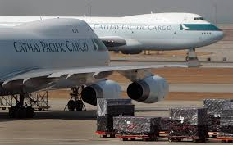
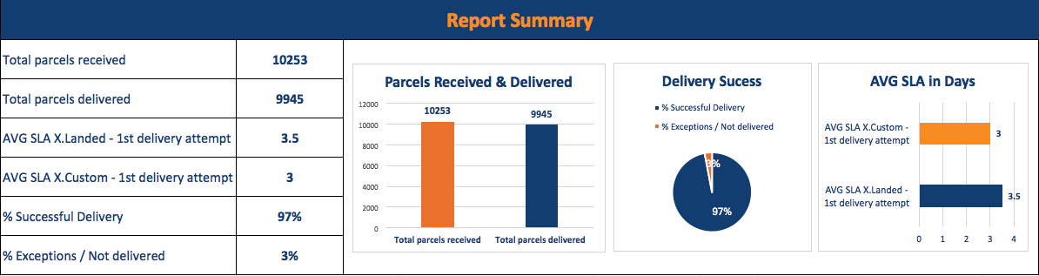



Exelot – Vison & Mission
Excellent Logistic Technology
for Growing Sales
Connecting sellers to cross border markets
  Making e-commerce logistic chain smooth, reliable & cost effective
    Assisting e-shops to grow sales in destination countries
3

Slide 4
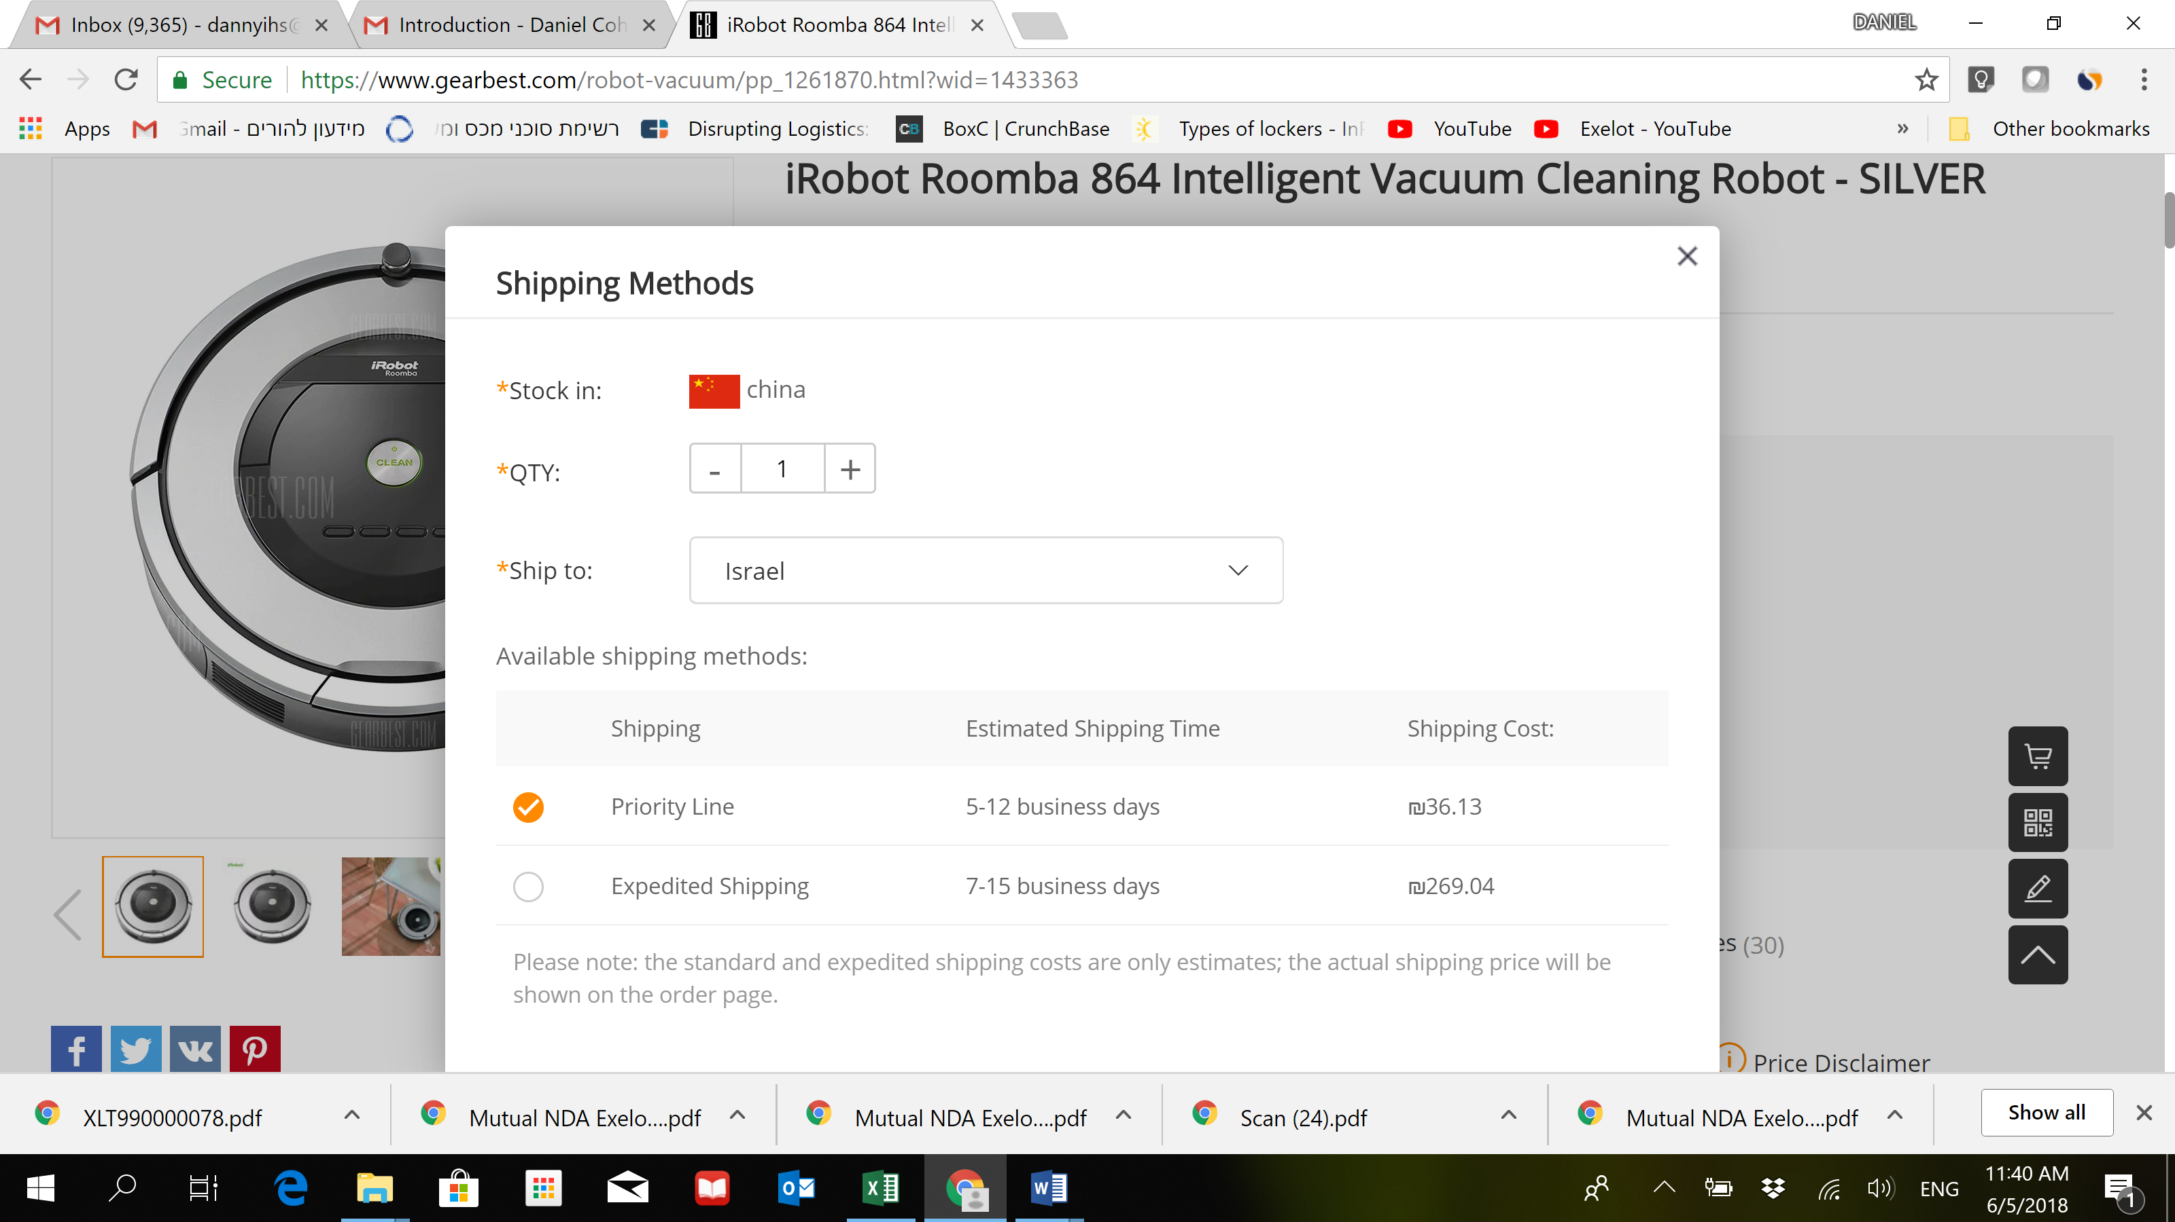
Embedded Solution at E-Commerce Shops
4

Slide 5
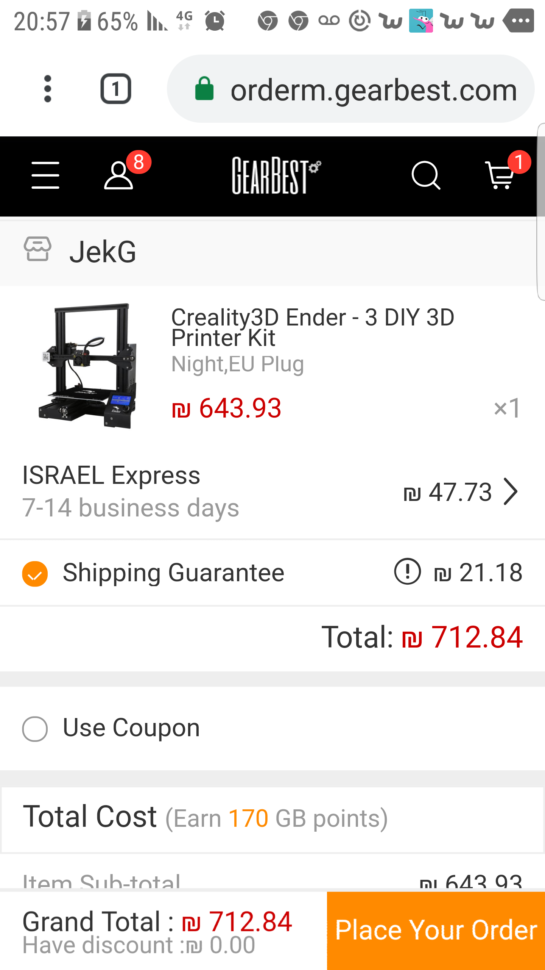
Enabling Default Options for Shipping & Delivery
5

Slide 6
Supporting FBA – From Bonded Warehouse
Fulfillment & Quick Delivery
6

Slide 7
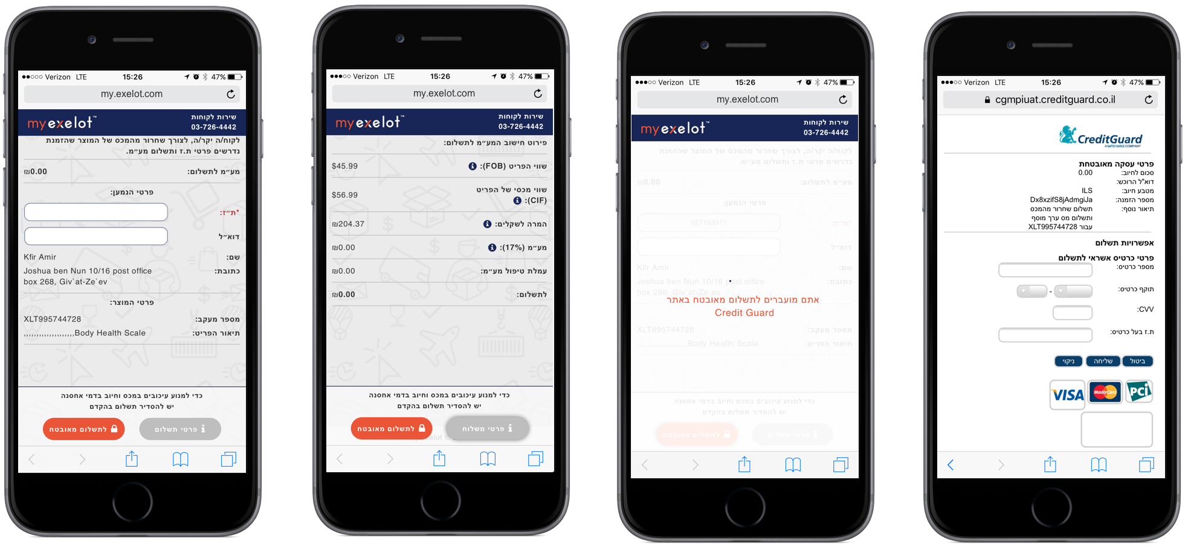
VAT, Customs Duty Payments & Invoicing - Multi-Currency App.
7

Slide 8
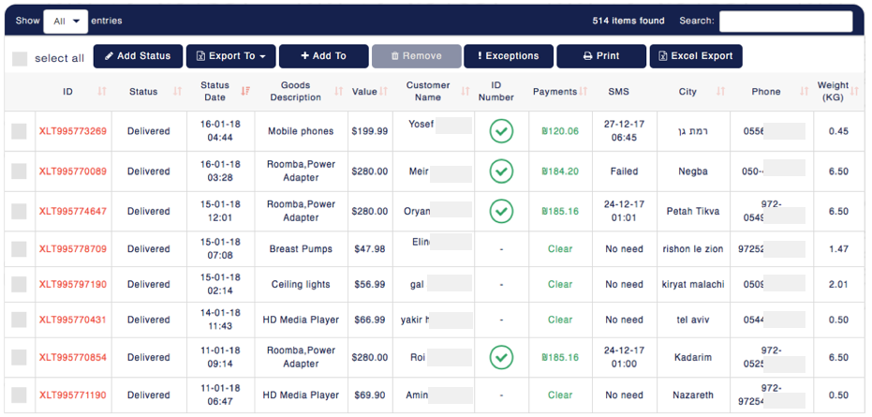
Packages’ Customs Clearance Control
批次/包裹搜索
8

Slide 9
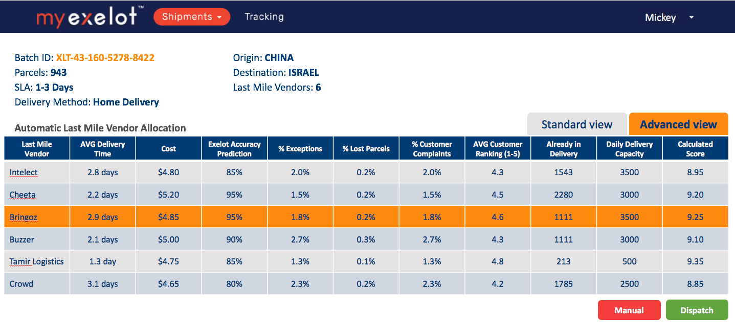
AI Prediction, Optimization & Scoring – Last Mile
Implementing AI & machine learning for predictions & comparisons
Enabling end-users scoring (as a “Booking.com” for delivery vendors)
Applying blockchain technology for docs. & verifications
9

Slide 10
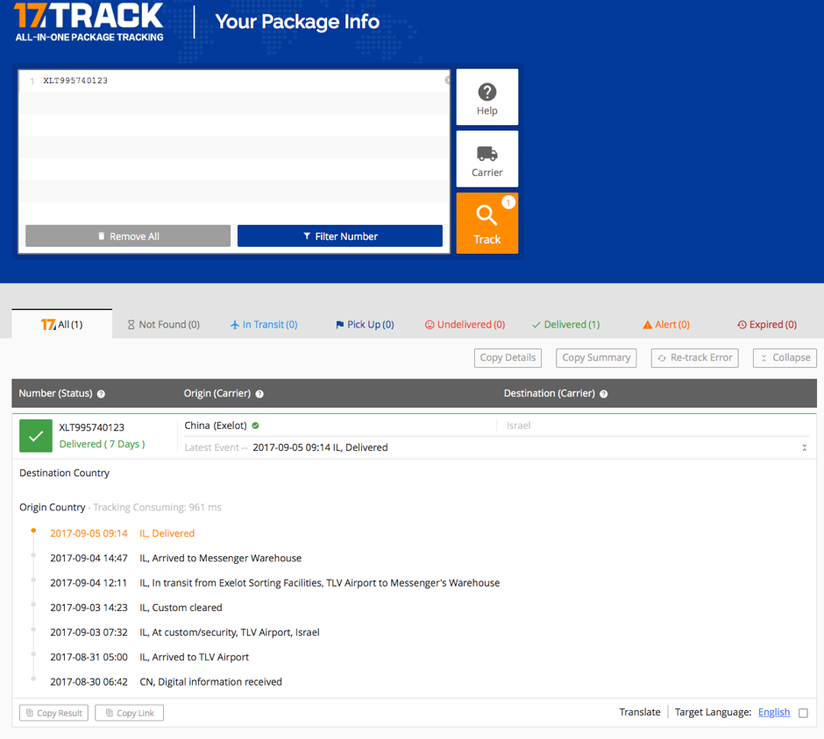
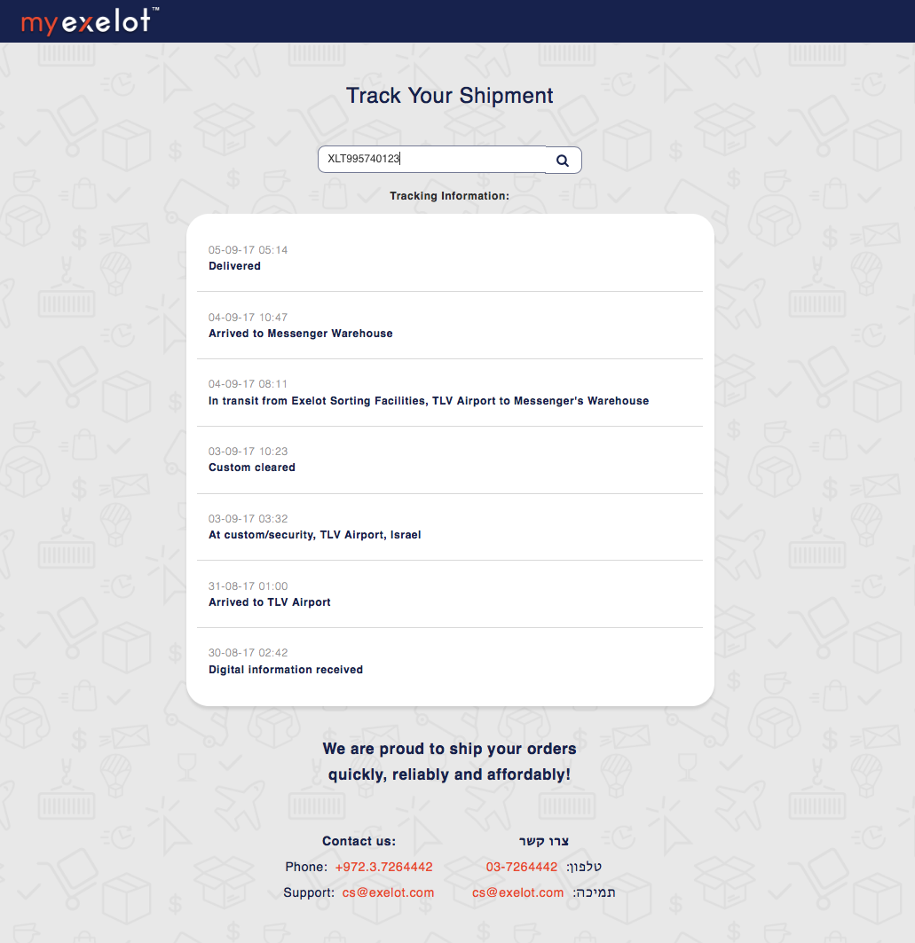
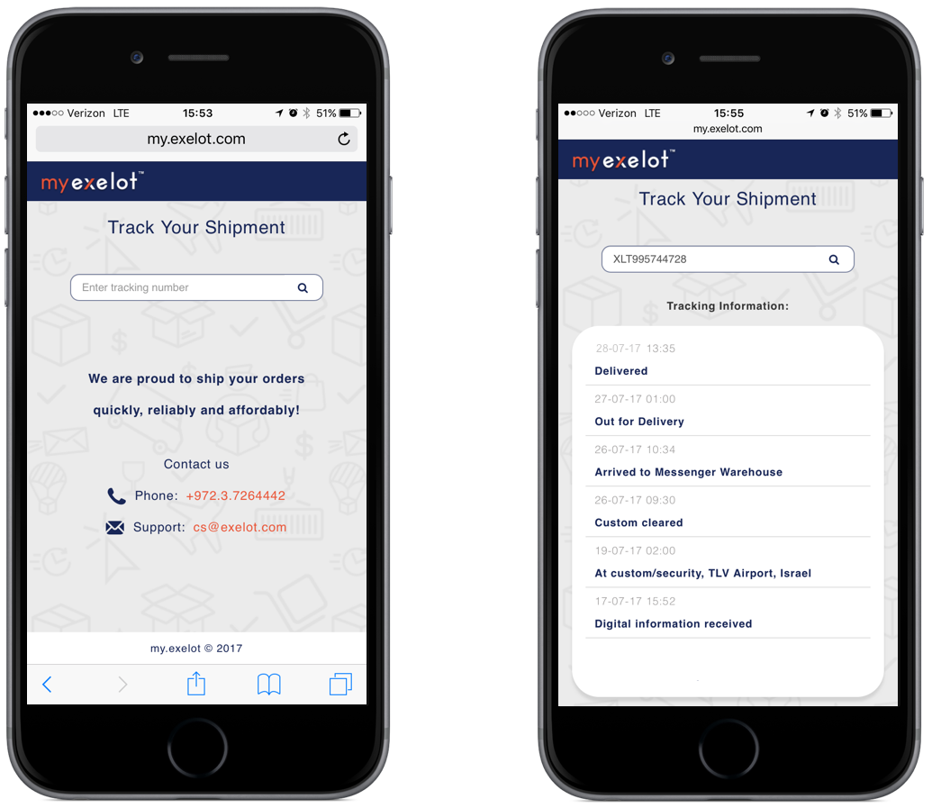
End-to-End Tracking & APP
10

Slide 11
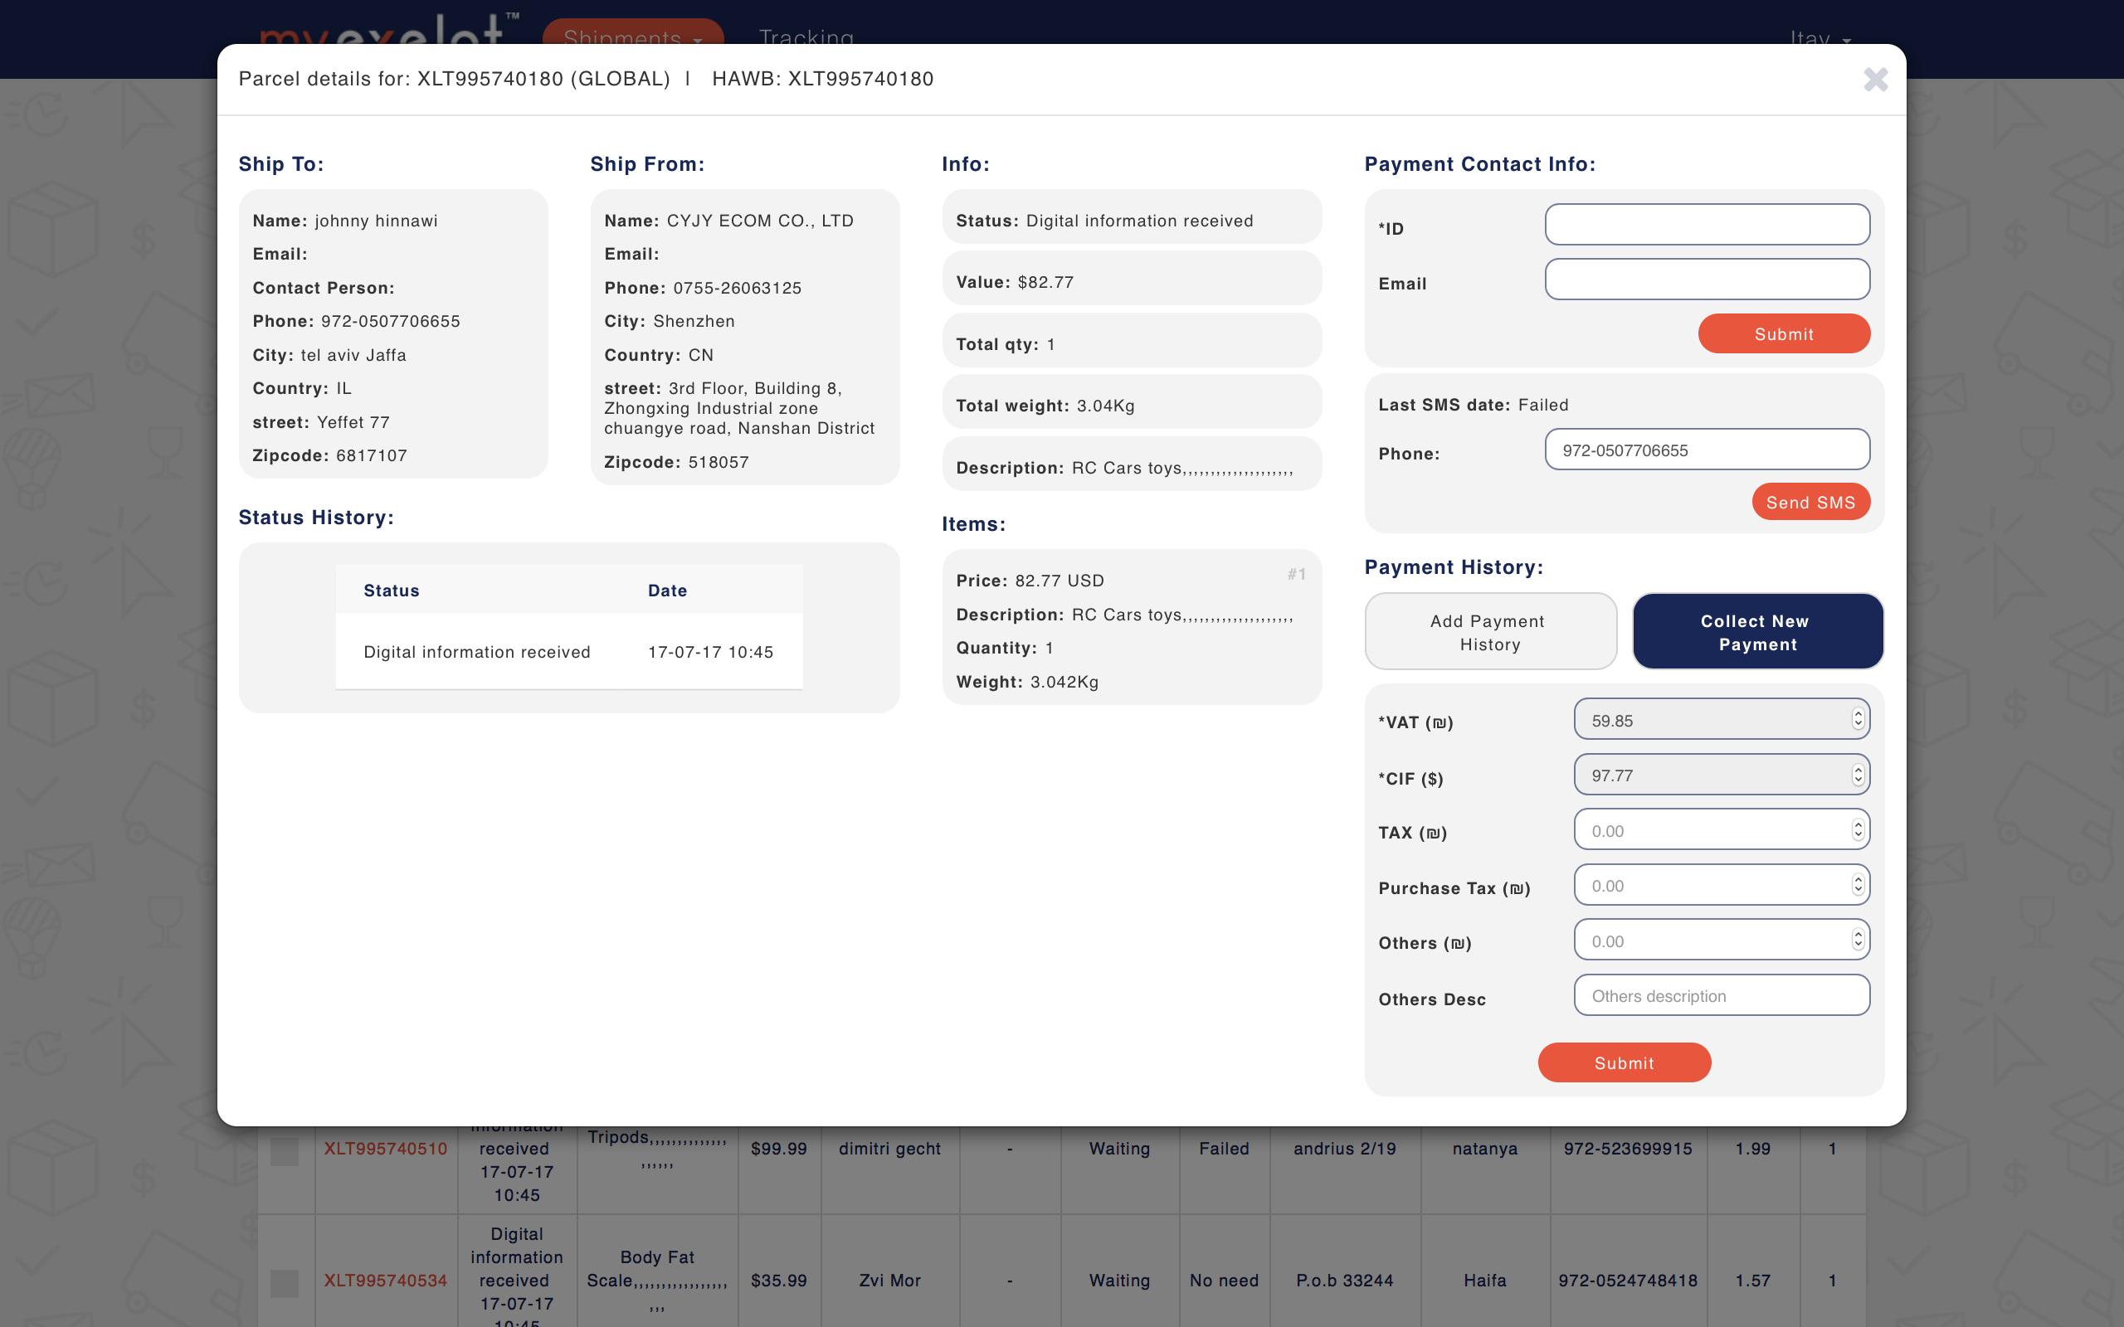
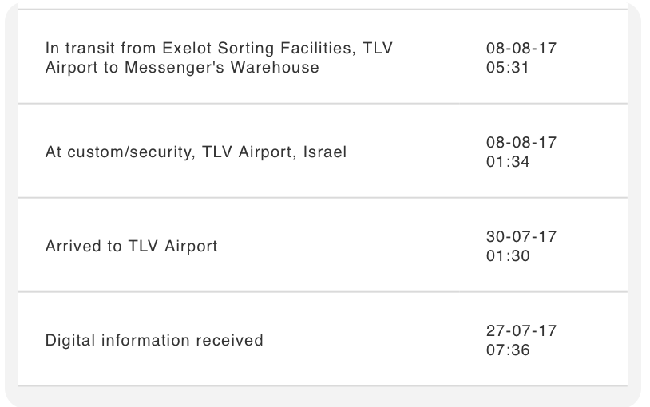

A – Z Logistic Control
11

Slide 12
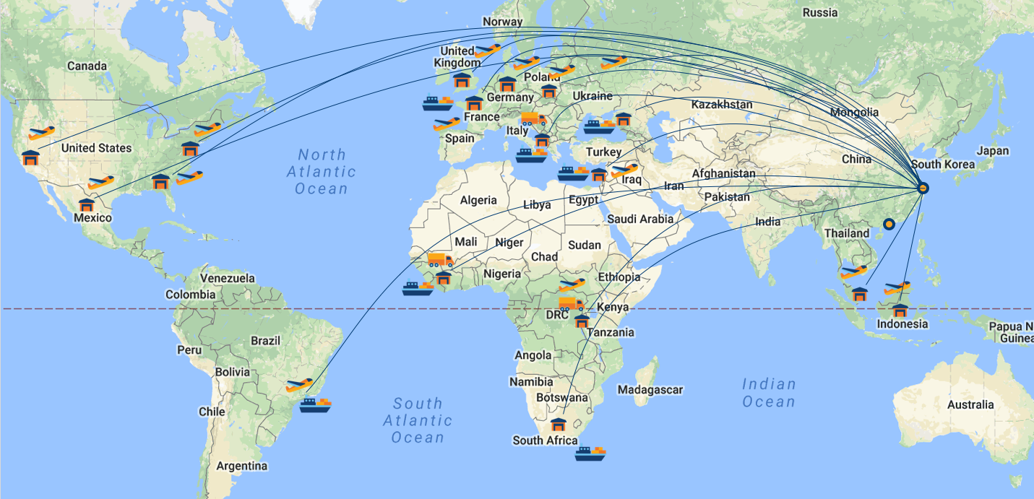
Enabling Global Coverage – Ocean, Air, Land
12

Slide 13
JOINT VENTURE & GENERAL BUSINESS MODEL
Partner | % | Activity | Payment
Exelot | 52% | Managing platform & cross-border logistics | Transaction over platform / logistic service & License
Main investor | 33% | Ownership | Dividends
Warehouse Owner/s | 10% | Warehouse Management | Logistic service & fulfillment
Coccus Group | 5% | Business Development | Marketing & BD services
Use of proceeds / Investment:
800 K | 700 K | 300 K
technology and platform implementation, applications & localization. | all on going management and operations | marketing and business development activities
13

Slide 14


Thank You!
Contact: danny@exelot.com; eli@exelot.com
www.exelot.com

