Slide 1
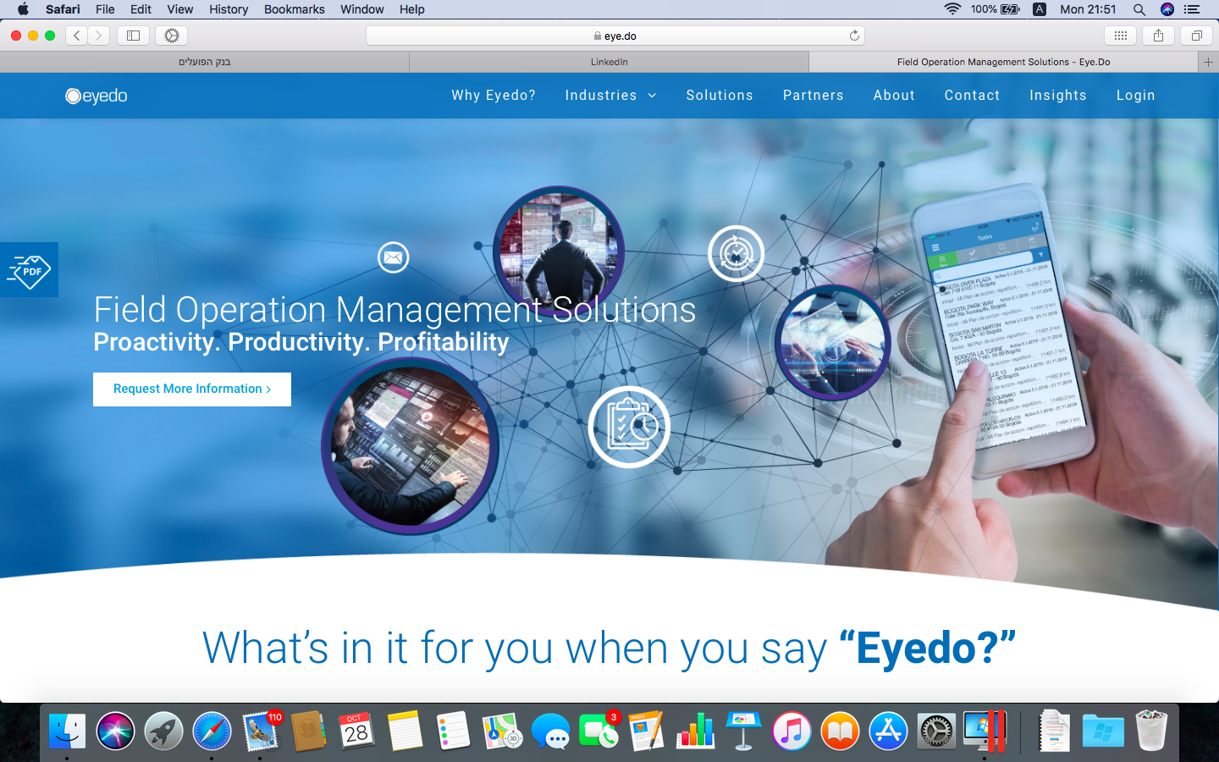


A.I. powered technology

Slide 2

Mobile workforce management pioneer
Founded 2012
Headquarters at Tel Aviv
Top Technology capabilities
Global deployment
Global international clients
Businesses, governmental, municipal etc’

Slide 3


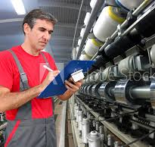

The world it transferring from analog to digital management

Slide 4
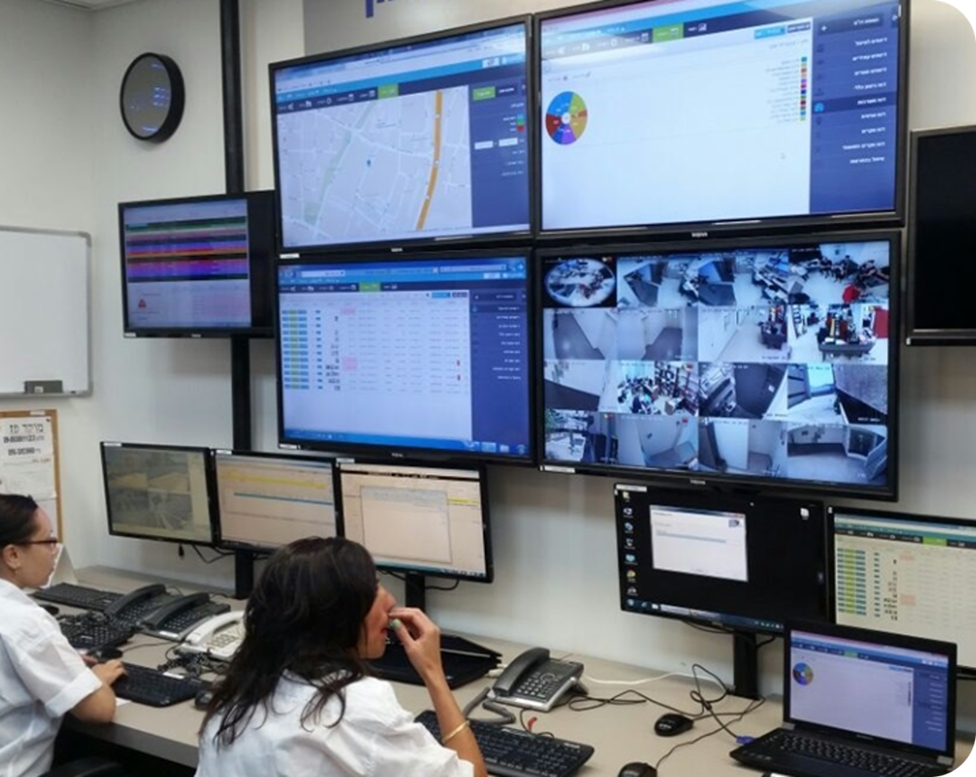
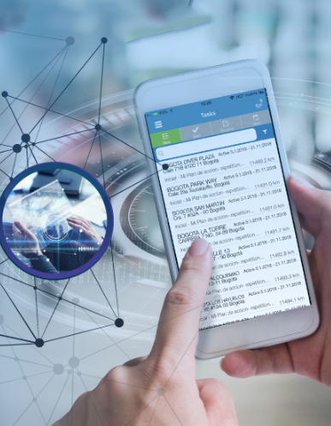
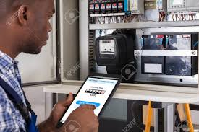

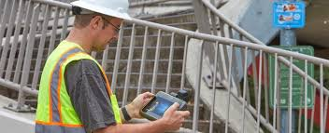



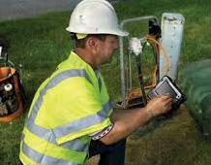
Field workers have digital devices with all required data, workplan, best practices, procedures etc’

Slide 5
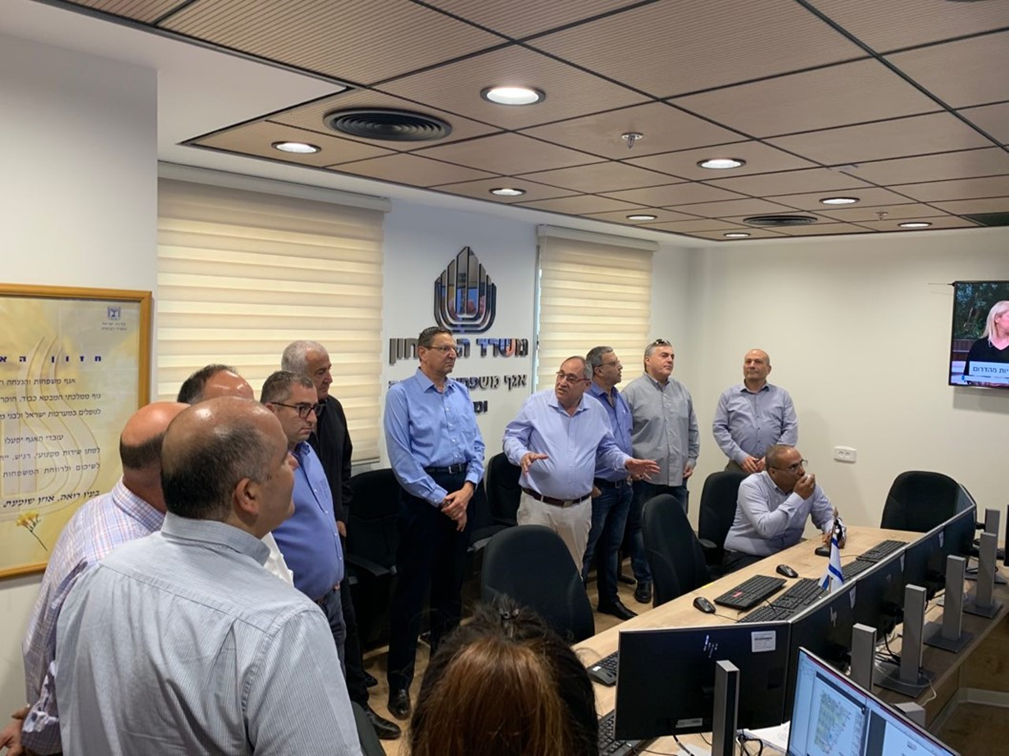
management and back-office have full control and real time insight

Slide 6

Eyedo’s field operations management app
simple-to-use
Professional
increase team work
dedicated field management system
rapid and measurable impact on all KPI’s
Define
processes
Publish
task
Analyze
execution
Manage alerts
and escalation
Analyze
And
improve

Slide 7






Added value Metrics *short list
 | Defense and security |  | Global companies | Food industry | Retail | Municipalities and infrastructure | Governmental offices
Service level improvement
Tax and compliance audits
technician management
Maintenance
Regulation compliance
workforce management

Slide 8
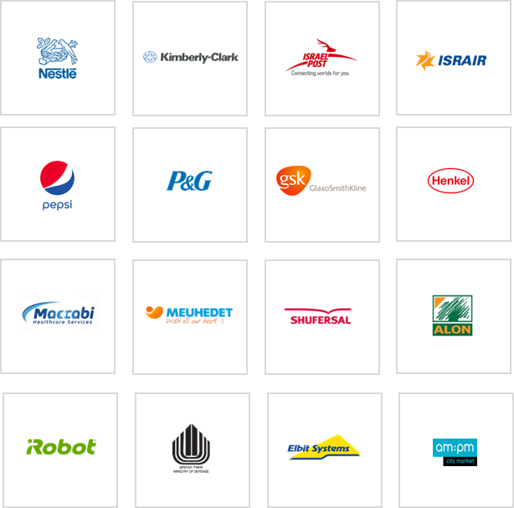


CUSTOMERS SPOTLIGHT
municipality

Slide 9
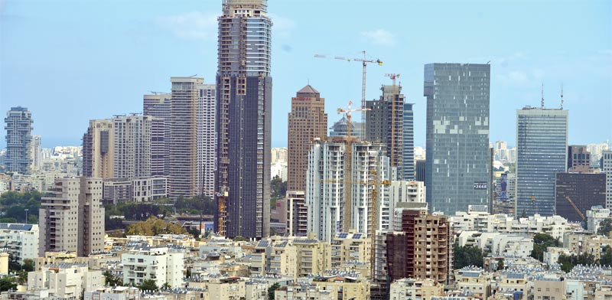



Safety
Scheduled audits and real time reporting helps you avoid accidents and save lives
Quality
Implement procedures into app, improve quality, save redoing expenses, manage employee work hours
Public health
guarantees timely exams, get a fast improvement in public health and death prevention

Slide 10
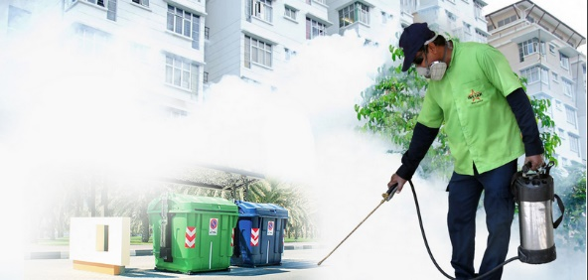
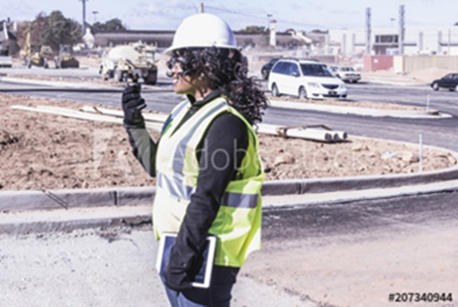
Pest control
Implement and control pest control action and trends to avoid diseases
infrastructure
Implement procedures into app and prevent fraud, improve quality, prevents death, saves rebuilding expenses, manage employee work hours
Meter reading
guarantees accurate readings, prevent Fraud, increase municipal revenues

Slide 11
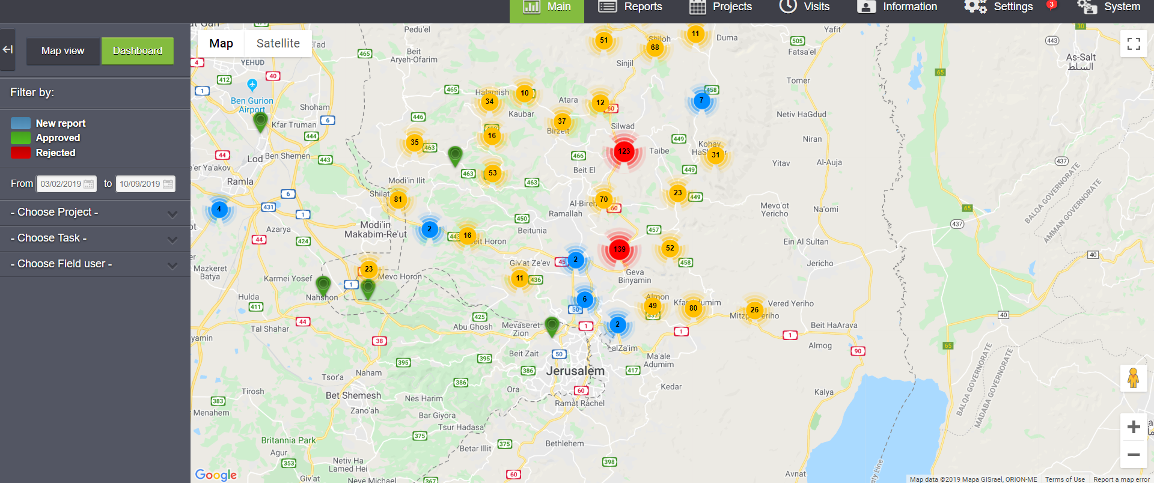
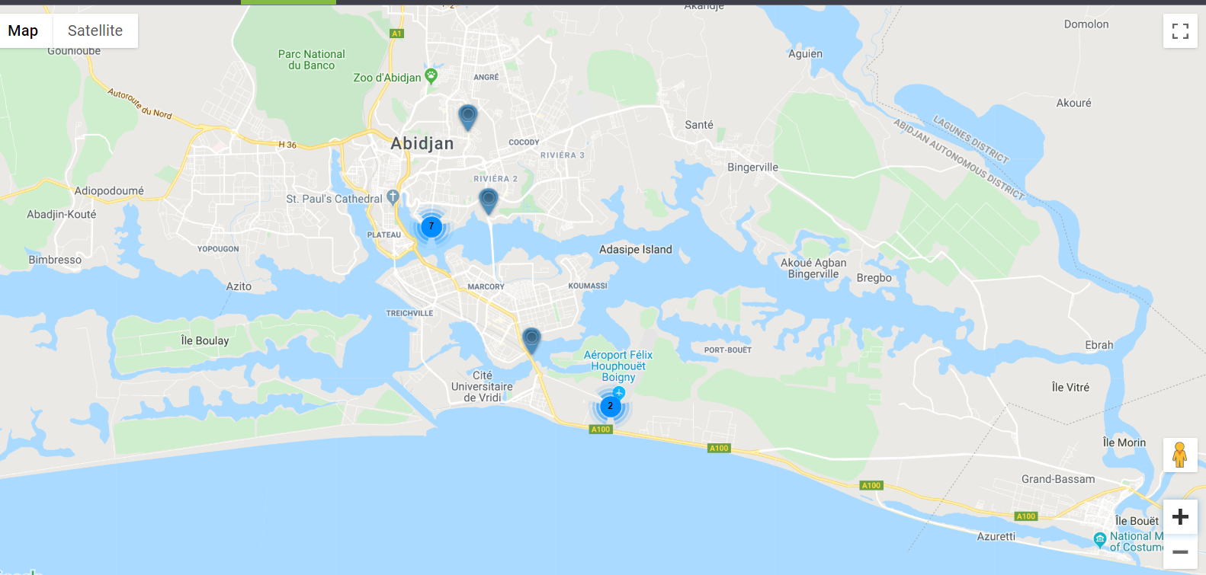
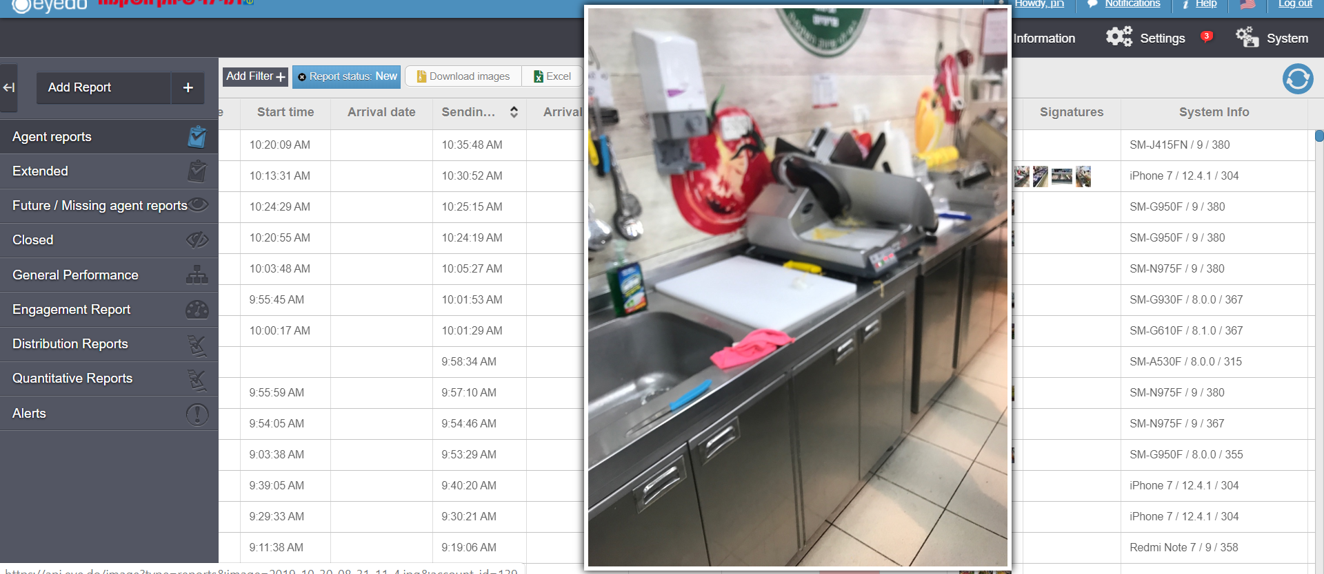
Municipal services
Reduces response times, Prevents waste of resources, Diseases and deaths, Increases municipal income, Helps manage employee work hours
Security & defense
Make real time Essential tests and Prevent smuggling, increases revenue for the state
Prevent air traffic disasters
Hotels & restaurants
Stable coordination between the various departments and regulator, helps prevent deseases and death

Slide 12

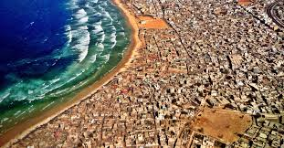

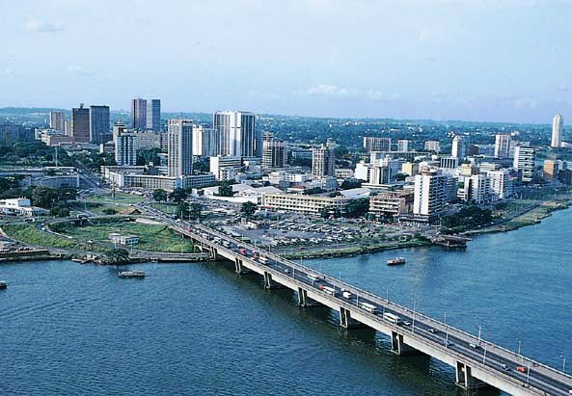
Get better!! Save lives!! Prevent fraud!! Increase revenues!!

Slide 13
Next steps
1. Order (budget signature)
2. Payment transfer
3. The CUSTOMER SUCCESS team comes for two months characterization
4. Deployment of infrastructure in Africa (servers and communications)
5. Purchase of end equipment
6. Build the system according to the characterization of the CS team
7. Field Implementation (6-10 months)

Slide 14

Thank You!! www.eye.do office@eye.do

