Slide 1
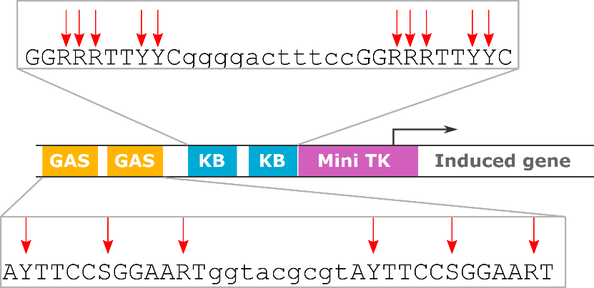
Figure 1 – The G1K06 library design. The basic structure of the G1K06 CARTIV promoter and the variable elements used to construct the CARTIV promoter library. Red arrows indicate variable nucleotide position. Y=C/T, S=G/C, R=A/G.

Slide 2
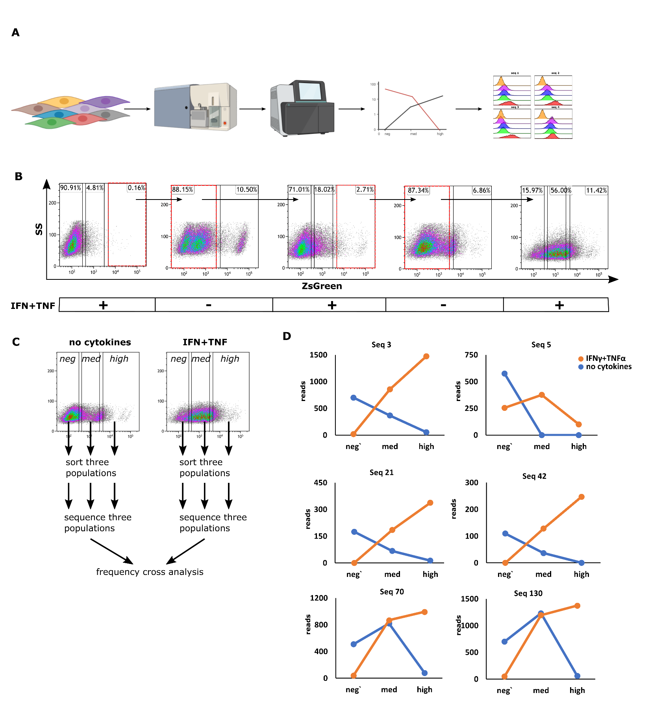
Figure 2 – The GK CARTIV promoter library show increment for responsive promoters following three sorting rounds: (A) an overview of the steps applied to the library screen. (B) FACS plots of HEK293T cells infected using lentiviruses with ZsGreen under the control of the CARTIV promoter library. They are showing three consecutive rounds of activation and relaxation. Red boxes and arrows show the sorted population in the specific selection round; 72 hours following infection, cells were treated with 500U/mL of IFNγ and TNFα for 48 hours, then harvested and proceeded for cell sorting. Data is single discriminated (C) FACS plots HEK293T cells after three consecutive rounds of positive and negative selection. They are showing data and gating for the six-cell population extracted for sequencing and frequency cross-analysis. Data is single discriminated and DAPI negative. (D) frequency cross analysis for six representative promotors selected for the functional studies. Cut off for reading number was 150, only sequences showing “x” trend were selected for cloning.

Slide 3
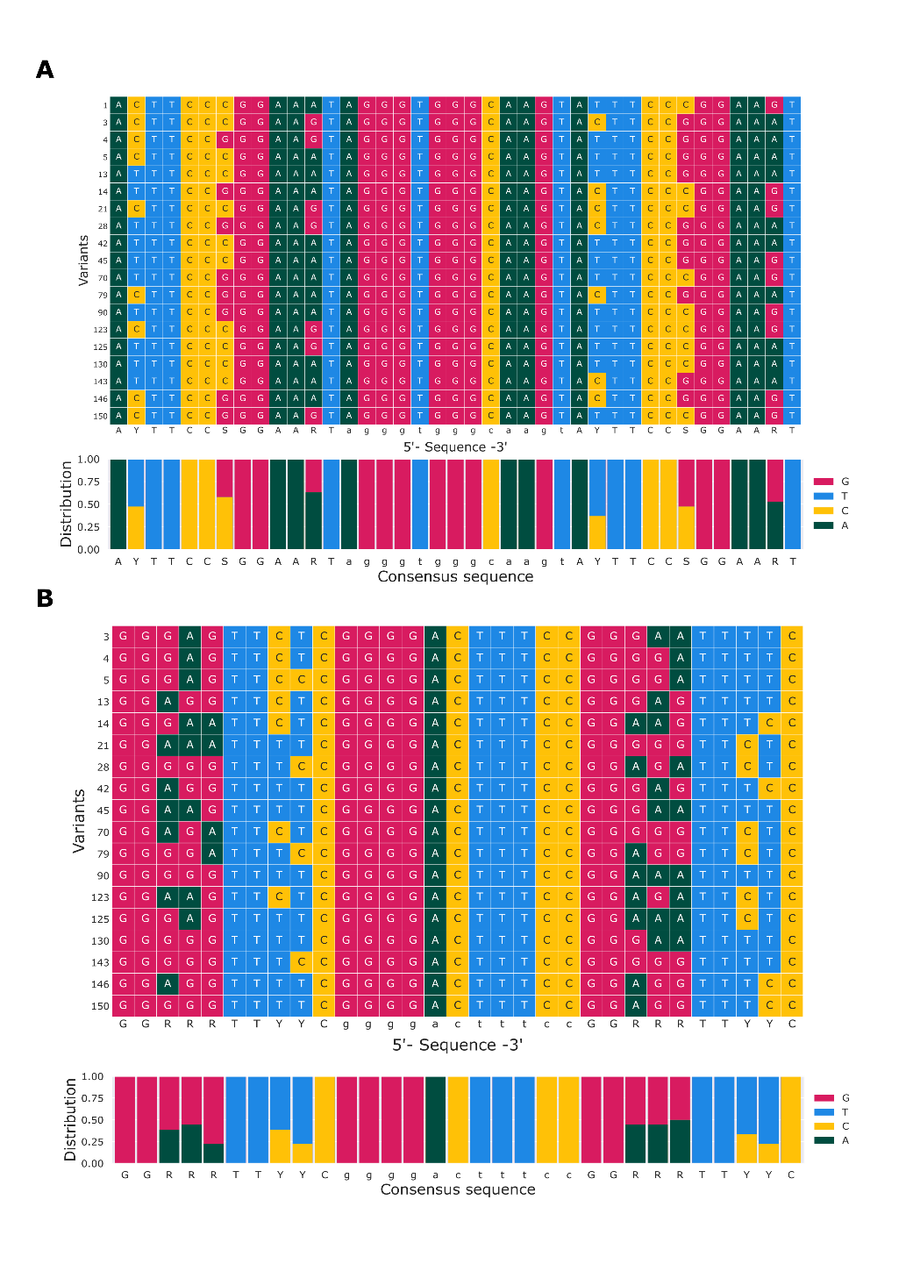
Figure 3 – The selected GK CARTIV promoter library shows no strong tendency for a specific position (A) Multiple sequence alignment of GAS elements (B) MSA of KB elements. Each row represents a sequence derived from the bioinformatics analysis. At the bottom of A and B is a distribution analysis between 0 to 1.

Slide 4
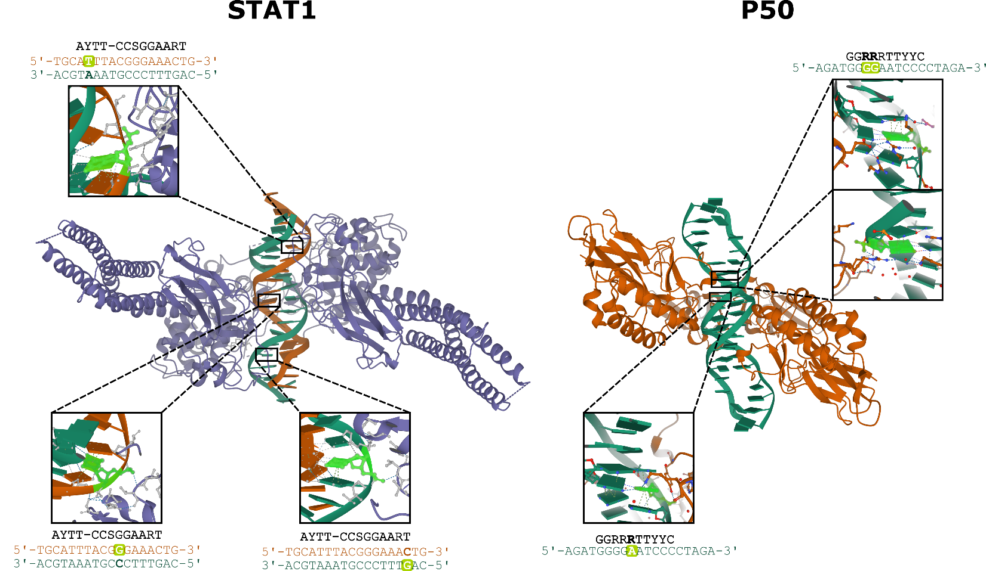
Figure 4. The DNA in the variable positions in the CARTIV library interact with P50 and STAT1 by the phosphate backbone: structures of STAT1 and P50 crystalized with a consensus DNA sequence. Left panel, the crystal structure of STAT1 together with STAT1 binding sequence, in orange the 5‘ DNA strand, in deep green the 3‘ DNA strand. In glowing green, the nucleotide interacting with the protein, marked on the DNA sequence is the relevant nucleotide pair, outlined the interacting nucleotide. The right panel showing the crystal structure of P50 with a binding sequence; in deep green, the 5‘ DNA strand. In glowing green, the nucleotide interacting with the protein marked the relevant nucleotide pair on the DNA sequence outlined the interacting nucleotide.

Slide 5
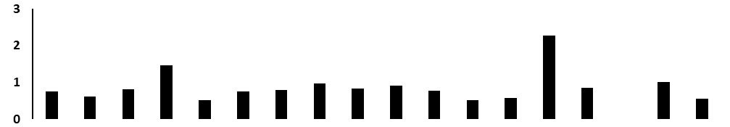
A
Clean
IFNγ
TNFα
IFNγ + TNFα
B
C
Background/synergism
D
Figure 5 – Promoters 5 and 130 show a robust and synergistic following IFN and TNF activation: (A) Representative FACS plots from a. (seq 130). Cells were single discriminated and gated on Dapi- (B) Normalized reporter expression. Each clone was treated with IFNγ and TNFα. The reporter’s geometric mean fluorescent intensity of each clone was divided by the response of the non-treated of the same clone. (C) Synergism is calculated by dividing the geometric mean of the fluorescence intensity (MFI) of cells stimulated with IFNγ and TNFα divided by the sum MFI of cells stimulated with IFNγ or TNFα vs. background levels (solid grey bars) were calculated by dividing the MFI of transduced cells by the MFI of non-infected cells in the same well. (D) potency score (dashed bars). Data are shown from one out of 2 experiments.

Slide 6
A
B
Figure 6. Sequence 5 displays better activation kinetic. (A) activation rate. The Y-axis is normalized RFP670 expression. The X-axis is time. The time interval is 1 hour. (B) deactivation rate. Media was replaced with fresh media without cytokines at time zero.
Note- we are doing similar experiments for additional Seq.
May add later

Slide 7
A
B
Figure 7. Adding complexity to the G1K06-5/130 promoters does not effect response to external stimuli. (A) the basic structure of the HG1K06 CARTIV promoters. (B) The geometric mean of RFP670 in ZsGreen positive cells, showing the average of triplicates, error bars indicated standard deviation.

Slide 8
No cytokines
IFNγ
TNFα
IFN γ +TNFaα
4
5
RFP670
11
90
130
ZsGreen
Supplementary Figure 1: representative FACS plots of selected library sequences displaying promoter expression in response to cytokine combination. Data shown are single-discriminated, and Dapi-.

Slide 9
Supplementary Figure 2: G1K06 library derived sequences raw GeoMFI

Slide 10
Supplementary figure 3: background levels. Clones background MFI levels were divided by miniTK MFI
Supplementary Figure 4: potency score calculated for raw GeoMFI

