Slide 1

Figure 1
A
B
i.m. immunizations with W614A-3S-CRM
W0
W2
W4
W10
EC50 (OD 450nm)
IgG ELISA
IgG ELISA
NAb assays
C
Time (week)

Slide 2

Figure 2
A
i.m. immunizations with W614A-3S-KLH
W0
W2
W4
W10
IgG ELISA
dLN analysis
NAb assays
B
C
No peptide
D
0.37
Absolute numbers of
W614A-3S-specific
B cells (in 2dLNs)
W614A-3S-Ova
W614A-3S
+ Alum
W614A-3S
+ SQE
0.96
0.84
W614A-3S-KLH
Alum
SQE
-
-
-
+
+
-
+
-
+
+
+
-
+
-
+
+
+
-
+
-
+
B220
W1
W3
W5

Slide 3
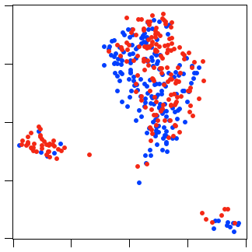
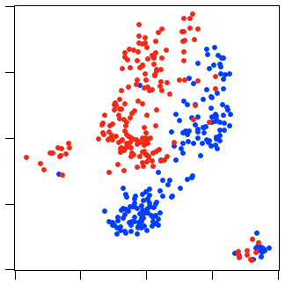
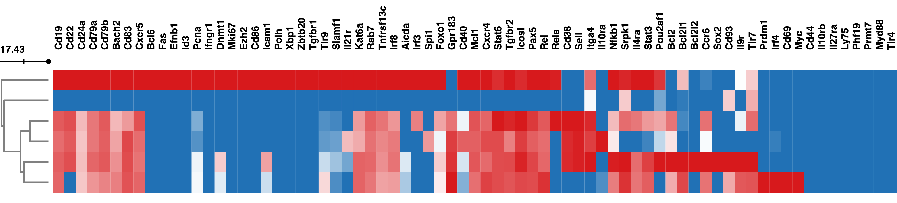

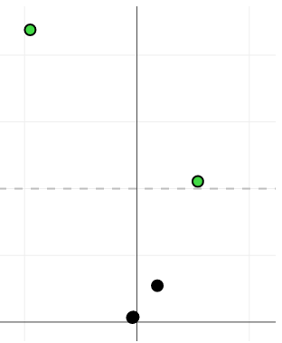
Figure 3
A
W3
W5
7.1
Alum
4.4
SQE
Umap-2
1.7
-1.0
-3.7
-5.9
-2.9
0.1
3.1
6.1
-5.9
-2.9
0.1
3.1
6.1
Umap-1
B
Low
High
GC B cells
Low gene-expressing cells
Il10ra⁻Rela⁺ MBCs
Il10ra⁺Rela⁻ MBCs
Memory precursors
Plasma cell precursors
C
Plasma cell precursors
D
W3 Alum
W5 Alum
2
W3 SQE
W5 SQE
1.5
GC B cells
Plasma cell precursors
-Log10 (p-value)
Memory precursors
1
Il10ra⁺Rela⁻ MBCs
0.5
Il10ra⁻Rela⁺ MBCs
0
-5
0
5
GC B cells
LogFC
Percent of cells
(all experiments)
E
*
**
Absolute numbers of
peptide-specific GC B cells
(in 2dLNs)
W614A-3S-KLH
Alum
SQE
-
-
-
+
+
-
+
-
+
+
+
-
+
-
+
+
+
-
+
-
+
W1
W3
W5

Slide 4
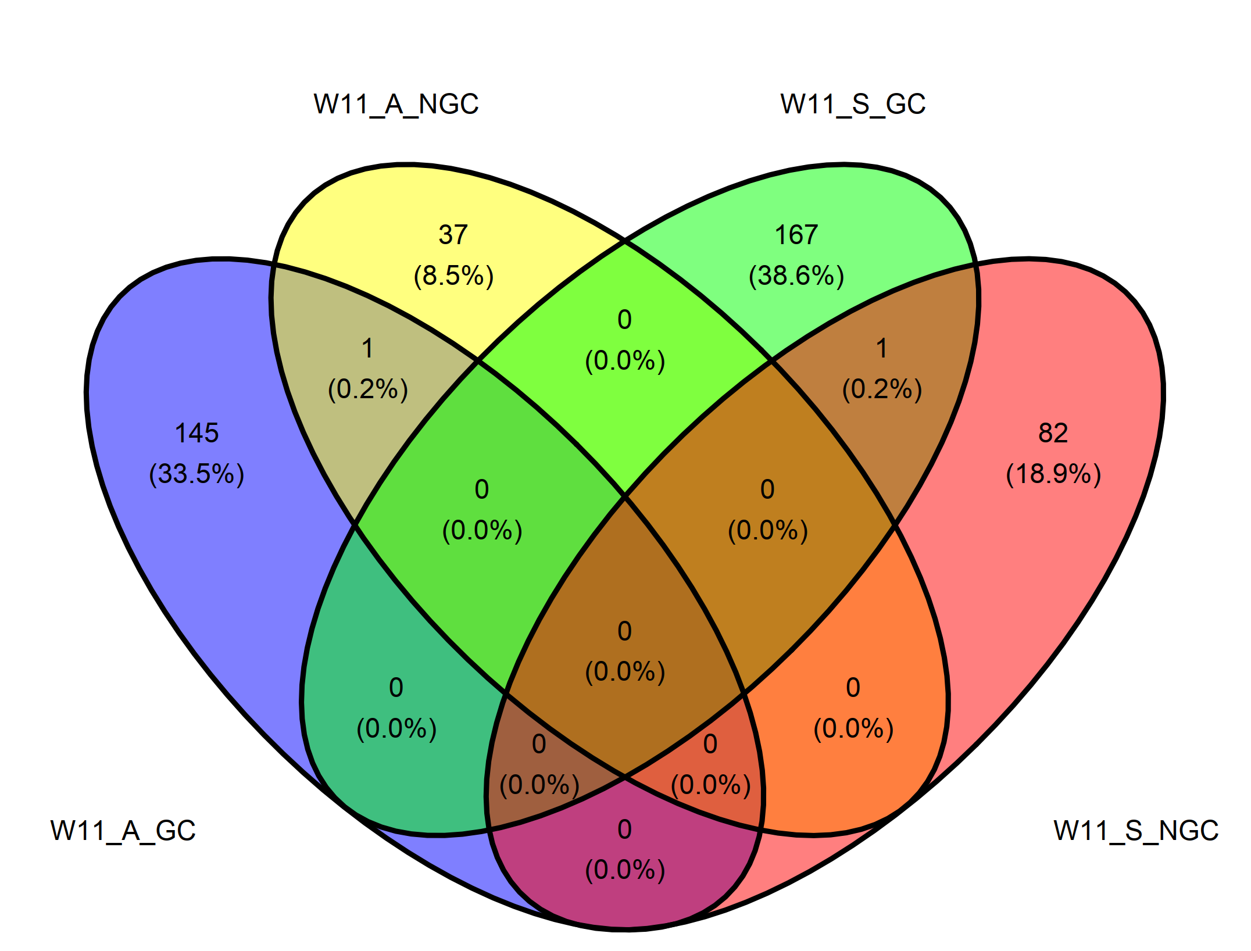
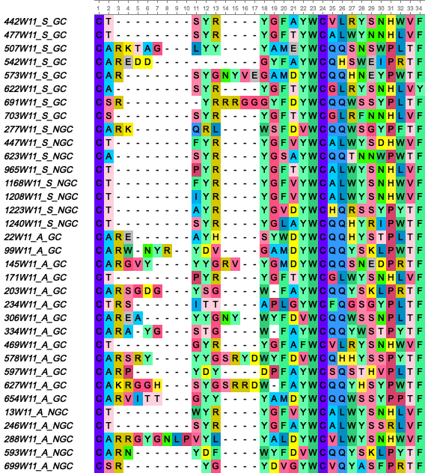
Figure 4
A
B
PBS
0.75
GC B cells
NGC B cells
W614A-3S
+ Alum
1.6
Absolute numbers of
peptide-specific IgG1⁺ B cells
(in 2dLN)
W614A-3S-Ova
IgG1
GL7
W614A-3S
+ SQE
1.1
B220
B220
IgD
GC
B cells
NGC
B cells
C
D
GC B cells
NGC B cells
Alum
NGC
SQE
GC
Alum
Proportion
SQE
Alum
GC
SQE
NGC
Length
E
CDRH3
CDRL3
G
2.0
1.5
OD 450nm
1.0
0.5
F
CDRH3
CDRL3
0
0
1
2
3
4
5
Log10 of concentration (ng/ml)

Slide 5
Squalene emulsion adjuvant is more effective than Alum at prompting broadly neutralizing antibodies in response to HIV-1-peptide-conjugated vaccine
Olivia Bonduelle¹, Chloé Chaudesaigues¹, Monica Tolazzi², Ehsan Suleiman³, Simon de Bernard⁴, Julien Nourikyan⁴, Mylene Bohec⁵, Laura Baudrin⁵, Dietmar Katinger³, Patrice Debré¹, Vincent Vieillard¹, Gabriella Scarlatti², Behazine Combadière¹.
Supplementary Table

Slide 6
Supplemental Table 2: List of 73 genes and probe sequences used for the interrogation of peptide-specific single B cells. Related to Figure 3.

Slide 8
Squalene emulsion adjuvant is more effective than Alum at prompting broadly neutralizing antibodies in response to HIV-1-peptide-conjugated vaccine
Olivia Bonduelle¹, Chloé Chaudesaigues¹, Monica Tolazzi², Ehsan Suleiman³, Simon de Bernard⁴, Julien Nourikyan⁴, Mylene Bohec⁵, Laura Baudrin⁵, Dietmar Katinger³, Patrice Debré¹, Vincent Vieillard¹, Gabriella Scarlatti², Behazine Combadière¹.
Supplementary Figures

Slide 9
Supplementary Figure 1: Rabbits were immunized with W614A-3S-CRM197 carrier non adjuvanted (n=2), adjuvanted with Alum (n=2) or SQE (n=5) at W0, W2, W4 and W10. Serum W614A-3S specific Abs of 2 to 5 rabbits per condition were analyzed at W20, and neutralizing IC50 were evaluated against different virus strains: Montefiori Global panel, Tier2 and Tier1. Color codes of neutralization assay (1/dilution): green, ≤40; yellow, 41-100; orange, 101-200 and red, >201. Breadths represent percentage of total tested HIV strain neutralized by anti-W6141-3S IgG. T/F: Transmitted Founder virus.

Slide 10
Supplementary Figure 2: Mice were immunized with W614A-3S-CRM197 carrier adjuvanted with Alum or SQE at Week 0 (W0), W2, W4 and W18. Neutralizing IC50 of serum purified W614A-3S-specific IgG were evaluated at W20 against two Tier 2 virus strains (JR-CSF and YU-2). Purified peptide-specific IgG were obtained by pooling sera of 5 mice for each condition. Color codes of neutralization assay (IgG mg/ml): green, >2; orange, 1-1.9 and red, <0.9.

