Slide 1


VENTURES II

Slide 2




HANACO VENTURES II
Hanaco Ventures invests in the most promising emerging start ups from the Israeli ecosystem.
Hanaco partners with Israeli companies, wherever they are in the world,
helping them become category leaders beloved by their customers.
HANACO VENTURES I
LAUNCHED Jan 2018
HANACO VENTURES I
2018 - $87M
(+$16.5M SIDE CAR)
OFFICES NY &
TEL AVIV
EARLY STAGE
LEADING
SEED/A ROUNDS
HANACO VENTURES II
$100M TARGET
($120M CAP)
2
HANACO VENTURES II

Slide 3




ISRAELI ENTREPRENEURS ARE NOW GLOBAL
• Founding start ups in the US from Day One
EXPECTS MORE FROM THEIR VC
• Customer introductions
• Hiring
• Platform
• Strategy
• Follow up Funding
THE ISRAELI FOUNDER TODAY
NEW GENERATION OF FOUNDERS
• Younger
• Multidisciplinary
• International founding teams
DISRUPTING NEW MARKETS
• Israeli founders expanding industry focus from cyber to fintech, mobility, AI, agrifood and others
3
HANACO VENTURES II

Slide 4



























ISRAELI FOUNDERS ARE GLOBAL
Hanaco’s Investments into Israeli Founders Globally
Boston:
Hanaco LP opps:
Previous:
Israel:
Hanaco LP opps:
Previous:
NY:
Hanaco LP opps:
Previous:
*
SF:
Hanaco LP opps:
Previous:
Cyverra
LatAm:
Previous:
4
HANACO VENTURES II
*Washington DC

Slide 5






ISRAELI FOUNDERS – US AND ISRAEL
NUMBER OF COMPANIES AND KEY CONTRIBUTORS TO GROWTH
BOSTON
100+ Israeli Start-Ups
Sources:
MIT, Harvard
Companies:
EMC, RSA, Demandware, Hubspot, TripAdvisor
SF
500+ Israeli Start-Ups
Sources:
Stanford, Berkley, Singularity U
Companies:
Palantir, Facebook, Google, Intel, Salesforce
ISRAEL
5,000+ Israeli Start-Ups
Sources:
Technion, TAU, 8200, Hebrew U, Weizmann Inst
Companies:
Apple, Amazon, Google, Microsoft & many more
NY
500+ Israeli Start Ups
Sources:
Cornell Tech, Columbia, NYU
Companies:
Goldman Sachs, JPM, Oscar, Lemonade
LA
~50 Israeli Start Ups
Sources:
CalTech, UCLA, USC
Companies:
SNAP, Netflix, Disney,
Bird, Tala
5
HANACO VENTURES II

Slide 6




WHAT IS HANACO
$100M MODERN SEED/SERIES A FUND INVESTING IN ISRAELI FOUNDED START UPS
In Israel
  Established next gen fund for the next gen Israeli founder
  One of the go to local tier one vc’s
  Access to US customers and US VC coinvestors/follow on
In the US
  Only Israeli founder focused in the US *
    *Other than YL Ventures – seed, sf, cyber focused
  Legacy of investing in top Israeli start ups in the US
IN ISRAEL
IN THE US
  Established next gen fund for the next gen Israeli founder
  One of the go to local tier one VCs
  Access to US customers and US VC coinvestors/follow on
  Only Israeli founder focused fund in the US *
  Legacy of investing in top Israeli start ups in the US
6
  *Other than YL Ventures – seed, sf, cyber focused
HANACO VENTURES II

Slide 7





HANACO VENTURES – MISSION DRIVEN VC
WHAT WE DO
WHAT WE DO NOT DO
• Increasing female participation and leadership in tech:
• Favor investments with social impact:
• Proactive Vice Clause:
• Voluntary category restrictions committed to not investing in:
• 1/3 of portfolio has a female founder
• Cheetah – empowering small and medium businesses
• SeeTree – Supporting farmers and preventing agriculture diseases
• Guns
• Gambling
• Porn
• Tobaccoo
• Increasing Israeli tech footprint globally
7
HANACO VENTURES II

Slide 8


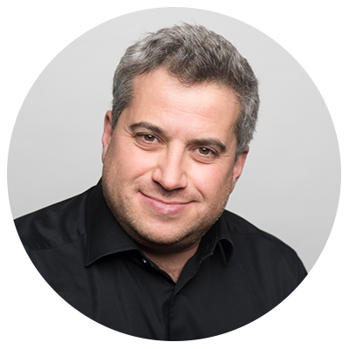




















HANACO GP – STRONG INVESMENT TRACK RECORD
ALON LIFSHITZ
PARTNER
LIOR PROSOR
PARTNER
PASHA ROMANOVSKI
PARTNER
Partner at Blumberg Capital ($700m+ US venture capital fund) – launched the Israel office and built Israel team
Technology scout for British Telecom and British Airways – previously for NTT, Vodafone, Softbank and others
38.0% IRR (as of Dec 2019)
4.47X Investment Multiple
$900M+ invested into portfolio alongside and followed on by VC funds such as Sequoia, Bessemer, Blackstone, Intel, GC and others
Director of Investments at multi-family office fund primarily investing early-stage into Israeli founders in the US
54.3% IRR (as of Dec 2019)
3.99X Investment Multiple
$1B+ invested into portfolio alongside and followed on by VC funds such as Softbank, Daimler, A16Z, Lightspeed, Bessemer, ICONiQ, DST and others
Entrepreneur turned investor
3X founder with 2 exits transitioned to angel investor and venture capitalist
Strong networks of fellow founders from his entrepreneurial past
20+ years experience in digital marketing and media
Follow-on and coinvestors into his angel investments include Sequoia, Intel, BMW, Alibaba, Access Industries and others
Chain Reaction
8
HANACO VENTURES II

Slide 9
HANACO TEAM FULLY BUILT OUT
ALON LIFSHITZ
PARTNER
LIOR PROSOR
PARTNER
PASHA ROMANOVSKI
PARTNER
GABI HELLER
PARTNER CFO
OREN CHARNOFF
VP
DAVID FRANKEL
VP
Frmr CFO, Walden Ventures and Trendlines Group
Frmr Board Director at public and private companies such as Ashtrom, Electra, Elco and Others
Frmr SR Associate at CN Family Office, on the Israel VC team (Fiverr, Credorax, Mapanything acq by Salesforce)
Start up experience at Omega Point and Windward
Frmr Investor at B Capital
Frmr Sr Associate at FFVC
Frmr Strategy Consultant at EY
MBA - UCLA
DANA KOCHAVI
OPERATIONS MANAGER
ITAI HOFFMAN
ASSOCIATE
TED KWARTLER
ADVISOR
Community Manager – Labs
Marketing Manager – Altshuler Shaham Benefits
Foreign Relations – Tel Aviv University
Consultant – Accenture and Shaldor Consulting
Data Analyst – Central Bank of Israel
Director of AI at Datarobot
Frmr Director of Data Science at Liberty Mutual
Adjunct Professor at Harvard & GSERM
9
HANACO VENTURES II

Slide 10
HANACO VENTURES I – OFF TO A GREAT START
Hanaco Ventures I (2018)
Fund Size:
MOIC:
$87m ($104m)
1.26x (1.34X)
Called to Date:
IRR (on deployed):
$60.9m($77.8m)
30.2% (35.2%)
DPI:
Companies:
0.0
12
$88.3m
$80.0
$70.0
$60.0
$50.0
$40.0
$30.0
$20.0
$10.0
$0.0
$26.5m
$65.8m
Total Follow on Funding
Time to Next Round
Portfolio Company Valuation Increase
Blended IRR
Blended MOIC
$137m
10 Month
$322m
35.2%
1.34x
$16.9m
$61.8m
$48.9m
Capital Deployed
Current Value
Hanaco Ventures I
Side-Car
Total
Data includes TS executing 1/20
10
HANACO VENTURES II

Slide 11
Data includes TS executing 1/20
HANACO VENTURES I, LP
 | DATE OF INITIAL INVESTMENT | TOTAL INVESTMENT AMOUNT | CURRENT VALUE
ShowFields | 2.18 | $3.6m | $4.6m
Namogoo | 3.18 | $8.8m | $11.9m
SeeTree | 8.18 | $7.5m | $12.0m
Darillium | 7.18 | $1.5m | $1.5m
Cheetah | 10.18 | $9.0m | $12.9m
Solidus | 12.18 | $2.5m | $2.5m
CNVRG | 1.19 | $3.6m | $3.6m
Hyro (Airbud) | 7.19 | $2.2m | $2.2m
Strigo | 7.19 | $2.0m | $2.0m
Redefine Meat | 8.19 | $1.9m | $1.9m
Chain Reaction | 8.19 | $1.7m | $1.7m
Sepio Systems | 10.19 | $4.6m | $5.0m
Total Hanaco Fund |  | $48.9m | $61.8m
IRR |  |  | 30.2%
MOIC |  |  | 1.26x
Value Increase |  |  | $12.8m
HANACO VENTURES SIDE CARS
 |  | INVESTMENT AMOUNT | CURRENT VALUE
Namogoo |  | $8.4m | $13.3m
Cheetah |  | $8.5m | $13.2m
Total |  | $16.9m | $26.5m
COMBINED TOTAL
 |  | INVESTMENT AMOUNT | CURRENT VALUE
Combined Total |  | $65.8m | $88.3m
IRR |  |  | 35.2%
MOIC |  |  | 1.34x
Value Increase |  |  | $22.5m
HANACO VENTURES I PORTFOLIO SUMMARY
11
HANACO VENTURES II

Slide 12













TOP & STRATEGIC INVESTORS COINVEST AND FOLLOW-ON
TO HANACO LED ROUNDS
Led Series B after Hanaco lead Series A
Led Series B after
Hanaco lead Series A
Coinvested in A and B
Coinvested in
Hanaco-Led Seed Round
Strong seed firm in SF coinvested with Hanaco in Seed
Largest US govt cyber system integrator participated in Hanaco lead Series A
Largest Brazilian Firm
Led Series A-II two months after Hanaco Led Series A
Coinvested in Seed and Led Series A
$1B leading European fund co-invested with Hanaco in Seed
Led Series A1 2 months after Hanaco round
… Pre-Hanaco coinvestors include:
12
HANACO VENTURES II

Slide 13

HANACO VENTURES FUND I VALUE-ADD EXAMPLES
  ► Introduction to COO
  ► Introduction to Advisor, former Head of AI at Liberty Mutual
  ► Recruited their first four sales and customer success hires
  ► Cofounder introduction
  ► Introduction to customers such as Brex, eightsleep, byChloe, iMax
  ► Introduction to Swan&Legend (A Lead and seed colead) and Communitas
  ► Recruited their first two data science hires
  ► Introduction to CFO
  ► Introduction to Levi’s ($1m ARR), River Island and Deckers
  ► Introduction to VP Product
  ► Introduction to OakHCFT – led $40m Series B
  ► Facilitated China customer roadshow
  ► Introduction to multiple VCs –
  co-led Series B with Eclipse ($30m)
  ► Helped launch and recruit Data Science team in Israel
  ► Introduction to Inventory and Retail Partner (NDA)
  ► Introduction to Greycroft Ventures (coinvest in Seed round)
  ► Introduction to Head of Business Development
  ► Introduction to first client in the retail space
  ► Introduction to Spider Capital, SF fund that participated in Seed
13
HANACO VENTURES II

Slide 14










BUILDING A PORTFOLIO OF INCREDIBLE REPEAT
AND EXPERIENCED FOUNDERS
Founder | Prior Co | Current Co
Na’ama Moran | (Acq by Groupon) | Cheetah
Tal Nathanel | (Acq by Livenation) (Acq by Shiji Group) | Showfields
Nevo Peretz | (Valued at $2B) | Strigo
Chemi Katz | (Acq by Click Media) | Namogoo
Alon Webman | (Acq by Nvidia) | Chain Reaction
REPEAT
Yossi Appelbaum | (Acq by Harman) | Sepio
Asaf and Praveen |  | Solidus
Israel Talpaz | PMO | SeeTree
Ori Shachar | (Acq by Intel) | SeeTree
Lev Oren |  | Darillium
Israel Krush |  | Airbud
Uri Valevski |  | Airbud
Leah Forkosh | WatchDox (Acq by Blackberry) | CNVRG
Eshchar Ben-Shitrit |  | Redefine Meat
EXPERIENCED
14
HANACO VENTURES II

Slide 15




HANACO VENTURES PORTFOLIO REVENUE PERFORMANCE
Hanaco actively tracks portfolio performance across a variety of metrics
See below for examples of Revenue (actual and projections)
$25m Series C
Q1 2020
$40m Series B
Q3 2019
$30m Series B
Q2 2019
Hanaco lead
Series A
3/18
Hanaco lead
Series A
10/18
Launching own supply chain and warehouse
$6M Series A II 10.18
$9m Series A
closing Q4 2019
Hanaco lead
Series A 8.18
Hanaco lead
Seed 2/18
15
HANACO VENTURES II

Slide 16





HANACO’S EDGE WITH COMPANIES
TEAM
COINVEST & FOLLOW ON FUNDING
• Same generation as
founders
• “Hustle”
• Coinvest mostly
with US funds
• Follow on funding
from Hanaco
PORTFOLIO VALUE-ADD
FOUNDER REFERENCES
• US offices: Customer Access
• Platform: Hanaco Boost
• Established track record/reputation
• Deal flow through founders
16
HANACO VENTURES II

Slide 17




MACRO THESIS
EXAMPLES OF MACRO TRENDS WE ARE PROACTIVELY INVESTING IN
MILLENNIAL BUYING POWER
AGRICULTURE & FOODTECH
BLOCKCHAIN
MODERN ENTERPRISE
MOBILITY SERVICES
”More Than the Vehicle”
Modern transportation requires reinvented mobility services such as data, ride sharing, infrastructure and new cyber vulnerabilities
Generational shift of spending power to millennials with modern preferences
New technology advancing one of the largest, most inelastic and outdated industries
Core HW and SW infrastructure to support blockchain adoption
Enterprise budgets moving from CIO to micro-business units
Chain Reaction
17
HANACO VENTURES II

Slide 18
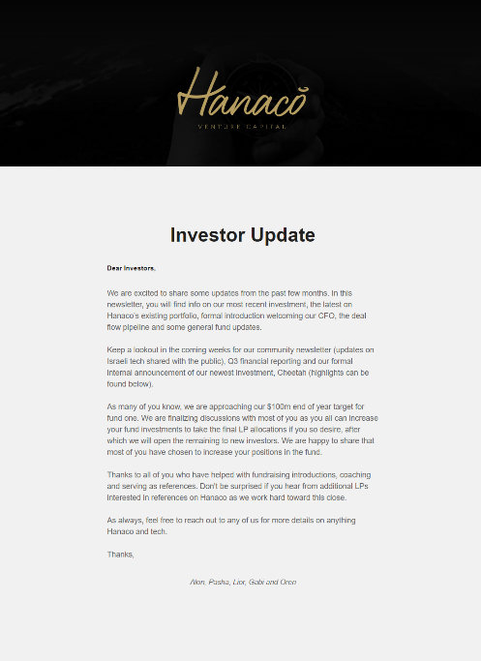
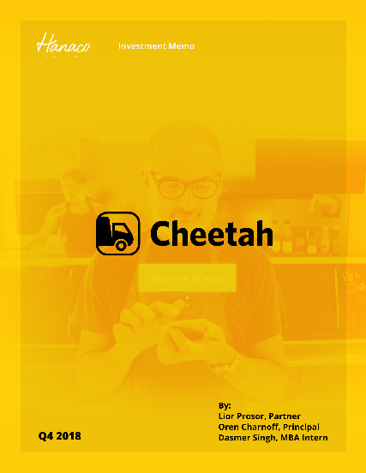
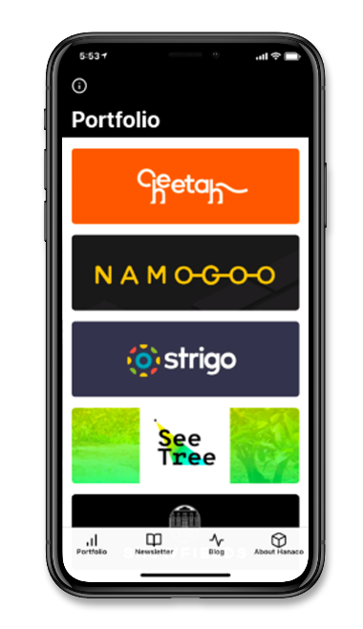
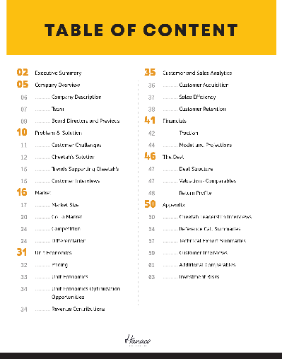
LP COMMUNICATION
FINANCIAL REPORTING
CO-INVESTMENT OPPORTUNITIES
  Although everyone should, we actually deliver our financial report well before deadlines - 30 days quarterly; 90 days yearly
  Very active in offering coinvests
DATA ROOM
DETAILED NEWSLETTER
HANACO APP
  Robust investment memo outlining diligence
  LINK
  Complete with portfolio updates, founder interviews and links to all of the above
18
HANACO VENTURES II

Slide 19









HANACO VENTURES I PORTFOLIO TO DATE
HANACO I TO INVEST IN UP TO ANOTHER 3 COMPANIES
Raised $40m Series B
2.1X Valuation Increase
Executing $8m Series B
2.2x Valuation Increase
Executing $20m B
3.5X Valuation Increase
Raised $55m Series B
2.6X Valuation Increase
Namogoo is a cyber security company that prevents customer journey hijacking, removes false bot traffic and optimizes site performance to improve sales conversion and cleanse corrupt data
Showfields is a real estate technology company reinventing retail for 21st century consumers by offering digital-native and traditional brands short term colocation physical space leases
SeeTree is an agriculture analytics platform that leverages computer vision and artificial intelligence to help farmers to manage and improve their crop yields
Darillium enables enterprises to efficiently deploy applicative workloads and new business services across multiple platforms and clouds
Cheetah’s e-commerce marketplace offers the simplest, fastest and most affordable solution for SMBs (restaurants) to manage their daily purchasing of supplies and services
CNVRG is a data science platform that helps companies manage, build and automate machine learning from research to production
Lead $15m Series A II
Coinvestors: Oak HCFT, GPV
Lead $6m Seed
Coinvestors: Swan & Legend, Communitas
Lead $6m Series A
Coinvestors: 3G Capital,
Canaan
Lead $2m Seed
Coinvestors: Janvest
Lead $21m Series A II
Coinvestors: Eclipse, ICONiQ, DST, Floodgate
Lead $6m Series A
Coinvestors: JVP
Executing $3.6m Series A1
28% Valuation Increase
Chain Reaction
Solidus Labs develops trade surveillance software to combat blockchain based trading market manipulation and fraud
AIRBUD’s plug and play AI platform enables websites to offer a conversational bot to allow customer to more naturally and easily transact.
STRIGO is enhancing SaaS customer training by improving the training experience for customers while empowering SaaS companies to offer more effective and flexible training
Chain Reaction is developing dedicated hardware (silicon) and software (cryptography) to unlock scale and security for blockchain
Redefine Meat is the world’s first company to develop a new additive manufacturing technology specifically for alternative meat printing
Sepio uncovers previously hidden hardware cyber attacks. Hackers today are attacking large companies through the physical layer
Lead $3.5m Seed
Coinvestors: GFC
Lead $3.8m Seed
Coinvestors: Spider, ERA
Lead $2.5m Seed
Coinvestors: Greycroft
Lead $2m Seed
Co-Lead $6m Seed
Coinvestors: CPT Capital
Lead $6.5m Series A
Coinvestors: Merlin Cyber
19
HANACO VENTURES II

Slide 20


DEALFLOW
Companies listed below are the top opportunities from the dealflow pipeline
Executing - Hanaco Ventures I
CYOLO is a secure access solution connecting internal and external users to enterprise applications, resources and files located anywhere.
Cyolo provides visibility and control to enhance security posture and reduce infrastructure costs.
  Access: Lior was introduced by a founder he previously invested in at his previous fund
  Traction: Launching POC with many customers including banks and publicly traded companies
MealCo is a digitally native restaurant brand focused on solving the problems associated with restaurant delivery. In doing so, they are creating high quality, delivery-focused food brands with an innovative cost-structure and strong economics.
  Access: Oren was introduced through a previous co-investor
  Traction: Launched POC with its first brand in NYC at the end of 2019, a health-forward Mexican food company.
MDGo uses advanced crash detection technology and real-time AI-based trauma analysis to connect a driver in an accident with emergency medical services.
  Access: Lior was introduced by a previous co-investor
  Traction: Early investment / strategic partnerships with Volvo Cars and Hyundai Motor
20
HANACO VENTURES II

Slide 21
HANACO PORTFOLIO CONSTRUCTION
$120m
  Fund Size
$104m
HANACO VENTURES I*
HANACO VENTURES II
 | # of Companies | 12 to date Targeting 13 (Two-three more Seed or one more Series A) |  | Targeting 13-15
 | Round Target | 7 Seed | 5 A | 9 Seed | 6 A
 | Vintage Year | 2018 |  | 2020
 | Average Check | $2.0m Seed (actual) | $5.5m A (actual) | $2m Seed | $5.5m A
 | Average Ownership | 19.7% (actual) | 14.9% (actual) | 20% | 15%
 | Allocation | 45% Initial | 55% Follow On | 45% Initial | 55% Follow On
21
HANACO VENTURES II
*Including side cars, as we are measuring our allocation

Slide 22



DEAL FLOW
SECTORS WE HAVE REVIEWED – FUNNEL – SOURCING CHANNELS
COMPANIES REVIEWED
BY SECTOR
DEAL FLOW FUNNEL
SOURCING
SaaS
236
FOUNDER REFERRALS
COMMUNITY
1148
Deals Reviewed
FinTech
162
GP’s founder relationships provides Hanaco unparalleled access
Hanaco connects with the community for recruiting, mentoring, speaking at meet-ups and conferences and publishing content
Misc
160
443
First Meeting
Cyber
153
153
232
Second Meeting
Consumer
Frontier Tech
92
72
Due Diligence
INVESTOR REFFERALS
Mobility
81
Angel and seed investors refer top performing companies from their portfolio to Hanaco
Health Tech
57
12
Term Sheets
Chain Reaction
Real Estate Tech
54
12
Portfolio
22
HANACO VENTURES II

Slide 23
FUND TARGETS
FUND TARGETS
Target Fund Size | $100m Target – ($120m cap)
Portfolio | 13-15 Investments $1-$5m Per Investment 15-20% Ownership Target
Fees | 2% Committed Capital
Terms | 20% Carry
Min Entry Ticket | $2m
TARGET
3-5x
Investment Period
3 Years
Fund Life
7 Years
23
HANACO VENTURES II

Slide 24

THANKS!
LIOR PROSOR
Lior@Hanacovc.com
+1-347-449-2688
ALON LIFSHITZ
Alon@Hanacovc.com
+972-526-802086
PASHA ROMANOVSKI
Pasha@Hanacovc.com
+972-546-462702

