Slide 1


VENTURES II

Slide 2





HANACO VENTURES II
Hanaco Ventures invests in the most promising Seed & Series A start ups from the Israeli ecosystem.
Hanaco partners with Israeli companies, wherever they are in the world,
helping them become category leaders beloved by their customers.
HANACO VENTURES I
LAUNCHED Jan 2018
HANACO VENTURES I
2018 - $87M
(+$16.5M SIDE CAR)
OFFICES NY &
TEL AVIV
TEAM OF 10
EARLY STAGE
LEADING
SEED/A ROUNDS
HANACO VENTURES II
$100M TARGET
($120M CAP)
2
HANACO VENTURES II

Slide 3





HANACO TODAY
2018
2020
PRE-HANACO
HANACO FUND I
HANACO FUND II
GPs track records greater than 4X MOIC
Connecting US & Israel for 10+ years
  Lior - Relocated to US in 2012 to invest in Israeli expats
  Alon - launched Israel office of US VC fund in 2010
  Pasha – 3X Entrepreneur and angel investor
Key investments include:
$87M Fund (+$16.5M side car)
Built firm brand in Israeli ecosystem
12 Investments
  7 already with up rounds
  $123m follow on funding into portfolio
  Portfolio Company valuation increase of $270m
$60m first close March ‘20
Completed first two deals
Team in place across both offices
YTD dealflow up 45% compared to the same period last year
EXIT
EXIT
Hanaco Ventures II remains focused on executing our proven strategy
3
HANACO VENTURES II

Slide 4


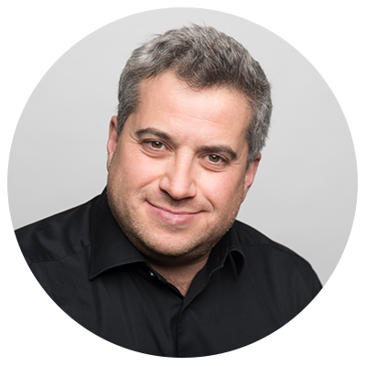



















HANACO GP – STRONG INVESMENT TRACK RECORD
ALON LIFSHITZ
PARTNER
LIOR PROSOR
PARTNER
PASHA ROMANOVSKI
PARTNER
Partner at Blumberg Capital ($700m+ US VC fund) → launched the Israel office and built Israel team
Technology scout for British Telecom and British Airways – previously for NTT, Vodafone, Softbank and others
37.6% IRR (as of Dec 2019)
4.5X Investment Multiple → Already returned more capital than invested
$900M+ invested into portfolio alongside and followed on by VC funds such as Sequoia, Bessemer, Blackstone, Intel, GC and others
Director of Investments at multi-family office fund primarily investing early-stage into Israeli founders in the US
52.9% IRR (as of Dec 2019)
3.7X Investment Multiple
$1B+ invested into portfolio alongside and followed on by VC funds such as Softbank, Daimler, A16Z, Lightspeed, Bessemer, ICONiQ, DST and others
Entrepreneur turned investor
3X founder with 2 exits transitioned to angel investor and venture capitalist
Strong networks of fellow founders from his entrepreneurial past
Angel investment track record: 4.5x Investment Multiple and 51.9% IRR
Follow-on and coinvestors into his angel investments include Sequoia, Intel, BMW, Alibaba, Access Industries and others
EXIT
EXIT
EXIT
4
HANACO VENTURES II

Slide 5


HANACO TEAM
ALON LIFSHITZ
PARTNER
LIOR PROSOR
PARTNER
PASHA ROMANOVSKI
PARTNER
GABI HELLER
PARTNER CFO
OREN CHARNOFF
VP
DAVID FRANKEL
VP
Frmr CFO, Walden Ventures and Trendlines Group
Frmr Board Director at public and private companies such as Ashtrom, Electra, Elco and Others
Frmr SR Associate at CN Family Office, on the Israel VC team (Fiverr, Credorax, Mapanything acq by Salesforce)
Start up experience at Omega Point and Windward
Frmr Investor at B Capital
Frmr Sr Associate at FFVC
Frmr Strategy Consultant at EY
MBA - UCLA
DANA KOCHAVI
OPERATIONS MANAGER
ITAI HOFFMAN
ASSOCIATE
ASIA BINUS
OPERATIONS MANAGER
Community Manager – Labs
Marketing Manager – Altshuler Shaham Benefits
Foreign Relations – Tel Aviv University
Consultant – Accenture and Shaldor Strategy Consulting
Data Analyst – Central Bank of Israel
Attorney – Israeli Ministry of Justice
Project manager – Meggi & Tuly
LLM and LLB – College of Management
5
HANACO VENTURES II

Slide 6



















OUR GLOBAL REACH
Hanaco’s Investments into Israeli Founders Globally
Boston:
Hanaco LP opps:
Previous:
Israel:
Hanaco LP opps:
Previous:
NY:
Hanaco LP opps:
Previous:
*
SF:
Hanaco LP opps:
Previous:
LatAm:
Previous:
6
HANACO VENTURES II
*Washington DC

Slide 7



OUR UNIQUE POSITIONING
MACRO TRENDS → ISRAELI FOUNDERS NOW GLOBAL AND ISRAELI VCS OVERSIZED
US BASED ISRAELI FOUNDERS
“COMPETITOR” FUNDS NOW TOO LARGE FOR SEED AND TRADITIONAL SERIES A
Israeli entrepreneurs founding their companies in the US from day one
  Diverse, multi-national founding teams
  Split US & Israeli HQ
2,000 Israeli start ups in the US
Israeli ex-pat founders are either experienced domain experts or repeat entrepreneurs
US VCs in Israel investing from $1b+ funds → positioning themselves for large Series A, B and growth rounds
Fellow tier one Israeli VCs investing from $200m+ funds → Sizing beyond $2m seed check and “traditional A”
Hanaco uniquely positioned in the VC landscape due to US office and disciplined fund size
7
HANACO VENTURES II

Slide 8









OUR CORE STRATEGY
INVESTMENT STRATEGY
PORTFOLIO CONSTRUCTION
Lead Seed & Series A
Seed 20% Ownership
Series A 15% Ownership
$100m Fund
12-15 Companies
2/3 Seed
1/3 A
Round Size Avg $2.0m Seed
Round Size Avg $5.5m A
Generalist
Thesis and Founder driven
40% Initial → 60% Follow On
50% US &
50% Israel Distribution
Hanaco Ventures II’s core strategy remains the same as Fund I
8
HANACO VENTURES II

Slide 9
WHY NOW
SHIFTING MARKET DYNAMICS INCREASING DEALFLOW QUANTITY AND QUALITY
“NEW NORMAL” MARKET CONDITIONS…
… HANACO UNIQUELY POSITIONED TO CAPITALIZE ON
Unfair advantage to new entrants into marketplace tackling new and heightened challenges created in a post corona world
Entry price valuations 30-40% lower than during last fund cycles
Increased founder emphasis on capital efficiency
True product-market-fit apparent → ability to grow during tight market conditions
Unprecedented deal flow volume – YTD up 45% compared to same period in ‘19
Building a portfolio with zero pre-COVID legacy while others are in “portfolio triage”
Adjusted investment strategy to capitalize on opportunities and trends accelerated by Corona
Our brand and value add DNA is more critical to founders than ever before
Launching Hanaco Ventures II in the new market conditions is an amazing opportunity to be extremely selective and leverage our brand as we build our new portfolio
9
HANACO VENTURES II

Slide 10






WE HAVE MADE COVID ADJUSTMENTS
HANACO’S ADJUSTED INVESTMENT STRATEGY
As Fund 2 launches during this period of uncertainty → We remain more excited than ever to be early-stage investors
HANACO ADJUSTED STRATEGY
STRICT VALUATIONS
  We are not flexibile on valuations
  Founders quickly returning after initally rejecting our porposed valuations
CASH ON HAND
  Investing in rounds providing at least 24 months of runway
CO-LEAD and COINVESTOR PREFERENCE
  Prefer to co-lead to increase pool of reserves
  Selecting coinvestors with ability to lead the following rounds
  Hanaco also increasing reserves per company
CAPITAL EFFICIENCY EVEN MORE CORE TO UNDERWRITING
  Implementing “growth” metrics to early stage
  Ex. Growth Cost efficiency → Net Burn/Net new ARR
    Includes upselling and new logos
    Net Burn:Net New Logo Account Value
Innovation does not stop and great companies are founded and grow regardless of the economic environment
10
HANACO VENTURES II

Slide 11






ONGOING MACRO THESIS
MACRO TRENDS WE CONTINUE TO TRACK → TWO THESES WE ARE ACTIVELY LEANING INTO GOING INTO FUND TWO
MOBILITY SERVICES
MILLENNIAL BUYING POWER
AGRICULTURE & FOODTECH
BLOCKCHAIN
MODERN ENTERPRISE
”More Than the Vehicle”
Modern transportation requires reinvented mobility services such as data, ride sharing, infrastructure and new cyber vulnerabilities
Generational shift of spending power to millennials with modern preferences
New technology advancing one of the largest, most inelastic and outdated industries
Core HW and SW infrastructure to support blockchain adoption
Enterprise budgets moving from CIO to micro-business units
11
HANACO VENTURES II

Slide 12

CORONA ACCELERATING TRENDS
WE ARE UNBUNDLING MACRO THESES AND DIVING DEEPER INTO SUBSECTORS ACCELERATED BY CORONA
LOGISTICS INFRASTRUCTURE
Online ordering and ecommerce poised to grow faster resulting in increased focus on inventory, payments, shipping and logistics
MACRO:
AGRICULTURE & FOODTECH
GROCERY AND FOOD
Online grocery, cloud kitchens and enabling technology for incumbents
Tools enabling remote work (screensharing collaboration, productivity tools, recruiting) and the cyber response to a further distributed workforce
WORK FROM HOME SOLUTIONS
MACRO:
MODERN ENTERPRISE
DIGITAL TRANSFORMATION
Digitizing offline workflows to increase efficiencies and conversions → especially for financial services
12
HANACO VENTURES II

Slide 13


SERIES A
$11m A round co-lead by Hanaco and Intel Capital
EasySend enables enterprises to digitize forms and processes to improve customer experience, increase conversion rates and reduce costs by optimizing process efficiency
ARR
INVESTMENT THESIS
QUICK FACTS
$6m
Enterprises still rely on physical forms and manual processes for customer onboarding and service (ex. Insurance claims) and lack the internal development teams to build and deploy internal and external technology alternatives
Founded in 2015
Bootstrapped and scaled in Israel through 2018
Raised Seed in 2018
45 employees
25 customers across Germany, United States and Israel
Customers from insurance, banks and financial services
0 churn to date
$2.7m
$1.4m
MACRO:
MODERN ENTERPRISE
DIGITAL TRANSFORMATION
2019
2020
2021
Corona accelerated trend
COINVESTOR:
CUSTOMERS:
13
HANACO VENTURES II

Slide 14




SERIES A
$7.5m A round co-lead by Hanaco and Lightspeed
FeeX enables financial advisors to monitor and trade upon a clients held-away assets
  REVENUE
INVESTMENT THESIS
QUICK FACTS
$2M
MACRO:
MODERN ENTERPRISE
DIGITAL TRANSFORMATION
Founded in 2012 as a consumer-facing fee management software
Raised $20m+ of capital prior to this recap
30 employees
>$380m in AUM on the platform
>500 advisors on the platform
>300 advisory firms on the platform
>2k customer accounts managed
→ only 1 sales rep
$0.1M
$.5M
Refocused business accelerating through Corona despite negligible marketing spend to-date. The company is well positioned to maintain its growth post-Corona as recent market volatility resurfaced the need for active management across one’s assets, especially their held-away retirement savings.
# OF ADVISORS
700
65
264
COINVESTORS:
CUSTOMERS:
14
HANACO VENTURES II

Slide 15
DEALFLOW
Thesis: Grocery & Food 2.0
Description: Package.AI is a SaaS platform optimizing last-mile delivery enabling delivery operators to provide more efficient delivery services by automating consumer communications and optimizing productivity
  Access: Lior was introduced by the pre-seed investor
  Traction: $700k of ARR tracking towards $1.3m ARR by EOY ‘20
Thesis: Digital Transformation of Healthcare
Description: MDI improves patient outcomes and reduces payer costs by enabling providers to offer data-driven polypharmacy management (MTM)across all populations
  Access: Pasha was introduced by the seed investor
  Traction: Launching two POCs this quarter with payer-providers in the US (CT) and Israel
Thesis: Logistics Infrastructure
Description: BOXSENSE is developing an IoT layer for packages to unlock insights for brands of their delivered products to increase revenues and operational efficiencies
  Access: Lior & Alon have a longstanding relationship with the founder
  Traction: Design partnership with one of the largest
  e-grocers and logistics companies in the US
15
HANACO VENTURES II

Slide 16


DEAL FLOW
SECTORS WE HAVE REVIEWED – FUNNEL – SOURCING CHANNELS
COMPANIES REVIEWED
BY SECTOR
DEAL FLOW FUNNEL
SOURCING
SaaS
339
FOUNDER REFERRALS
COMMUNITY
1648
Deals Reviewed
FinTech
232
GP’s founder relationships provides Hanaco unparalleled access
Hanaco connects with the community for recruiting, mentoring, speaking at meet-ups and conferences and publishing content
Misc
229
636
First Meeting
Cyber
219
219
333
Second Meeting
Consumer
Frontier Tech
132
86
Due Diligence
INVESTOR REFFERALS
Mobility
116
Angel and seed investors refer top performing companies from their portfolio to Hanaco
Health Tech
81
12
Term Sheets
Real Estate Tech
76
12
Portfolio
16
HANACO VENTURES II

Slide 17




HANACO VENTURES – MISSION DRIVEN VC
WHAT WE DO
WHAT WE DO NOT DO
• Increasing female participation and leadership in tech:
• Favor investments with social impact:
• Proactive Vice Clause:
• Voluntary category restrictions committed to not investing in:
• 1/3 of portfolio has a female founder
• Cheetah – empowering small and medium businesses
• SeeTree – Supporting farmers and preventing agriculture diseases
• Guns
• Gambling
• Porn
• Tobacco
• Increasing Israeli tech footprint globally
17
HANACO VENTURES II

Slide 18
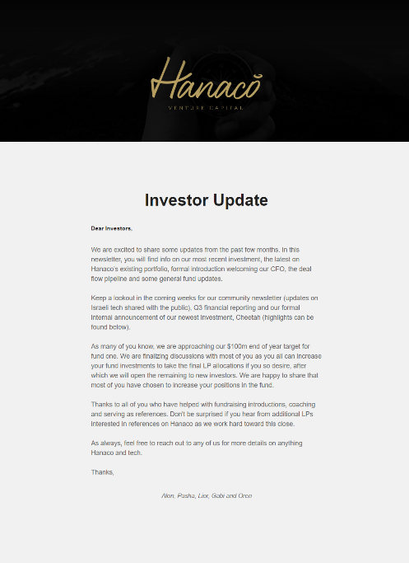
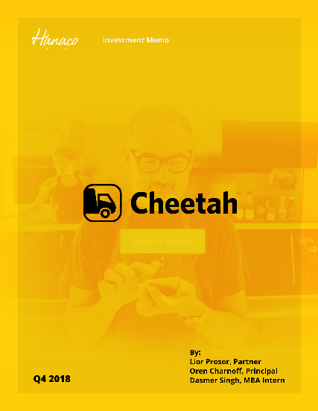
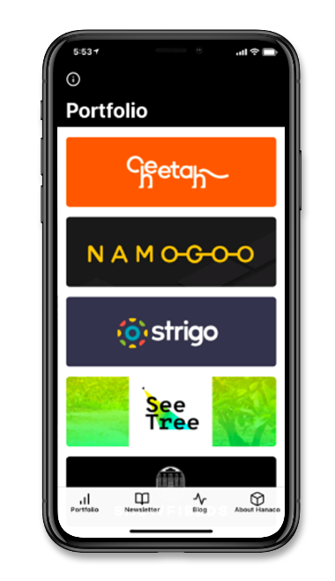
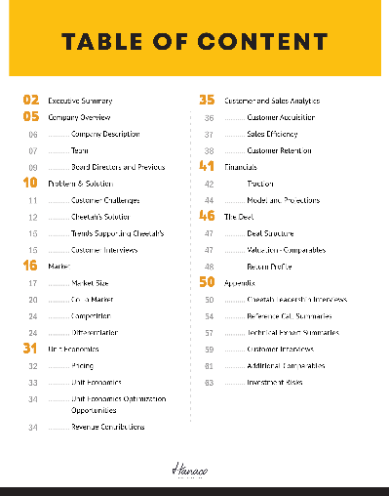
LP COMMUNICATION
FINANCIAL REPORTING
CO-INVESTMENT OPPORTUNITIES
  Although everyone should, we actually deliver our financial report well before deadlines - 30 days quarterly; 90 days yearly
  Very active in offering coinvests
DATA ROOM
DETAILED NEWSLETTER
HANACO APP
  Robust investment memo outlining diligence
  LINK
  Complete with portfolio updates, founder interviews and links to all of the above
18
HANACO VENTURES II

Slide 19
FUND TARGETS
FUND TARGETS
Target Fund Size | $100m Target – ($120m cap)
First Close | $60M
Portfolio | 12-15 Investments $1-$5m Per Investment 15-20% Ownership Target
Fees | 2% Committed Capital
Terms | 20% Carry
Min Entry Ticket | $2m
TARGET
3-5x
Investment Period
3 Years
Fund Life
7 Years
19
HANACO VENTURES II

Slide 20
DEEP DIVE INTO
HANACO VENTURES I
20
HANACO VENTURES II

Slide 21









HANACO VENTURES I PORTFOLIO
PROACTIVELY SOURCING DEAL FLOW IN VERTICALS WHERE DEMAND FOR INNOVATION GROWING
Raised $40m Series B
2.1X Valuation Increase
Raised $8m Series B
2.2x Valuation Increase
Executing $17.5m Series B
2.7X Valuation Increase
Closed
Raised $40m Series B
2.1X Valuation Increase
Namogoo is a cyber security company that prevents customer journey hijacking, removes false bot traffic and optimizes site performance to improve sales conversion and cleanse corrupt data
Showfields is a real estate technology company reinventing retail for 21st century consumers by offering digital-native and traditional brands short term colocation physical space leases
SeeTree is an agriculture analytics platform that leverages computer vision and artificial intelligence to help farmers to manage and improve their crop yields
Darillium enables enterprises to efficiently deploy applicative workloads and new business services across multiple platforms and clouds
Cheetah’s e-commerce marketplace offers the simplest, fastest and most affordable solution for SMBs (restaurants) to manage their daily purchasing of supplies and services
CNVRG is a data science platform that helps companies manage, build and automate machine learning from research to production
Lead $15m Series A II
Coinvestors: Oak HCFT, GPV
Lead $6m Seed
Coinvestors: Swan & Legend, Communitas Capital
Lead $6m Series A
Coinvestors: 3G Capital,
Canaan Ventures
Lead $2m Seed
Coinvestors: Janvest
Lead $21m Series A II
Coinvestors: Eclipse, ICONiQ, DST, Floodgate
Lead $6m Series A
Coinvestors: JVP
Raised $8m Series A
2.8X Higher Valuation
Raised $3.8m Series A1
29% Valuation Increase
Solidus Labs develops trade surveillance software to combat blockchain based trading market manipulation and fraud
AIRBUD’s plug and play AI platform enables websites to offer a conversational bot to allow customer to more naturally and easily transact.
STRIGO is enhancing SaaS customer training by improving the training experience for customers while empowering SaaS companies to offer more effective and flexible training
Chain Reaction is developing dedicated hardware (silicon) and software (cryptography) to unlock scale and security for blockchain
Redefine Meat is the world’s first company to develop a new additive manufacturing technology specifically for alternative meat printing
Sepio uncovers previously hidden hardware cyber attacks. Hackers today are attacking large companies through the physical layer
Lead $3.5m Seed
Coinvestors: GFC
Lead $3.8m Seed
Coinvestors: Spider, ERA
Lead $2.5m Seed
Coinvestors: Greycroft
Lead $2m Seed
Co-Lead $6m Seed
Coinvestors: CPT Capital
Lead $6.5m Series A
Coinvestors: Munich RE, Merlin Cyber, EDP Ventures
21
HANACO VENTURES II

Slide 22
HANACO VENTURES I, LP
 | DATE OF INITIAL INVESTMENT | TOTAL INVESTMENT AMOUNT | CURRENT VALUE
ShowFields | 2.18 | $3.6m | $4.6m
Namogoo | 3.18 | $8.8m | $11.9m
SeeTree* | 8.18 | $7.5m | $10.1m
Darillium | 7.18 | $1.5m | $0.0m
Cheetah | 10.18 | $9.0m | $11.0m
Solidus | 12.18 | $2.5m | $2.5m
CNVRG | 1.19 | $3.6m | $3.6m
Hyro (Airbud) | 7.19 | $2.2m | $2.2m
Strigo | 7.19 | $3.6m | $4.9m
Redefine Meat | 8.19 | $1.9m | $1.9m
Chain Reaction | 8.19 | $2.7m | $2.7m
Sepio Systems | 10.19 | $4.8m | $5.2m
Total Hanaco Fund |  | $51.8m | $60.6m
IRR |  |  | 15.7%
MOIC |  |  | 1.17x
Value Increase |  |  | $8.8m
HANACO VENTURES SIDE CARS
 |  | INVESTMENT AMOUNT | CURRENT VALUE
Namogoo |  | $8.4m | $13.3m
Cheetah |  | $8.5m | $10.9m
Total |  | $16.9m | $24.2m
COMBINED TOTAL
 |  | INVESTMENT AMOUNT | CURRENT VALUE
Combined Total |  | $68.7m | $84.8m
IRR |  |  | 19.2%
MOIC |  |  | 1.23x
Value Increase |  |  | $17.1m
HANACO VENTURES I PORTFOLIO SUMMARY
*Data includes TS executing 5/20
22
HANACO VENTURES II

Slide 23
HANACO VENTURES I – OFF TO A GREAT START
Hanaco Ventures I (2018)
Fund Size:
MOIC:
$87m ($104m)
1.17x (1.23X)
Called to Date:
IRR (on deployed):
$60.9m($77.8m)
17.1% (19.2%)
DPI:
Companies:
0.0
12
$90.0
$80.0
$70.0
$60.0
$50.0
$40.0
$30.0
$20.0
$10.0
$0.0
$84.8m
$68.7m
$24.2m
$16.9m
Total Follow on Funding
Time to Next Round
Portfolio Company Valuation Increase
Blended IRR
Blended MOIC
$124m
10 Month
$270m
19.2%
1.23x
$60.6m
$51.8m
Capital Deployed
Current Value
Hanaco Ventures I
Side-Car
Total
Data includes TS executing 5/20
23
HANACO VENTURES II

Slide 24








TOP & STRATEGIC INVESTORS COINVEST AND FOLLOW-ON
TO HANACO LED ROUNDS
Led Series B after Hanaco lead Series A
Coinvested in Seed and Co-led Series A
Led Series B after
Hanaco lead Series A
Coinvested in A and B
Co-led Series A
Strong seed firm in SF coinvested with Hanaco in Seed
Largest US govt cyber system integrator participated in Hanaco lead Series A
Largest Brazilian Firm
Led Series A-II two months after Hanaco Led Series A
Coinvested in Seed and Led Series A
$1B leading European fund co-invested with Hanaco in Seed
Led Series A1 2 months after Hanaco round
… Pre-Hanaco coinvestors include:
24
HANACO VENTURES II

Slide 25
HANACO VENTURES FUND I VALUE-ADD EXAMPLES
  ► Introduction to COO
  ► Introduction to Advisor, former Head of AI at Liberty Mutual
  ► Recruited their first four sales and customer success hires
  ► Cofounder introduction
  ► Introduction to customers such as Brex, eightsleep, byChloe, iMax
  ► Introduction to Swan&Legend (A Lead and seed colead) and Communitas
  ► Recruited their first two data science hires
  ► Introduction to CFO
  ► Introduction to Levi’s ($1m ARR), River Island and Deckers
  ► Introduction to VP Product
  ► Introduction to OakHCFT – led $40m Series B
  ► Facilitated China customer roadshow
  ► Introduction to multiple VCs –
  co-led Series B with Eclipse ($36m)
  ► Helped launch and recruit Data Science team in Israel
  ► Introduction to Inventory and Retail Partner (NDA)
  ► Introduction to Greycroft Ventures (coinvest in Seed round, Series A co-lead) & Velvet Sea Ventures (Series A co-lead)
  ► Introduction to Head of BD
  ► Introductions to two signed $80k+ ARR customers
  ► Introduction to first client in the retail space
  ► Introduction to Spider Capital, SF fund that participated in Seed
25
HANACO VENTURES II

Slide 26










BUILDING A PORTFOLIO OF INCREDIBLE REPEAT
AND EXPERIENCED FOUNDERS
Founder | Prior Co | Current Co
Na’ama Moran | (Acq by Groupon) | Cheetah
Tal Nathanel | (Acq by Livenation) (Acq by Shiji Group) | Showfields
Nevo Peretz | (Valued at $2B) | Strigo
Chemi Katz | (Acq by Click Media) | Namogoo
Alon Webman | (Acq by Nvidia) | Chain Reaction
REPEAT
Yossi Appelbaum | (Acq by Harman) | Sepio
Asaf and Praveen |  | Solidus
Israel Talpaz | PMO | SeeTree
Ori Shachar | (Acq by Intel) | SeeTree
Lev Oren |  | Darillium
Israel Krush |  | Hyro
Uri Valevski |  | Hyro
Leah Forkosh | WatchDox (Acq by Blackberry) | CNVRG
Eshchar Ben-Shitrit |  | Redefine Meat
EXPERIENCED
26
HANACO VENTURES II

Slide 27








HANACO VENTURES PORTFOLIO REVENUE PERFORMANCE
Hanaco actively tracks portfolio performance across a variety of metrics
See below for examples of Revenue
$40m Series B
Q3 2019
$30m Series B
Q2 2019
Hanaco lead
Series A
3/18
Hanaco lead
Series A 10/18
Launching own supply chain and warehouse
Hanaco lead
Series A I 8.18
Hanaco lead
$2.5m Seed 6.19
$6M Series A II 10.18
27
HANACO VENTURES II

Slide 28

THANKS!
ADITIONAL MATERIALS INCLUDE:
• Corona Impact Deep Dive
• Introduction to Israel
• Data room with investment memos, track records and much more
LIOR PROSOR
Lior@Hanacovc.com
+1-347-449-2688
ALON LIFSHITZ
Alon@Hanacovc.com
+972-526-802086
PASHA ROMANOVSKI
Pasha@Hanacovc.com
+972-546-462702

