Slide 1


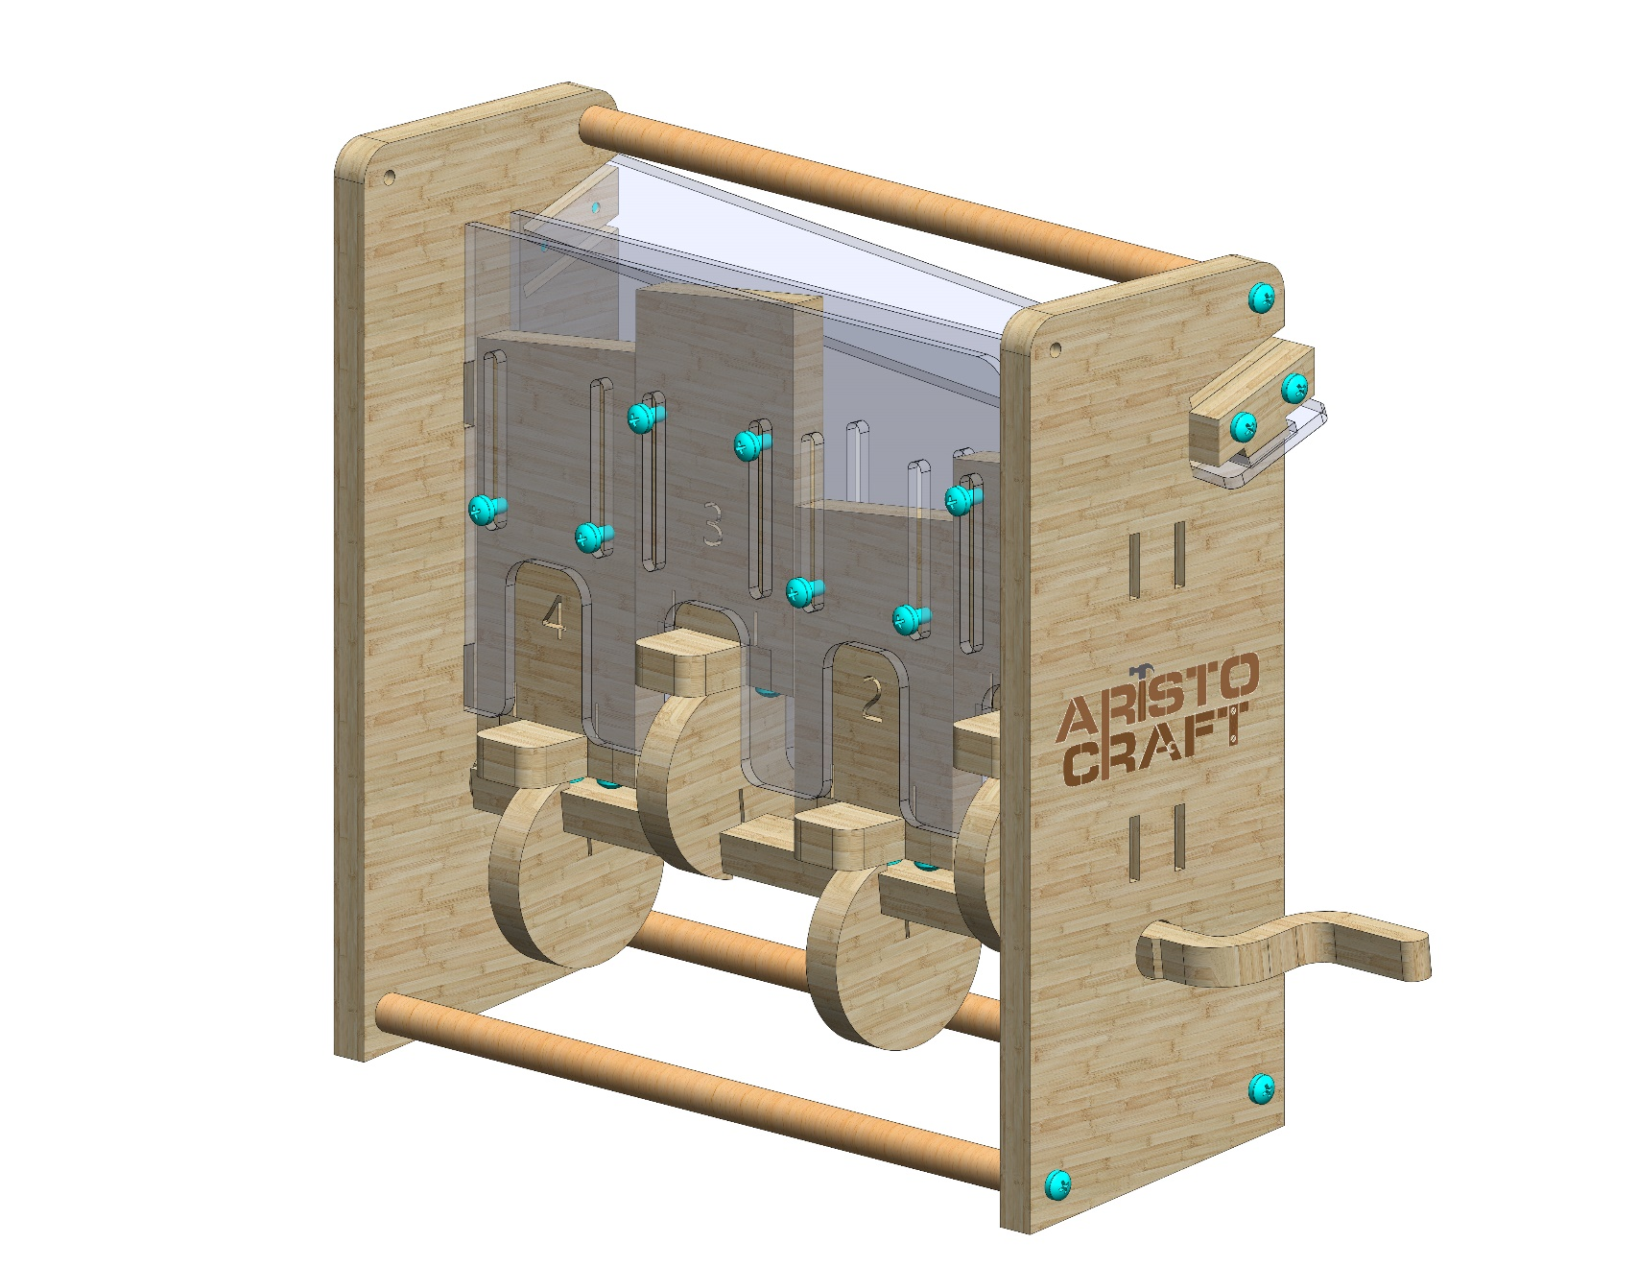
MOVING STAIRS
Assembly instruction
© All rights reserved to AristoCraft Ltd. Do not copy or reproduce without written permission.

Slide 2
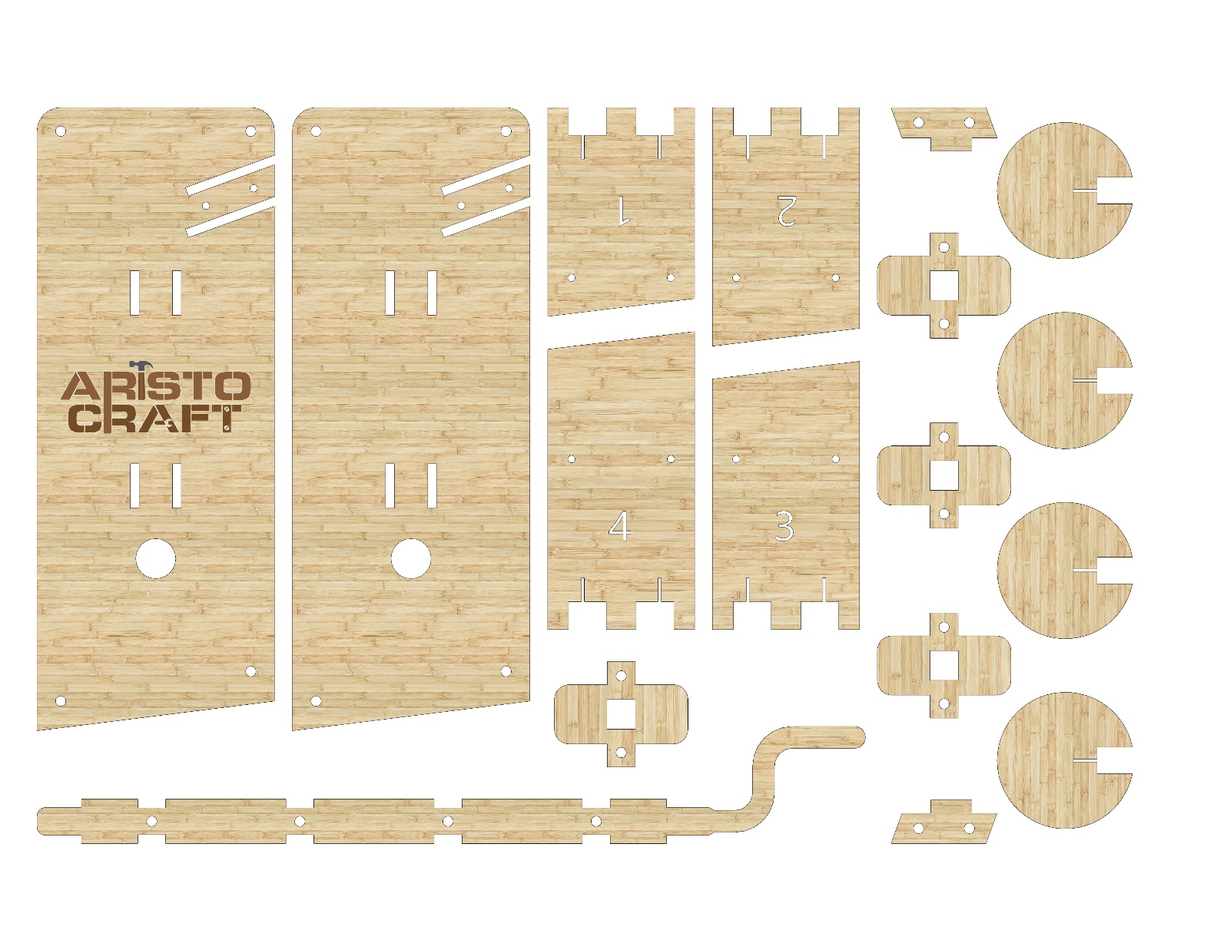
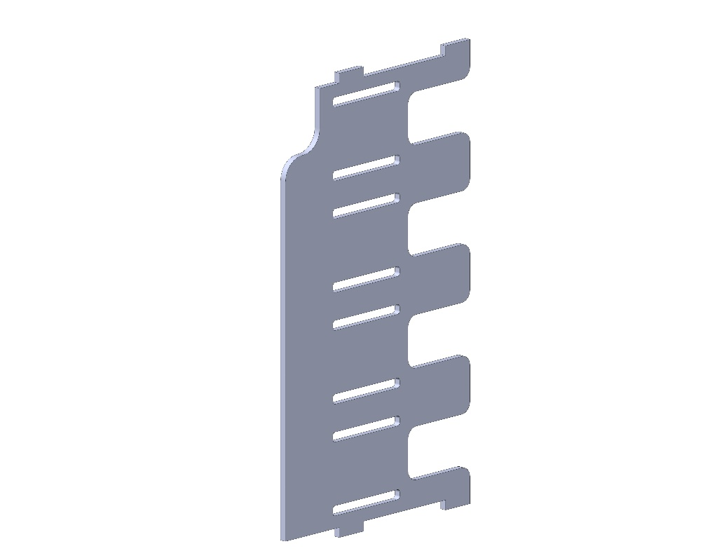
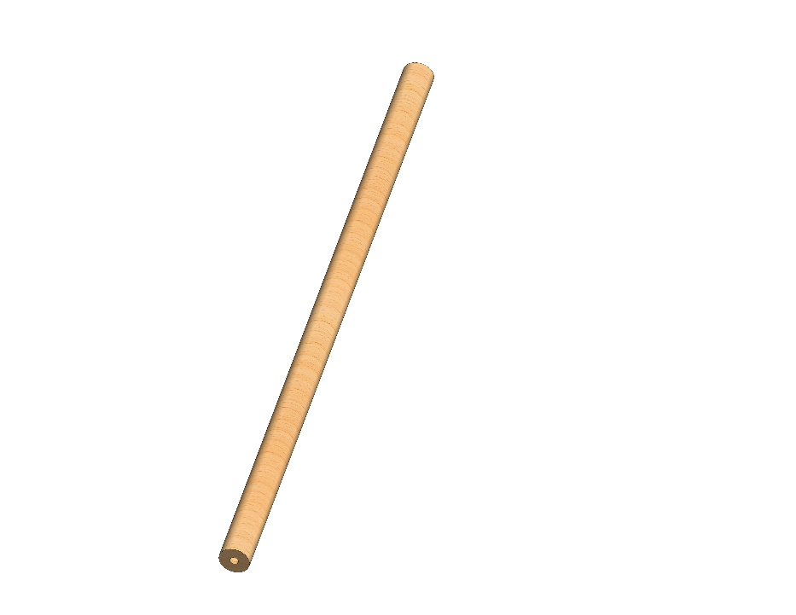
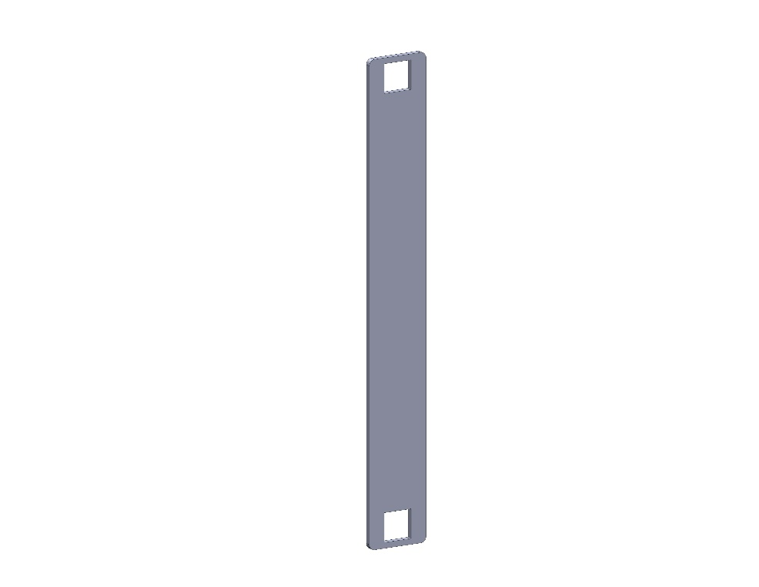
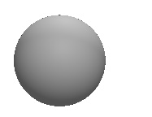
Part list
9
6
7
8
1
2
5
6
5
4
3
6
5
5
9
6
10
11
12
13
14
© All rights reserved to AristoCraft Ltd. Do not copy or reproduce without written permission.

Slide 3
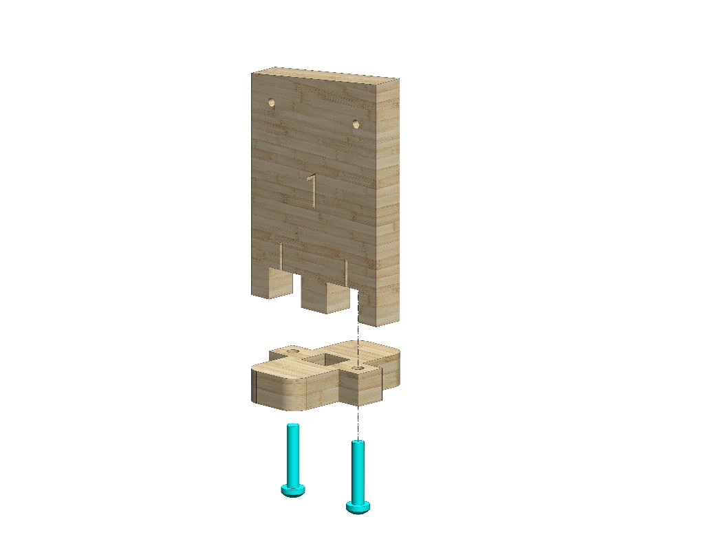
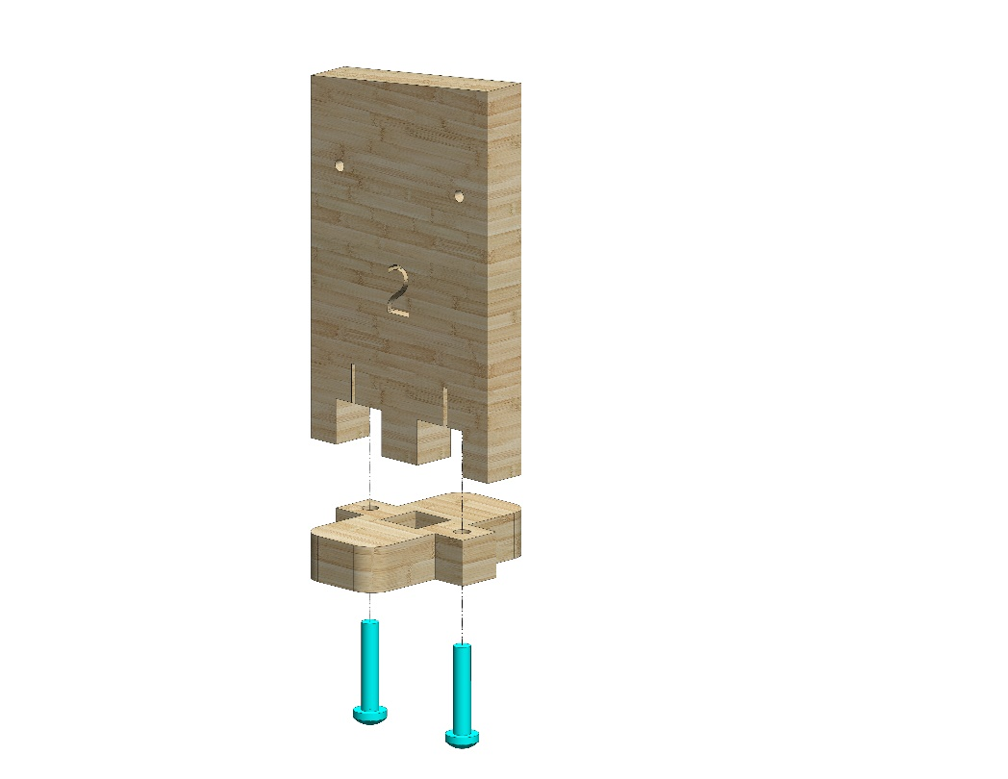
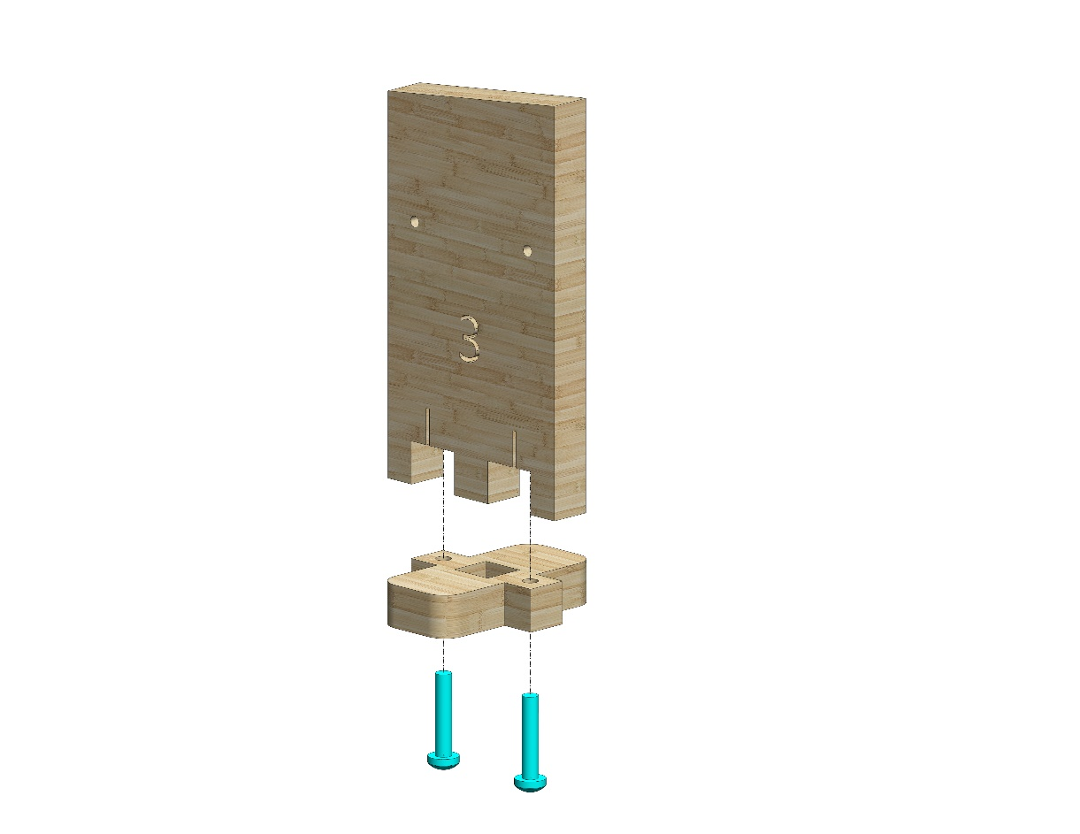
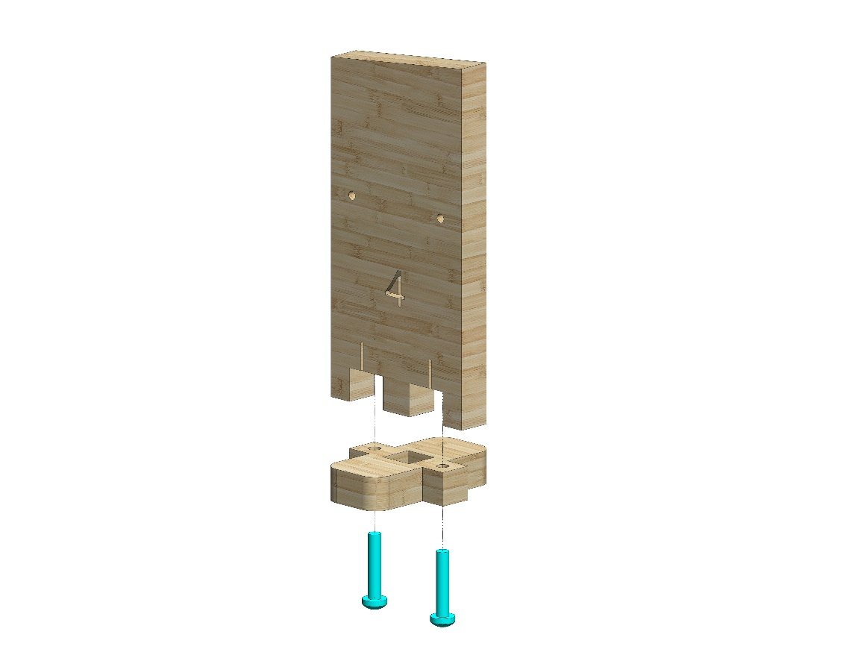
Instructions
Attach Part 5 to Part 1.
Use two #20 bolts.
1
2
5
5
Attach Part 5 to Part 2.
Use two #20 bolts.
Attach Part 5 to Part 3.
Use two #20 bolts.
3
4
5
5
Attach Part 5 to Part 4.
Use two #20 bolts.
© All rights reserved to AristoCraft Ltd. Do not copy or reproduce without written permission.

Slide 4
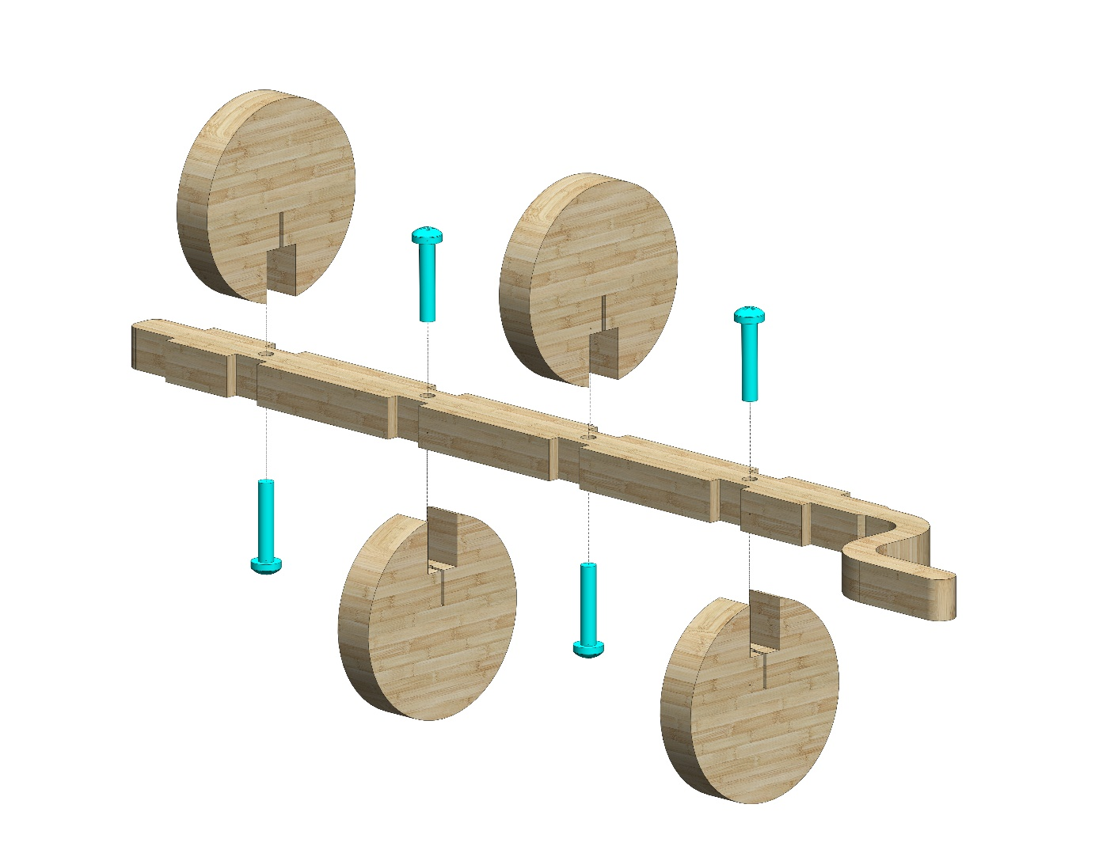
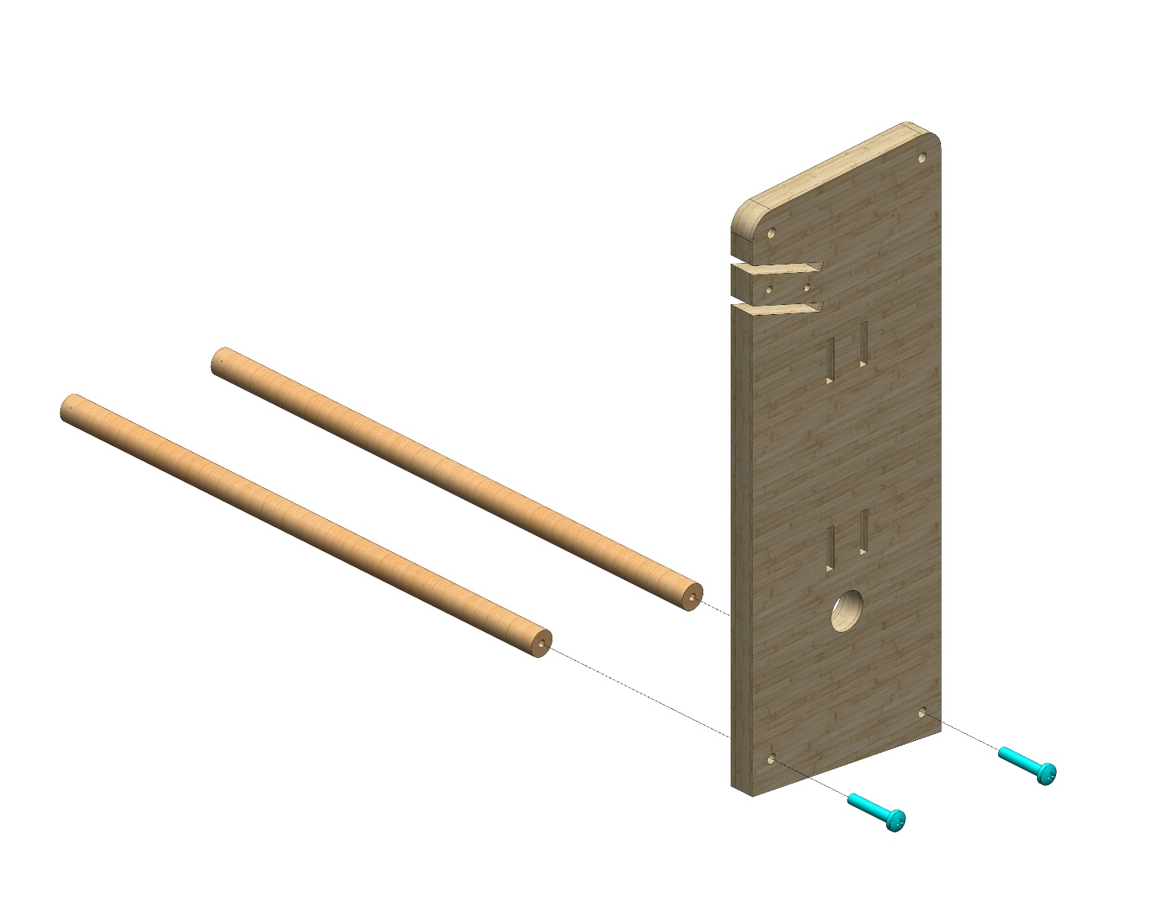
נחבר ארבעה חלקים מסוג 6 לחלק מספר 10
כפי שמתואר בציור.
נשתמש ב 4 ברגי 20#.
6
6
10
6
6
Attach two Part 13s to Part 8. Note the position of the slots on the side. Use two #20 bolts.
13
13
8
© All rights reserved to AristoCraft Ltd. Do not copy or reproduce without written permission.

Slide 5
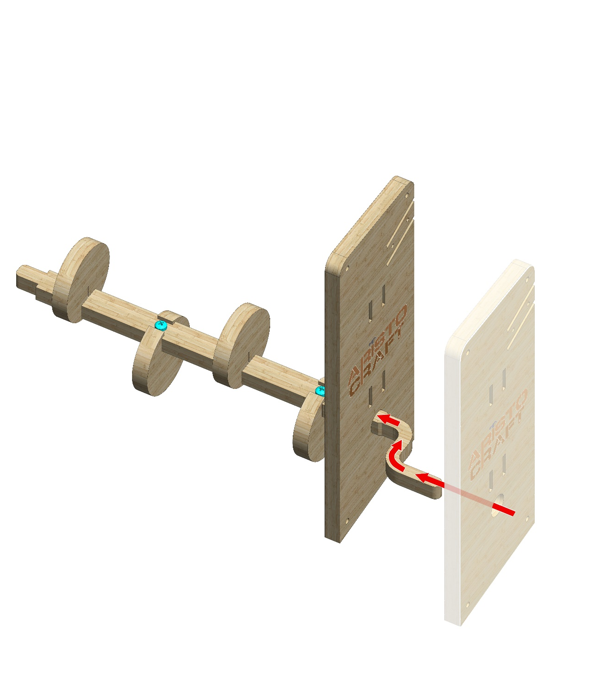
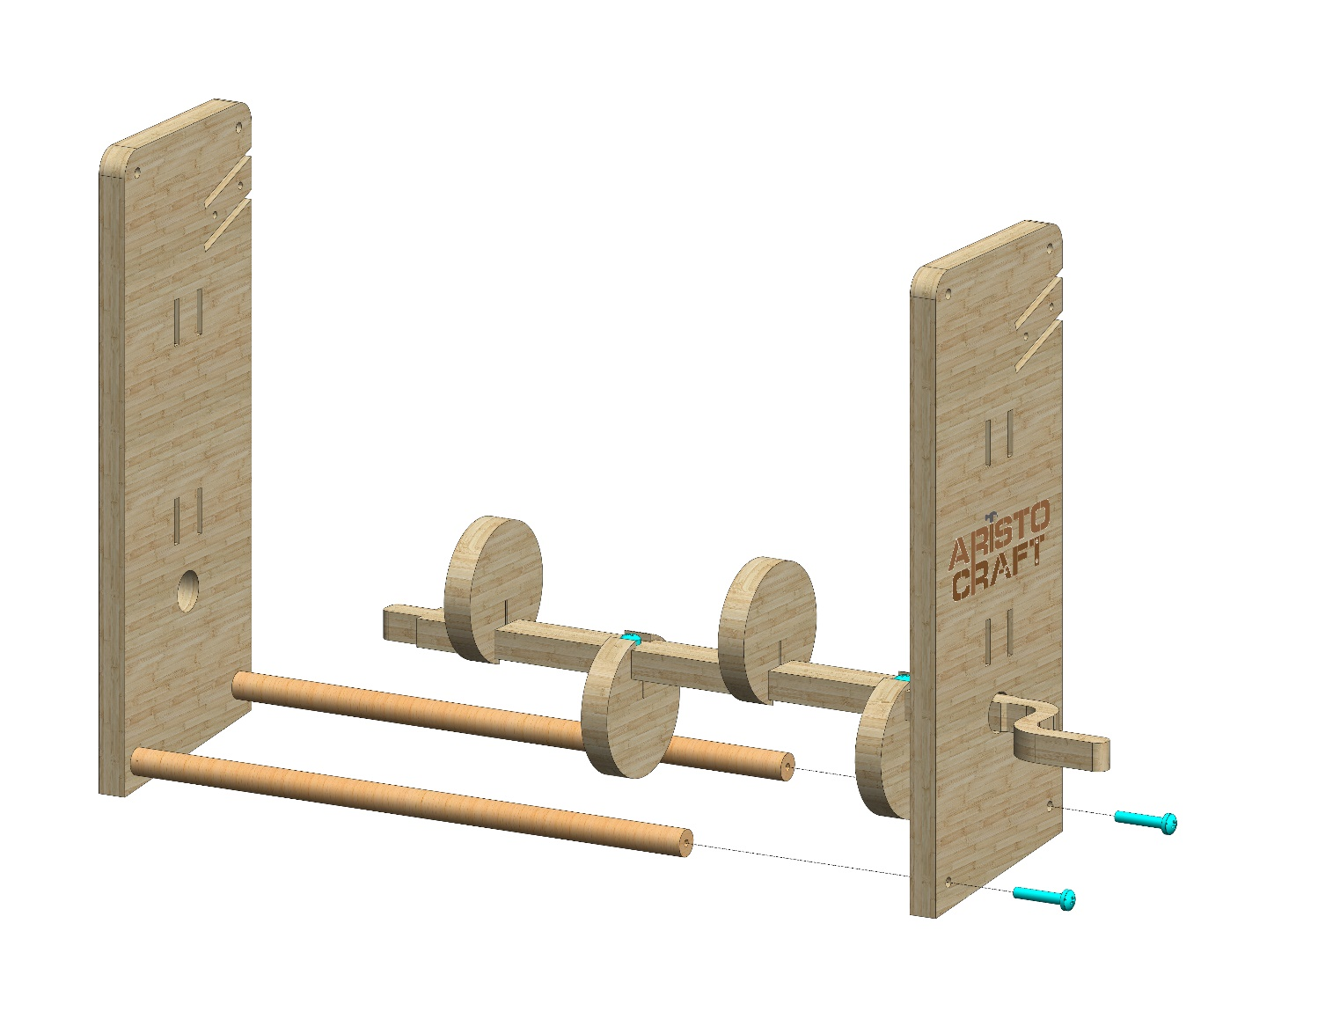
7
נשחיל את חלק מספר 7 כפי שמתואר בציור.
נשים לב לכיוון החריצים בחלק מספר 7.
נשחיל את המכלול כפי שמתואר בציור.
נשתמש ב 2 ברגי 20#.
© All rights reserved to AristoCraft Ltd. Do not copy or reproduce without written permission.

Slide 6
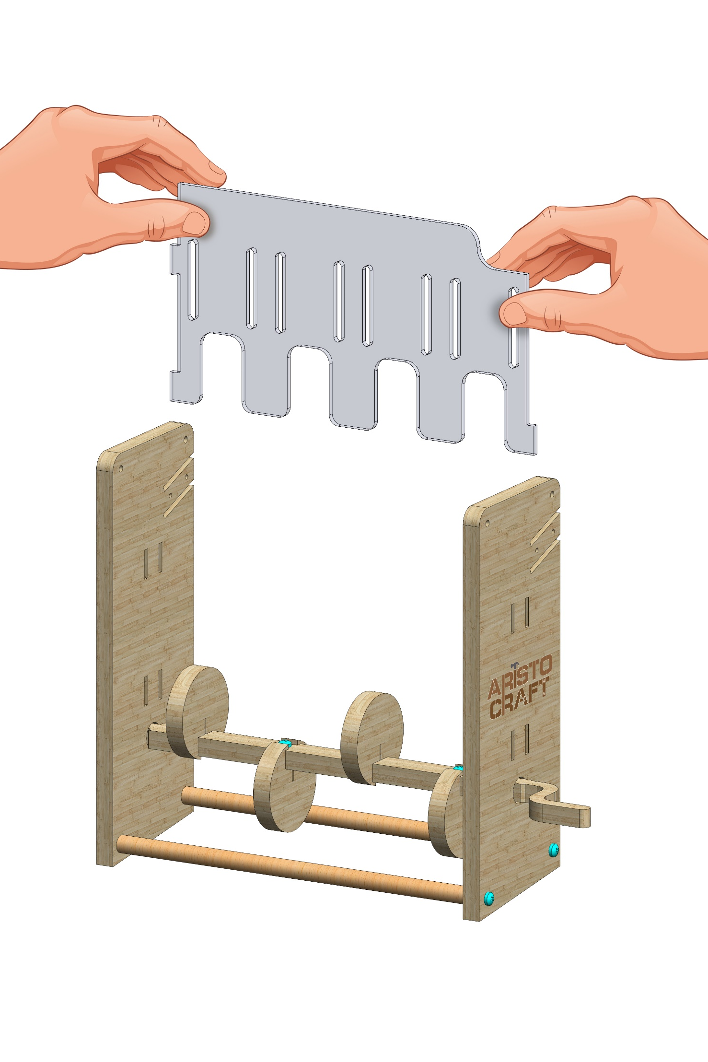
Hold Part 11 as pictured.
Make sure it is facing in the right direction!
Bend it gently and insert the tabs into the indicated slots.
11
© All rights reserved to AristoCraft Ltd. Do not copy or reproduce without written permission.

Slide 7
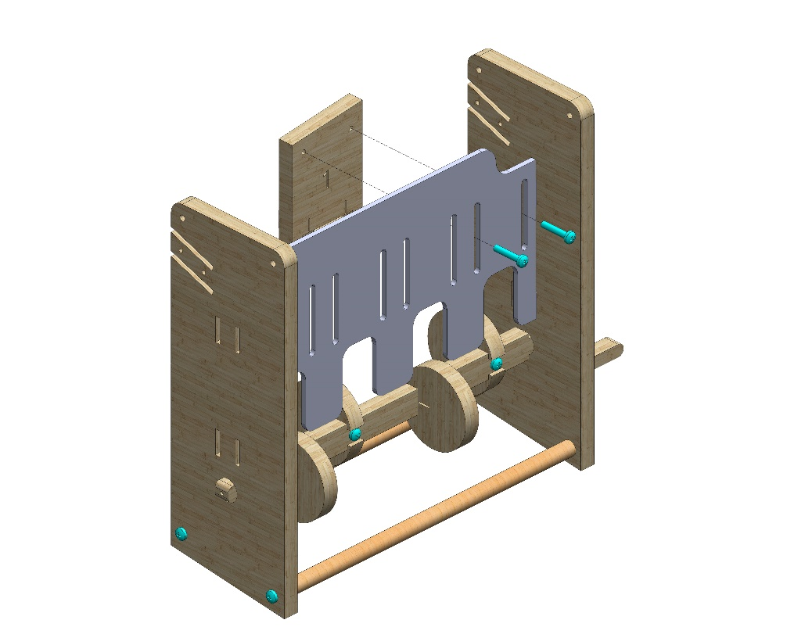
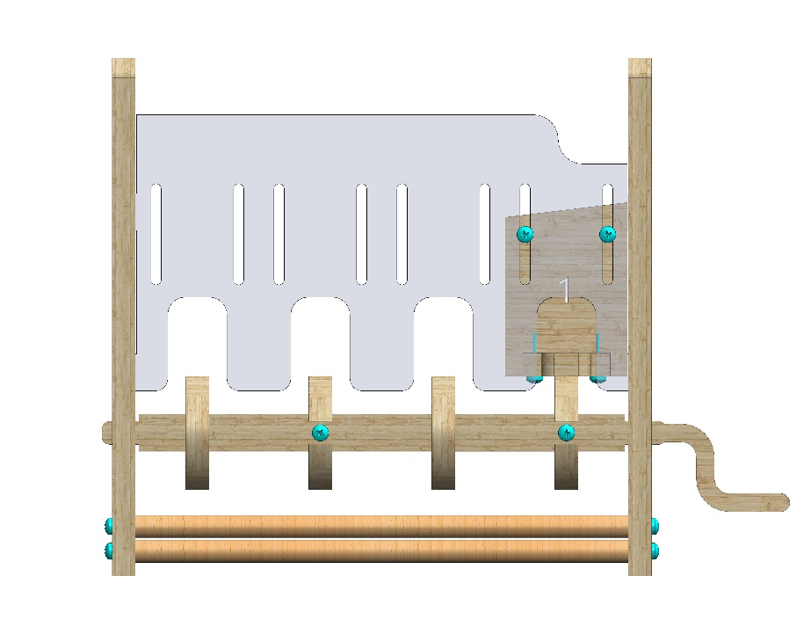
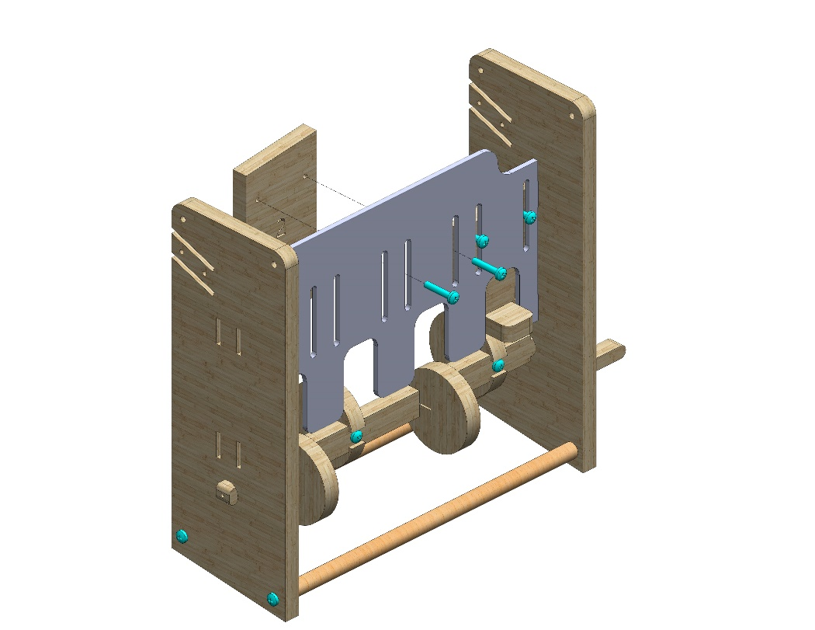
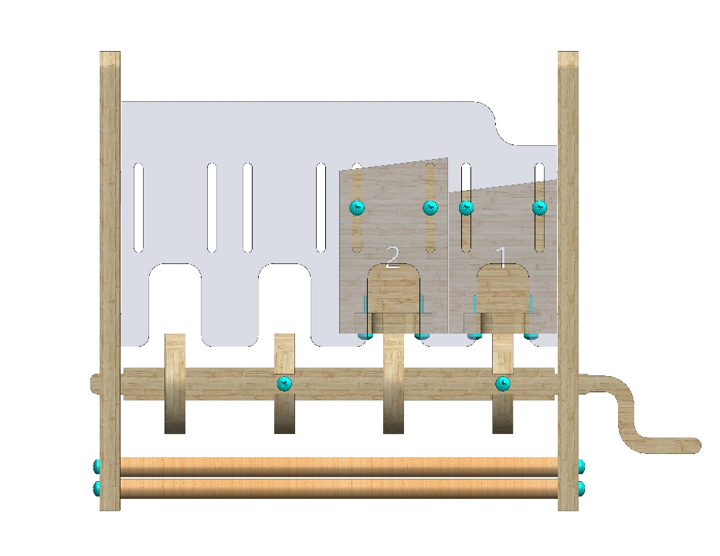
Attach Part 1 as pictured. Note the angle of the step.
Use two #20 bolts. Do not tighten the bolts.
The step must be able to move up and down freely.
1
Attach Part 2 as pictured. Note the angle of the step.
Use two #20 bolts. Do not tighten the bolts.
The step must be able to move up and down freely.
2
© All rights reserved to AristoCraft Ltd. Do not copy or reproduce without written permission.

Slide 8
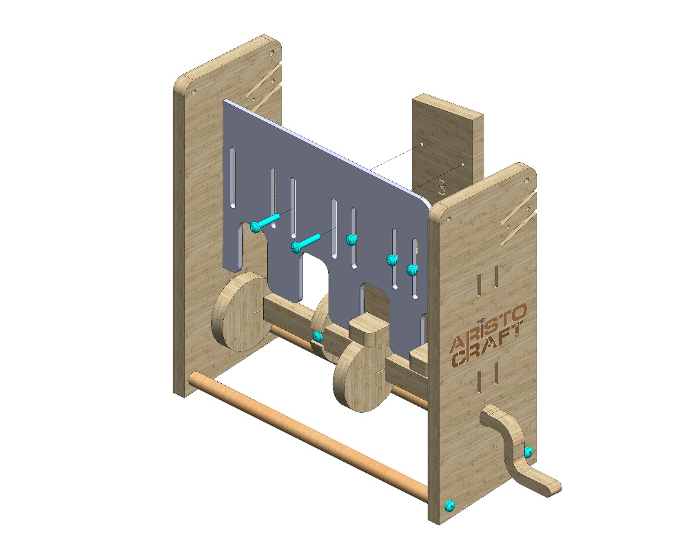
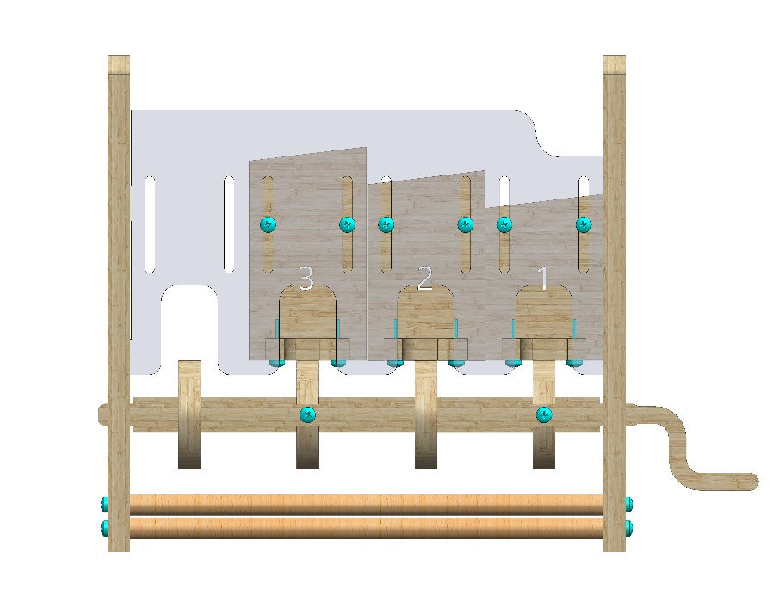
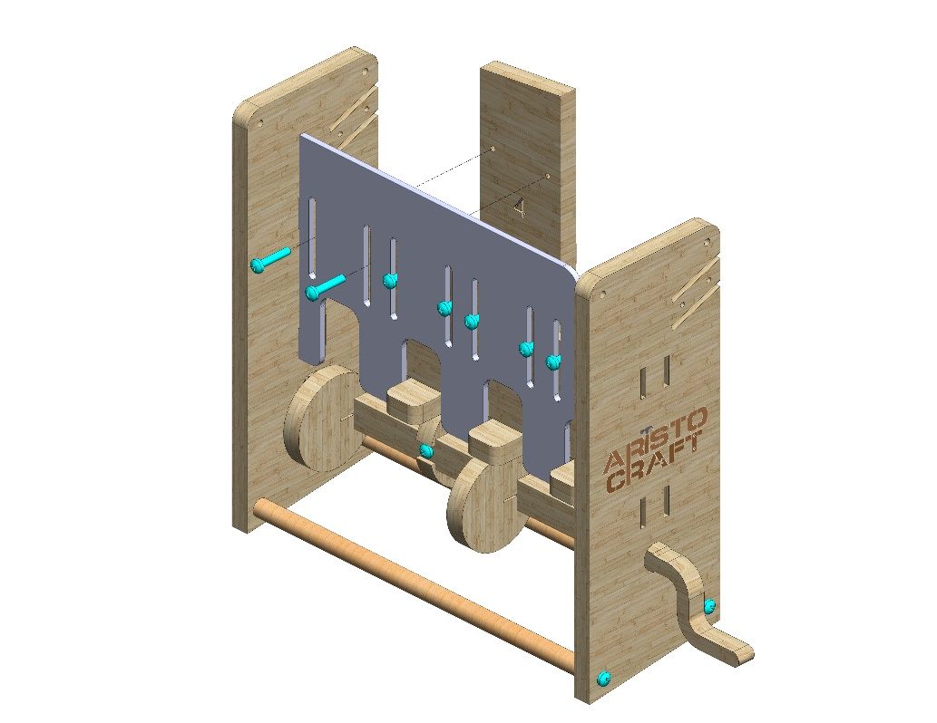
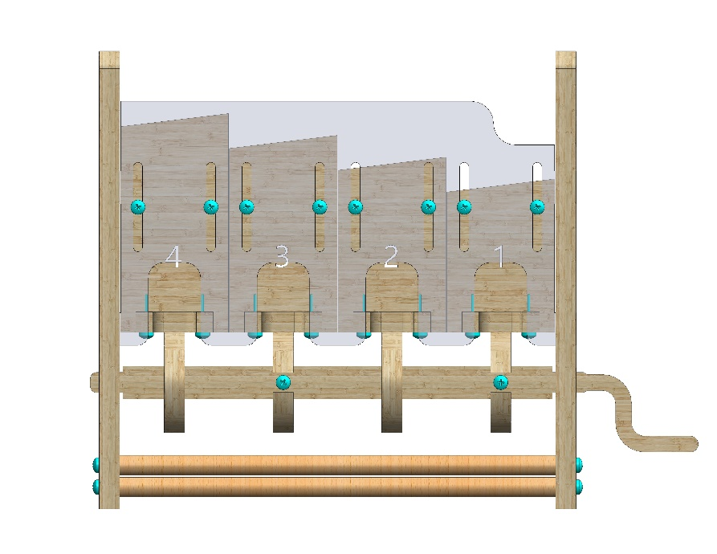
Attach Part 3 as pictured. Note the angle of the step.
Use two #20 bolts. Do not tighten the bolts.
The step must be able to move up and down freely.
1
3
Attach Part 4 as pictured. Note the angle of the step.
Use two #20 bolts. Do not tighten the bolts.
The step must be able to move up and down freely.
4
© All rights reserved to AristoCraft Ltd. Do not copy or reproduce without written permission.

Slide 9
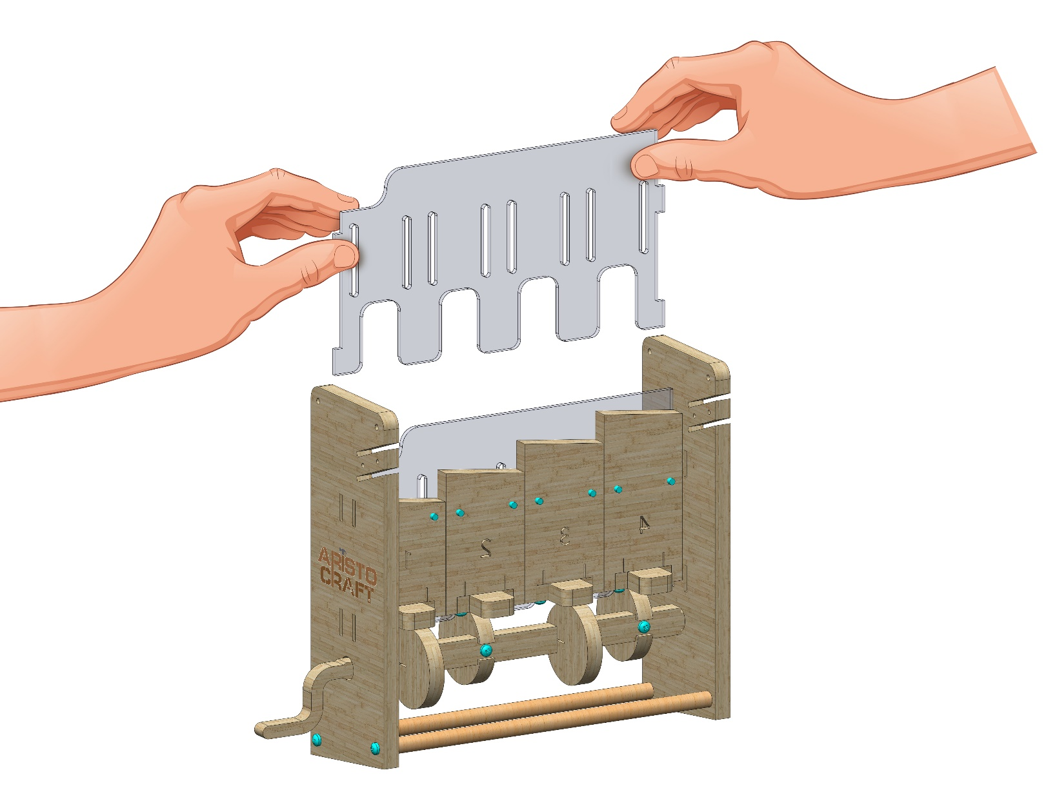
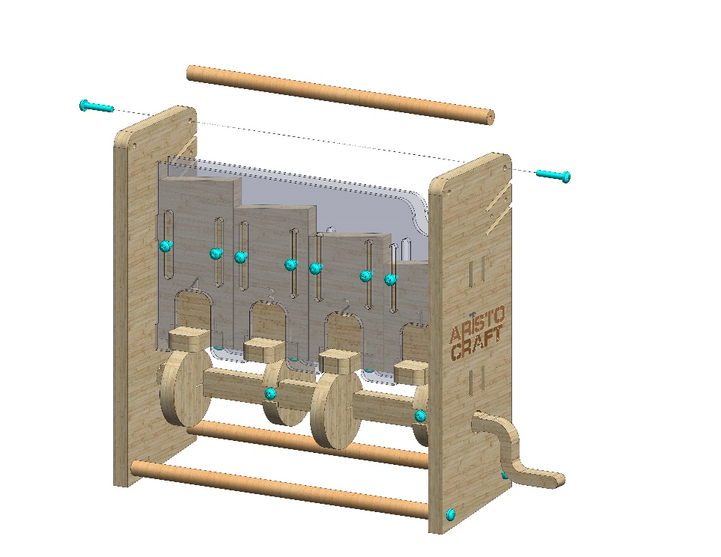
Hold Part 11 as pictured.
Make sure it is facing in the right direction!
Bend it gently and insert the tabs into the slots.
11
13
Attach Part 13 as pictured. Use two #20 bolts.
© All rights reserved to AristoCraft Ltd. Do not copy or reproduce without written permission.

Slide 10
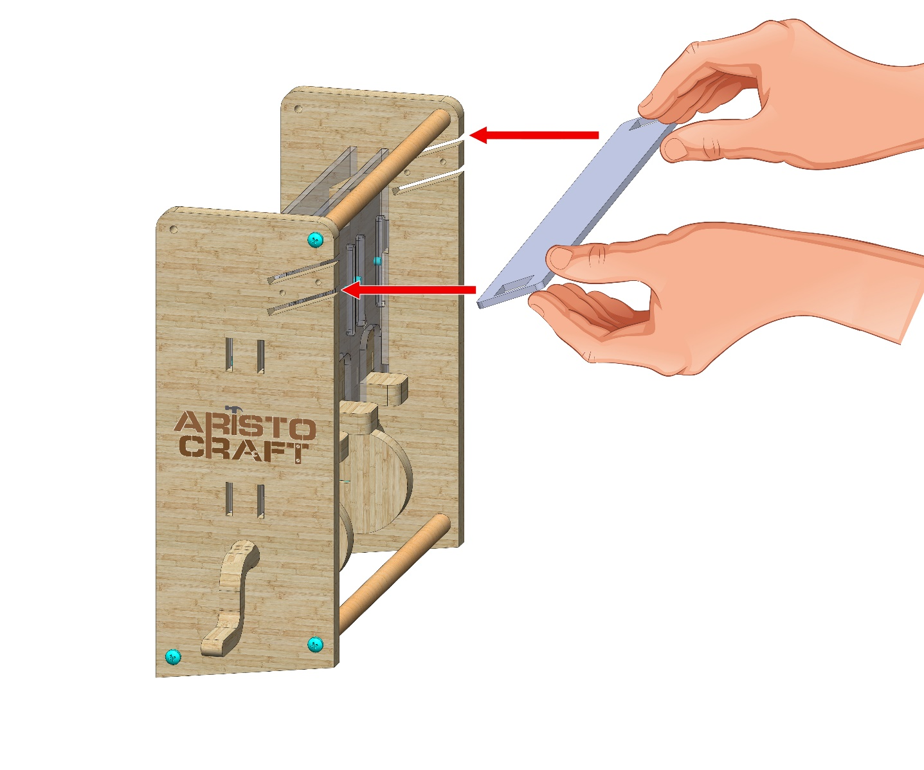
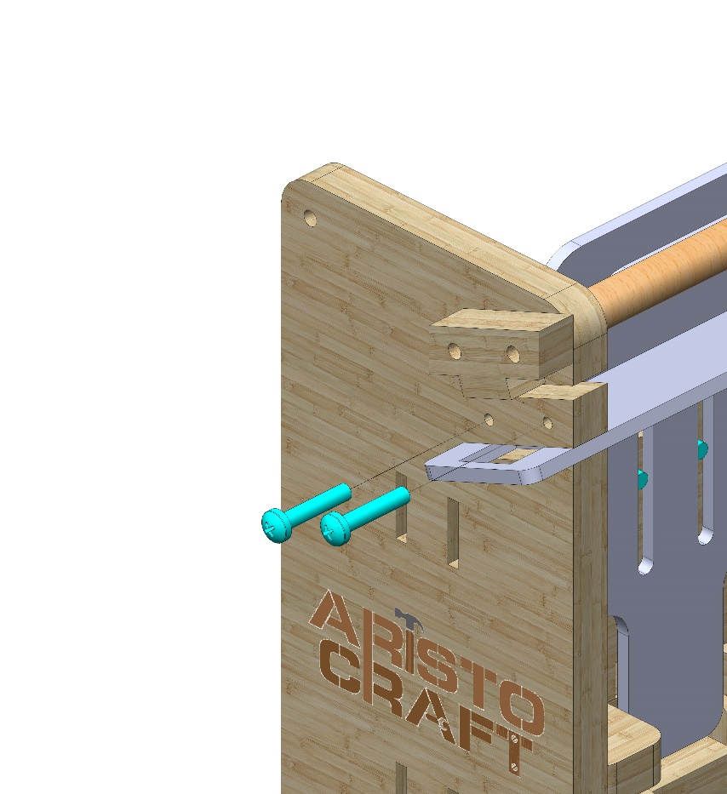
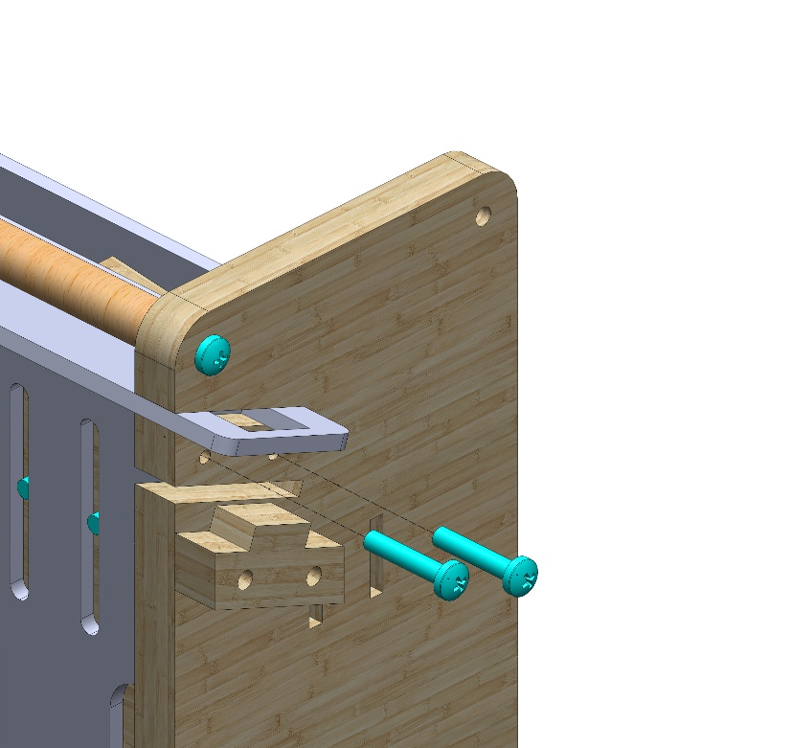
12
Hold Part 12 as illustrated in the diagram.
Make sure that the right side is inserted into the upper slot.
Make sure that the left side is inserted into the lower slot.
ניקח שני חלקים מסוג 9 ונכניס אותם אל תוך החריץ המתאים בפרספקס.
נשתמש ב 2 ברגי 20# מכל צד.
9
9
© All rights reserved to AristoCraft Ltd. Do not copy or reproduce without written permission.

