Slide 1
UMatch Analytics
More than just connections

Slide 2
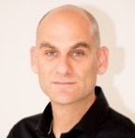
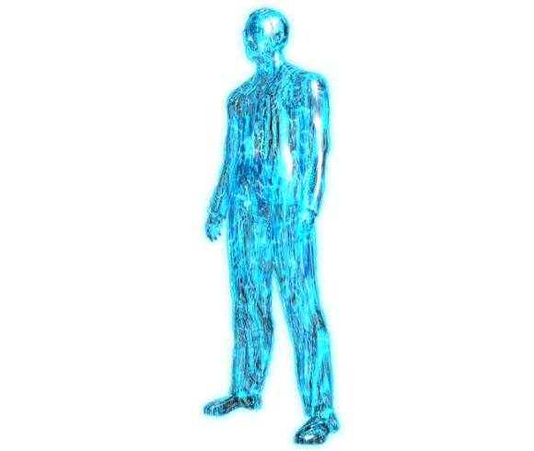
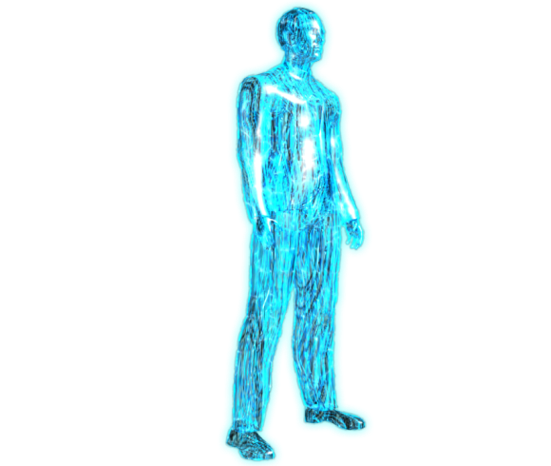
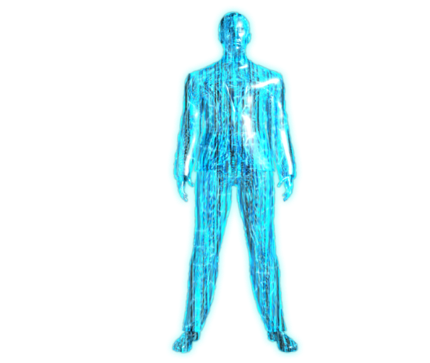
Let me Take You behind the scenes of the cyber intelligence world
Golan Malca | Founder & CEO
LTC (IDF) – A Lieutenant Colonel (reserve), serves as a head of staff in artillery brigade in the Northern Command
Former Vice President of Business Development in the intelligence and cyber division at NICE and Elbit systems.
More than 20 years leading a unique technological business activity, in more than 30 countries , from the need stage through the selling stage till delivery in the Defense, HLS and Cyber fields.

Slide 3
“THE BIG BUSINESS LEGO GAME”

Slide 4
THE NEED
We Want To Bring Real Business Value:
At
Specific TIME
In
Specific PLACE
For
Specific PEOPLE
In
Specific CONTENT
FOR A NEW MATCHING PARADIGM
WE MUST BRING NW KNOW- HOW
8
9

Slide 5
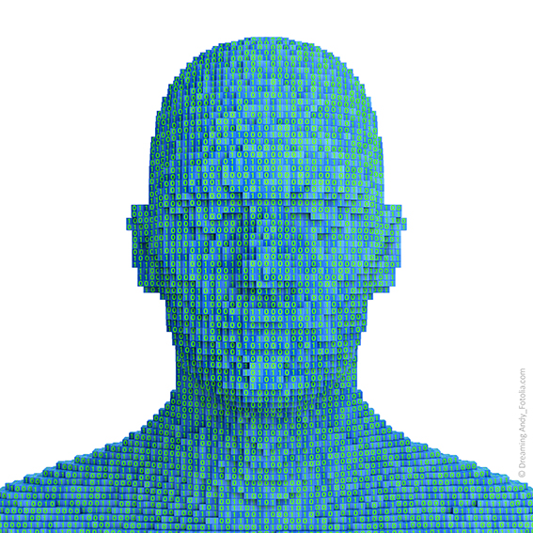
THE TECNOLOGY
UMatch’s breakthrough business matching technology knows companies intentions and people’s motivations and encourages for action

Slide 6
THE TECNOLOGY
COLLECTING AND ANLAYZING DATA
HIGH VOLUME RELEVANT AUTOMATIC DATA COLLECTION
DATA PROCESSING BASED ON DEEP LEARNING ALGORITEMS
BI ANALYTICS DASHBOADS

Slide 7
BI PLATFORM LAYERS
01
Startups
02
Investors
03
Corporates
04
Academies (Research)
Industry Main Trends
05
Personnel
06
08
Motivations
07
Transactions

Slide 8
PLATFORM SECOND LAYER
Creating a business synergy network between companies and people that learns the market deeply and automatically create day to day business insights and connections.

Slide 9
THE PLATFORM
Main Services
Dynamic up to date data collection & analytics
Ability to ask questions the platform connection map and receive answers
“Your Business WAZE” -Platform recommendations to all next business steps
Predication - the next transactions in the field, industry, acquisitions, etc.
Creation of B2B event connections

Slide 10
Users Profiles 4
COOPERATES
STARTUPS
INNOVATION CENTERS
TECH VENDORS
INVESTORS
INVESTMENT BANKER
ACCELERATORS
ENTERPRISES
CAPITAL MARKETS
ADVISORY COMPANIES

Slide 11
Thanks
Golan Malca | Founder & CEO
Mail : golan@umatchbi.com
Tel :0523452855

